Slide 1
Misalignment of proprioceptive and visual estimates of limb position
Gregg Eschelmuller
482D

Slide 2
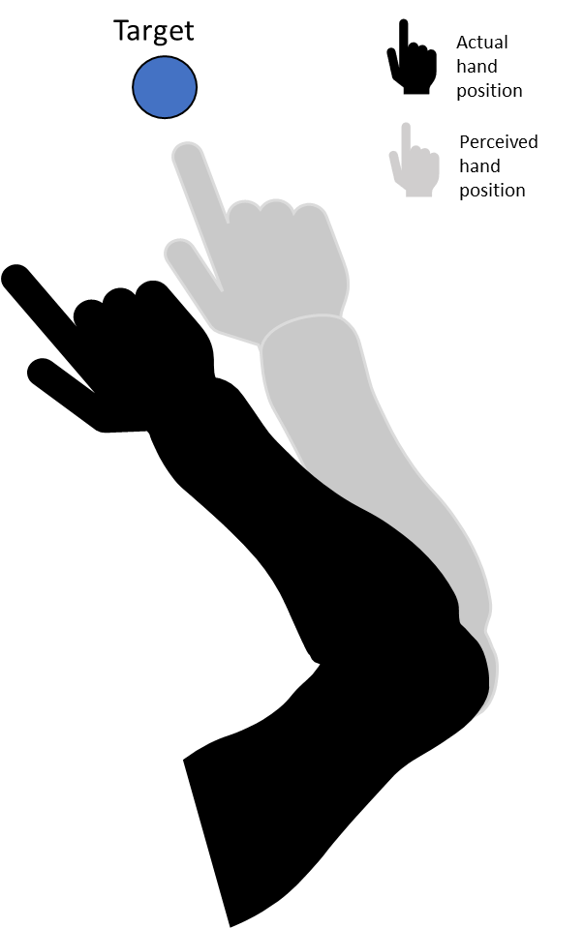
Bias in targeting tasks
When participants are asked to move their unseen hand to a target, we commonly see a bias in end point. More specifically, in joint extension tasks, participants tend to undershoot the target.
Indicating, our proprioceptive estimate of the hand is misaligned with our visual estimate of the hand.
We have seen this in many studies in our lab (e.g. Grose et al., 2022; Eschelmuller et al., 2023; Eschelmuller et al., in prep)

Slide 3
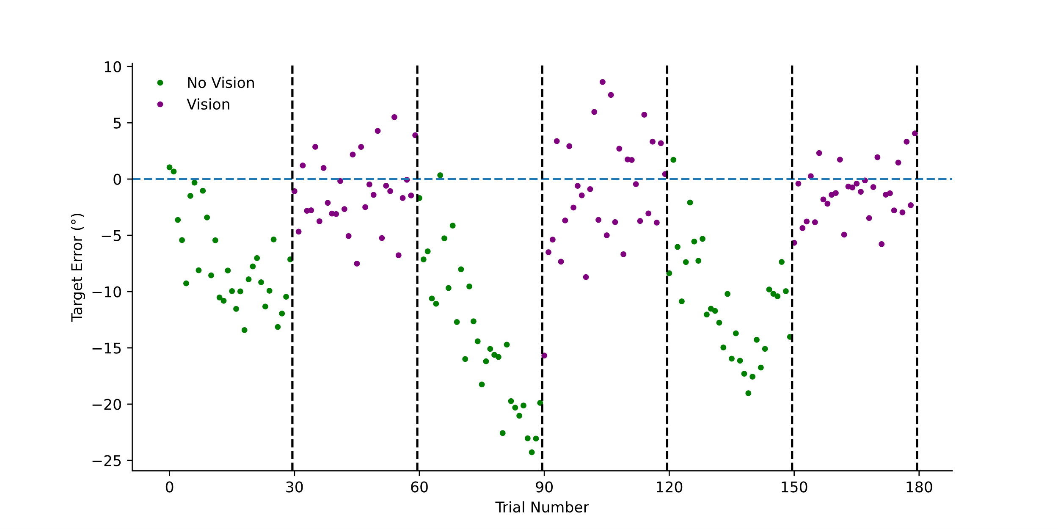
Previous results
Previous work typically only uses trials without vision of the hand. However, when participants receive vision of the hand and then it is removed, the display a phenomena known as proprioceptive drift.

Slide 4
Smeets et al., (2006) – Sensory integration does not lead to sensory recalibration
Built a Bayesian model to explain this ‘drift’ behaviour.
They argue a few key components of sensory integration in this type of task:
When vision is present, proprioceptive and vision are integrated in an optimal way (Bayesian cue combination)

Slide 5
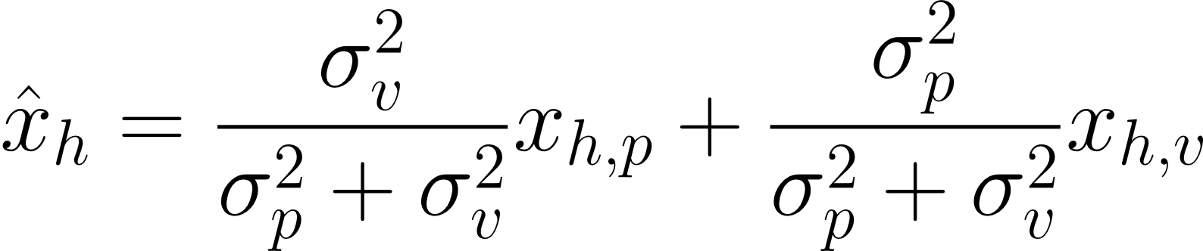
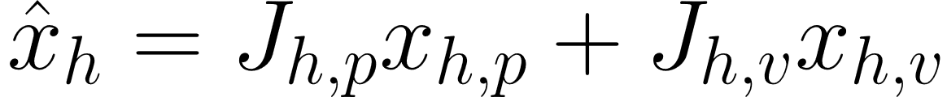
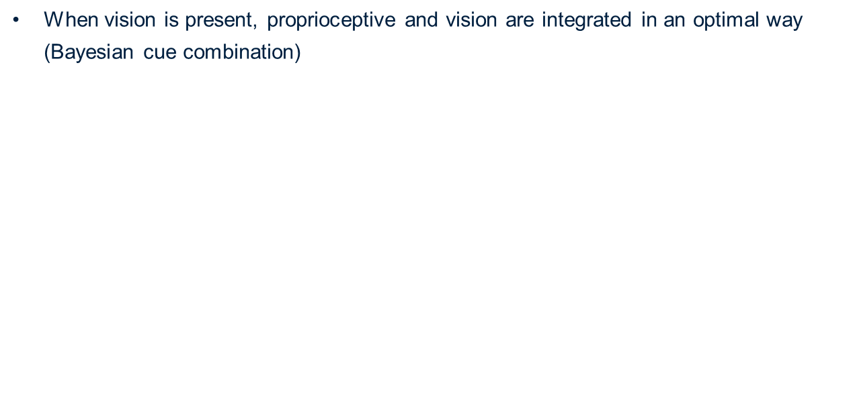
Smeets et al., (2006)
When vision is present, proprioceptive and vision are integrated in an optimal way (Bayesian cue combination)

Slide 6
Smeets et al., (2006) – Sensory integration does not lead to sensory recalibration
Built a Bayesian model to explain this ‘drift’ behaviour.
They argue a few key components of sensory integration in this type of task:
When vision is present, proprioceptive and vision are integrated in an optimal way (Bayesian cue combination)
When moving to a target, we have a visual and a proprioceptive estimate of both our hand and the target.

Slide 7
Smeets et al., (2006) – Sensory integration does not lead to sensory recalibration
Built a Bayesian model to explain this ‘drift’ behaviour.
They argue a few key components of sensory integration in this type of task:
When vision is present, proprioceptive and vision are integrated in an optimal way (Bayesian cue combination)
When moving to a target, we have a visual and a proprioceptive estimate of both our hand and the target.
When vision is removed, our proprioceptive estimate of the target remains the same as it is relative to our hand. However, when we make movements, the object’s position relative to the hand becomes less precise.
Thus, when movements are made without vision, the hand will drift towards our proprioceptive estimate of the hand and the target will drift toward the visual estimate of the target. Because these two estimates are not aligned, drift occurs.

Slide 8
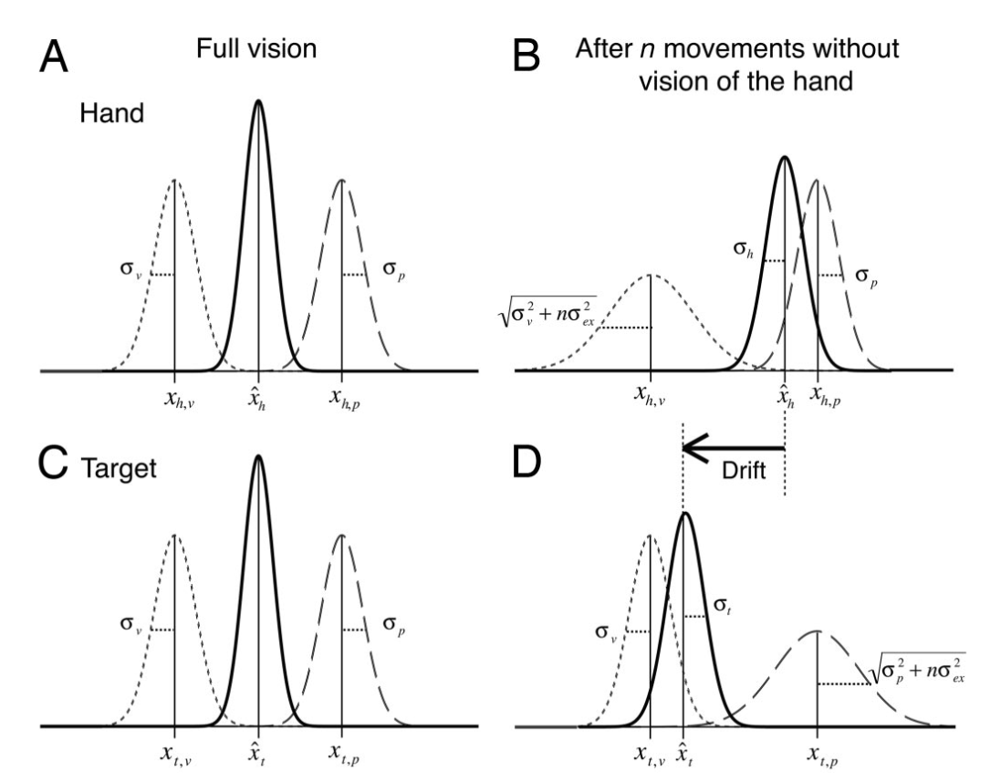
Smeets et al., (2006)

