Slide 1
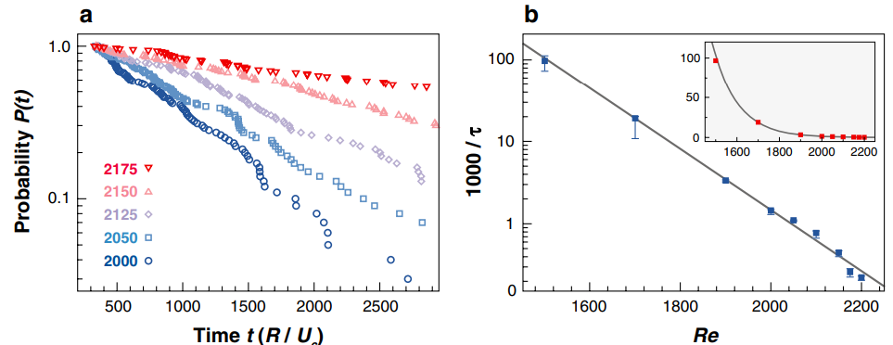
a) Exponential distribution for tau_decay , b) exponential scaling law (altough there is conflicting evidence for this)

Slide 2
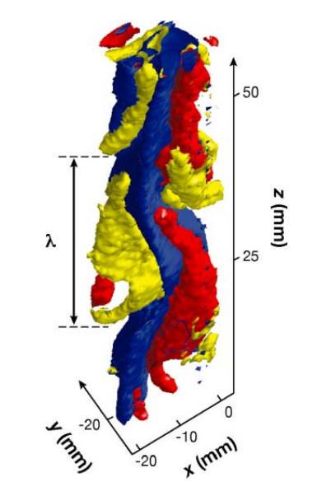
ECS

Slide 4
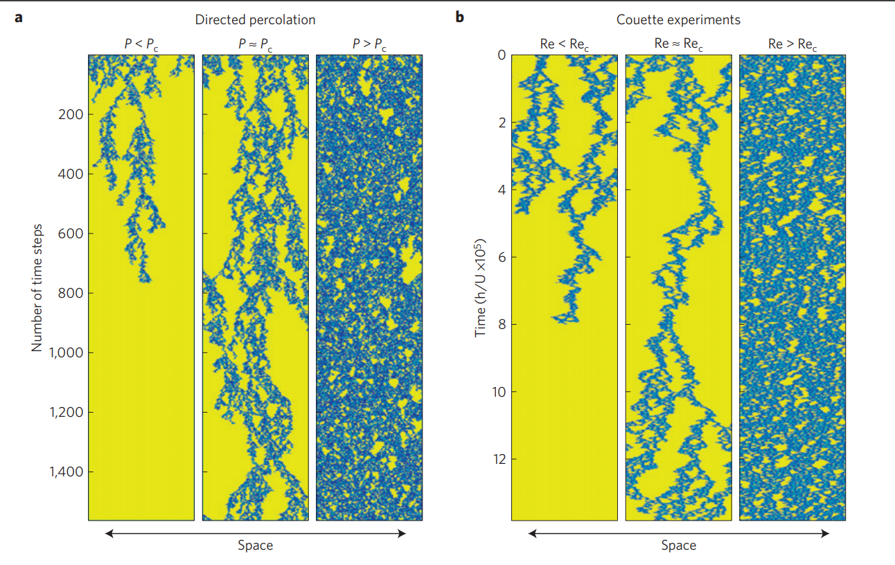
Directed percolation phase transition to sustained turbulence in Couette flow. Active sites in Blue, and the Laminar sites in Yellow. Re = Re_c is not completely symmetric bc of the asymmetric rules of directed percolation. Horizontal lines correspond to snapshots of the flow field in the experiment at a given time

Slide 5
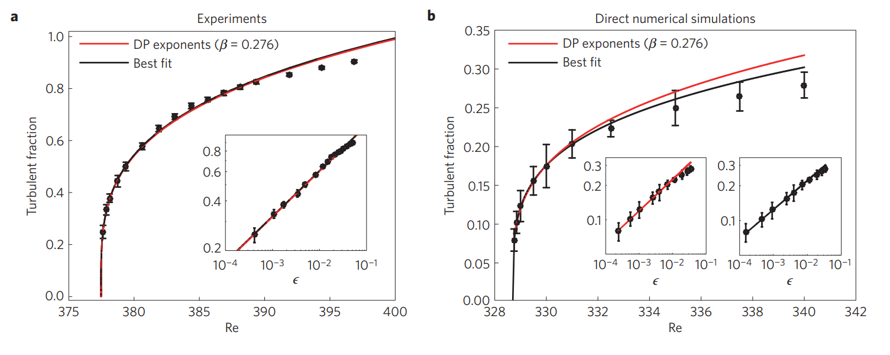
Equilibrium turbulent fraction as a function of Re ( the percentage of the flow that is turbulent). (Re_c = 328.7 in simulations and Re_c = 377.5 in experiments). Universal Direct Percolation exponent Beta = 0.276 (in 1D)
DP predicts that the turbulent fraction rises smoothly from zero at $Re_c$, rather than jumping discontinuously.

Slide 6
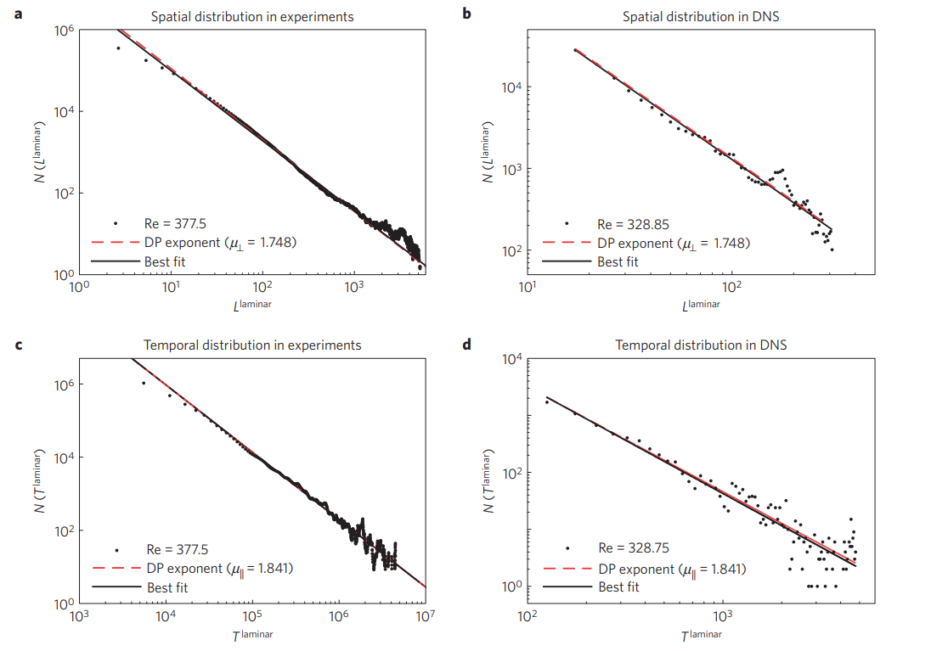
Distribution of laminar gaps in space and time

Slide 7
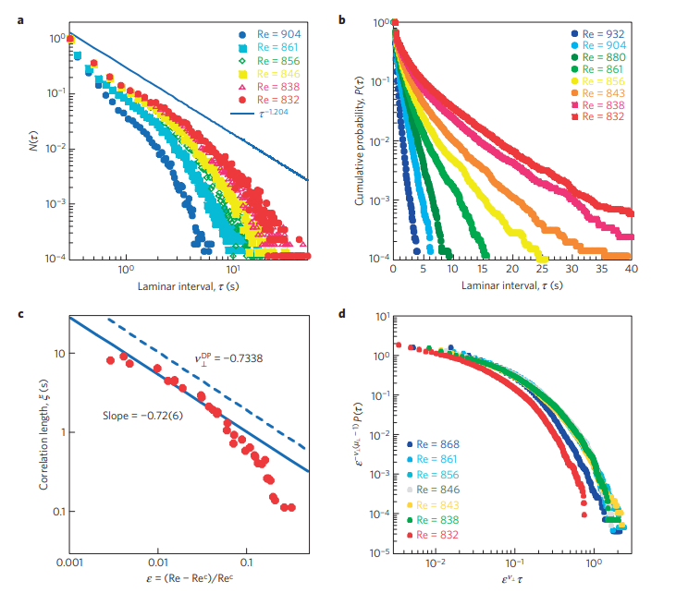

Slide 8
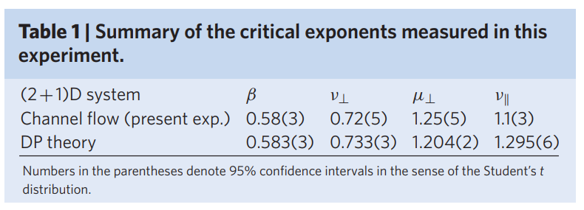
A universal transition to turbulence in channel flow measuring four critical exponents, a universal scaling function and a scaling relation, all in agreement with the (2+1)-dimensional directed percolation universality class.

Slide 10
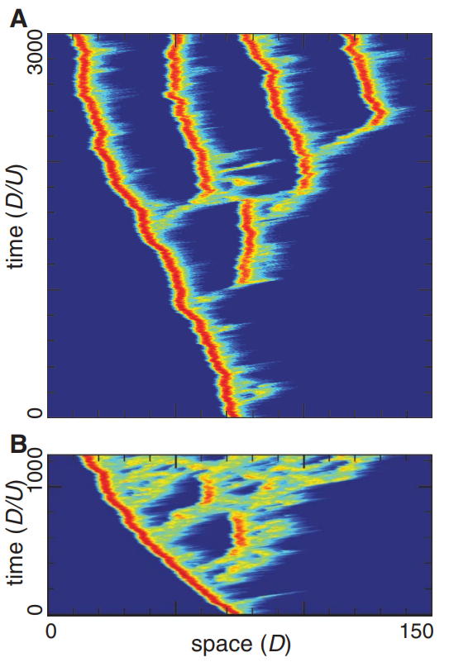
Spreading of turbulence in numerical simulation. Space-time diagram at (A) Re = 2300 and (B) Re = 2450 from numerical simulation (DNS2)
The cross-sectional average of streamwise vorticity squared is plotted on a logarithmic scale in a comoving reference frame

