Slide 1
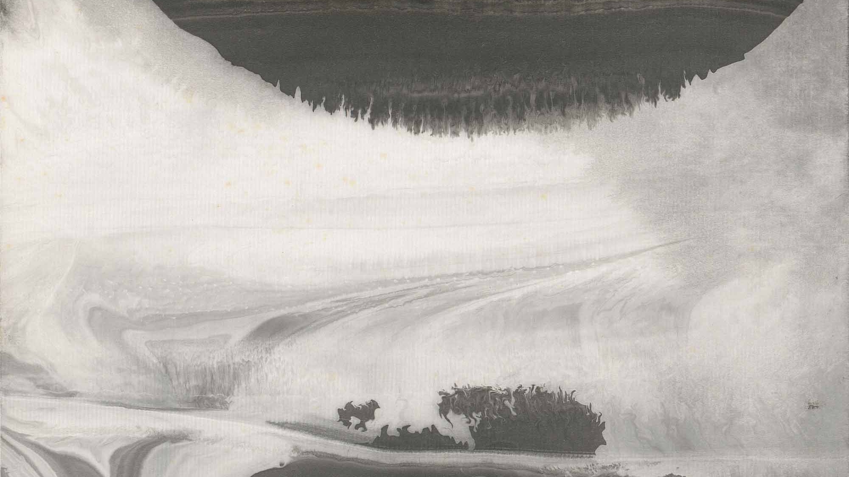

Launch in December 2026 / FiFi & Greg
Preserving a Legacy:
The Lee AnCheng Curating
Platform & Exhibition Website
Bringing Traditional Ink Art to the Global Stage

Slide 2

SECTION 1
01 / A Master's Legacy, Dispersed
Cherished but dispersed
Lee An-cheng's (1959-2015) groundbreaking works are currently safeguarded across the private collections of family and friends. While physically safe in the hands of loving custodians, this decentralized ownership creates a logistical wall.
A unified digital legacy
Large-scale international curation-such as upcoming initiatives targeting galleries in France-is profoundly complex to organize, track, and execute.

Slide 3
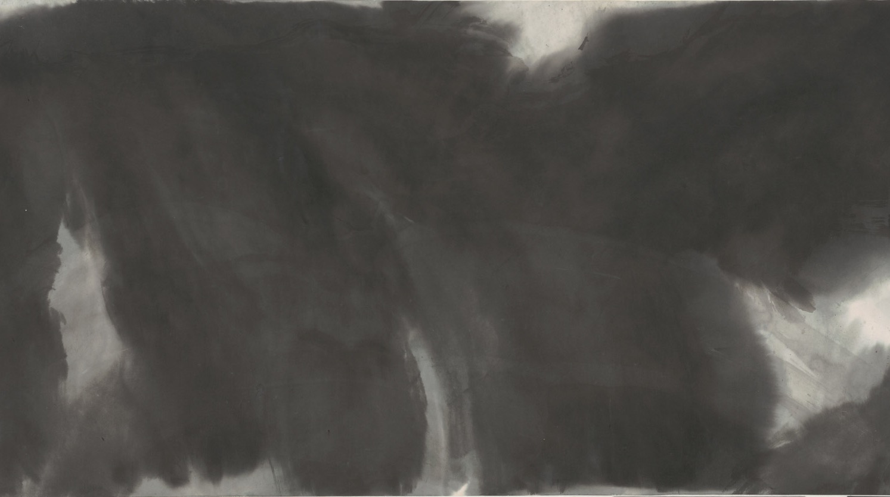

SECTION 01
GOALS TO REACH POSTERITY
Presenting what is the current situation and what we ultimately want to achieve

Slide 4

SECTION 1
01 / Architecture of curation
1 The Vault (backend)
Security
Exhaustive Metadata
Ownership Tracking
2 The Engine (curation)
Dynamic Narratives
Thematic Groupings
Taxonomy Filtering
3 The Gallery (frontend
Global Access Showcase Control, Dual-Language Interface.
Each block will be able to leverage AI to improve each steps of the journey, through creativity, venue scooting, match making.

Slide 5
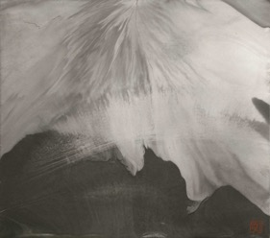
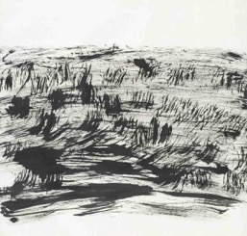
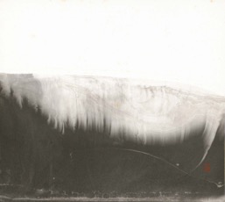
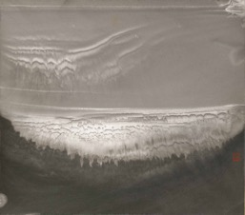
SECTION 1
02 / Private ownership & Transit security
Location tracking
Real-time, private logging of exactly which family member or friend currently holds which physical piece.
Transit lock
Secure status tracking required when artworks are shipped abroad or loaned to external galleries.
Privacy first
Custodian contact details and private ownership data remain strictly confidential and are completely hidden from the public-facing site.

Slide 6
SECTION 1
03 / Curatorial filtering parameters metadata
ERA | TECHNIQUE | MATERIAL | MOOD / THEME
Early explorations 1979 | Fluid wash blending | Single layer Xuan paper | Figurative landscape
The Keelung period | Heavy ink layering | Texture Korean Hanji | Abstract topography
Mountain seclusion 2000 | Flying white |  | Internal mental imagery
The Kaoshiung period | Flat vs. calligraphic brush
These are just an example of few parameters we will be using for the curating work.

Slide 7
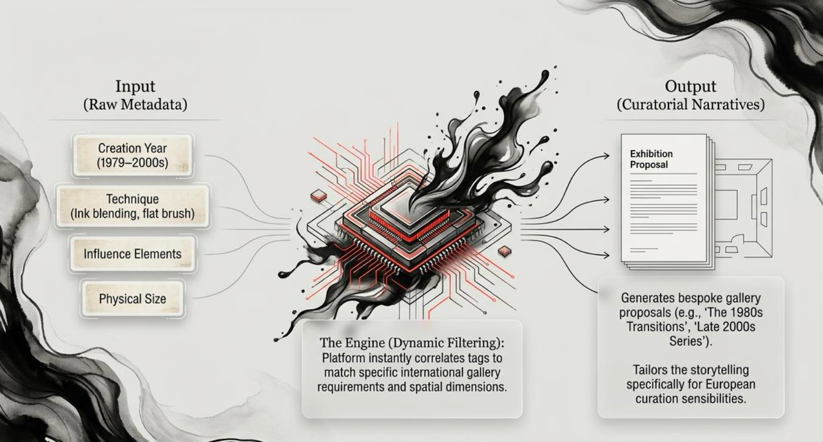
SECTION 1
04 / Generating new narratives
The platform acts as an active curatorial assistant. By tagging works dynamically, it suggests compelling exhibition groupings adapted to specific international gallery spaces and curatorial themes.

Slide 8
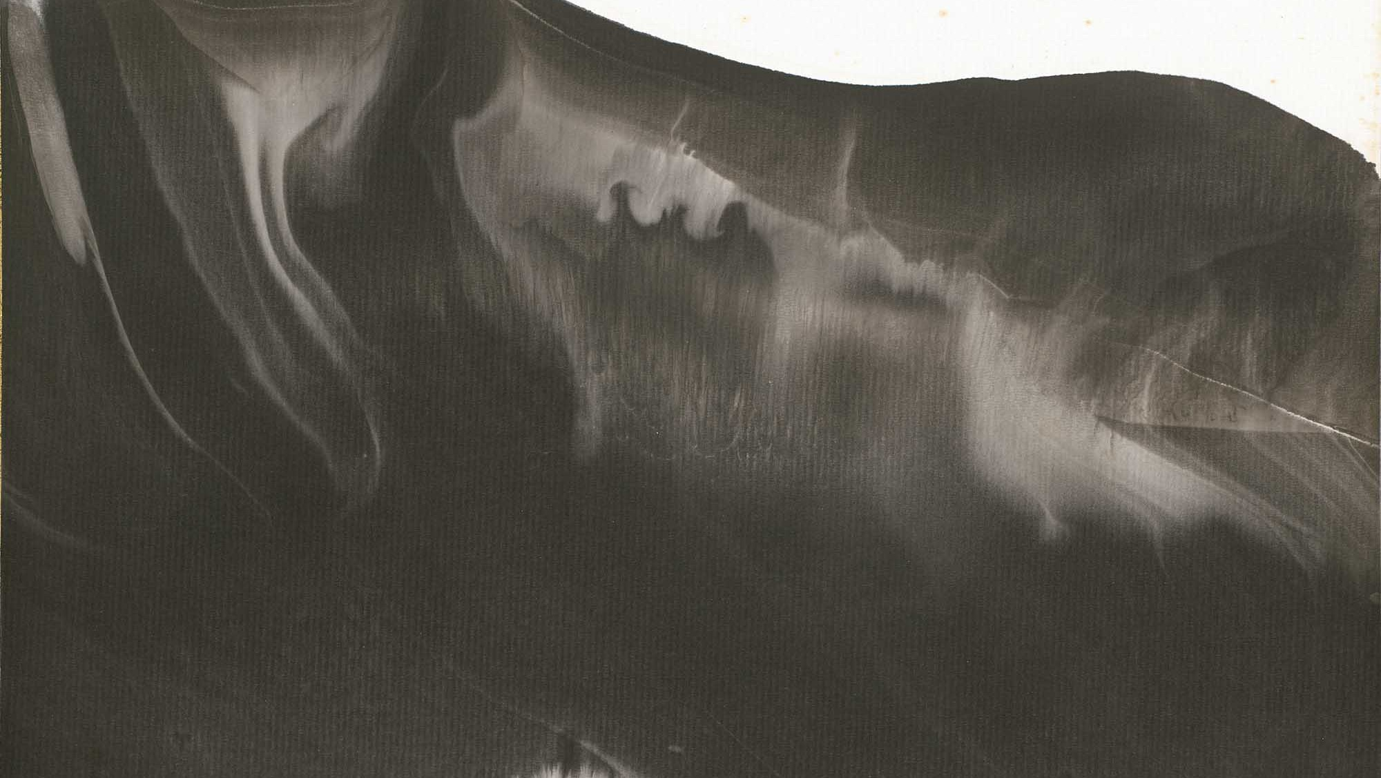
SECTION 02
KEY BENEFITS TO DIGITALIZATION
An organized and standardized digital twin allowing to broaden the art reach.

Slide 9
SECTION 2
01 / Preserving the physicality
Exhaustive reporting
Conservation status and detailed condition report
Material specifications (example: single-layer Xuan vs Korean Hanji)
Exact frame dimensions and unframed
International shipping: crating and customs requirements
Following international standards for the curating job:
Core Data Structures (what): CDWA / VRA Core / LIDO
Content Standards (how): COO
Controlled vocabulary and Authority files: AAT / ULAN / TGN
Taiwan used standards: Dublin Core / MICI / Metalogy

Slide 10
SECTION 2
02 / Curatorial control
Empowering editors to shape the narrative
Curate and group showcased works specifically for upcoming international exhibitions.
Toggle public visibility on/off for individual pieces instantly.
Customize and lock in translated public titles and descriptions prior to any global launch.

Slide 11
SECTION 2
03 / The global stage
Dual language to capture international curators
High-resolution, immersive digital galleries.
Interactive timeline mapping Lee An-Cheng's life and artistic evolution.
Bi-lingual artist biography tailored specifically for the global art market
English, Traditional Chinese expandable to French

Slide 12
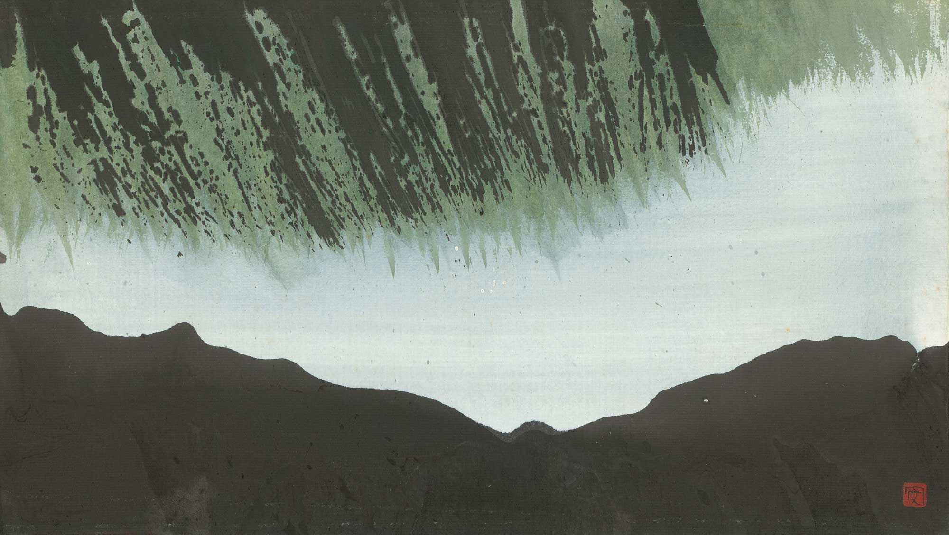
SECTION 03
PATH TO THE LAUNCH
A well scoped project

Slide 13
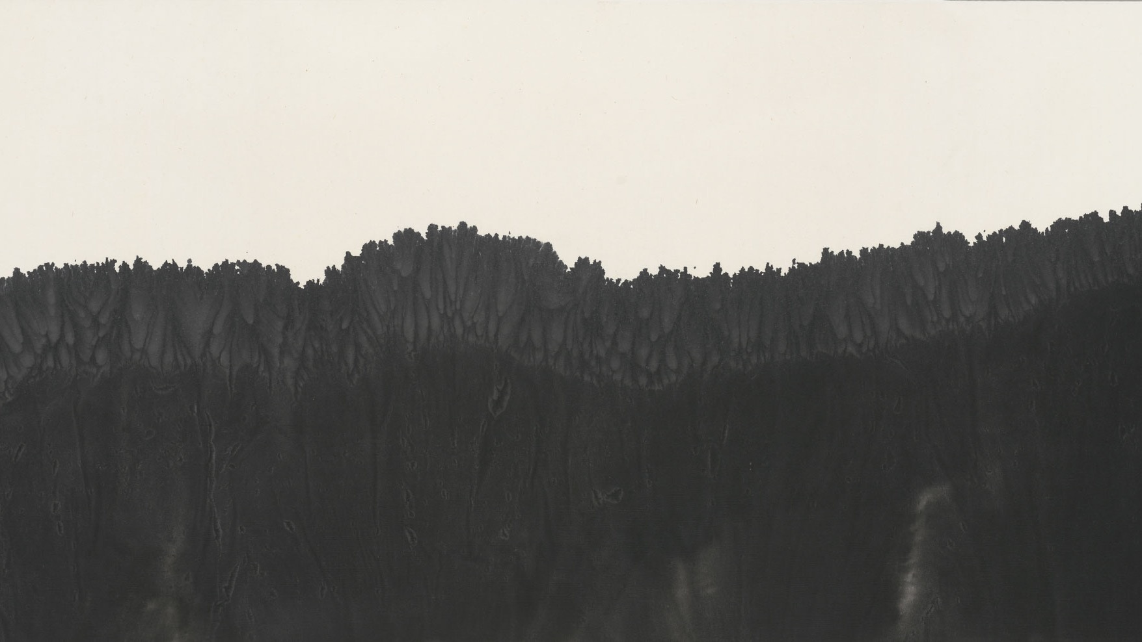
TIMELINE LAYOUTS
01 / Path to launch in 2026
PHASE 01
PHASE 02
PHASE 03
PHASE 04
SEPTEMBER
LAUNCH
OCTOBER
VAULT
NOVEMBER
GALLERY
DECEMBER
TEST

Slide 14
TIMELINE LAYOUTS
02 / Multi-Factor Specification Grid Template
An audit will be done before the launch to evaluate the curating work already accomplished.
LAUNCH
[ SEPTEMBER ]
Database schema design
Secure hosting environment
Bulk high-resolution image import
(Targeting the 52 key cataloged
paintings spanning 1979-2000s).
VAULT
[ OCTOBER ]
Admin portal development and user interface design.
Role configuration and security
permissions (Admins / Editors).
Implementation of the private
ownership, location, and transit
tracking modules.
GALLERY
[ NOVEMBER ]
Public facing website design and user experience development. Integration of the interactive timeline. Showcase selection module.
REFINING LAUNCH
[ DECEMBER ]
3-4 weeks content review and adjustments. Final security testing and quality assurance. Official global launch.
This is representing an overall schedule, detailed features and schedule will be defined after discussions and a refined schedule will be provided.
The Launch date is arbitrary and can shift to any date.

Slide 15
TIMELINE LAYOUT
03 / Next step
Prior agreement on scope, team resource identification, timeline and cost will be validated by all parties before starting implementation.
Finalize high-resolution photography
Curating database health check, benchmark industry standards
Collect initial ownership, data and location of physical pieces
Commence Phase 1 database modeling

Slide 16
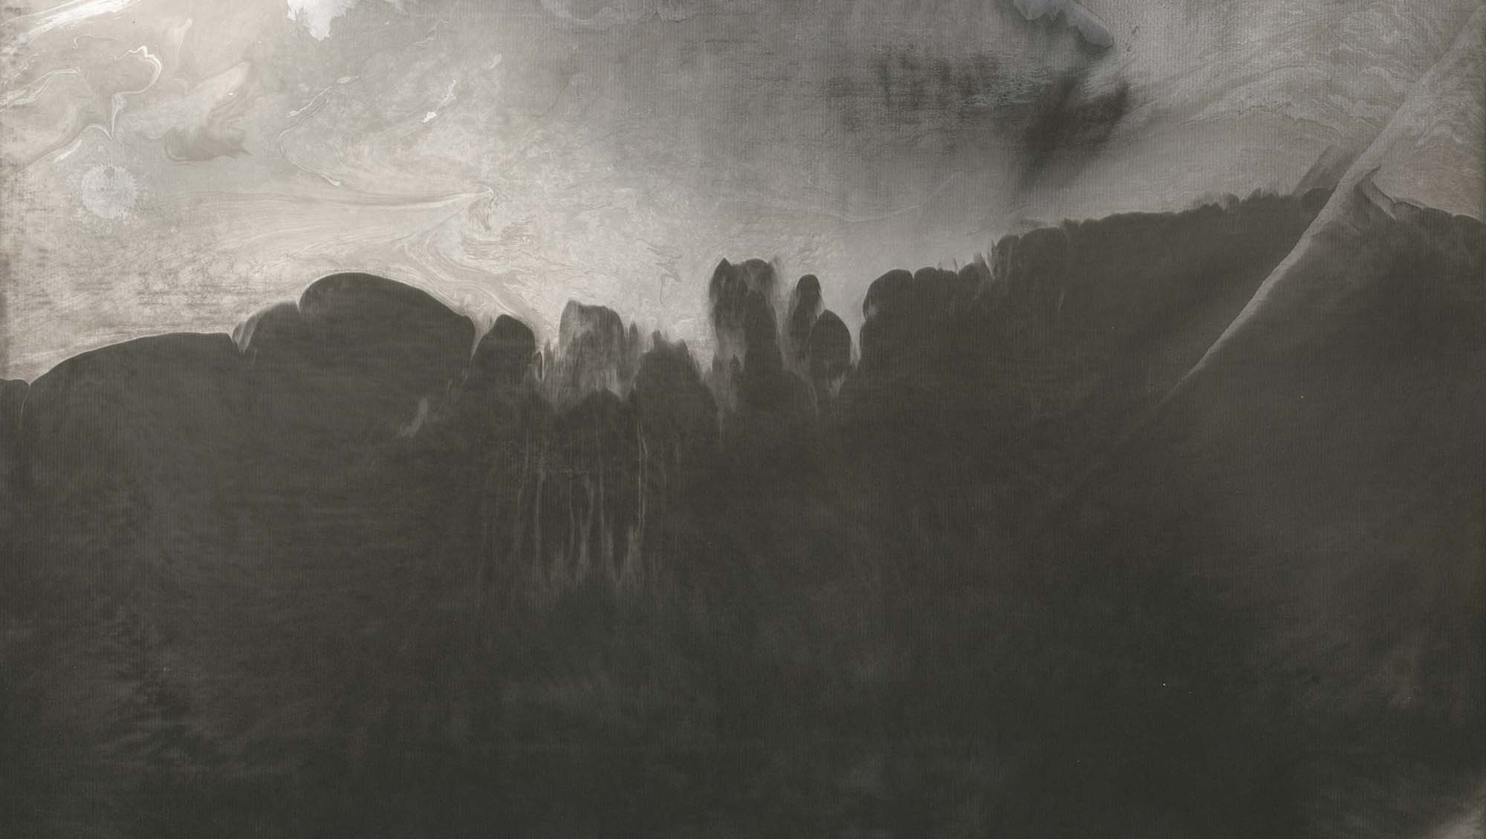
IN HARMONY WITH
LIGHT AND DUST
Preserving the legacy of Lee An-Cheng for the world

