Slide 1


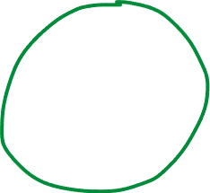



are they transcribed?
uncharacterized…
yellow+light green: DE
lyrata(Haim)
SNP-based phylogeny
no Expr…
in any accession
noExp
in
6909
expr
in 6909
na in 6909
expression

Slide 2






EDTA

Slide 3
