Slide 1
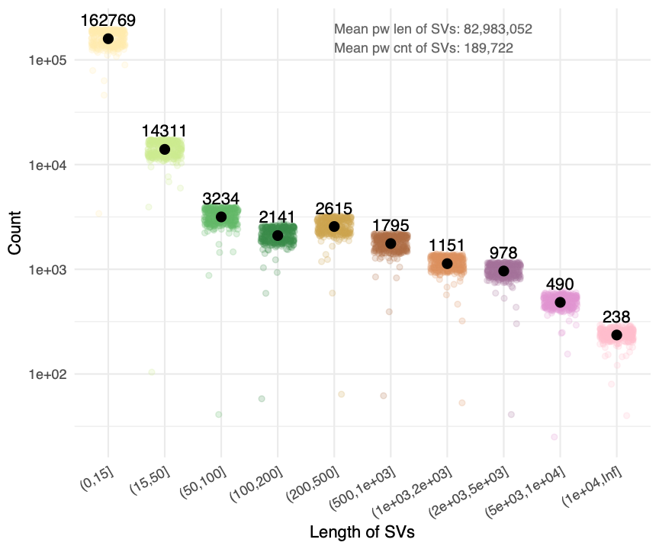

cummulative!!!
not inf

Slide 2
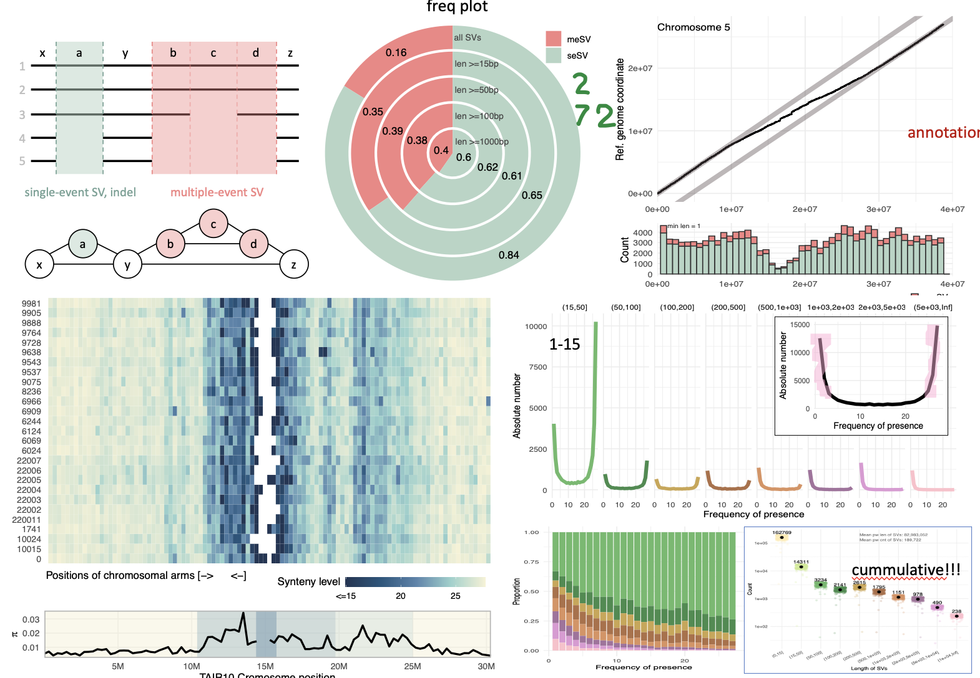
ratio: 0.7
4
4
4.5
5.7
3
1.2
2.7
3.5
3.5

Slide 3
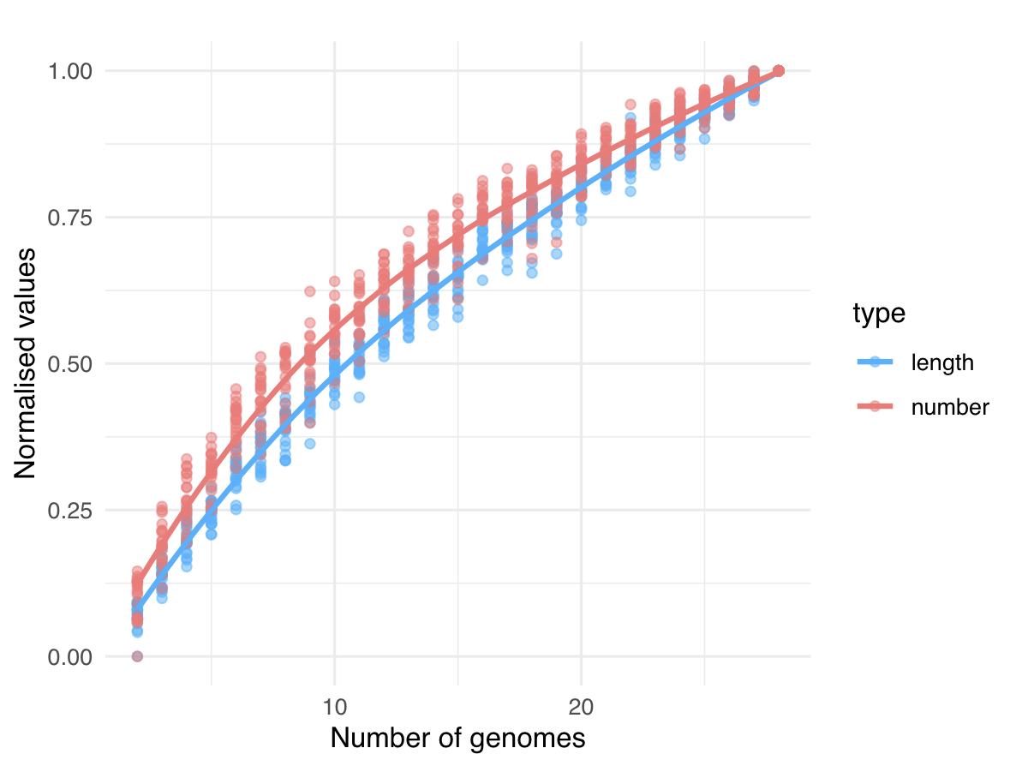

Slide 4
1
x
a
y
b
c
d
z
2
3
4
5
single-event SV, indel
multiple-event SV
a
b
c
d
x
y
z

