Slide 1
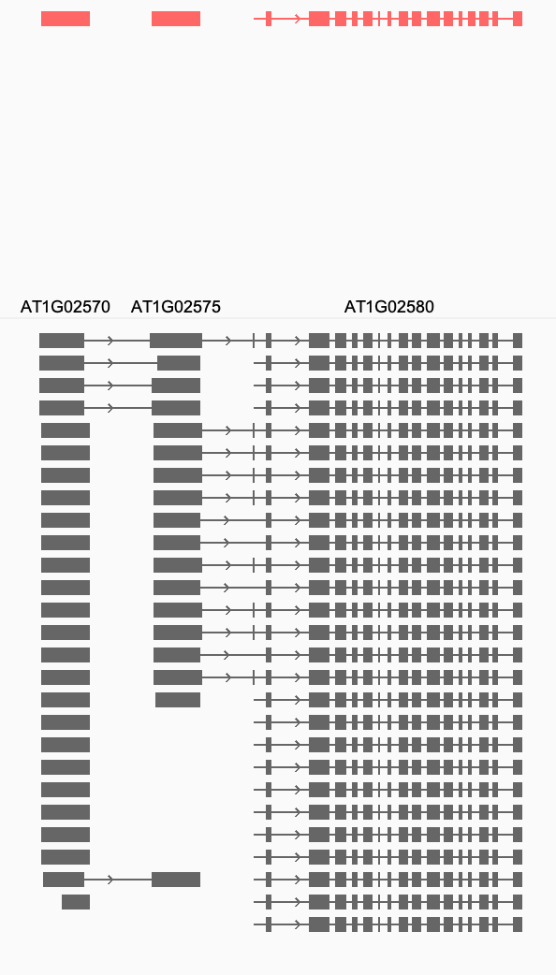
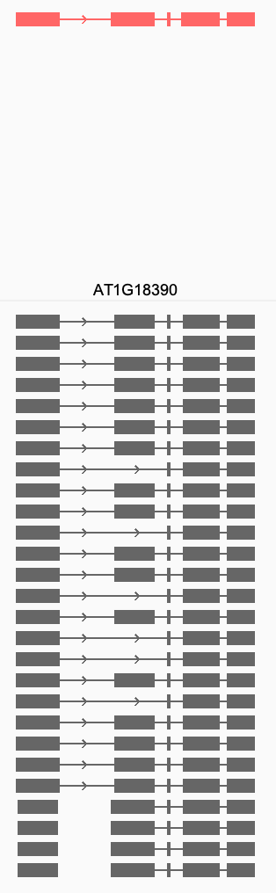
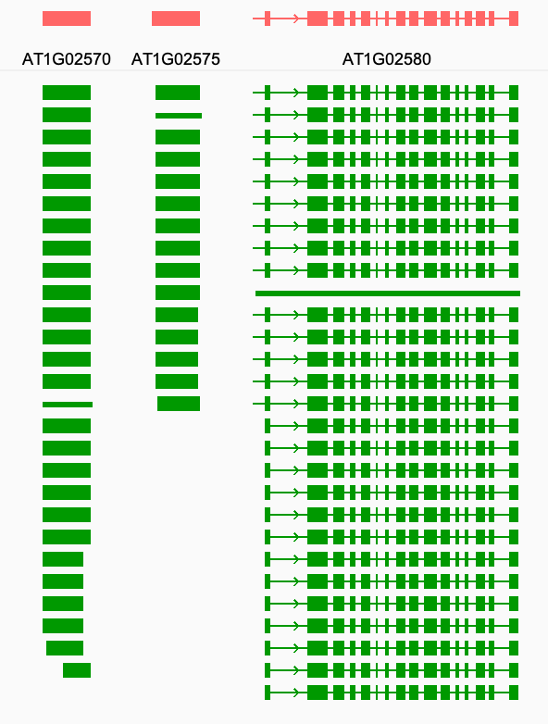
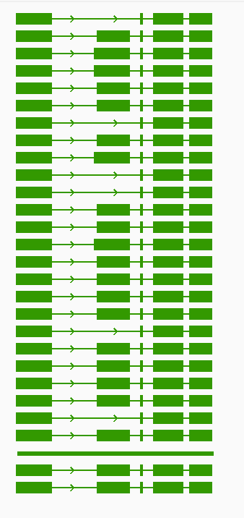
A
B
Preliminary annotation
The consensus annotation
PanGen_Chr_1:651,048-688,324
PanGen_Chr_1:7,676,672-7,713,948
Notes:
PanGen_Chr_1:632,409-706,962

Slide 2
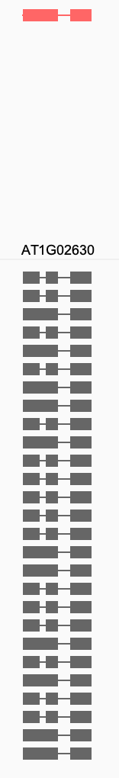
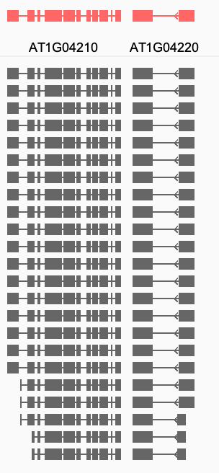
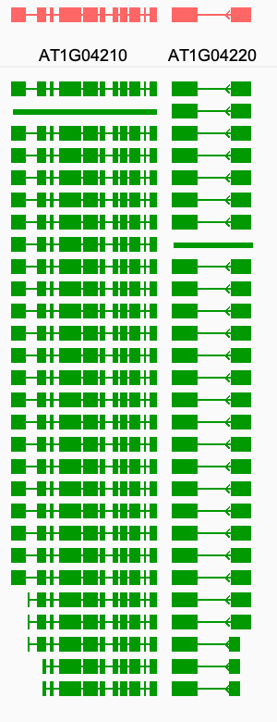
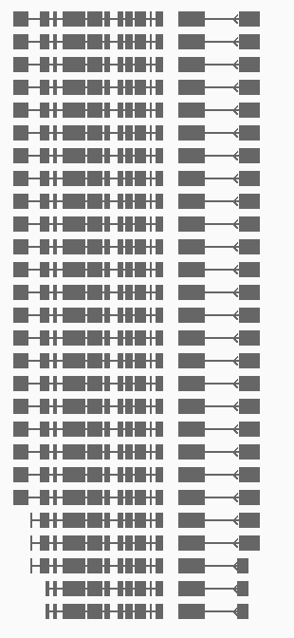
A
B
Preliminary annotation
Preliminary annotation
The consensus annotation
PanGen_Chr_1:1,300,577-1,375,130
PanGen_Chr_1:667,449-704,726

Slide 3
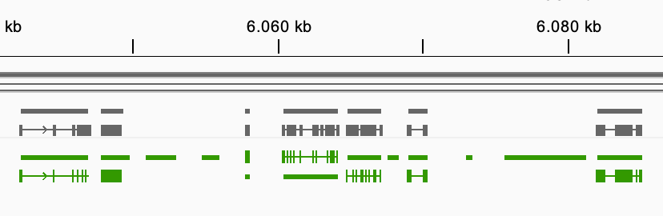
6024_Chr2:6,010,504-6,148,542
Accession 6024, Chromosome 2
AT2G14210
AT2G14282(add)
new
new
new
AT2G14255
AT2G14270
AT2G14285
AT2G14247
AT2G14260
new
AT2G14265(add)

Slide 4
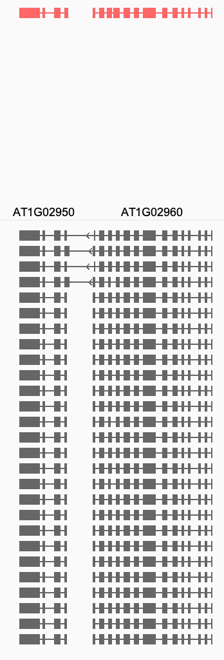
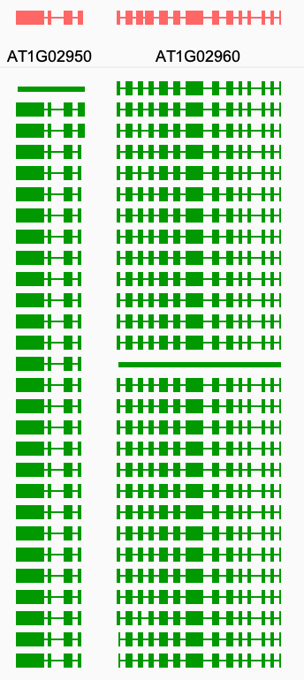
PanGen_Chr_1:804,629-841,905

Slide 5
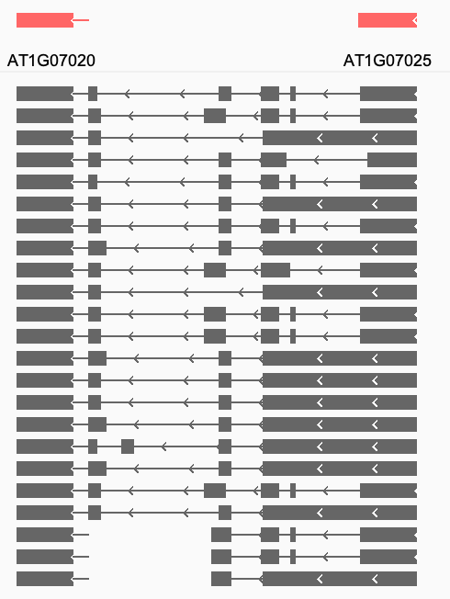
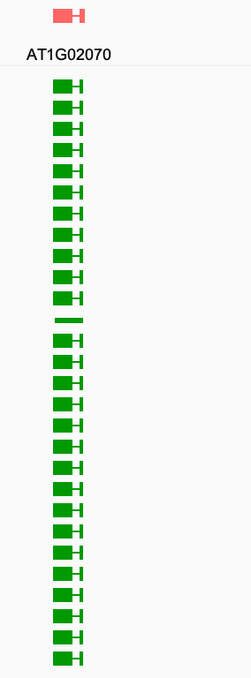
Sehr blöd

Slide 6
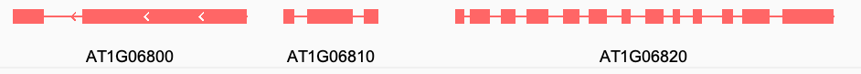
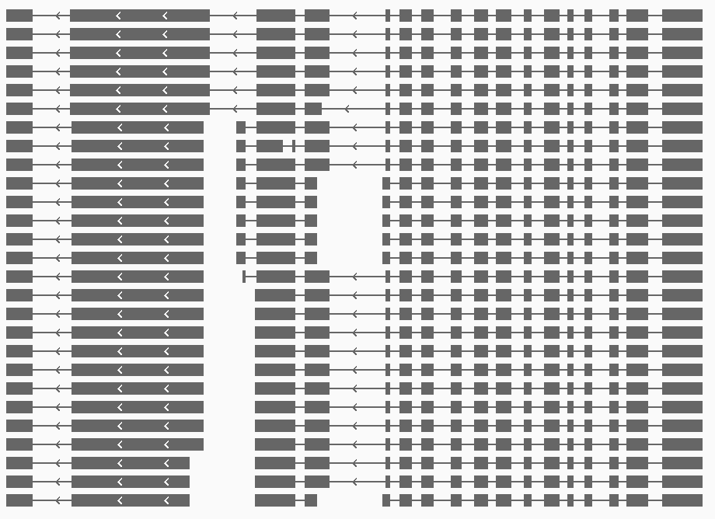
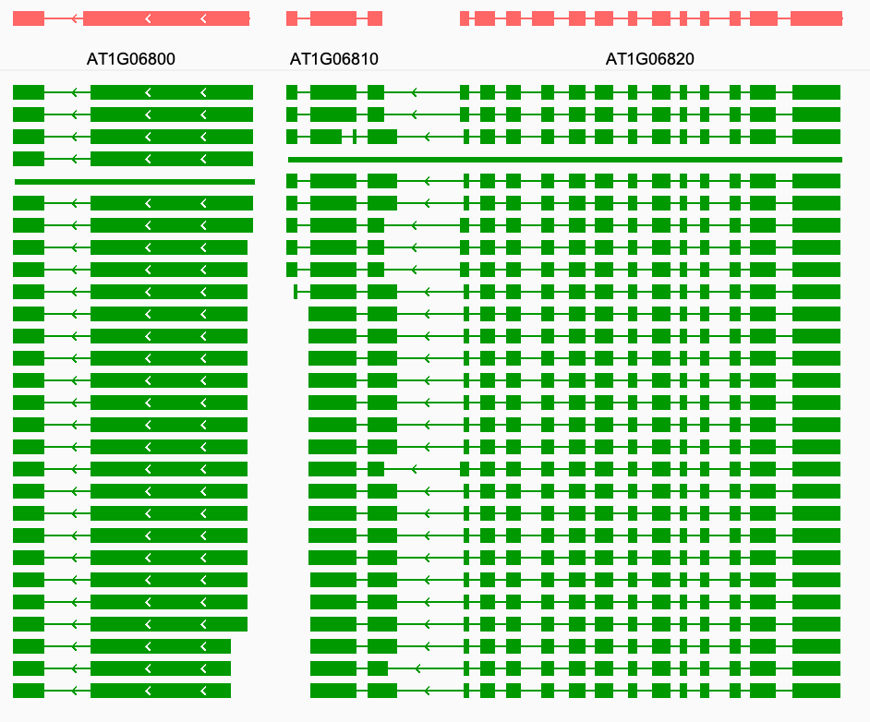
The raw annotation
The fixed annotation
PanGen_Chr_1:2,449,823-2,468,460

Slide 7
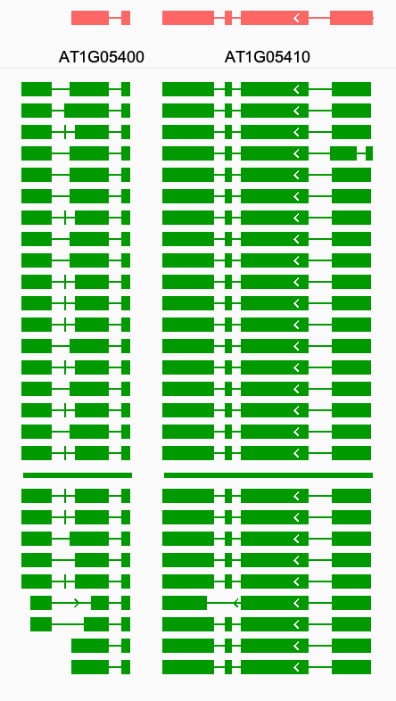
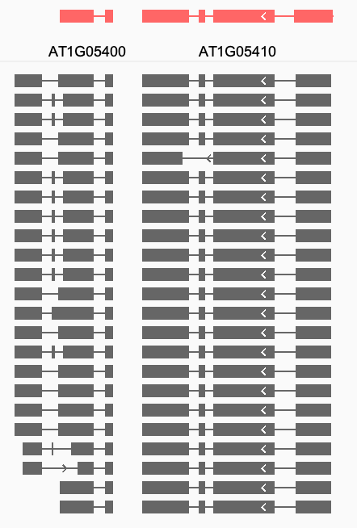
PanGen_Chr_1:1,877,250-1,895,888

Slide 8
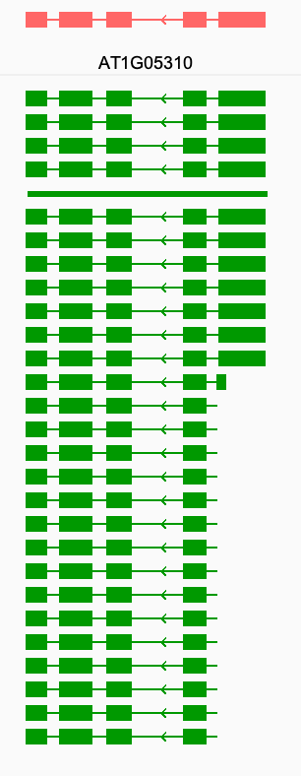
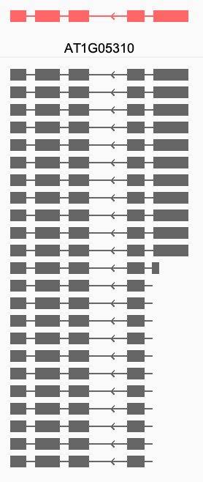
PanGen_Chr_1:1,836,991-1,855,629

Slide 9
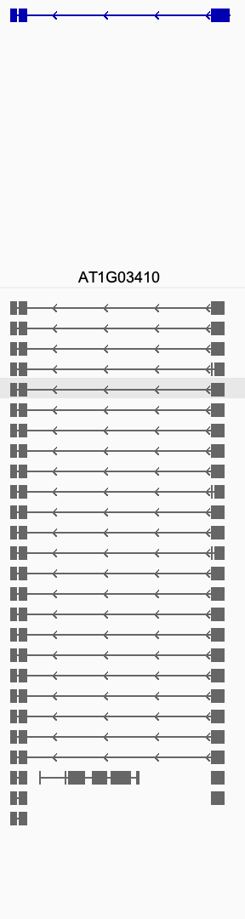
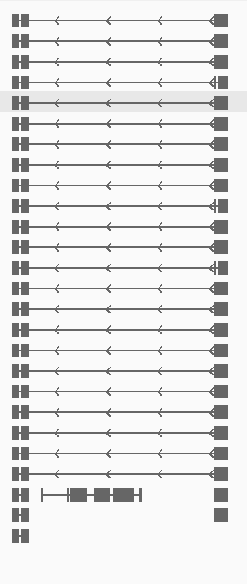
PanGen_Chr_1:1,004,965-1,079,517

