Slide 1
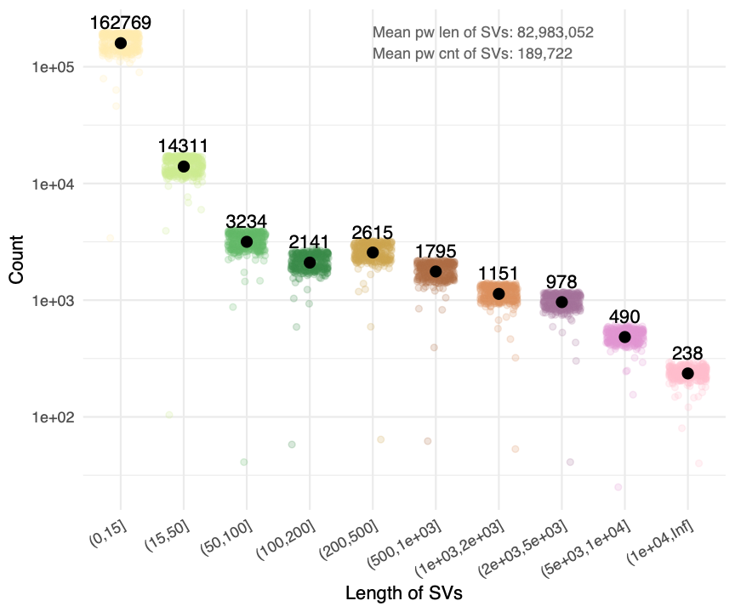
freq plot
annotation
1-15
cummulative!!!

Slide 2
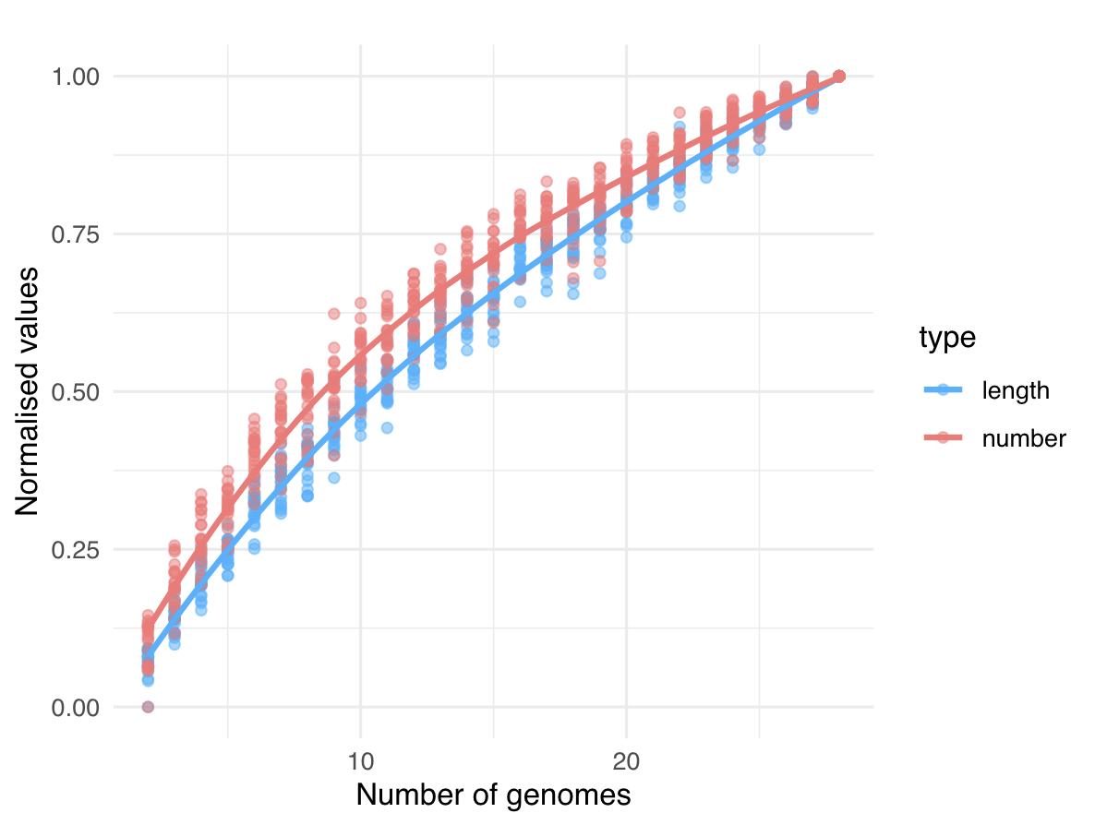

Slide 3
1
x
a
y
b
c
d
z
2
3
4
5
single-event SV, indel
multiple-event SV
a
b
c
d
x
y
z

