Slide 1
A
B
E
F
C
G
H
I
D
Figure: Structural Variants
A. Toy example of two types of structural variants (SVs) distinguished by the multiple alignment of genomes. Top: representation of these types in alignment. Bottom: representation of the alignment fragment in the genome graph. While a single event corresponds to one bubble in the graph, a multiple event is described by multiple bubbles.
B. Distribution of the absolute number of SVs of two types, based on their length. The prevalence of short-length single-event SVs is explained by the low probability of multiple events at this scale.
C. Density distribution of bubbles along the first chromosome. A higher density is observed in pericentromeric regions and in the region of the previous centromere (to the right side of the centromere).
D. Distribution of pi diversity based on SNPs called from the multiple alignment. The shape of the distribution matches the density distribution of bubbles.
E. Correspondence between pan-genome coordinates and the reference genome coordinates. A nonlinear spatial dependency is observed. Pericentromeric regions show a higher "dilution" of the spatial coordinate, indicating an increased number of structural variants in this zone.
F. The observed stretching of the spatial coordinate is supported by the distribution of multiple-event SVs, which are concentrated in the pericentromeric regions and are typically longer than single-event SVs.
G. Distribution of the absolute number of seSVs of different lengths according to their frequency of presence. Short seSVs were subplotted separately due to their extreme abundance. Short SVs tend to be deletions, while long SVs tend to be insertions.
H. U-shaped cumulative distribution of the absolute number of seSVs with a length > 15bp, based on their frequency of presence.
I. Normalized distribution of the number of seSVs with a length > 15bp according to their frequency of presence. Bars show a smooth trend.

Slide 2
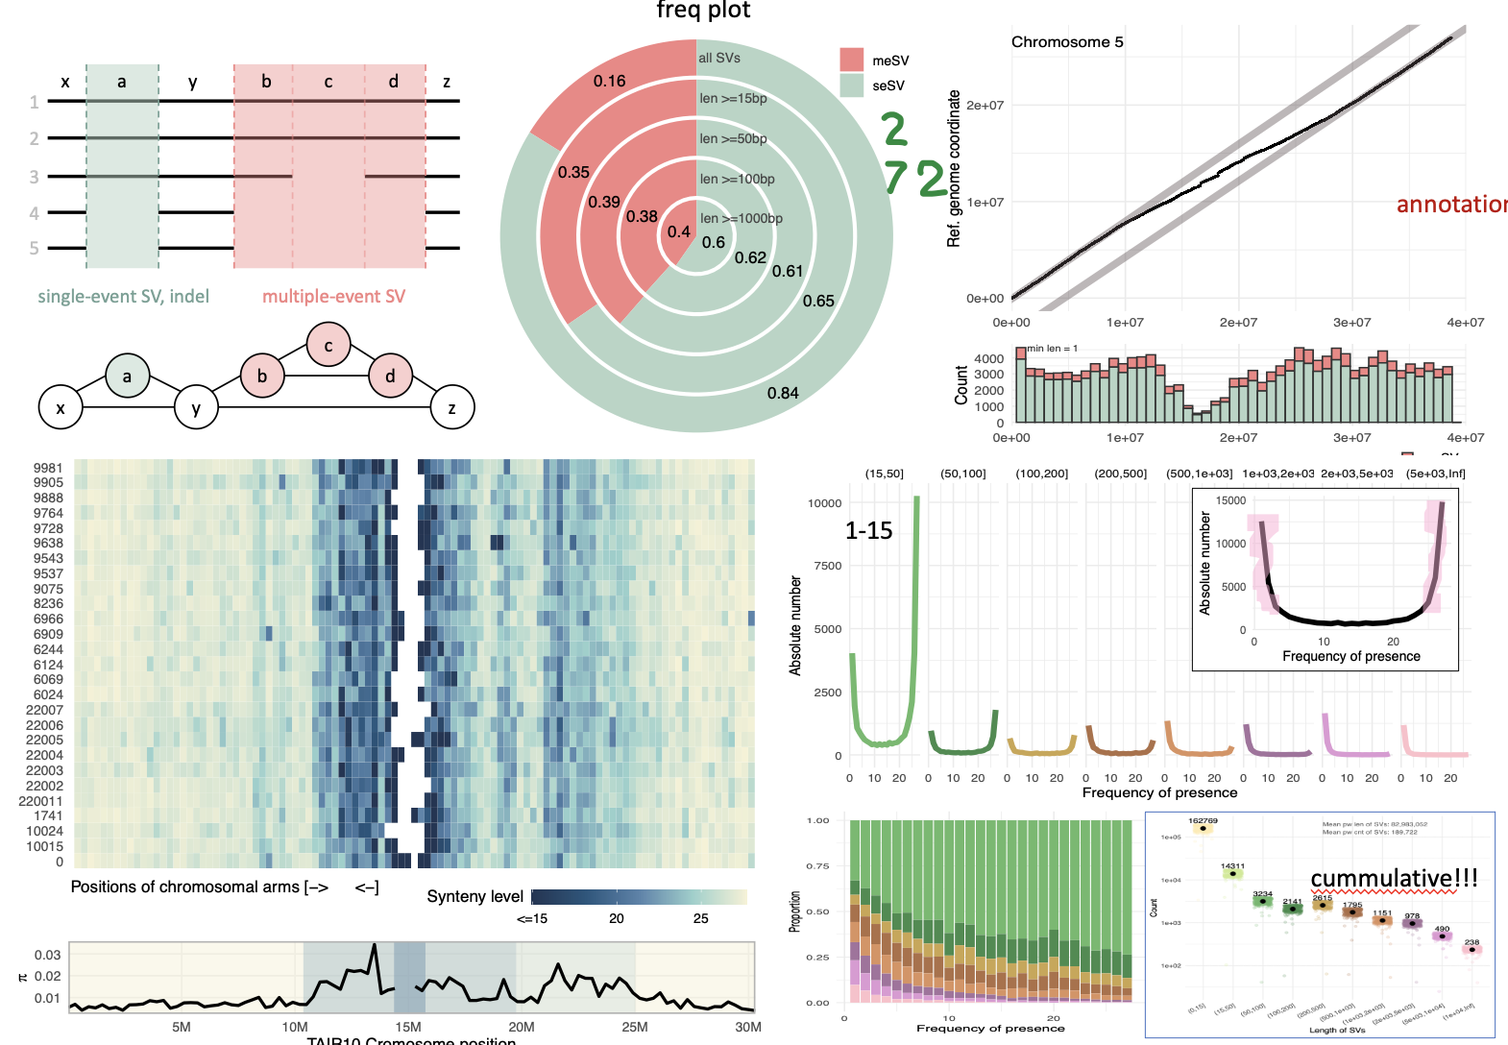
ratio: 0.7
4
4
4.5
5.7
3
1.2
2.7
3.5
3.5

Slide 3
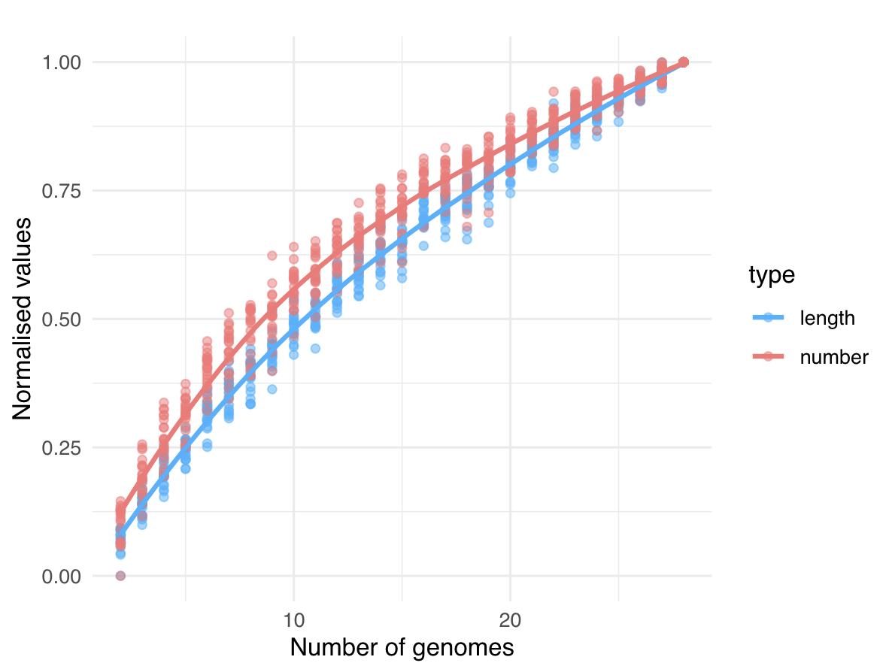

Slide 4
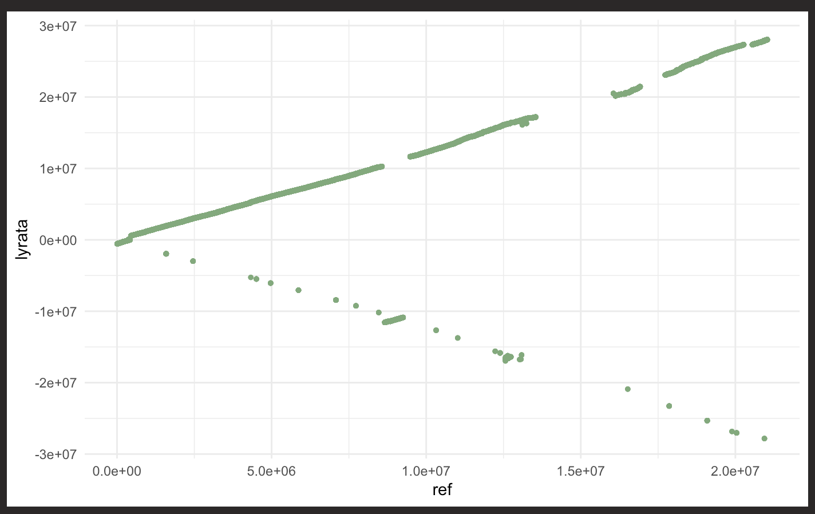
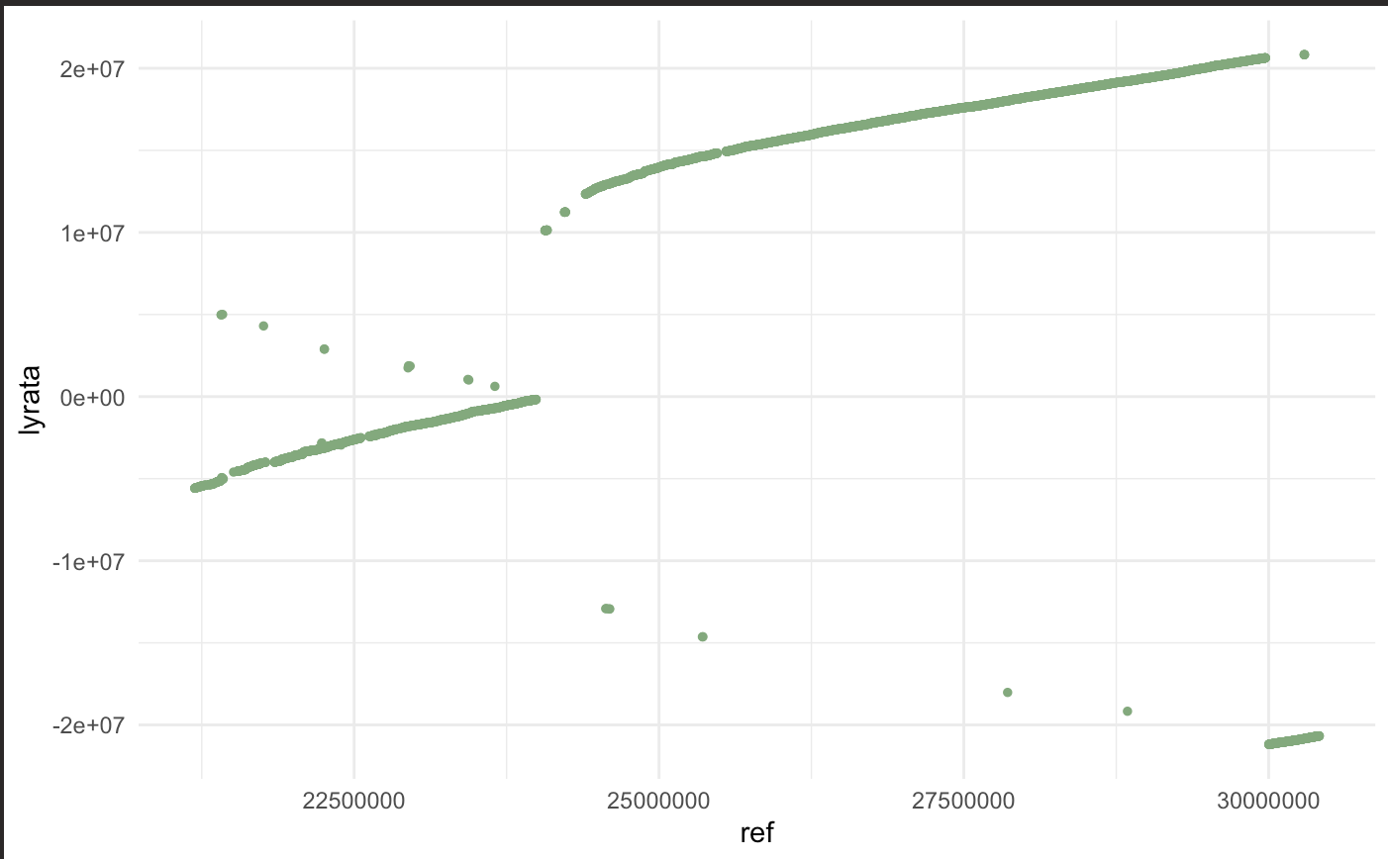
1
x
a
y
b
c
d
z
2
3
4
5
simple SVs
complex SVs
a
b
c
d
x
y
z

Slide 5
cSVs
sSVs
cSVs sSVs

