Slide 1



A Hands-on Introduction to GWAS
Anna Igolkina anna.igolkina@gmi.oeaw.ac.at
igolkinaanna11@gmail.com
PopGen intro course
2 October 2023

Slide 2
Step 0
Please, check that you have a virtual environment to run GWAS.

Slide 3
The goals for today
What is a genome-wide association study?
When to do GWAS?
Give a practical, non-technical introduction of how to do a “standard” linear mixed model GWAS
Identify possible challenges and pitfalls

Slide 4
When to do a GWAS?
Genotype to phenotype map
which loci/genes underly a specific phenotype
Breeding, human/medical genetics, molecular biology
Generates mechanistic hypotheses
Genomic prediction/ polygenic scores
Genetic architecture
Evolutionary genetics
which loci are involved in selection
Presumes selection on the phenotype under study
Identifies loci for further investigation

Slide 5
Origins of genetic variation
…ATGTTTAGCGTAGCGA…
…ACGTGCAGTGTAACGA…
…ACGTGCAGTGTAACGA…
…AGCTTAAGCGTAACGA…
…AGCTTAAGCGTAGCGA…

Slide 6
What is a GWAS?
Genome Wide Association Study links differences at specific genetic loci to phenotypic differences
…ATGTTTAGCGTAGCGA…
…ATGTTTAGCGTAGCGA…
…ATGTTTAGCGTAGCGA…
…ATGTTTATCGTAGCGA…
…ATGTTTATCGTAGCGA…
…ATGTTTATCGTAGCGA…
Independently test every polymorphic marker:
SNPs, INDELs, SVs (Structural Variants)…

Slide 7
What is a GWAS?
Genome Wide Association Study links differences at specific genetic loci to phenotypic differences
…ATGTTTAGCGTAGCGA…
…ATGTTTAGCGTAGCGA…
…ATGTTTAGCGTAGCGA…
…ATGTTTATCGTAGCGA…
…ATGTTTATCGTAGCGA…
…ATGTTTATCGTAGCGA…
Independently test every polymorphic marker:
SNPs, INDELs, SVs (Structural Variants)…

Slide 8
Association is not causation
Latent factor
causation
causation
Outctome1
Outctome2
association

Slide 9
Association is not causation
Warm weather
causation
causation
More swimming
More ice cream
association only,
NO causality!

Slide 10
Association is not causation
???
causation
causation
Phenotype
Genetic marker
Association only?

Slide 11
Linkage Disequilibrium, LD
LD
causation
causation
Phenotype
Genetic marker
association

Slide 12
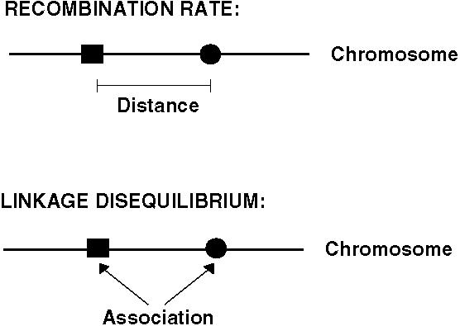
Linkage Disequilibrium, LD
LD = tendency for genetic markers to be inherited together
Q: Can one SNP can tag many variants, so we don’t need to test every SNP?

Slide 13
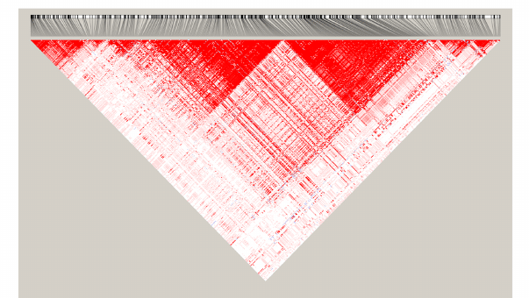
Linkage Disequilibrium, LD
LD blocks = DNA sections, which get passed down together through generations
LD pattern along the physical coordinate
Colour – correlation between genetic markers

Slide 14
Linkage Disequilibrium, LD
LD blocks = DNA sections, which get passed down together through generations
What if the causal marker is located here?
LD pattern along the physical coordinate
Colour – correlation between genetic markers

Slide 15
Population structure
Kinship
causation
causation
Phenotype
Genetic marker
Spurious correlation

Slide 16
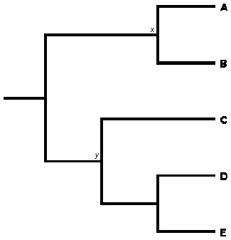
Population structure
SNPs and phenotypes are linked with the phylogeny
PC2
…
…
PC1
PCA based on SNPs
Color – phenotype

Slide 17
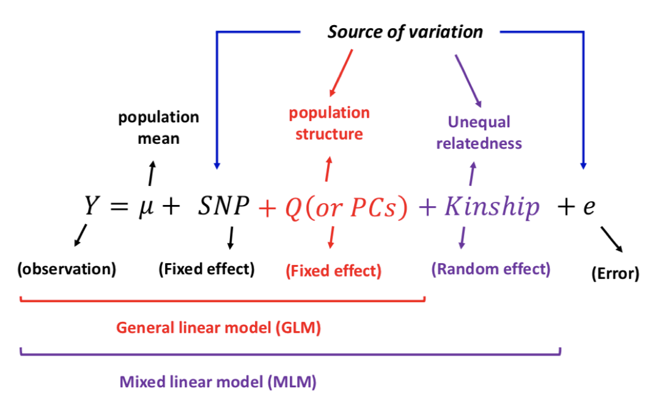
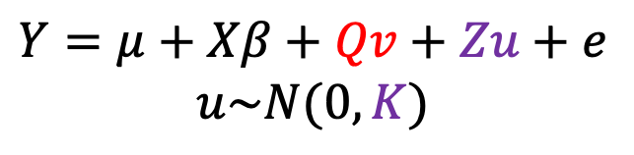
GWAS model
Decomposition of a phenotype
$$Y=μ+Xβ+Qv+Zu+e$$
$$u\sim N(0,K)$$

Slide 18
GWAS results
p-value for each SNP
(result of comparing models with and without the SNP)
2. The effect of the SNP on the phenotype (𝛽)

Slide 19
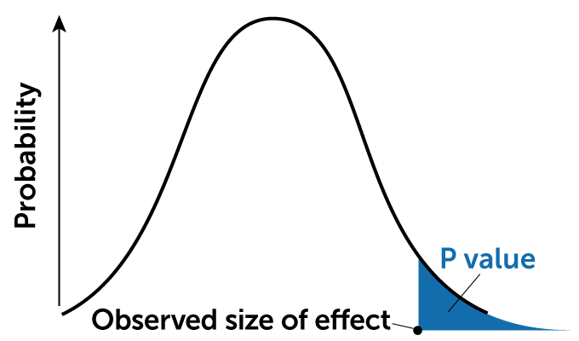
p-value
The p-value represents the probability of observing the given data (or something more extreme) if the null hypothesis were true.
H0: Everything is fine, no one influences anyone. (SNP has no association)
H1: Your prime interest, which is the opposite to H0. (SNP is associated)
Testing: finding the probability that H0 is correct (p-value).
If p-value is low, then you can’t accept H0, so you rather accept H1!
probability density
under H0

Slide 20
Phenotypes
Phenotypic Variation should be sufficient for the effective GWAS
Quantitative and Categorical nature of phenotypes requires an appropriate GWAS model. This should be checked in advance.
Covariates. Some additional traits should be taken into account (age, sex, environmental factors…).
Normally distributed residuals is one of the main assumptions.

Slide 21
Genotypes
How much of the genome are you actually assaying?
Coding versus non-coding variation?
SNPs aren’t the only type of polymorphism.
Common genotyping methods:
Whole-genome resequencing
RADseq/Genotyping by Sequencing
mRNA-Seq
Exome sequencing
SNP arrays

Slide 22
Fixed effects
Covariates
PCA
output from the Structure/ADMIXTURE programs

Slide 23
Kinship (K) matrix (random effect)
K matrix represents the genetic background relatedness between individuals.
Pairwise relatedness matrix / IBS matrix / genetic correlation.
Many programs for estimation: limix, plink, R packages, etc.
Calculation could be slow
(Today we will use a pre-calculated matrix )
Sometimes population structure correction will take other forms:
PCA
output from the Structure program

Slide 24
Options for running GWAS
Online options
EasyGWAS (https://easygwas.ethz.ch/)
GWA-Portal (https://gwas.gmi.oeaw.ac.at/)
easy interface
limited data availability
limited types of analysis
not flexible
Do-it-yourself
limix (https://github.com/limix/limix)
gemma (https://github.com/genetics-statistics/GEMMA)
and MANY others…
requires coding skills
maximum flexibility and options
allows for more complicated GWAS analyses

Slide 25
The plan for hands-on work today
We will walk through GWAS together using a flowering time phenotype (3 Jupyter notebooks).
2. You will do some GWAS by yourself with two additional phenotypes. This independent exercise is outlined in:
GWAS_course_independent_work_instructions.pdf
Think about the different questions as you work. Please just ask questions if you aren’t sure you can answer them!
3. Conclusions, post-GWAS, advanced GWAS

Slide 26
The GWAS jupyter notebooks
0_running_Jupyter_notebooks.ipynb
Learn how to navigate a Jupyter notebook
1_phenotype_exploration.ipynb
Explore the phenotype we will use
2_GWAS.ipynb
Prepare input variables, run GWAS, and output results
3_GWAS_interpretation.ipynb
Visualize and understand GWAS results
https://github.com/picla/GWAS_workshop_CK

Slide 27
I did a GWAS, now what?
Association is not causality!
Most significant SNP is not necessarily causative (confounding, incomplete knowledge of variants).
The “peakiness” of a peak is not necessarily a sign of its importance
Interested in candidate genes?
Use biology, annotation, expression, etc. Be creative!
Sequence candidate genes/regions
Test causality by QTL and/or transgenics with different alleles in common background
Interested in evolutionary or ecological inferences?
Consider the consequences of your choice of accessions and phenotypes
Associations with selective pressures (environment/climate)?
Other signs of selection?
The reference allele is not necessarily the ancestral allele.

Slide 28
Moving beyond simple GWAS
Generalized linear models for different data distributions
Adding covariants
Incorporating genotype-by-environment interactions
Analyzing correlated traits together (increases power)
Bayesian approaches
Polygenic scores
Genomic prediction
There are endless packages/programs available to do GWAS, with more published all the time. Limix and gemma are great places to start.
Human GWAS is a bit of a different animal (no experiments, huge sample sizes, environmental confounding).

Slide 29
Final Questions/Comments?

