Slide 1
Payments
Specifications for the payments menu

Slide 2
General
For a waitress or a waiter to select items on the menu that are going to be payed, a payment menu exists. It allows to change the payment db status of an orderid.
The payments section is located on the notepad pane in the main menu to the right hand side.

Slide 3
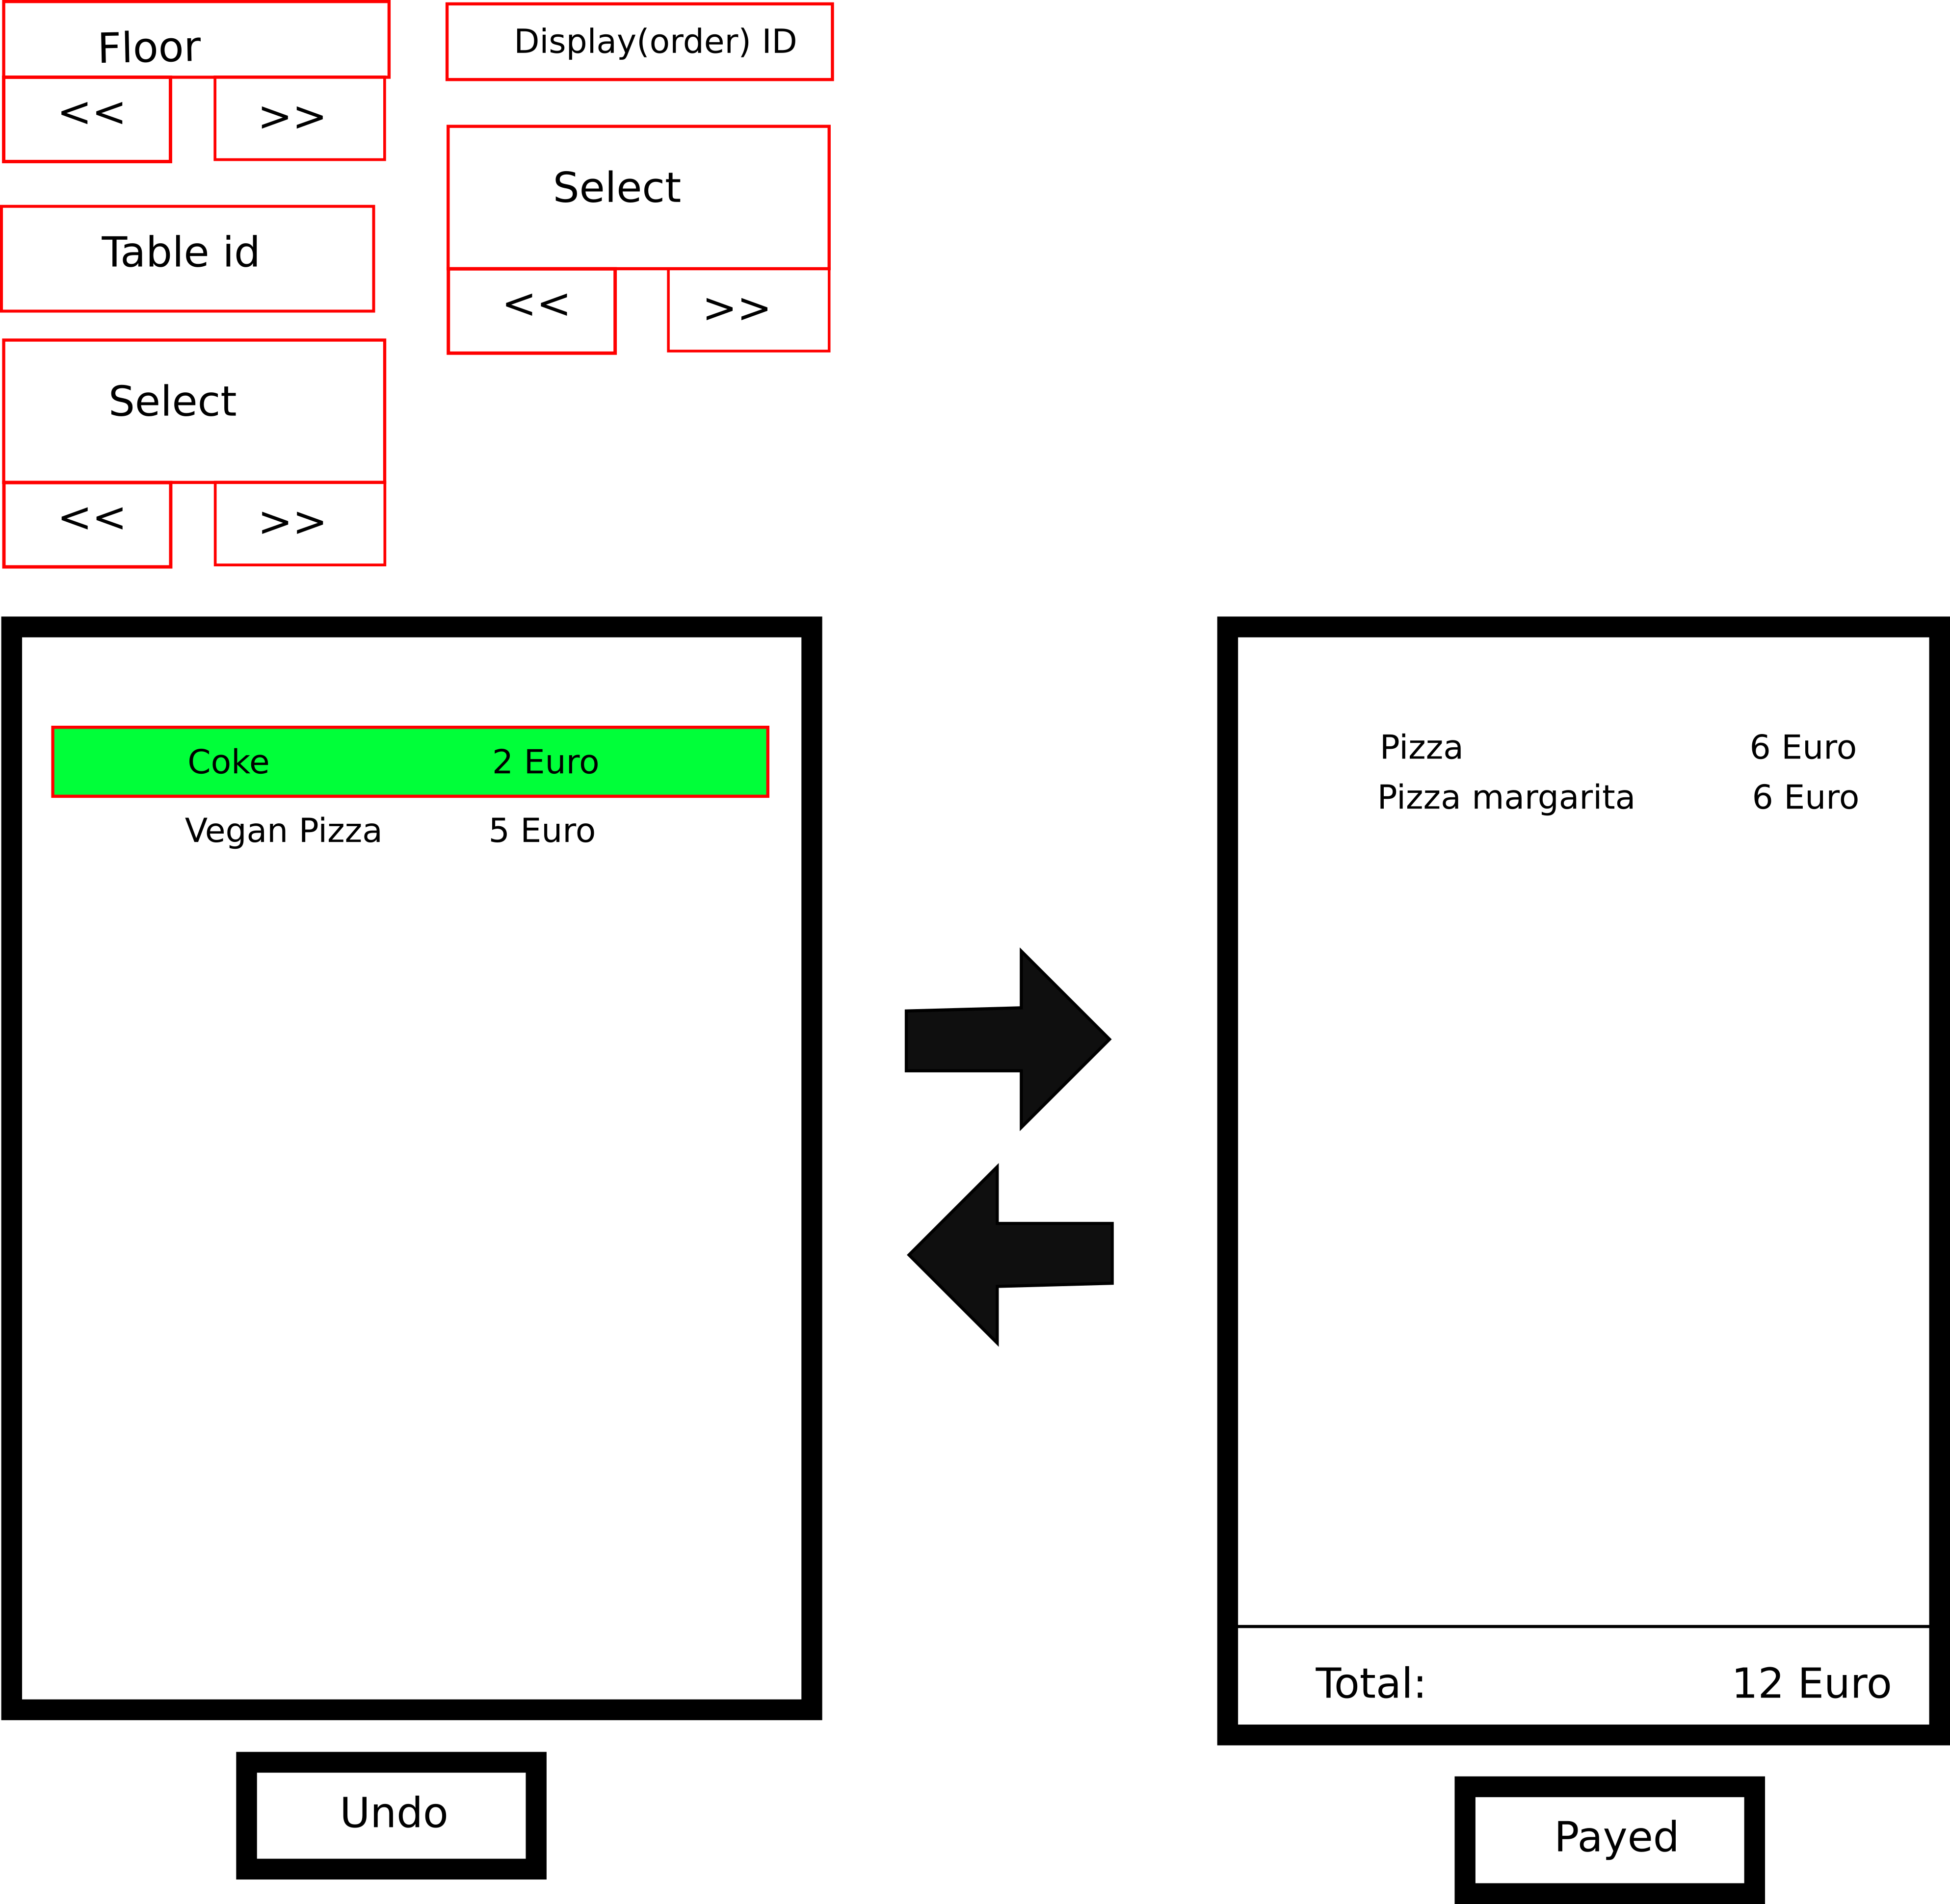
GUI
On the left hand side
are:
- floor selection
- table selection
- display order id selection
According to these the right hand side of the panel is filled with information (parsed xml db entry) according to the selected display order id. The green items have been payed.
The undo button allows to reverse the payed status

Slide 4
GUI – DB table
On the left hand side
are:
- floor selection
- table selection
- display order id selection
All the information mentioned can be found in the ordering_table
ordering_table
id | floor | table | chair | waiter | xml | endpoint | status | Printedstatus | datetime
payed | orderid | displayid | cost

Slide 5
GUI – DB table
Description of the db:
id – index
floor – the floor (varchar)
table – the selected table (varchar)
chair – the selected chair (varchar)
waiter – waiter id (varchar) *
xml (Text) – the corresponding XML for the selected node (generated from a leave to last parent node, all relevant xml nodes), the first parent node should have information about which printer to use for this item
endpoint – is the node leafs id
status – status of the entry (ready to order, ordered, served, payed)
print status – status of the printer (not printed, printed)
datetime – datetime created
payed – is payed
orderid – to what order group does this order belong (total index)
displayid – to what displayid does this order belong (0 to about 1000 per day). This is a daily id that indexes orders
cost – the total resulting cost of the item
ordering_table
id | floor | table | chair | waiter | xml | endpoint | status | Printedstatus | datetime
payed | orderid | displayid | cost
Red items are indexes

Slide 6
GUI
The user can select items and move them to the right hand pane where they can be marked as payed (see db Boolean payed).
These items will be marked with a green color on the right hand side pane. If the process needs to be reversed, then undo can be selected.

