Slide 1
Sockets
Specifications for the server client sockets

Slide 2
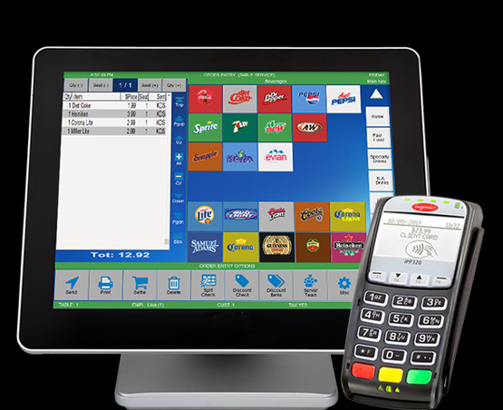
General
Server side sockets Client side socket
x

Slide 3

Client configuration
x
In the configuration pane, the following
options are taken care of:
- socket server address
- language
- reload menu from server
- menu pane
Configuration pane

Slide 4
Reloading the menu from server
When reloading the menu from server, the entire tree view
is exported to a xml string server side and then loaded by the client.

Slide 5

Client side menu
x
In the menu pane, the menu that is selected in
the configuration is being displayed.
The buttons are arranged according to the selected
Menu.
Each button represents a drill down menu, where
the child menus are created according to the
selected (in config) Xml tree view.
Finished orders are then added to the database
on the server side. Hence the selected items,
need to be sent back to the server.

Slide 6
Client side menu
x
table
Order
display id
New id
The table id associates the ordered item with a table.
The order display id associates the order to an order
display id. New order ids can be pulled by pressing
the button new order id. If “New id” is pressed, then
the user is going to be asked to confirm his action,
by asking “Are you sure to create a new order”.

Slide 7

Client side payments
x
The orders are listed on the left hand side in a
list overview. The selected orders are then added
To the “To be payed” overview. When the button
“payed” is pressed, then the items in the “to be payed”
list view are changed to payed in the database and
are erased from the list view.
Open question, how to do the undo???
Have a separate menu or add an undo button
to the view or leave the payed items on the right hand
side list view and mark them green?
orders
orders
To be payed
payed

