Slide 1
Printing
This document describes how printing will be done.

Slide 2
Scope / Use cases
Printing in the kitchen
Printing at the bar
Printing at a printer connected to the Ethernet

Slide 3
Printing GUI / Example
Printing will be done by parsing the XML of ordering items.
<item name="Pizza" uuid="1976266538">
<option id="size" name="small" price="0.5" uuid="124456611" >
<choice name="extra cheese" price="0.5" />
</option>
<option id="size" name="medium" price="0.8" >
<choice name="extra cheese" price="1" />
</option>
<option id="size" name="large" price="1.2" >
<choice name="extra cheese" price="1.5" />
</option>
<item name="topping" name_en="topping">
<option id="toppingammount" name="few" price="0.5" />
<option id="toppingammount" name="more" price="0.8" />
<option id="toppingammount" name="lots" price="1.2" />
<item name="margarita" menu_id="100">
<option id="size" name="small" overwrite_price="5.5" uuid="3462565" menu_id="100a" />
<option id="size" name="medium" overwrite_price="5.8" menu_id="100b"/>
<option id="size" name="large" price="1.2" menu_id="100c"/>
</item>
</item>
</item>

Slide 4
Printing GUI / Example
Pizza medium, lots, margarita : 5.8$
<item name="Pizza" uuid="1976266538">
<option id="size" name="small" price="0.5" uuid="124456611" >
<choice name="extra cheese" price="0.5" />
</option>
<option id="size" name="medium" price="0.8" >
<choice name="extra cheese" price="1" />
</option>
<option id="size" name="large" price="1.2" >
<choice name="extra cheese" price="1.5" />
</option>
<item name="topping" name_en="topping">
<option id="toppingammount" name="few" price="0.5" />
<option id="toppingammount" name="more" price="0.8" />
<option id="toppingammount" name="lots" price="1.2" />
<item name="margarita" menu_id="100">
<option id="size" name="small" overwrite_price="5.5" uuid="3462565" menu_id="100a" />
<option id="size" name="medium" overwrite_price="5.8" menu_id="100b"/>
<option id="size" name="large" price="1.2" menu_id="100c"/>
</item>
</item>
</item>

Slide 5
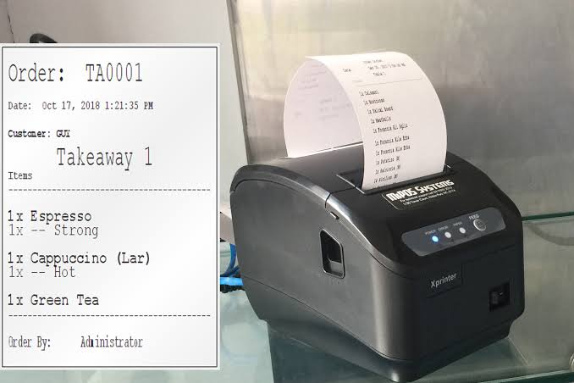
Examples
The xml samples from the previous sites has to be formed into a printable format that then is going to be printed. The format can be an item list.

