Slide 1
Ordering menu
This document describes how the ordering menu
is supposed to look like and how its internal functions are working

Slide 2
Scope
The ordering menu will be integrated to the server and the Android clients

Slide 3
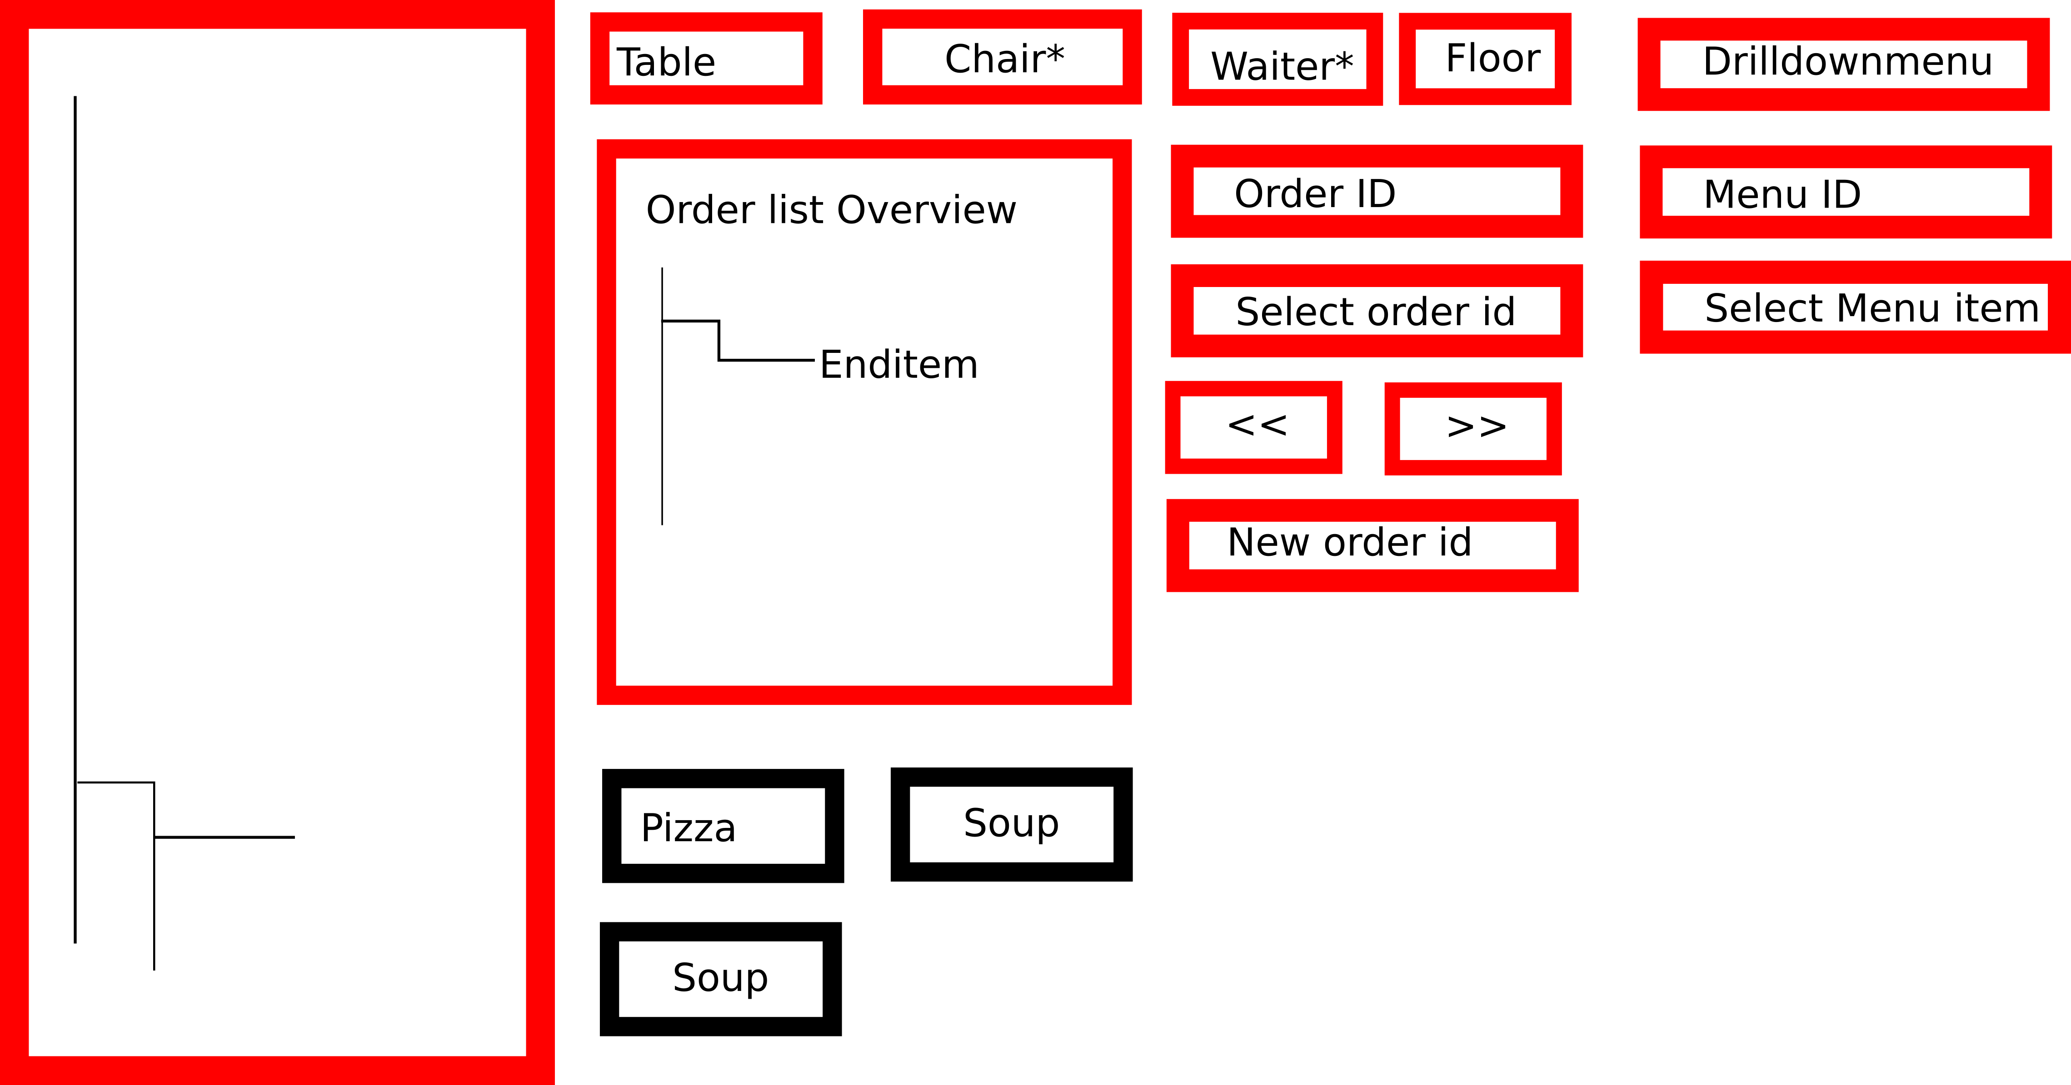
Ordering menu overview
List view of the orders
Menu for selecting the
drill down menu
Drill down menu

Slide 4
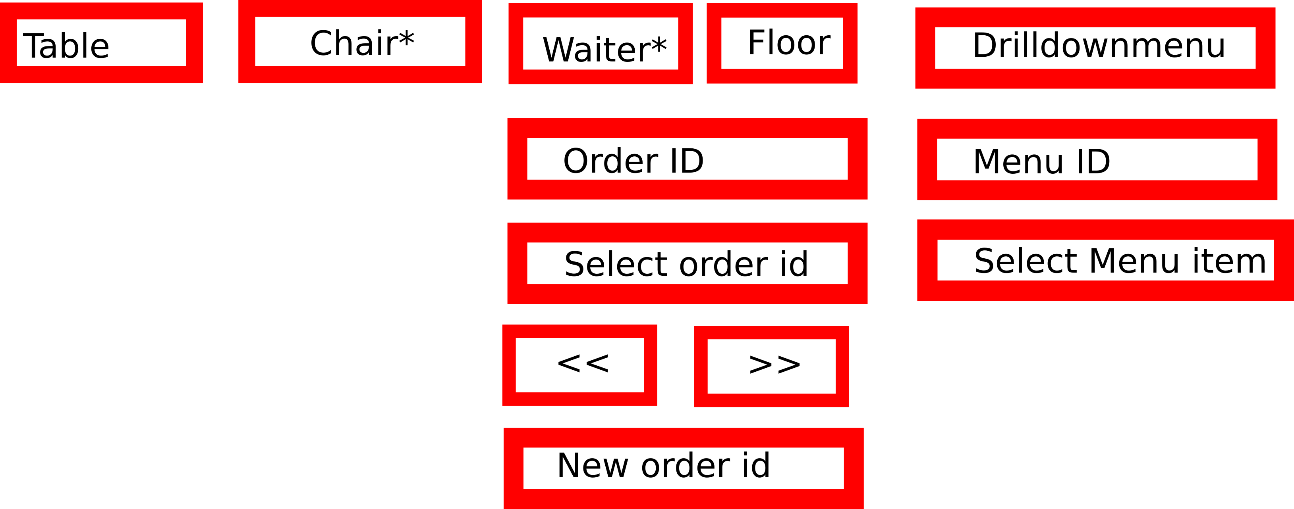
Ordering menu / menu
- The selection of a order menu is done by selecting a table id in “Table” and a floor id in “Floor”. Every time one of these entries is edited the “Order ID” (Human readable order id) is being updated. To finish the selection process, select order id needs to be pressed.
- In order to create a new order id (new customer associated with a table and a floor) a table and floor have to be inserted, then “New order ID is pressed. The user will be asked if a new order is going to be created in a message box
- The order ID can be scrolled through by using the << and >> buttons

Slide 5
Ordering menu / Drill down menu
- Drill down menu is a drop down menu where the drill down menu can be selected. According to the selection the drill down menu will be created below the menu

Slide 6
Ordering menu / Menu ID
- The Menu ID gives direct access to menu items by their menu item id. These items will be directly added to the current ordering id

Slide 7
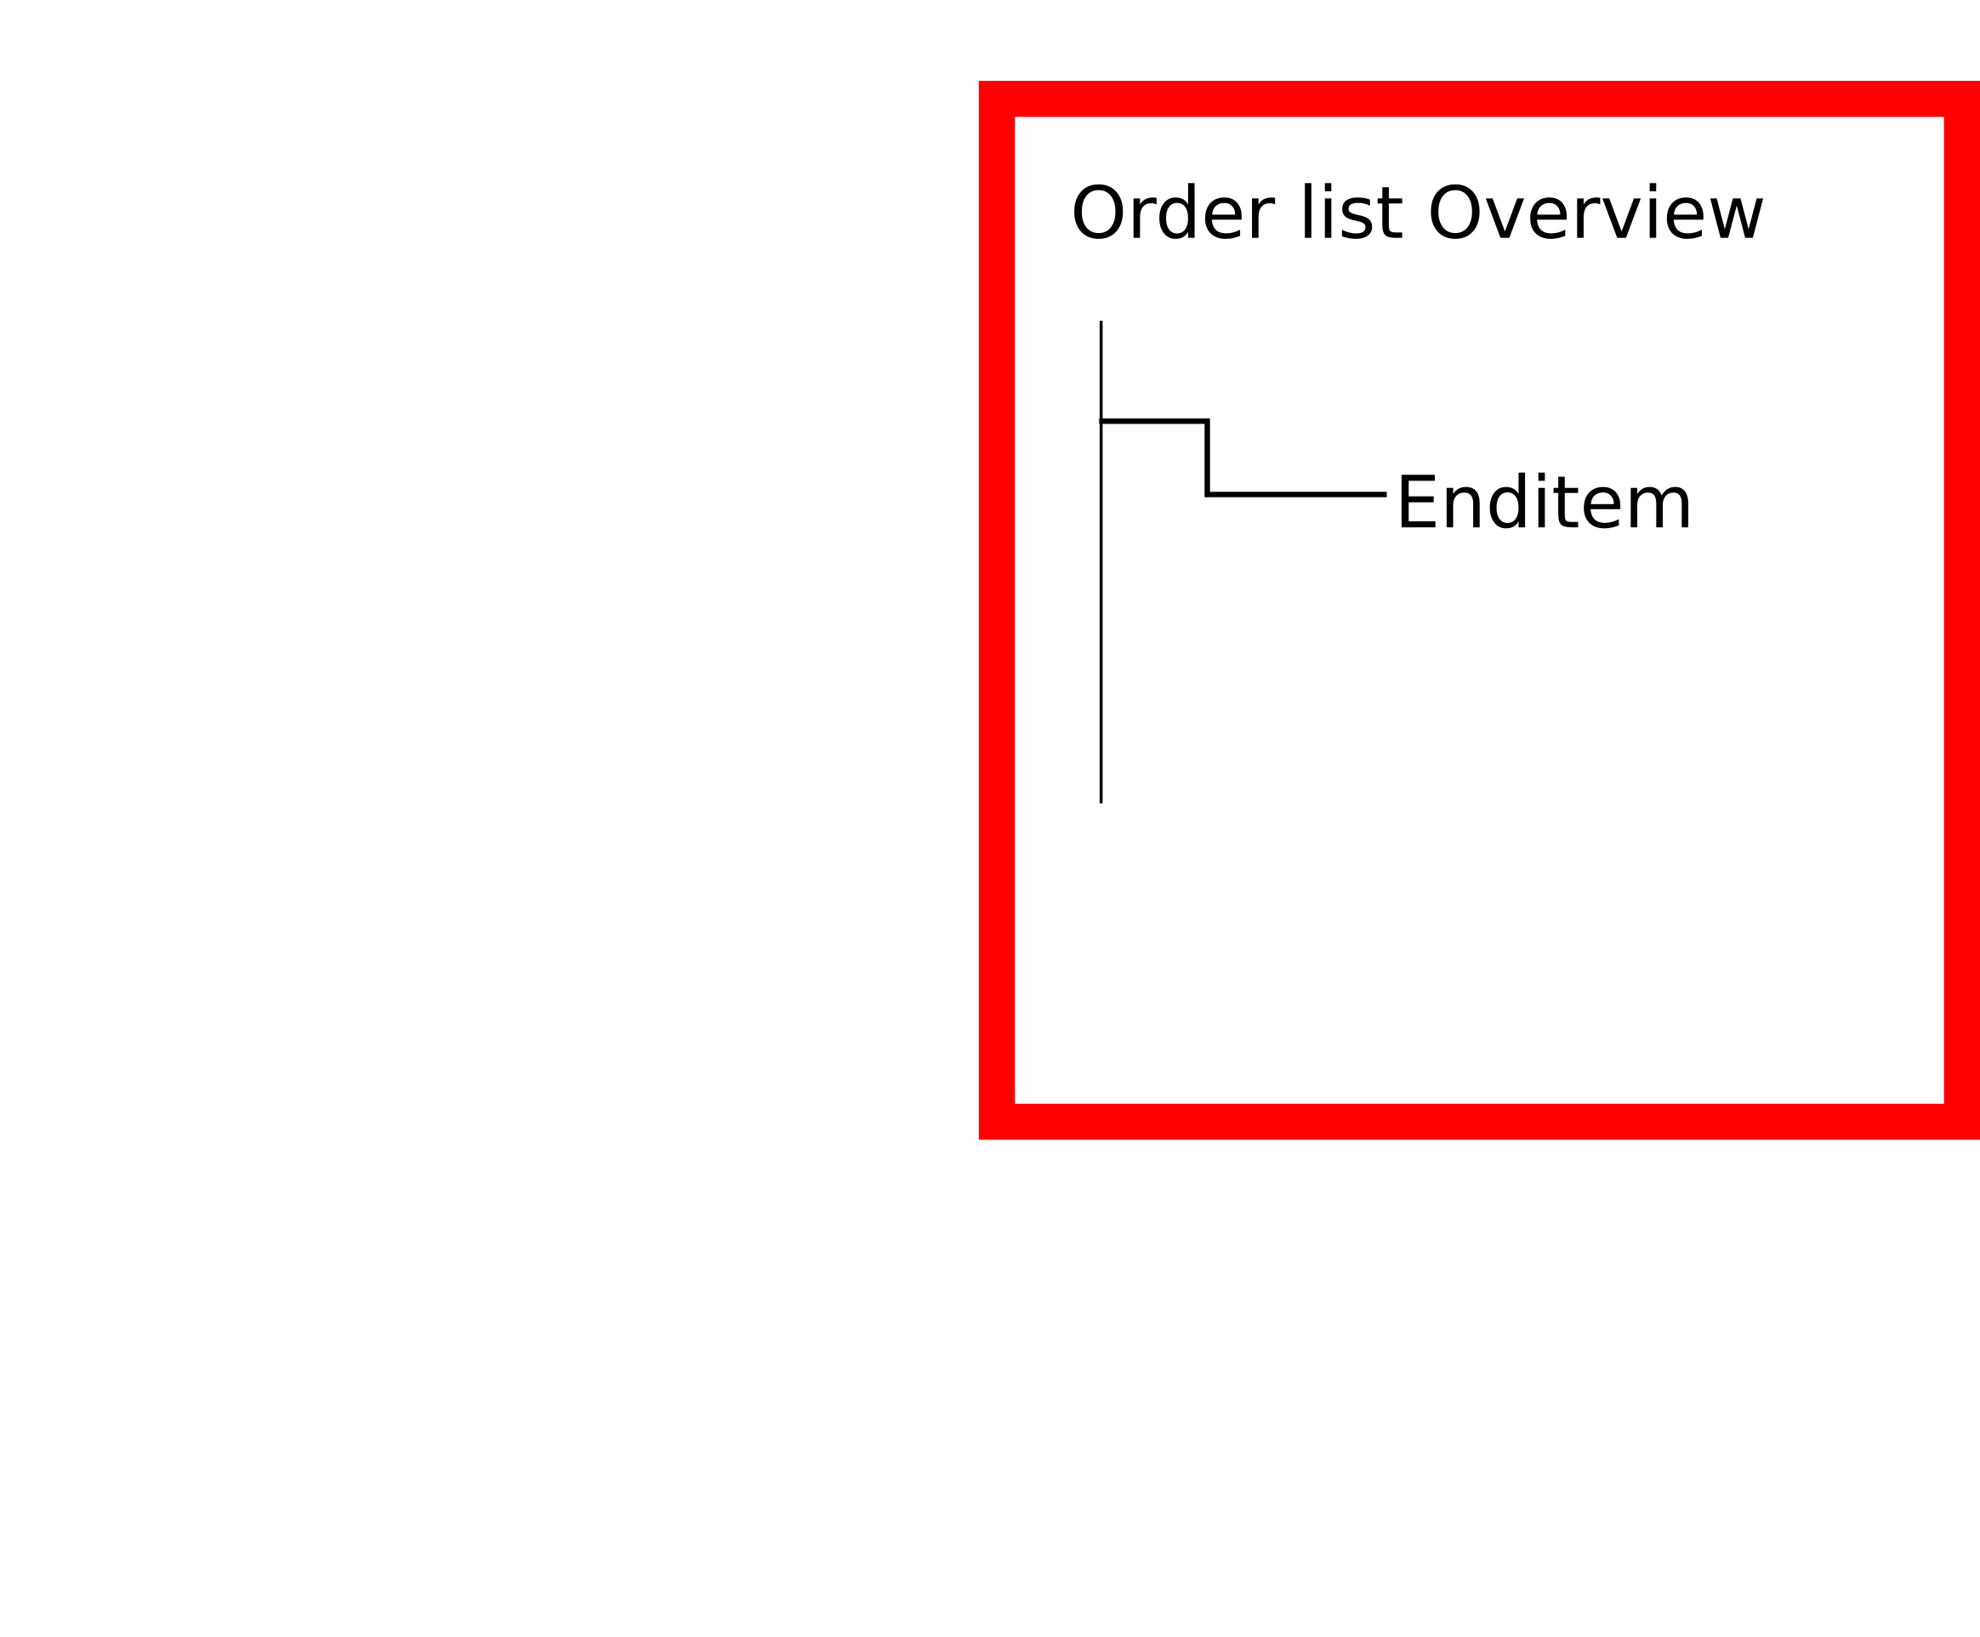
Ordering menu / Order list
- The order list displays the different items associated to an order id (human readable order id)
- These items can be selected and they can also be deleted from the order list using a remove button

Slide 8
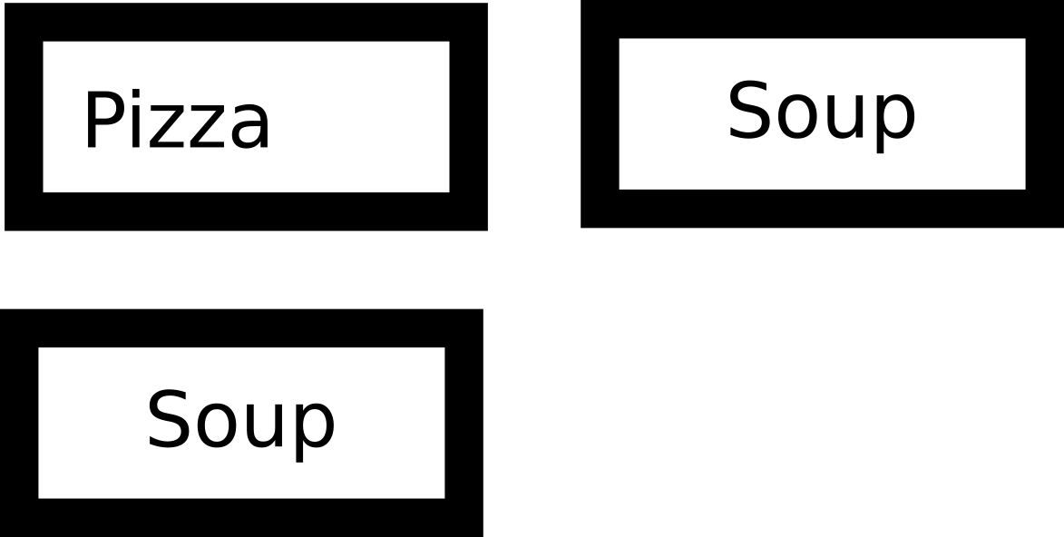
Drill down menu / Generation
If a user clicks on a button, then the following menu is generated automatically considering the various children of the menu node that was selected, see example for the file sample_template.xml, where the pizza node was selected.
Once small medium or large was selected the following menu would look like:
small
medium
large
Extra cheese
topping

Slide 9
Drill down menu / Generation
If topping was selected, then
would follow and then
would follow. Note that the choices (extra cheese) are always displayed and only out of sizing reasons were not displayed here. The end items (end nodes) following
margarita would follow automatically, as these options were set earlier and are identified by an id
few
more
lots
margarita

