Slide 1
Layout manager
Specifications for the layout manager

Slide 2
General
The main layout will be stored in an xml file on the main server side. So if someone is going to request the layout later, then that is where the data comes from
The user is able to add tables and chairs to the currently selected level layout.
Each element in a layout is resize able, translatable and rotate able.
Also the user can select an image which is displayed as background information.
The tables and chairs are indicating with a name and an index. Their current status is indicated by a color (black is not occupied, yellow is occupied, red needs service)
Table(1): prime
Table(1): prime
Table(1): prime
Chair(0)
Chair(0)
Chair(0)

Slide 3
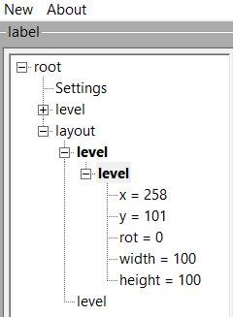
Overview treeview
Select the level (selected in bold)
Select the table (selected is bold)

Slide 4
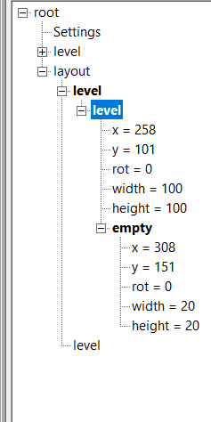
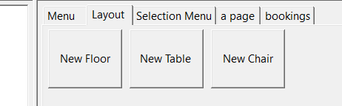
Adding nodes
Added chair
Add a floor
Add a char
To the active table
Add a table to
the active floor

Slide 5
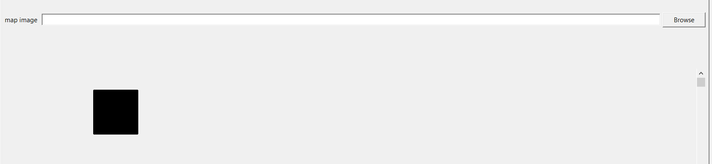
Layout overview
Select background image
Table
Overview

Slide 6
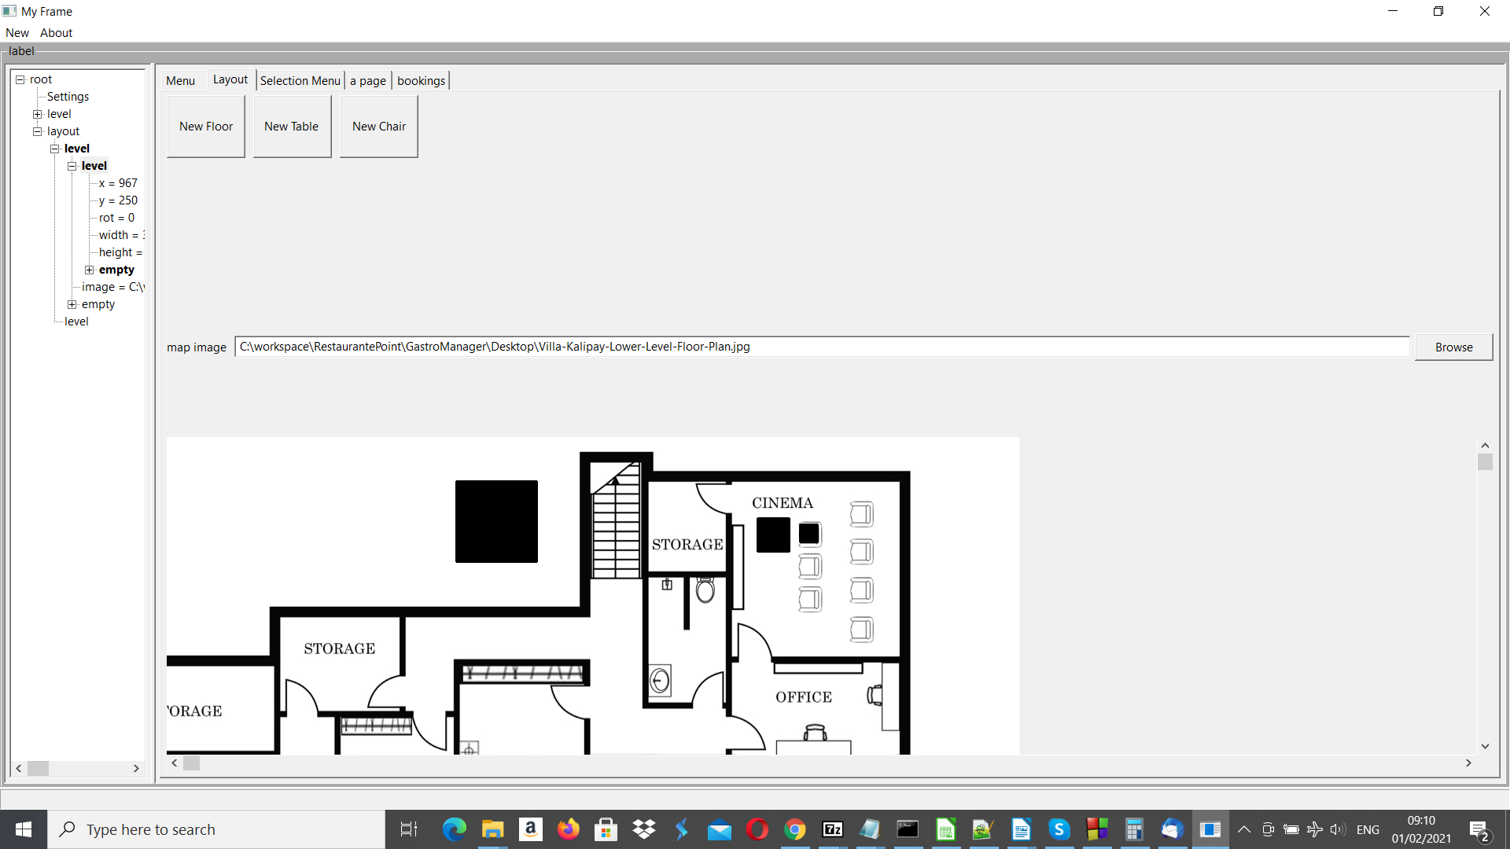
Layout with background image
Select background image
Table with chair

Slide 7
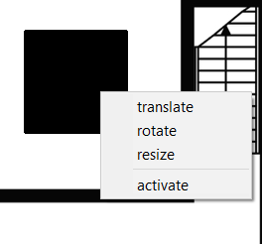
Menus / Layout
Right mouse button menu in the layout on a table or chair
Make active and translate
Make active and rotate
Make active and resize

Slide 8
Menus (right mouse button menu) / Treeview
Delete
Edit
Select
Delete and
activate nodes
Edit values in a
dialog menu

