Slide 1
Server
Specifications for the server panel

Slide 2
General
This documentation is the specification for the server pane.

Slide 3
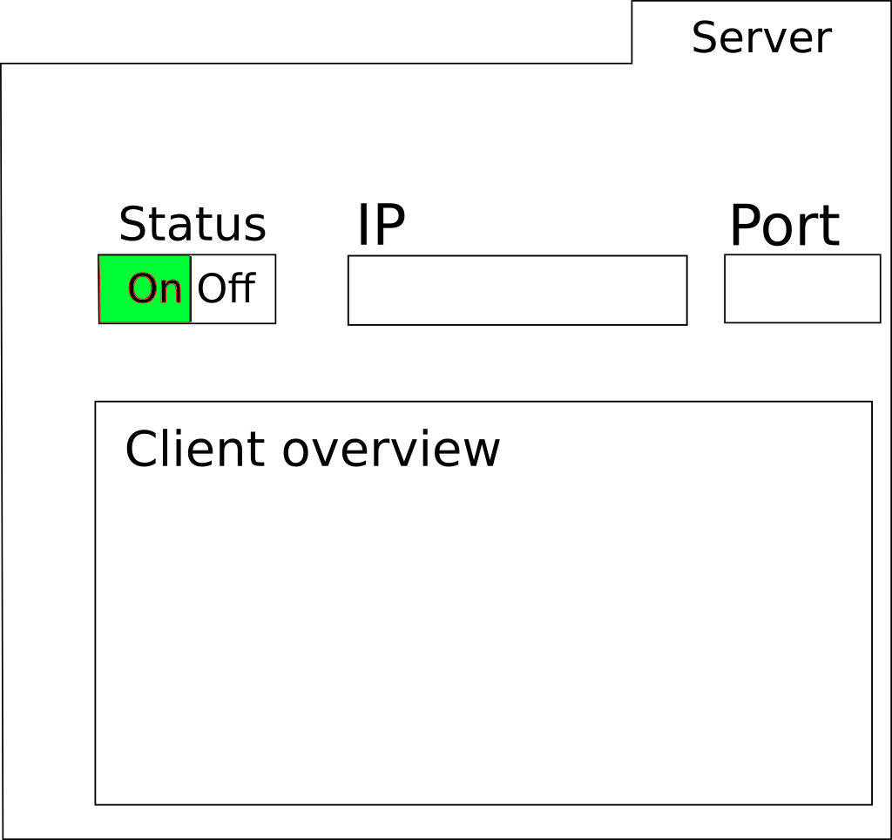
Panel look and function
Server port (display
Or editable)
Server IP address
(display)
On and off button for the server
(Optional) Client overview for the
connected clients

