Slide 1
Drill down menu
Specifications for the drill down menu

Slide 2
General
For a waitress or a waiter to select items on the menu that are going to be ordered, the drill down menu is the first choice to select them.
There are two main product feature in the software that take care of the drill down menu.
- Creation of a drill down menu
- Operation of a drill down menu
The node tree is provided by a file server side and by the server on Android devices

Slide 3
Creation of a drill down menu
The software comes with a drill down menu editor, that allows the configuration of a drill down menu (order menu). Each drill down menu is composed of a menu and a drill down menu. The menu defines various order-able items on a menu and defines how the drill down menu is presented to a user later on, as only the top level drill down menu is created manually. The following menus are created automatically.
There are three items on a order menu:
  Items, indicated by the xml tag name <item>
  These are order able items with a price tag. The price is estimated by either traversing from the root node to the end node or by an attribute called overwrite_price
  Options, indicated by the xml tag name <option>
  Options are item categories for instance large, small and medium. They come with an id to identify them later in the drill down menu
  Choices, indicated by the xml tag name <choice>
  Can be extra cheese or other addable choices

Slide 4
Order menu example
Look at the file sample_template.xml

Slide 5
Drill down menu / creation
The drill down menus are defined on the server side using a button creation tool
Add a drill down menu
Height of
the drill
down
menu
NAME
Add a button to the drill
down menum
Width of
the drill
down
menu
Target uuid,the menu node this
button is linked to.

Slide 6
Drill down menu / creation
These buttons are arranged by hand on the server side.
Button of a
drill down menu

Slide 7
Drill down menu / creation
These buttons are linked to node of the menu nodes using a uuid.

Slide 8
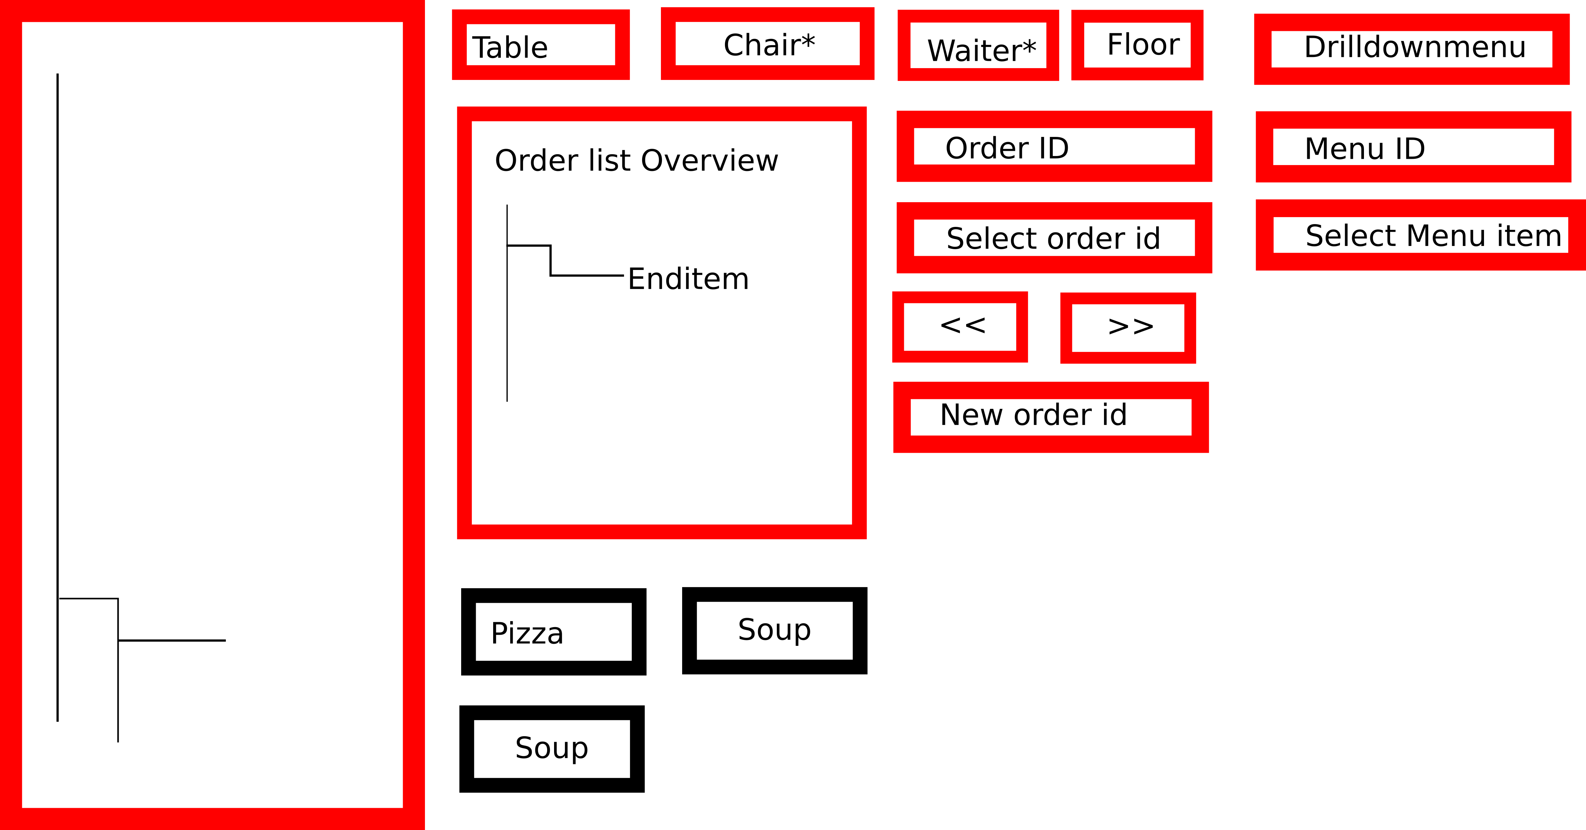
Ordering menu overview

Slide 9
Ordering menu overview
Table – textfield Example: 2(utrecht table),3,10
Char - textfield Example: 1,2,3 * optinoal
Waiter – textfield Example: 1,2,3 *optional
Floor – textfield Example: 1(bottom floor),2
Order ID – textfield Example: 1
Select order id – button
<< >> – button
New order Id – button
Drilldownmenu – dropdown menu (showcases the different drop down menus
Menu ID – Textfield example 100a
Select Menu ID - Button

Slide 10
Drill down menu / Generation
If a user clicks on a button, then the following menu is generated automatically considering the various children of the menu node that was selected, see example for the file sample_template.xml, where the pizza node was selected.
Once small medium or large was selected the following menu would look like:
small
medium
large
Extra cheese
topping

Slide 11
Drill down menu / Generation
If topping was selected, then
would follow and then
would follow. Note that the choices (extra cheese) are always displayed and only out of sizing reasons were not displayed here. The end items (end nodes) following
margarita would follow automatically, as these options were set earlier and are identified by an id
few
more
lots
margarita

