Slide 1




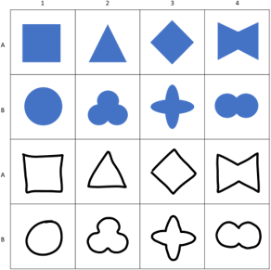
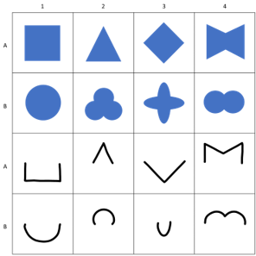
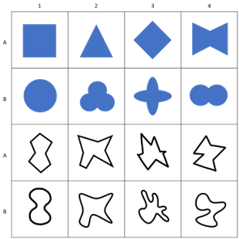
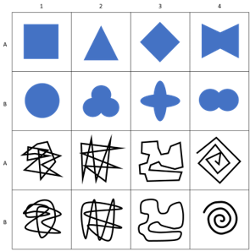
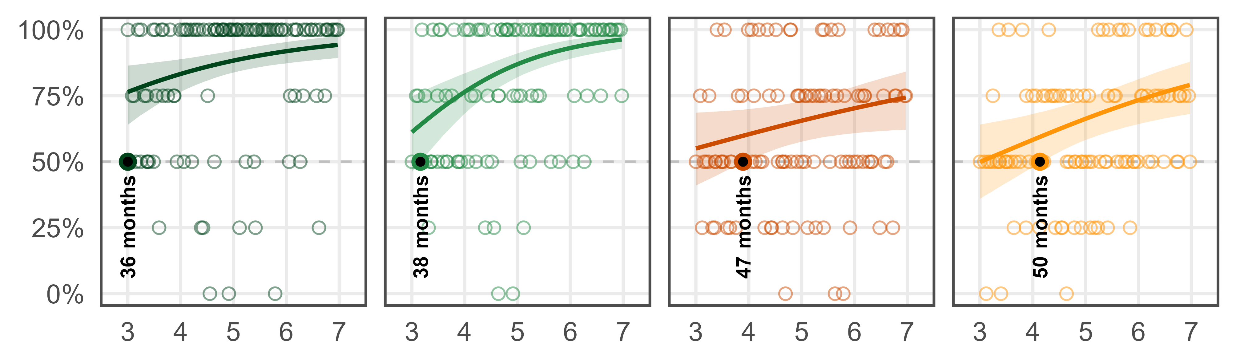
Representation
Pars Pro Toto
Simple Form Analogy
Complex Form Analogy
A
B
C

Slide 2
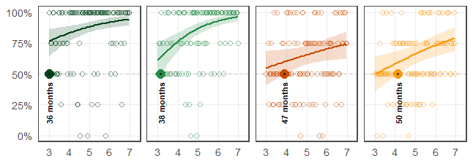
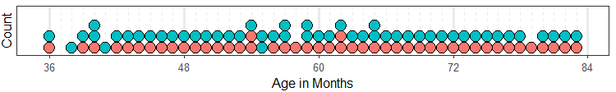
Representation
Pars Pro Toto
Simple Form Analogy
Complex Form Analogy
A
B
C
D

Slide 3
Representation
Pars Pro Toto
Simple Form Analogy
Complex Form Analogy
A
B
C

