Slide 1
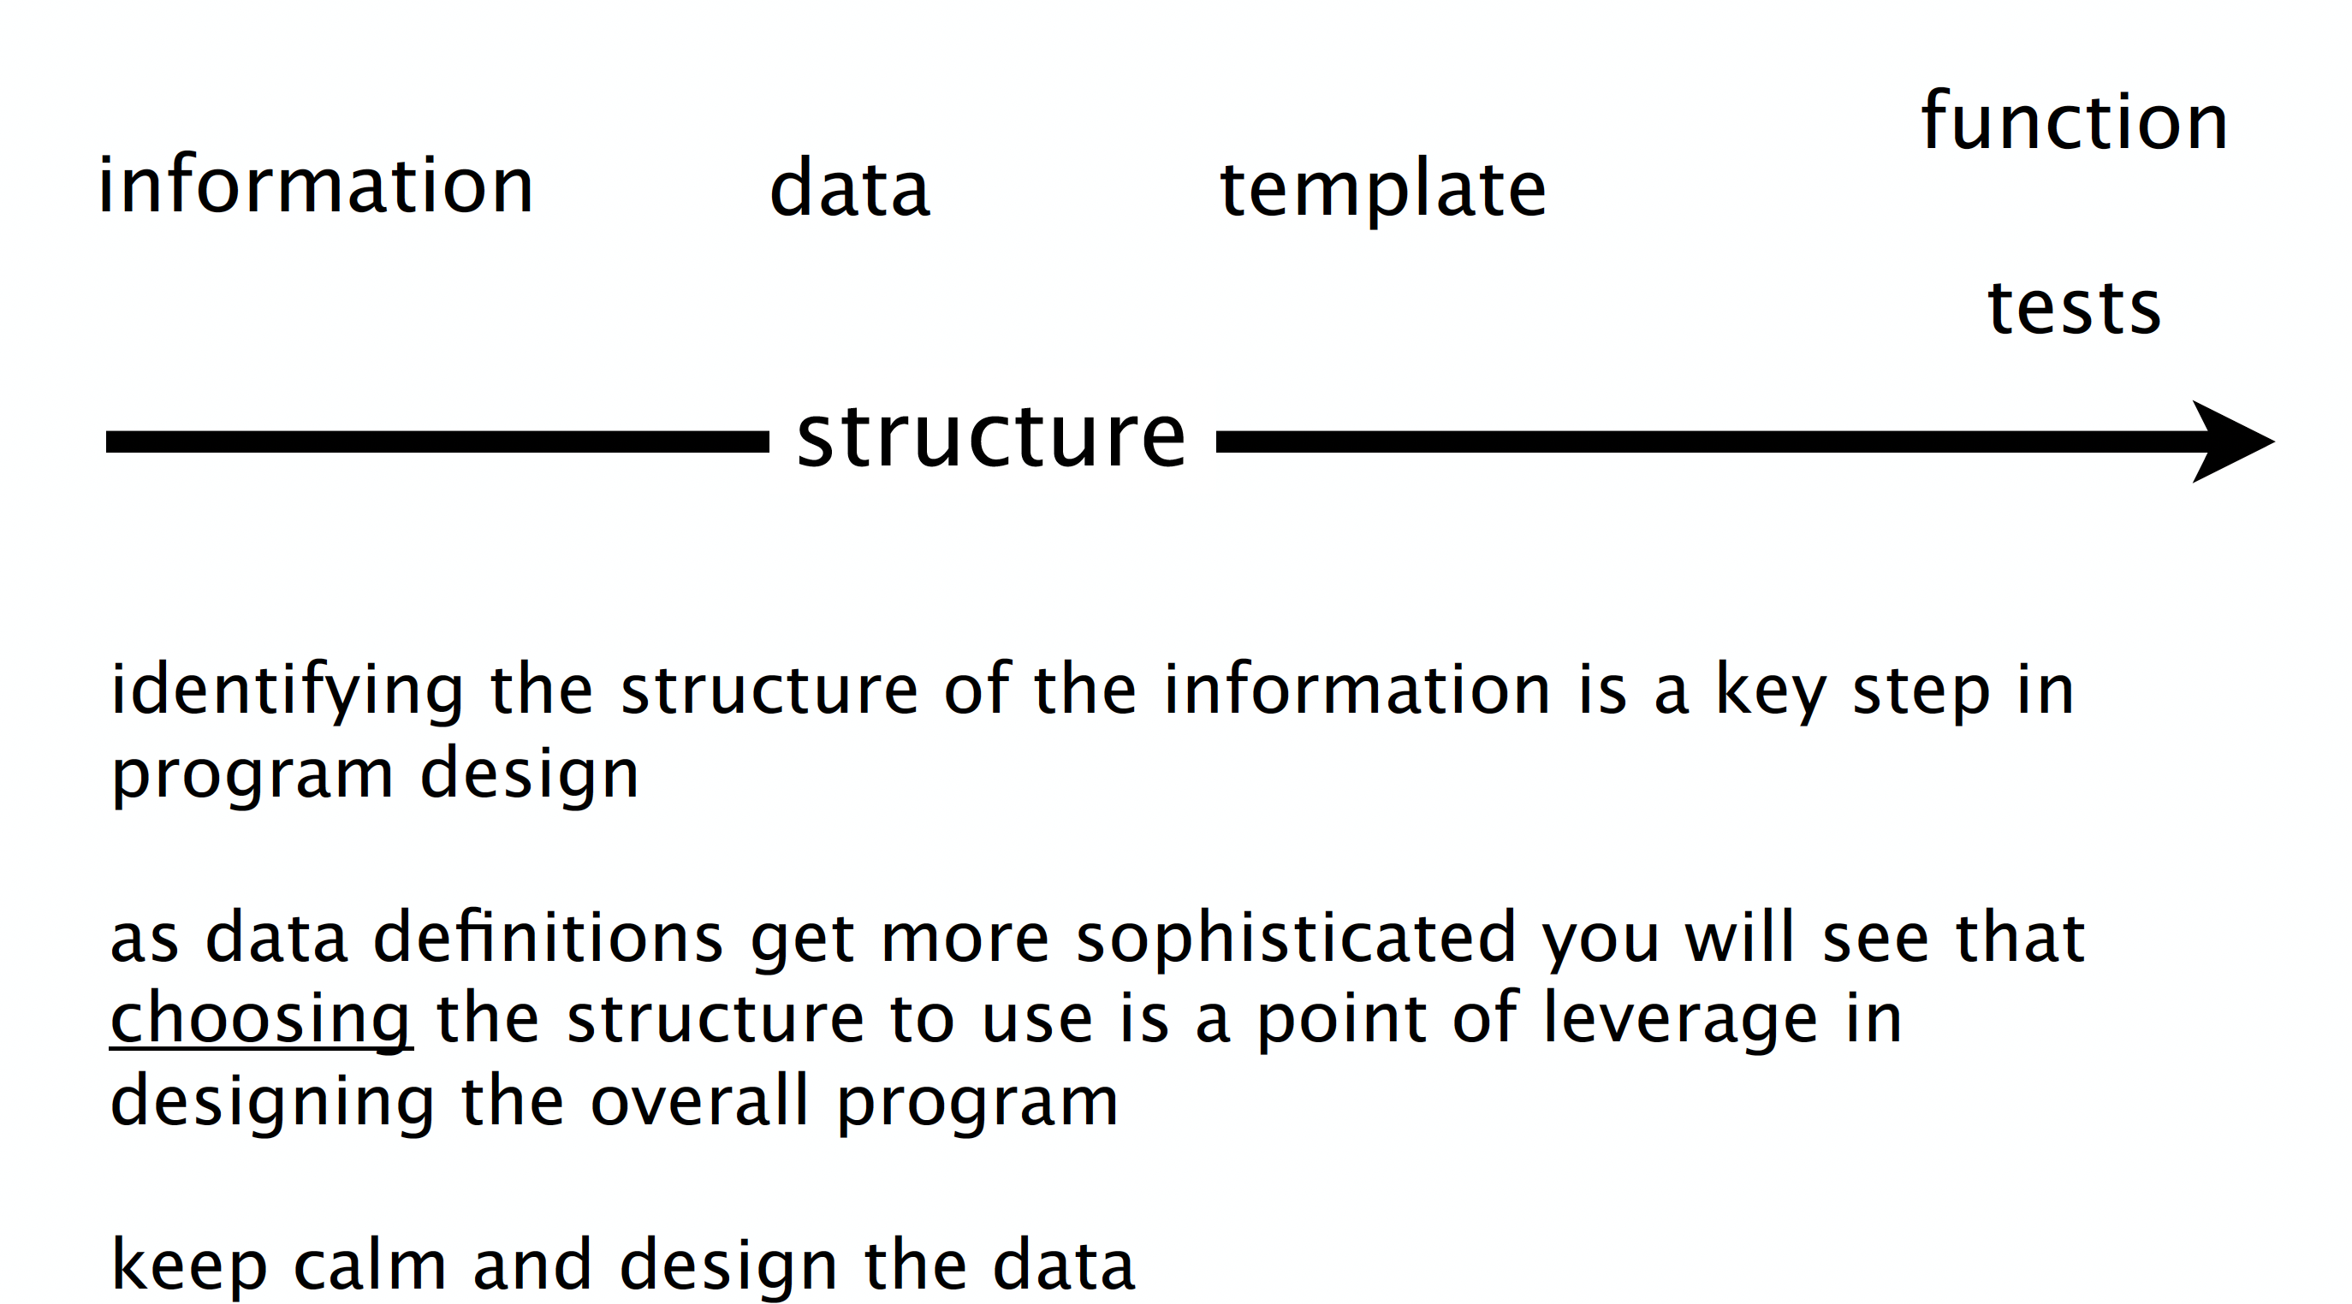

Slide 2
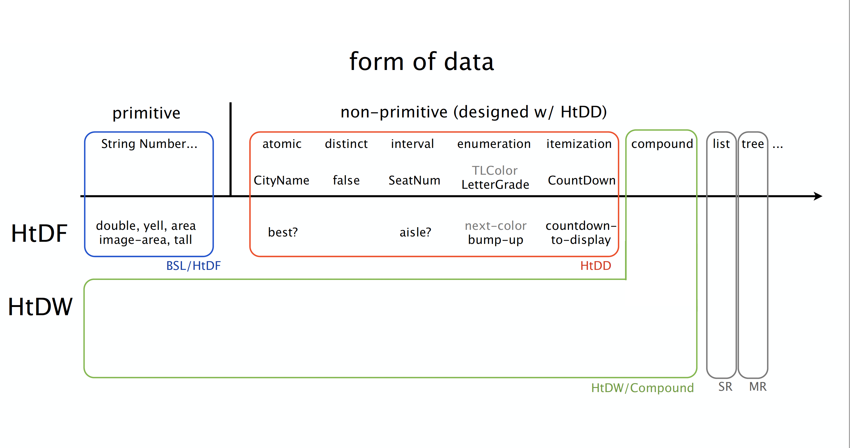

Slide 3
I want a function that ???=
one big problem?

Slide 4
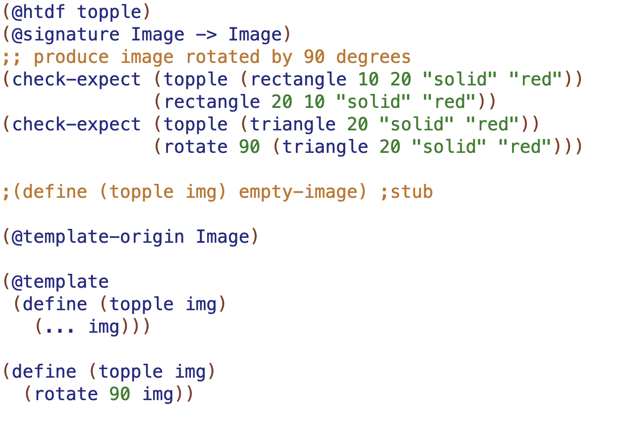
signature
6 smaller pieces
purpose
examples
how do I build template?
template
function definition

Slide 5
I want data that ???=
one big problem?

Slide 6
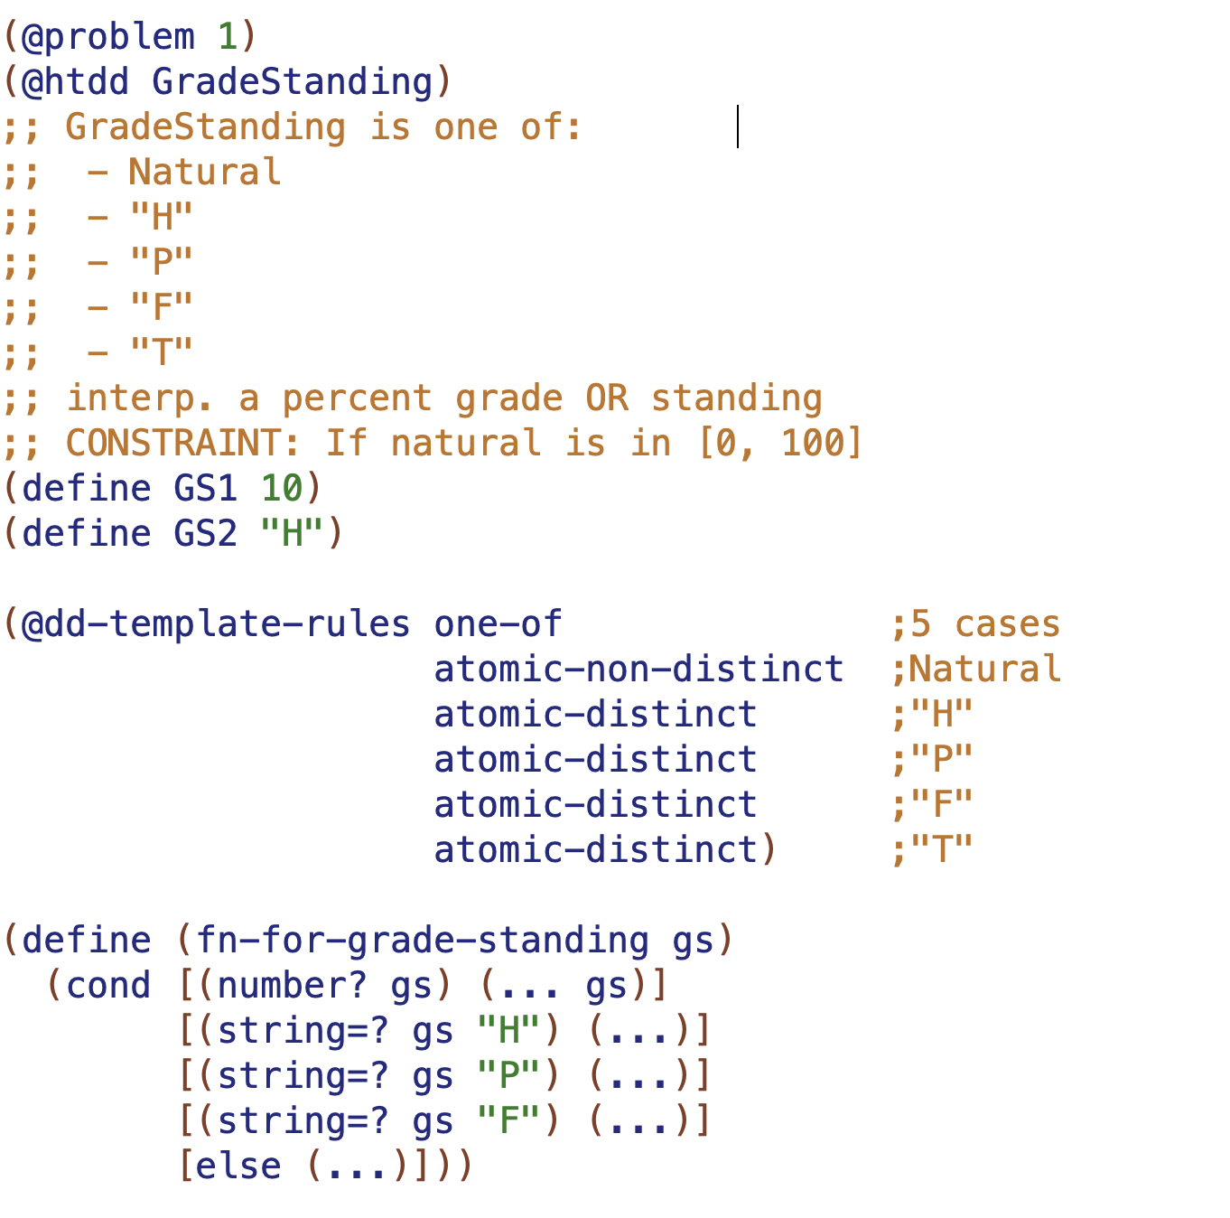
5 smaller pieces
type comment
interpretation
examples
how to produce template
template

Slide 7
Design methods tell us how & when to break problem into smaller pieces
HtDD
1
2
3
4
5
HtDF
1
2
3
4
5

Slide 8
Design methods tell us how & when to break problem into smaller pieces
HtDD
1
2
3
4
5
HtDF
1
2
3
4
5
HtDW
1.1
1.2
1.3
1.4
2.1
2.2
2.3
2.4

Slide 9
Trust the recipes
to help you make progress
Always ask: what’s next step of current recipe?
HtDD
1
2
3
4
5
HtDF
1
2
3
4
5
HtDW
1.1
1.2
1.3
1.4
2.1
2.2
2.3
2.4

Slide 10
Trust the recipes
to help you make progress
Always ask: what’s next step of current recipe?
HtDD
1
2
3
4
5
HtDF
1
2
3
4
5
HtDW
1.1
1.2
1.3
1.4
2.1
2.2
2.3
2.4
HtDF
1
2
3
4
5
HtDF
1
2
3
4
5

Slide 12
Don’t worry, handwriting
will be magically cleaned up!
Constant
Changing
BB options
on-tick to-draw on-key on-mouse

Slide 13
Constant
Changing
BB options
width height center x
speed
spider radius
spider image
mts
spider y
on-tick to-draw on-key on-mouse

Slide 14
0
0 + radius
Constant
Changing
BB options
width height center x
speed
spider radius
spider image
mts
spider y
on-tick to-draw on-key on-mouse
height – 1 - radius
height - 1

Slide 16
boundary case analysis for tock
BOT
result is BOT - 1
result is BOT
result is BOT

Slide 17
boundary case analysis for tock
(BOT - 1) + SPEED
(BOT ) + SPEED
(BOT + 1) + SPEED
BOT
result is BOT - 1
result is BOT
result is BOT

