Slide 2
Search problems – day 2
Last time – 2 way mazes (down and right only)
Videos – Sudoku
Problem bank – nqueens, programming contest
Today – Triangle solitaire
Lab - Clowns
Problem set – TA lab schedule solver
lot’s of problems to practice with
work them from the starter
don’t look at the solutions!!!

Slide 3

Tree of x,y positions moving through this maze
0, 0
1, 0
0, 1
1, 1
0, 2
2, 1
1, 2
changing search state: current position
next search search states: down and right, UNLESS wall or edges
done: solved when reach lower right corner
can also run out of moves
…

Slide 4
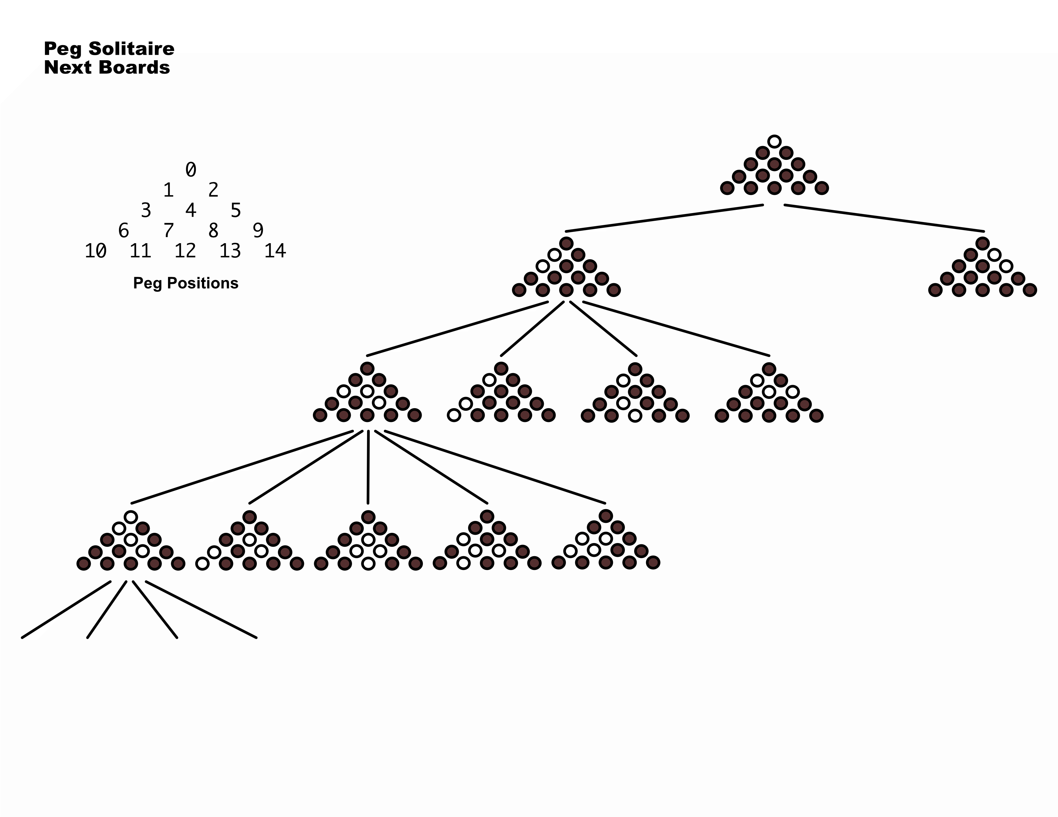
Peg solitaire

Slide 5
Jump has
start, over, to
To be valid,
start is full
over is full
to is empty
start
over
to

Slide 6
Jump has
start, over, to
To be valid,
start is full
over is full
to is empty

Slide 7
Jump has
start, over, to
To be valid,
start is full
over is full
to is empty

Slide 8
Jump has
start, over, to
To be valid,
start is full
over is full
to is empty
There are 36 possible jumps on the board

Slide 9
Jump has
start, over, to
To be valid,
start is full
over is full
to is empty
There are 36 possible jumps on the board

Slide 10
If we start here - what are possible next states?

Slide 11
and after here?

Slide 12
and after here?
What is CHANGING???

Slide 14
changing: what holes have pegs in them
next states: 36 jumps -> n valid jumps -> n new boards
done: only one peg left or no valid jumps

Slide 16
(define (solve bd)
;; Termination argument:
;; base: not possible to remove anymore pegs (solved or no valid jumps)
;; reduction: make one of n valid jumps
;; argument: making one jump at a time always reaches no more possible jumps
(local [(define (solve-bd bd)
(if (solved? bd)
(list bd)
(local [(define try (solve-lobd (next-boards bd)))]
(if (not (false? try))
(cons bd try)
false))))
(define (solve-lobd lobd)
(cond [(empty? lobd) false]
[else
(local [(define try (solve-bd (first lobd)))]
(if (not (false? try))
try
(solve-lobd (rest lobd))))]))]
(solve-bd bd)))

