Slide 2
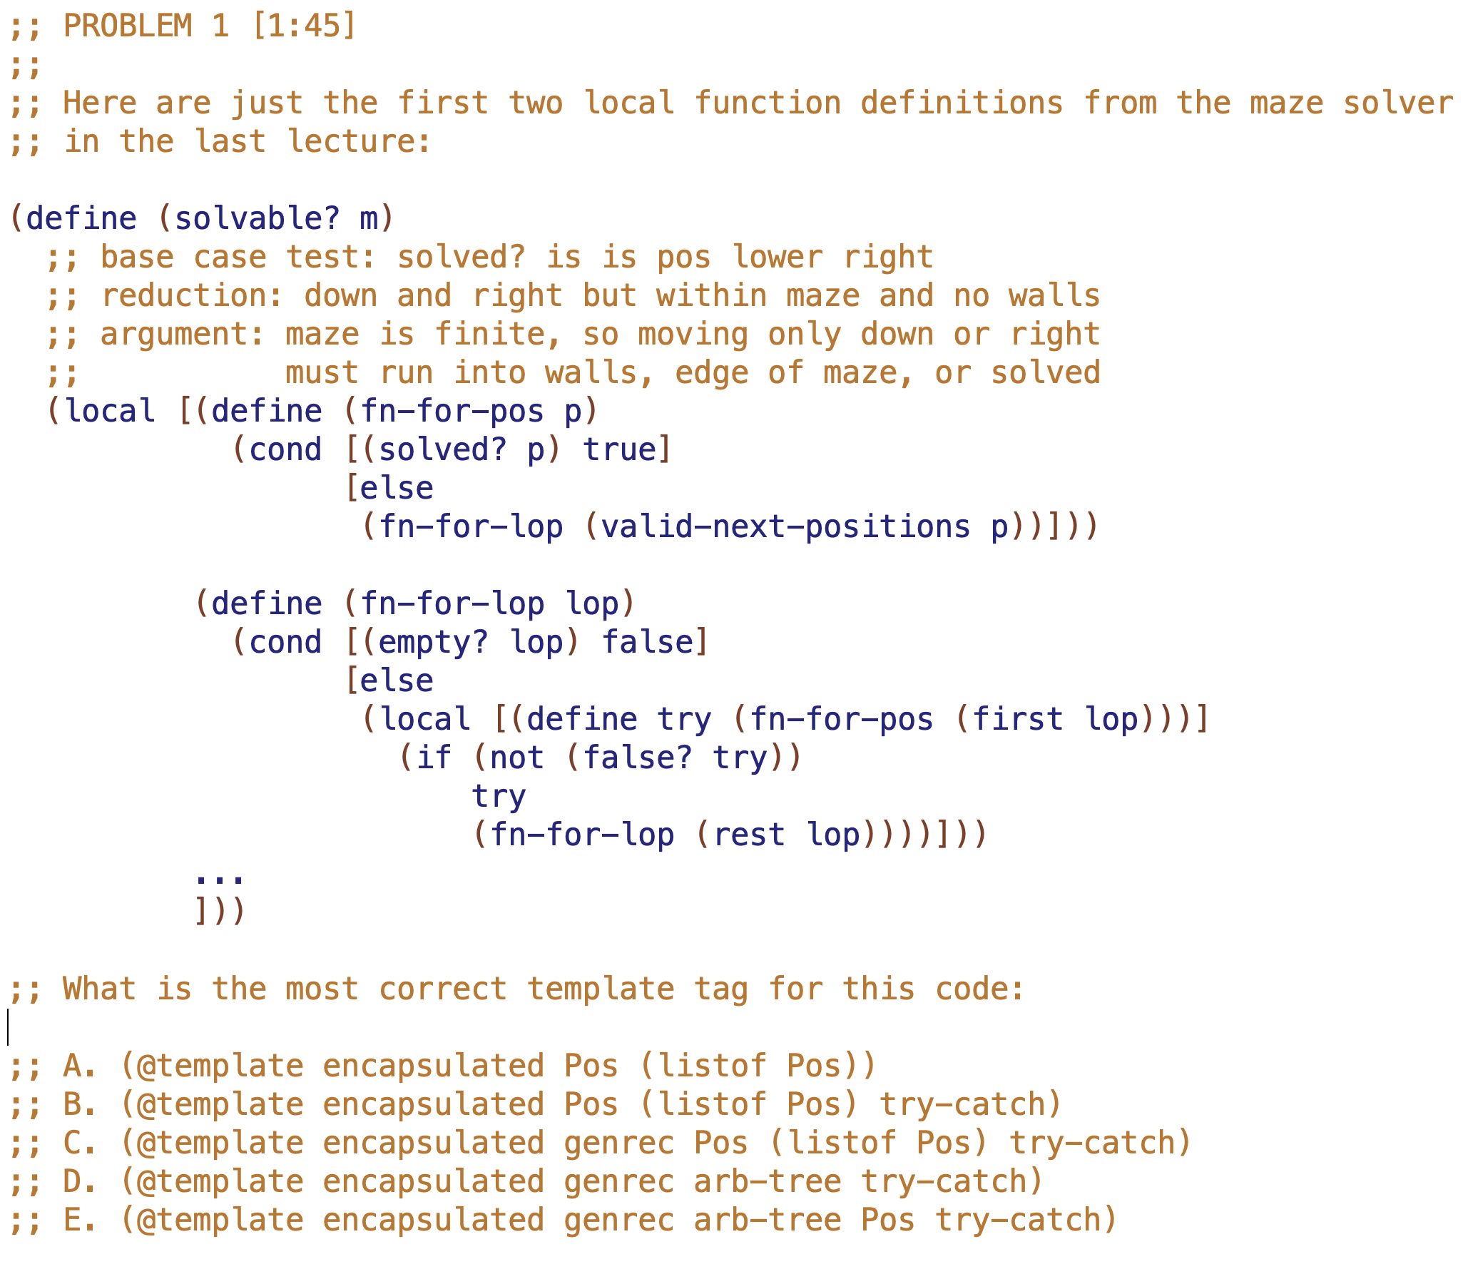

Slide 3
(define (solvable? m)
(local [(define (fn-for-pos p)
(cond [(solved? p) true]
[else
(fn-for-lop (valid-next-positions p))]))
(define (fn-for-lop lop)
(cond [(empty? lop) false]
[else
(local [(define try (fn-for-pos (first lop)))]
(if (not (false? try))
try
(fn-for-lop (rest lop))))]))
...
]))
Which is the correct assignment of template origins to colors?
A
B
C
D
E
arb-tree
genrec
try-catch
arb-tree
genrec
try-catch
arb-tree
genrec
try-catch
arb-tree
genrec
try-catch
arb-tree
genrec
try-catch

