Slide 2
Search problems – day 2
Last time – 2 way mazes (down and right only)
Videos – Sudoku
Problem bank – nqueens, programming contest
Today – Triangle solitaire
Lab - Clowns
Problem set – TA lab schedule solver
lot’s of problems to practice with
work them from the starter
don’t look at the solutions!!!

Slide 3

Tree of x,y positions moving through this maze
0, 0
1, 0
0, 1
1, 1
0, 2
2, 1
1, 2
changing search state: current position
next search search states: down and right, UNLESS wall or edges
done: solved when reach lower right corner
can also run out of moves
…

Slide 4
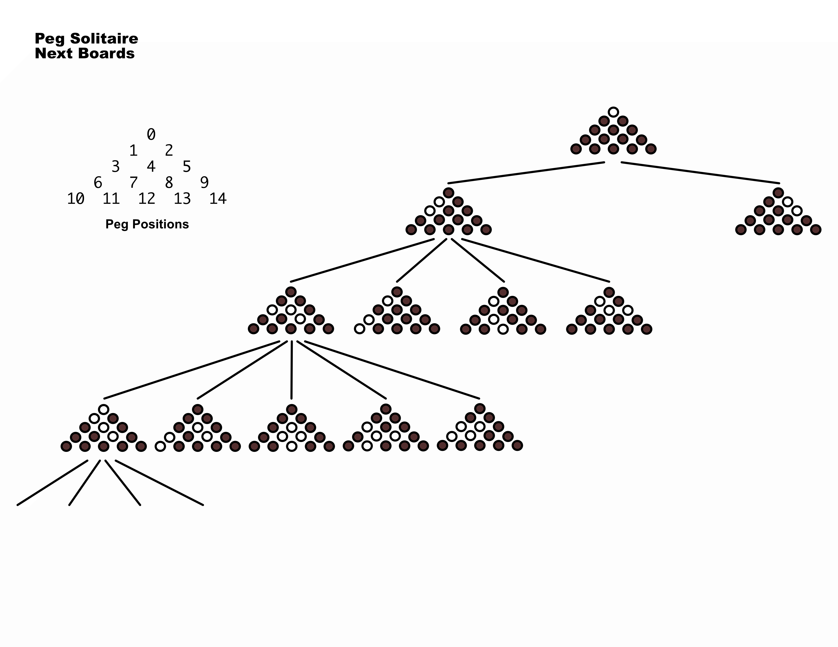
Peg solitaire

Slide 5
Jump has
start, over, to
To be valid,
start is full
over is full
to is empty

Slide 6
Jump has
start, over, to
To be valid,
start is full
over is full
to is empty

Slide 7
Jump has
start, over, to
To be valid,
start is full
over is full
to is empty

Slide 8
If we start here - what are possible next states?

Slide 9
and after here?

Slide 10
and after here?
What is CHANGING???

Slide 12
changing: board with pegs
next states: of the many possible from-to-over on the board, only
those where from and over are full and to is empty
done: only one peg left or run out of next boards

Slide 14
(define (solve bd)
;; Termination argument:
;; base: not possible to remove anymore pegs (solved or no valid jumps)
;; reduction: make one of n valid jumps
;; argument: making one jump at a time always reaches no more possible jumps
(local [(define (solve-bd bd)
(if (solved? bd)
(list bd)
(local [(define try (solve-lobd (next-boards bd)))]
(if (not (false? try))
(cons bd try)
false))))
(define (solve-lobd lobd)
(cond [(empty? lobd) false]
[else
(local [(define try (solve-bd (first lobd)))]
(if (not (false? try))
try
(solve-lobd (rest lobd))))]))]
(solve-bd bd)))

