Slide 1
L14
Clicker questions on using built-in abstract functions
match the argument and result of your function
to argument and result of one or more built-in abstract functions
Mutually-recursive fold functions
https://en.wikipedia.org/wiki/Fold_(higher-order_function)
easy data traversal shows up in most languages (visitor pattern etc.)
designing
using
complications

Slide 2
;; Course is (make-course Natural Natural (listof Course))
(listof Course) is one of:
- empty
- (cons Course (listof Course))

Slide 3
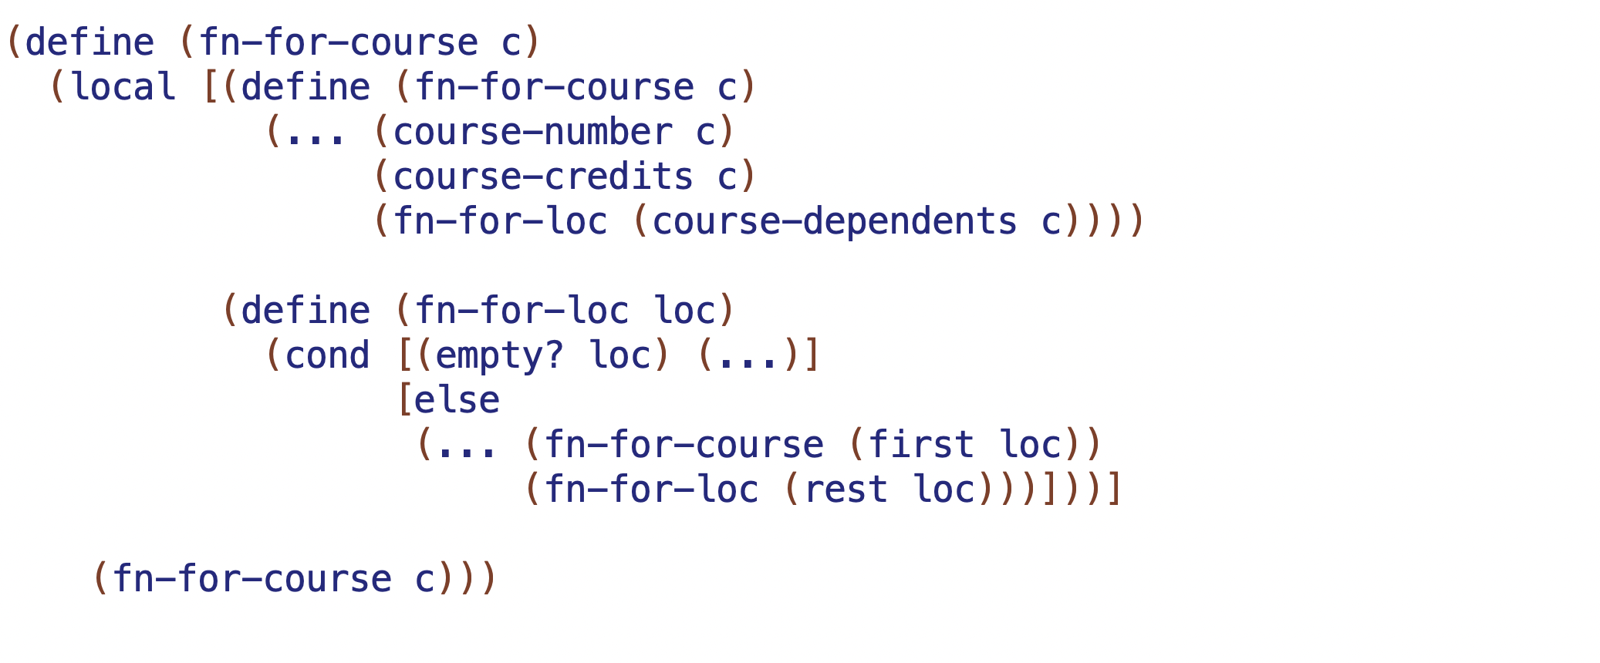
copy test
;; Course is (make-course Natural Natural (listof Course))
(listof Course) is one of:
- empty
- (cons Course (listof Course))
MR
MR
SR
C1
C2
B1

Slide 4
count test
;; Course is (make-course Natural Natural (listof Course))
(listof Course) is one of:
- empty
- (cons Course (listof Course))
MR
MR
SR
C1
C2
B1

Slide 5
all-course-numbers
;; Course is (make-course Natural Natural (listof Course))
(listof Course) is one of:
- empty
- (cons Course (listof Course))
MR
MR
SR
C1
C2
B1

Slide 6
courses-w-credits
;; Course is (make-course Natural Natural (listof Course))
(listof Course) is one of:
- empty
- (cons Course (listof Course))
MR
MR
SR
C1
C2
B1

Slide 7
find-course
;; Course is (make-course Natural Natural (listof Course))
(listof Course) is one of:
- empty
- (cons Course (listof Course))
MR
MR
SR
C1
C2
B1

Slide 8
c1
;; Course is (make-course Natural Natural (listof Course))
(listof Course) is one of:
- empty
- (cons Course (listof Course))
MR
b1
MR
SR
c2
 | C1 | C2 | B1

Slide 9
c1
;; Course is (make-course Natural Natural (listof Course))
(listof Course) is one of:
- empty
- (cons Course (listof Course))
MR
b1
MR
SR
c2
 | C1 | C2 | B1
All nums | (cons num rmr) | append | empty
Total credits | (+ cr rmr) | + | 0

Slide 10
c1
;; Course is (make-course Natural Natural (listof Course))
(listof Course) is one of:
- empty
- (cons Course (listof Course))
MR
b1
MR
SR
c2
 | C1 | C2 | B1
All nums | (cons num rmr) | append | empty
Total credits | (+ cr rmr) | + | 0
Courses w/ credits | (if (>= cr n) (cons <C> rmr) rmr) | append | empty
find
no access to actual course
whole tree every time

