Slide 1
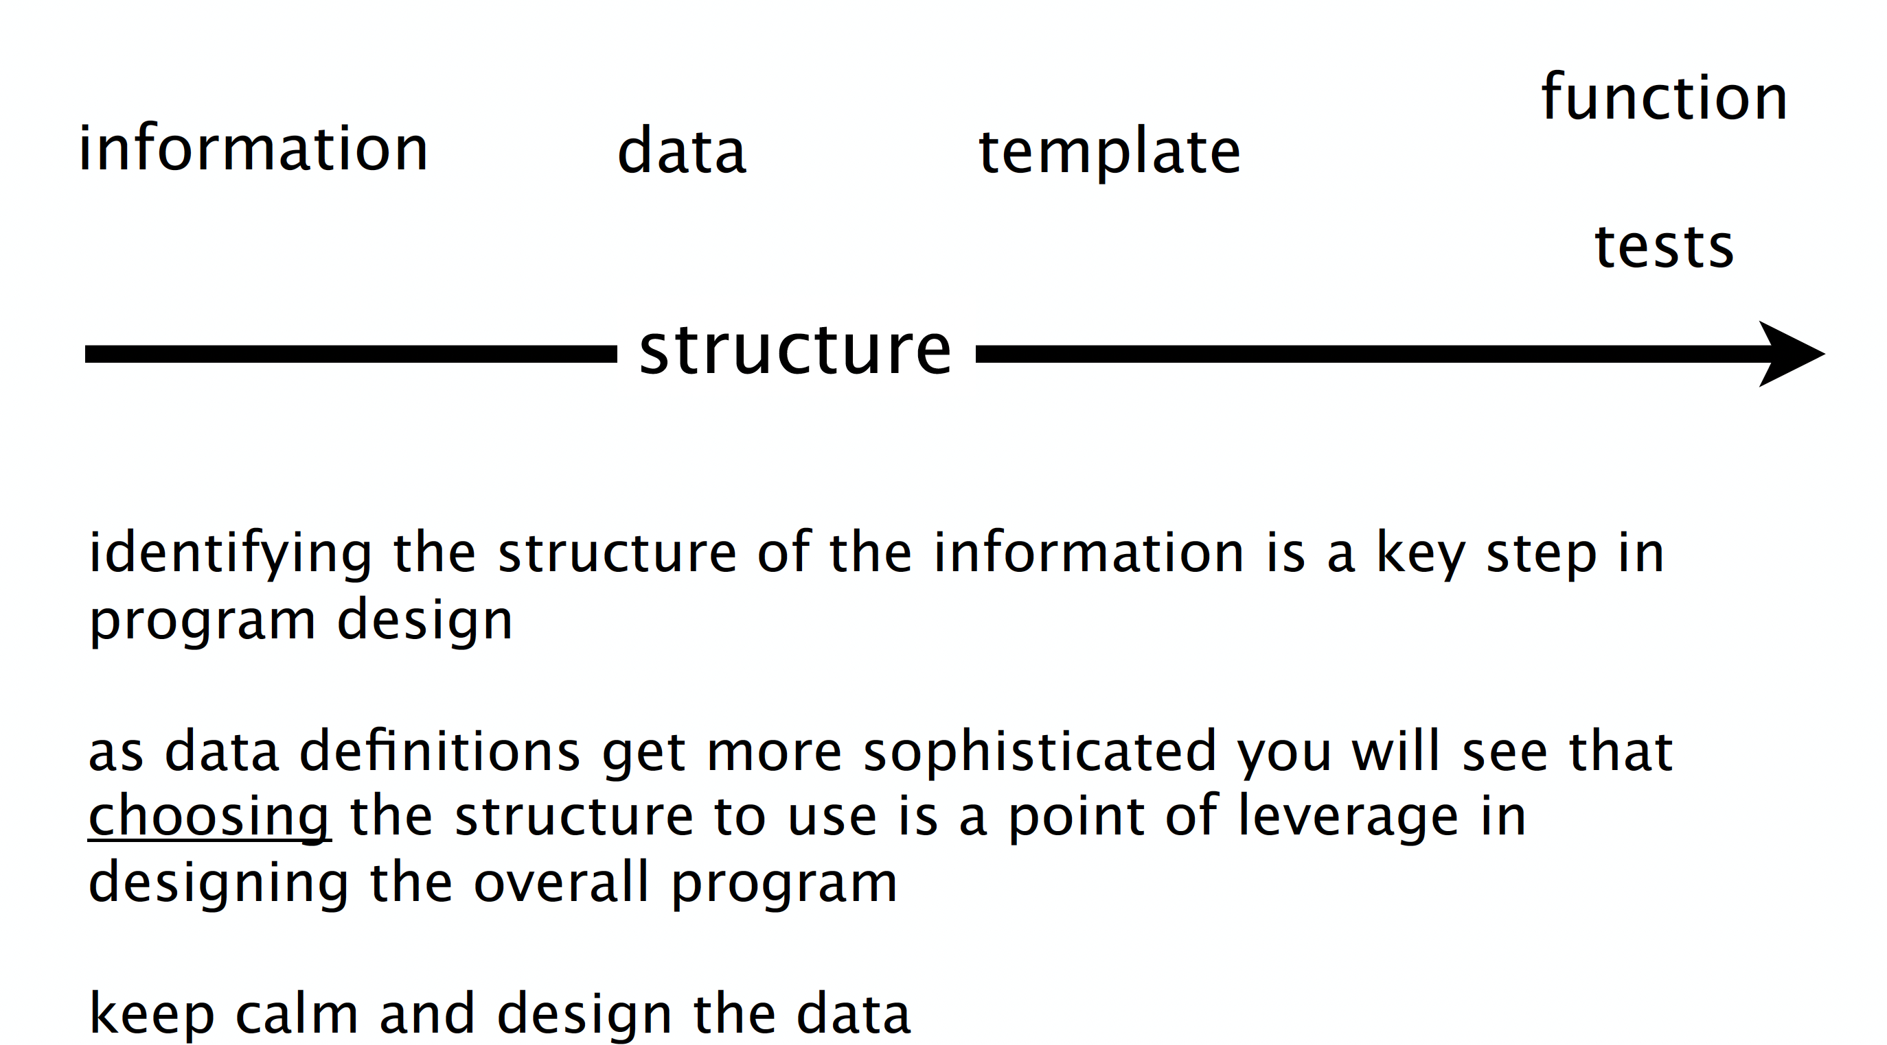

Slide 2
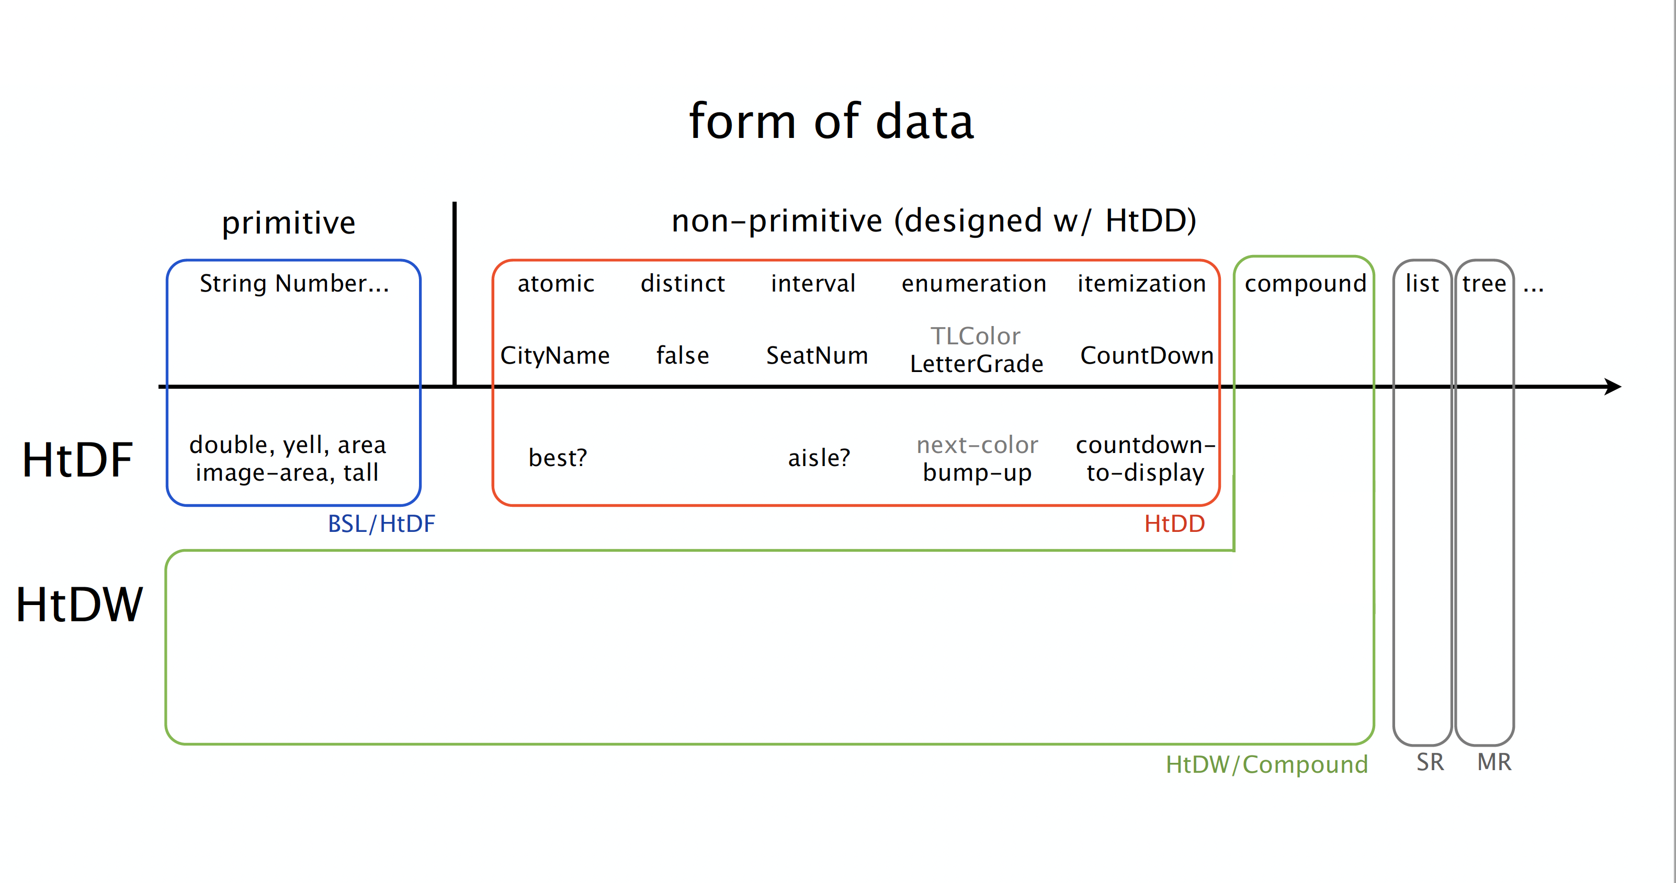

Slide 3
Trust the recipes
to help you make progress
What’s the next step of the recipe?
HtDD
1
2
3
4
5
HtDF
1
2
3
4
5
HtDW
1.1
1.2
1.3
1.4
2.1
2.2
2.3
2.4

Slide 4
Trust the recipes
to help you make progress
What’s the next step of the recipe?
HtDD
1
2
3
4
5
HtDF
1
2
3
4
5
HtDW
1.1
1.2
1.3
1.4
2.1
2.2
2.3
2.4

Slide 5
Trust the recipes
to help you make progress
What’s the next step of the recipe?
HtDD
1
2
3
4
5
HtDF
1
2
3
4
5
HtDW
1.1
1.2
1.3
1.4
2.1
2.2
2.3
2.4
HtDF
1
2
3
4
5
HtDF
1
2
3
4
5

Slide 6
Don’t worry, handwriting
will be magically cleaned up!
Constant
Changing
BB options
on-tick to-draw on-key on-mouse

Slide 7
Constant
Changing
BB options
width height center x
speed
spider radius
spider image
mts
spider y
on-tick to-draw on-key on-mouse

Slide 8
0
0 + radius
Constant
Changing
BB options
width height center x
speed
spider radius
spider image
mts
spider y
on-tick to-draw on-key on-mouse
height – 1 - radius
height - 1

Slide 9
BOT HEIGHT

