Slide 1
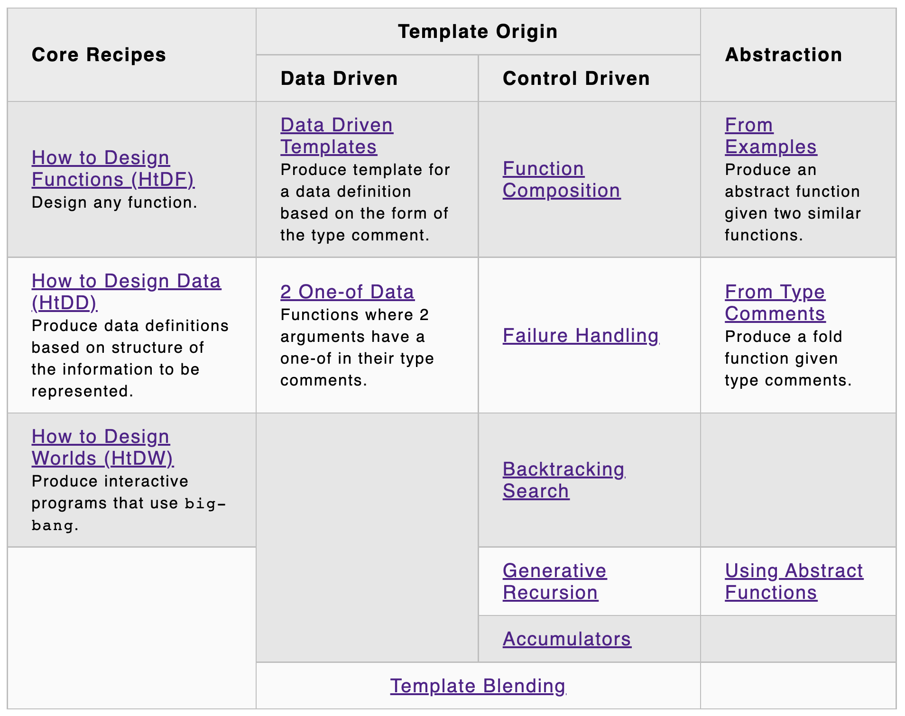
👍
👍
👍
👍
👍
atomic
compound
lists
trees
graphs
search
trees
graphs
👍
👍
👍
👍
👍
👍
👍
👍
👍
👍
👍
👍
👍

Slide 2
Accumulators – 2 goals, 3 kinds
Goal | Kind of invariant
Preserve context from prior recursive calls | Context preserving parent house in same house… Result so far rsf in sum, product Work list right fringe of tree
Achieve tail recursion

Slide 3
accumulator design recipe (htdf + this)
templating:
recursive template wrapped in local and top-level function
add acc(umulator) parameter to inner function
add acc after all …
add (… acc) in recursive call
add … in trampoline
work out example progression of recursive calls
wish for what the accumulator should be at the end
work backward through progression to get accumulator at each step
design type and invariant (may need a new data definition)
initialize invariant, preserve invariant, exploit invariant
test and debug

Slide 4
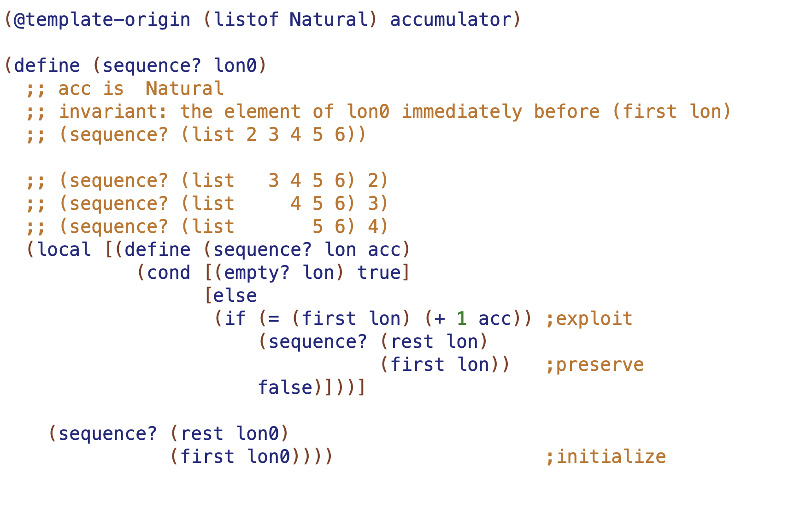

Slide 5
100
50
200
25
75
10
30
60
80

Slide 6
100
50
200
25
75
10
30
60
80
Why is 80 OK here? What range of numbers is OK here?

Slide 7
100
50
200
25
75
(75, 100)
10
30
60
80
Why is 80 OK here? What range of numbers is OK here?

Slide 8
