Slide 1
For midterm 1
I know that:
I need to read the exam instructions Piazza post tonight
the midterm will be all or mostly autograded
if I hand in files with “red errors” that file will receive a 0
if I comment out @tags I will lose most of not all points
if I don’t follow a problem statement carefully I will lose many points
I would like to get a good grade and will pay attention to all the above.
Nope, not going to read the instructions, not going to pay attention to the details, my grade will be what it will be

Slide 2
Lecture 06
Arbitrary-sized data
All my favorite hocky teams (L06)
All the eggs falling around Mario (L07)
All the balls bouncing around the box (Pset 4)
…
Self-referential type comments
Naturally recursive functions
Sound theory makes it easy to understand functions that might otherwise be confusing

Slide 3
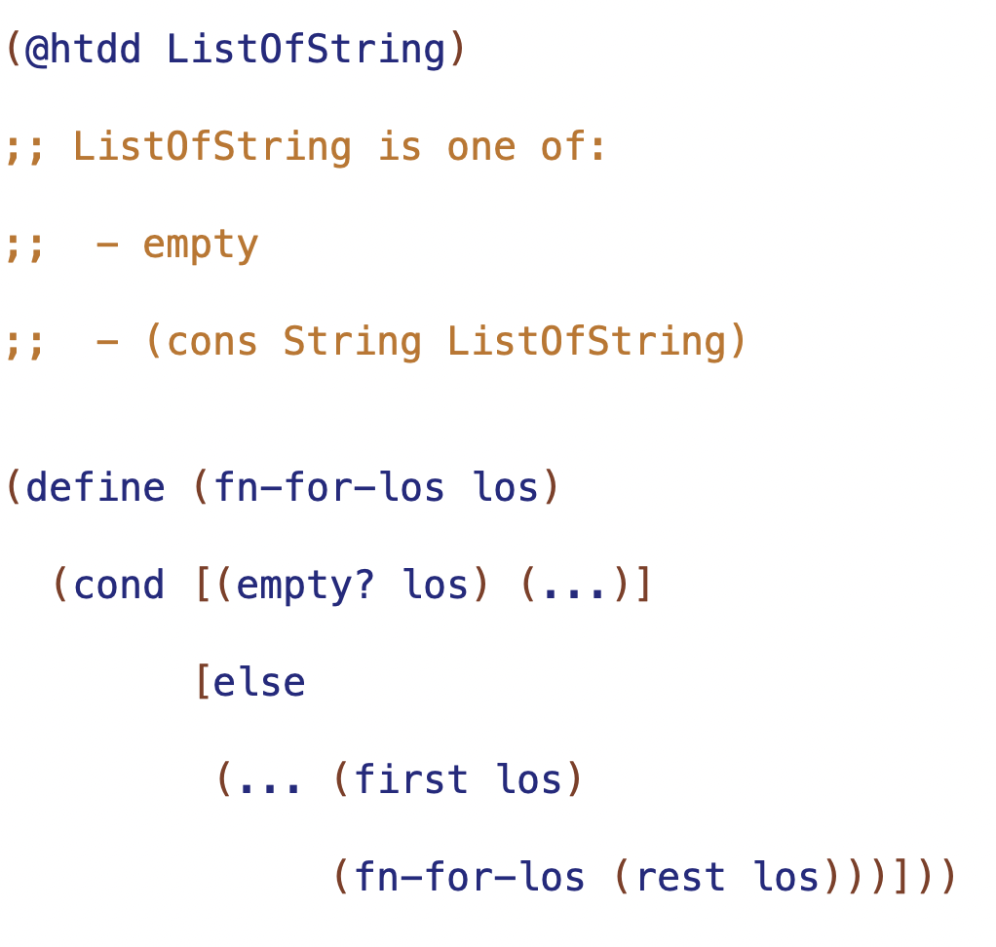

Slide 4
self reference
natural recursion

Slide 5
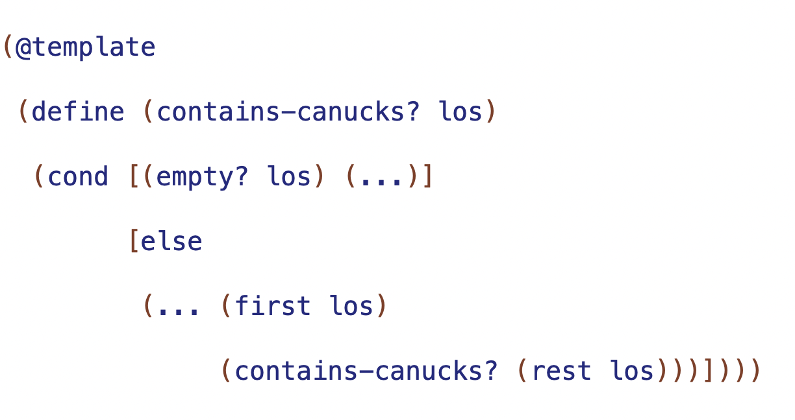

Slide 6
Trusting the Natural Recursion
result of natural recursion (RNR) will be correct if and only if
- correct base case result
- correct contribution of first
- correct combination of contribution and RNR
base case result
correct result for empty
combination
how to combine (first los) and result of natural recursion

Slide 7
arbitrary-sized information -> requires well-formed self-referential data definition
one of with:
one or more base subclass
one or more self-reference subclasses

Slide 8
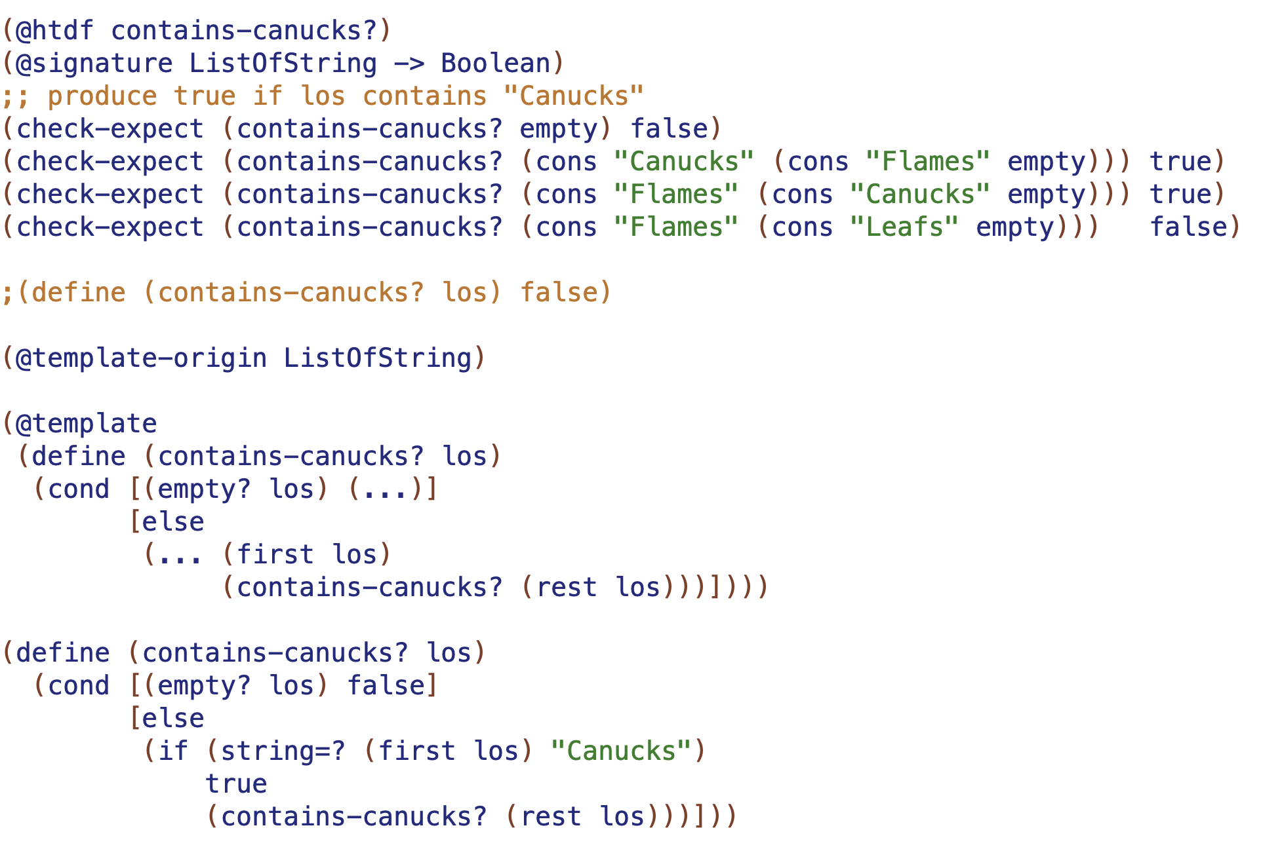
arbitrary-sized information -> requires self-referential data definition
test base case first
test 2 long
test recursion on both sides of conditional
rename natural recursion when templating
can "trust the natural recursion” if and only if: - correct base case result
- correct contribution of first
- correc combination

Slide 9
Function | Base case result | Combination

Slide 10
Function | Base case result | Combination
sum | 0 | (+ <first> RNR)
product | 1 | (* <first> RNR)
count | 0 | (+ 1 RNR)
doubles | empty | (cons (* 2 <first>) RNR)

