Slide 1
Clicker
I thought the midterm was:
Easier than expected
About as hard as expected
Harder than expected

Slide 2
Clicker
I should have:
Completed fewer practice exams than I did
Completed the same number of practice exams as I did
Completed more practice exams than I did

Slide 3
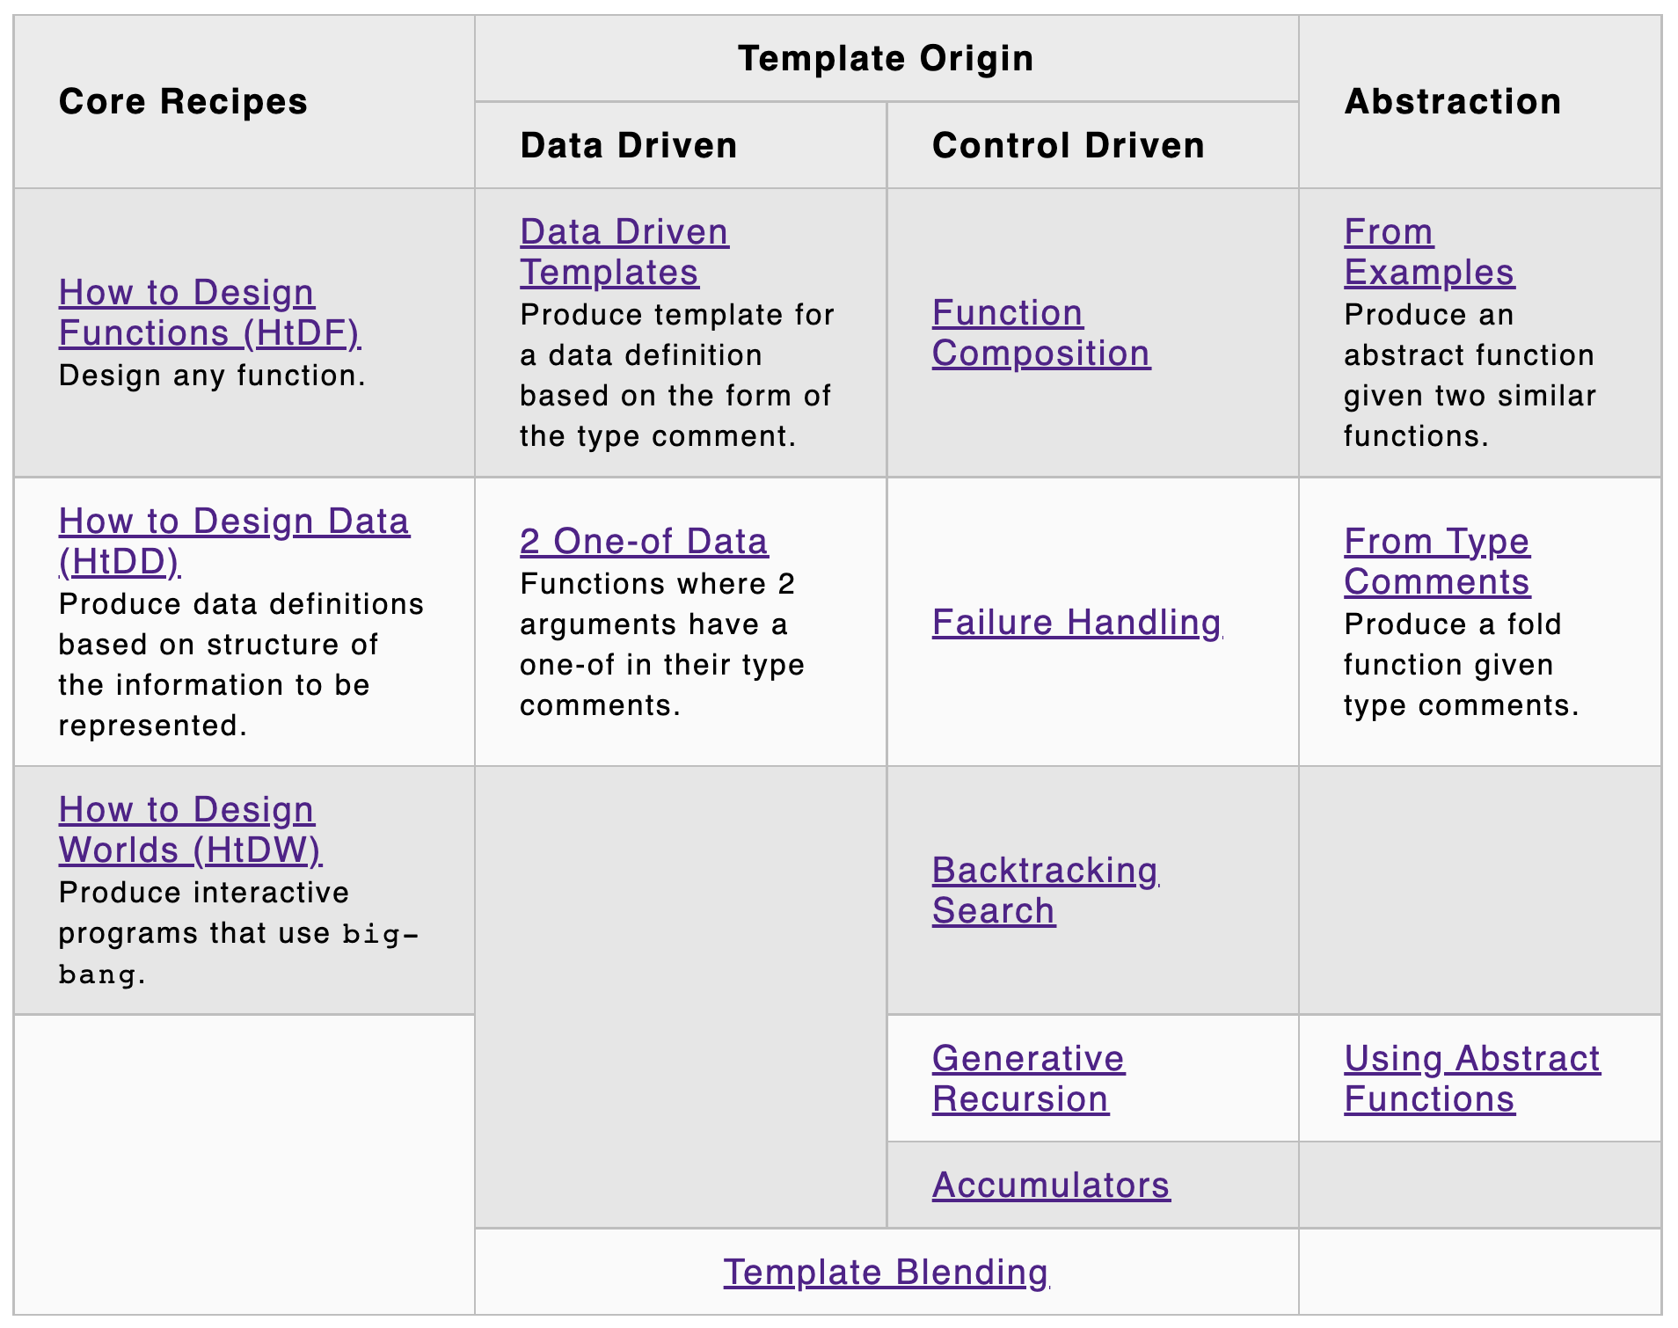
atomic
compound
lists
trees
graphs
search
trees
graphs
L20 L21 L22
L18 L19 L20

Slide 4
Accumulators
accumulate information from prior recursive calls
three categories
preserve context from prior recursive calls
result so far
worklist
these overlap some
next lecture

Slide 5
accumulator design recipe (htdf + this)
templating:
recursive template wrapped in local and top-level function
add acc(umulator) parameter(s) to inner function
add acc after all … (can use better name)
add (… acc) in recursive call
add … in trampoline
work out example progression of recursive calls
wish for what the accumulator should be at the end
work backward through progression to get accumulator at each step
design type and invariant (may need a new data definition)
initialize invariant, preserve invariant, exploit invariant
test and debug

Slide 6
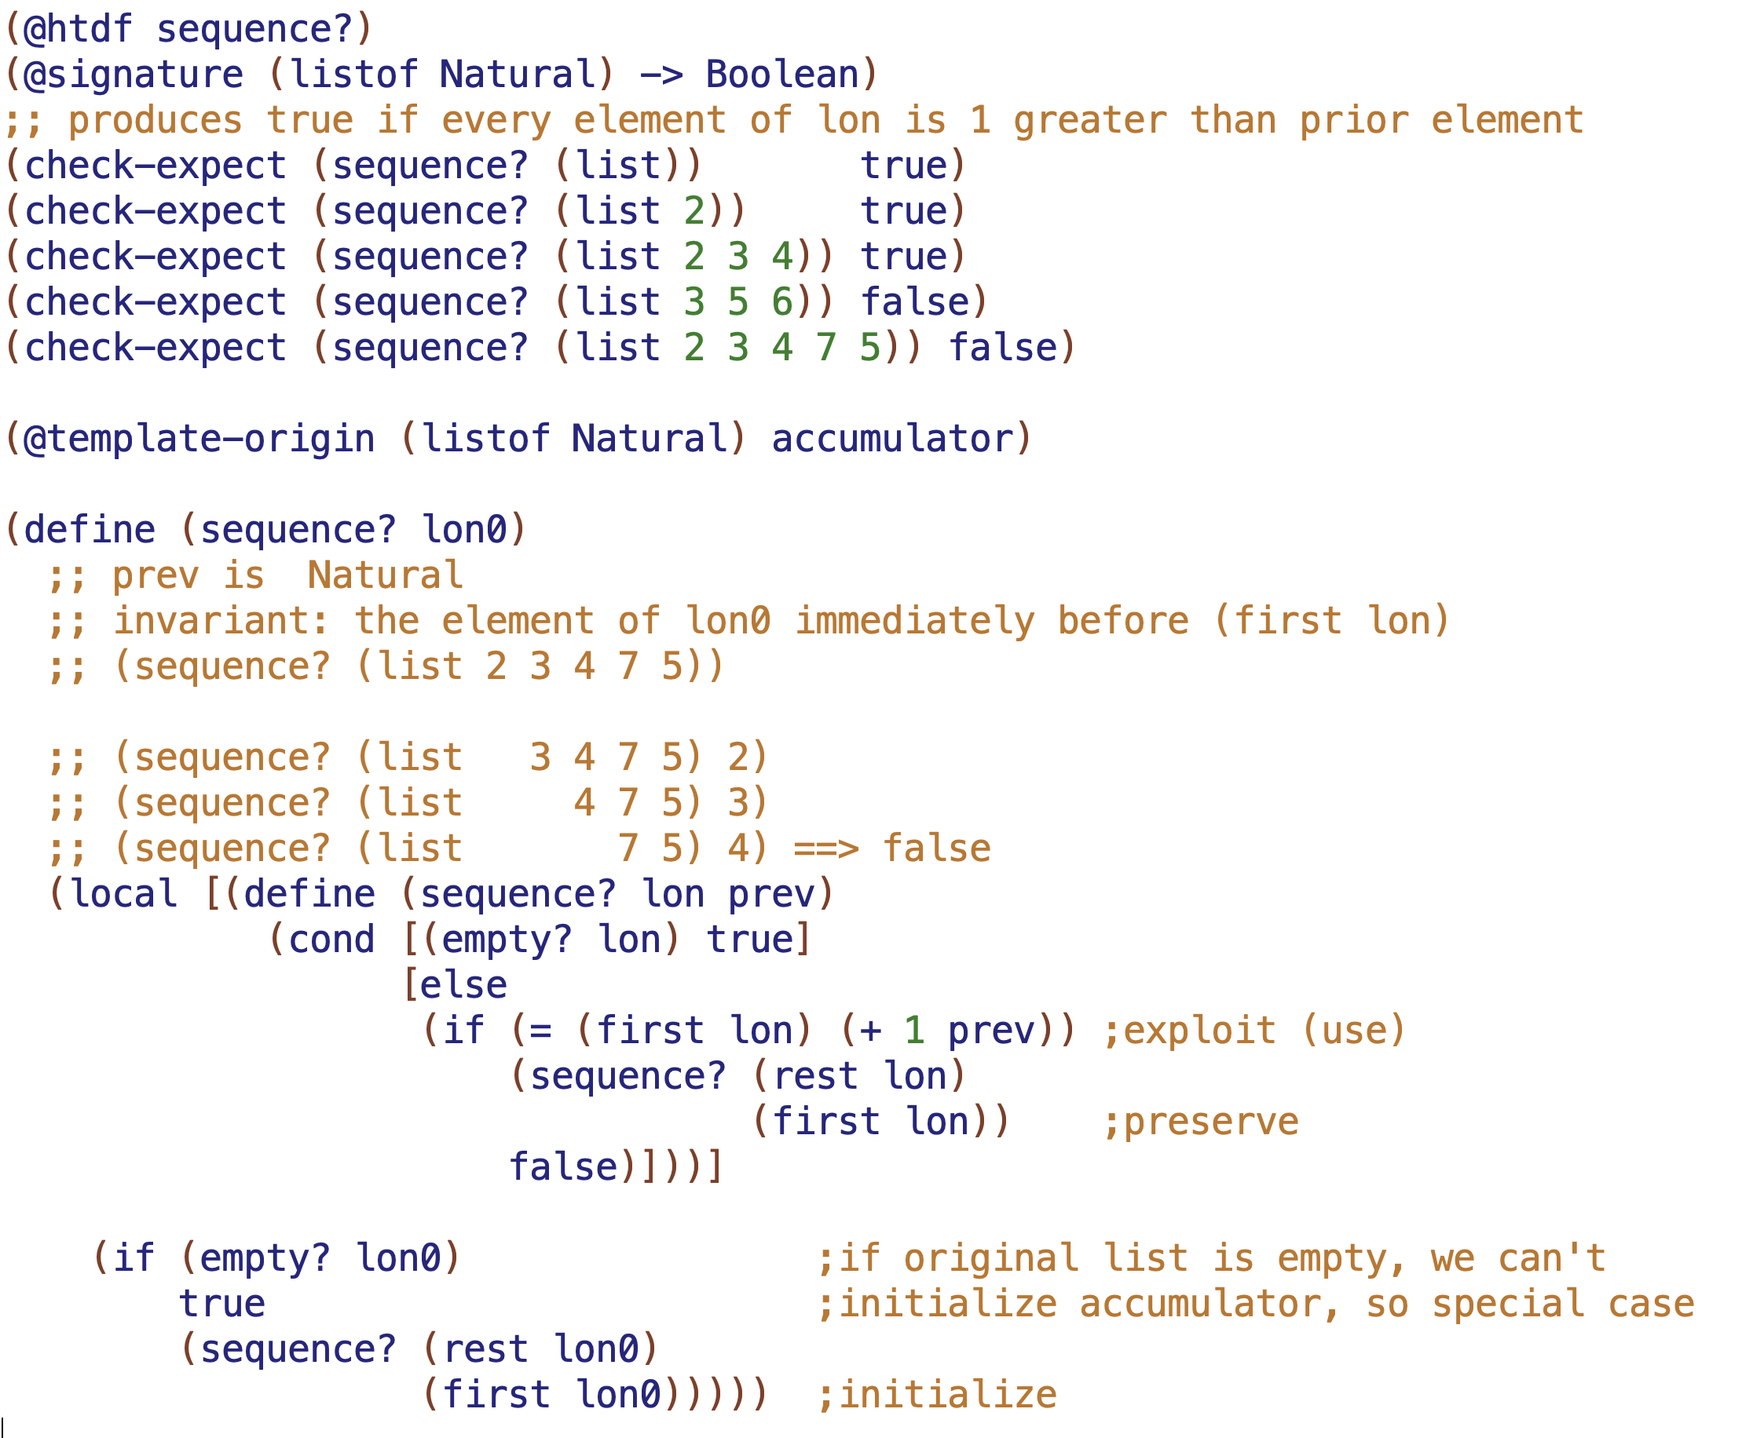

Slide 7
100
50
200
25
75
10
30
60
80

Slide 8
100
50
200
25
75
10
30
60
80
Why is 80 OK here? What range of numbers is OK here?

Slide 9
(-inf, +inf)
100
(-inf, 100)
(100, +inf)
50
200
(-inf, 50)
(50, 100)
25
75
(-inf, 25)
(25, 50)
(50, 75)
(75, 100)
10
30
60
80

Slide 10
(-inf, +inf)
100
(-inf, 100)
(100, +inf)
50
200
(-inf, 50)
(50, 100)
25
75
lower comes from most recent right branch parent
(-inf, 25)
(25, 50)
(50, 75)
(75, 100)
upper comes from most recent left branch parent
10
30
60
80

Slide 11
