Slide 1

You may have seen this, it seems to be making the rounds.
They claim to have gotten perfect grades for some students.
These grading reports are all fake!
- no such student number
- no such combination of scores
The moral is: Don’t trust a cheater!

Slide 2
Roadmap
These five lectures
forms of data: trees and graphs
recursion: structural non-tail and tail and generative
accumulators
path in data: previous, upper, lower, pnum, path
rsf (result so far)
path in tail recursion: vnum, count, leaves, visited
worklist
tandem worklist l18 l19 l20 l21 l22

Slide 3
A complicated clicker
Complex logistics
Harder problem
Will ask you to:
screen capture picture of tree
screen capture clicker question
Then I will show two functions and you will work on answer
graded on participation
BUT WORK HARD to try and figure it out
Then we will work it through together

Slide 4
Screen capture this figure…
TOP1 - 10
M1 - 20
M2 - 40
L1 -30
L2 - 50
L3 - 60

Slide 5
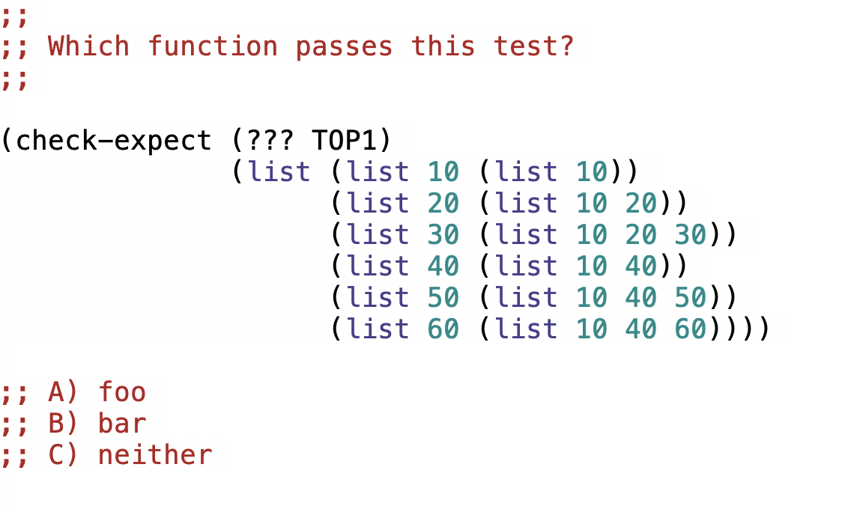
Screen capture this question…

Slide 6
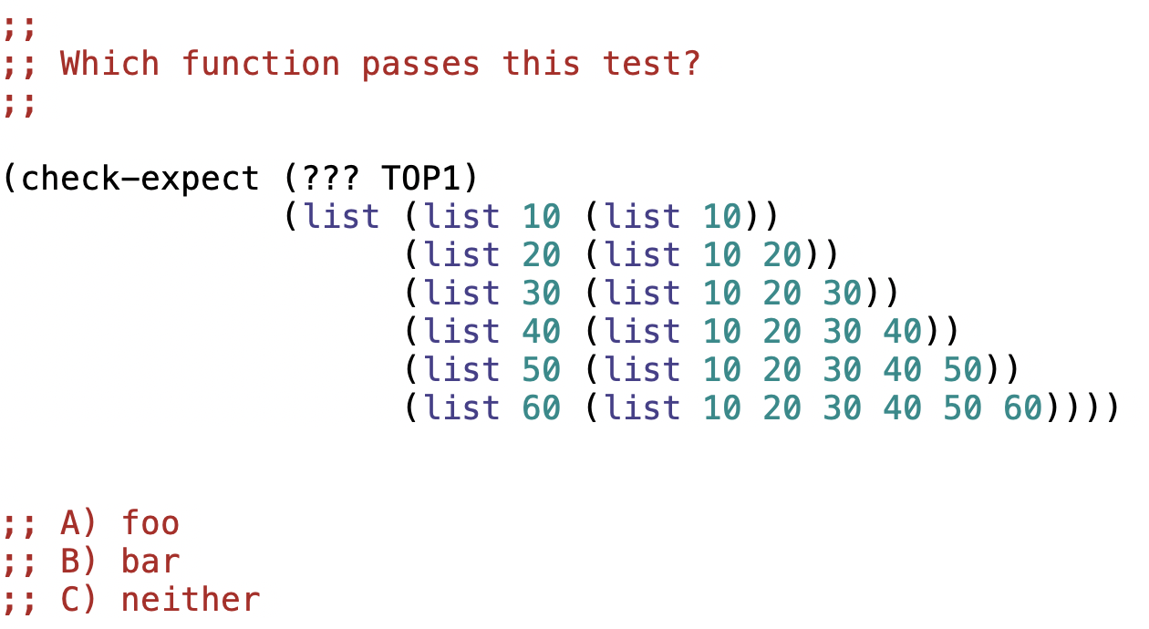
Screen capture this question…

Slide 7
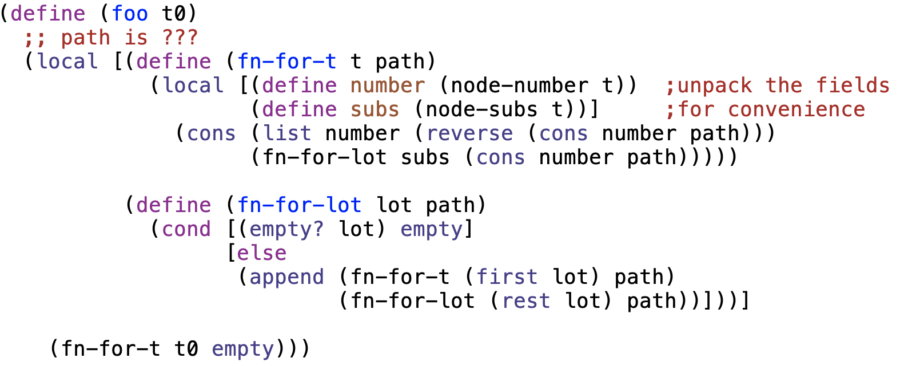
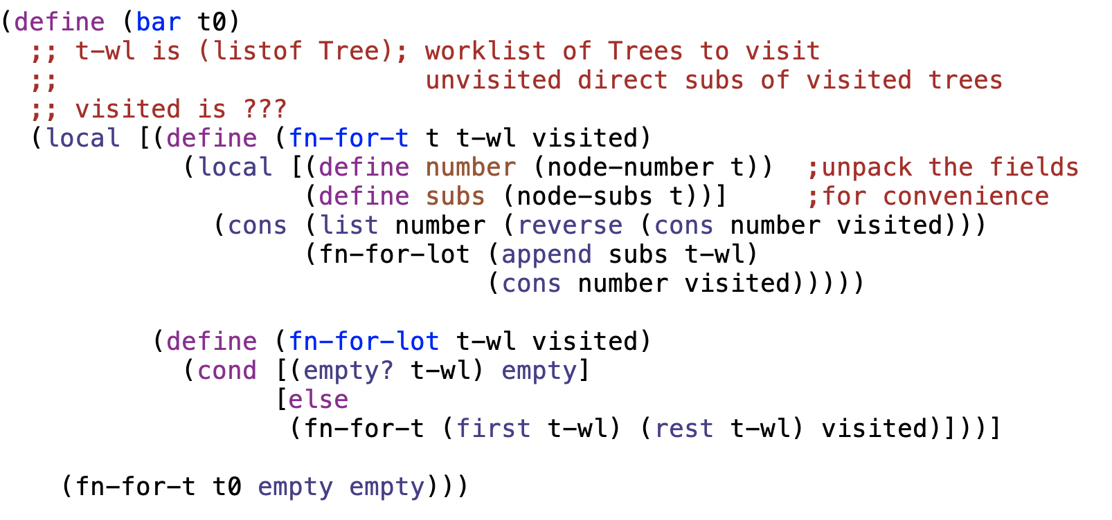
Here are the function definitions, without purpose statements, examples, template origins, or accumulator types and invariants.

Slide 9
foo
TOP1 - 10
M1 - 20
M2 - 40
L1 -30
L2 - 50
L3 - 60

Slide 10
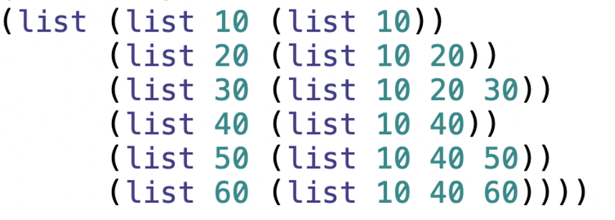
foo produce-path-at-nodes
()
TOP1 - 10
(10 )
(10 )
(10)
M1 - 20
M2 - 40
(20 10)
(40 10)
(20 10)
(40 10)
(40 10)
L1 -30
L2 - 50
L3 - 60
(30 20 10)
(50 40 10)
(60 40 10)

Slide 12
bar
TOP1 - 10
M1 - 20
M2 - 40
L1 -30
L2 - 50
L3 - 60

Slide 13
bar produce-visited-at-nodes
()
TOP1 - 10
(10 )
(10 )
(30 20 10)
M1 - 20
M2 - 40
(20 10)
(40 30 20 10)
(30 20 10)
(50 40 30 20 10)
(20 10)
L2 - 50
(40 30 20 10)
L1 -30
(40 30 20 10)
L3 - 60

Slide 14
What’s in the past depends on the recursion
tail recursion means current call can have all preceding calls
→ it can produce answer directly
in a tree
ordinary recursion can carry context of what is above current call
but tail recursion is required to carry context of what is above and to the LEFT

Slide 15
t-wl at fn-for-t and fn-for-lot
(list)
TOP1 - 10
1
(list M1 M2)
2
(list M2)
M1 - 20
M2 - 40
(list)
3
7
(list L1 M2)
(list L2 L3)
4
8
6
(list M2)
(list L3)
(list)
L1 -30
L2 - 50
L3 - 60
5
9
10
11
(list M2)
(list L3)
(list)

Slide 16
Module 11 - Graphs
3 examples
lecture – 4 way maze
lab – city map
problem set – secret castle

Slide 17

Tree of x,y positions moving through this maze
0, 0
1, 0
0, 1
1, 1
0, 2
2, 1
1, 2
At each step it is only possible to move right (x+1) or down (y+1). But sometimes those may be invalid because they run into a wall or off the edge of the maze.
Do not assume each position can have only one valid next position. In general it is an arbitrary-arity tree.
…
This maze is solveable, so will eventually reach 4, 4. Yay!

Slide 18
(define M4
(list O O O O O
O W W W O
O W O O O
O W O W W
W W O O O))
must move left
need to be able to move up down left right

Slide 19


Slide 20
(define M7
(list O O O O O O O O O O
W W O W W O W W W O
O O O W W O W O O O
O W O O W O W O W W
O W W O W W W O O O
O W W O O O W W W O
O W W O W O W O O O
O W W O O O W O W W
O O O O W W W O O O
W W W W W O O W W O))

Slide 21
(define M7
(list O O O O O O O O O O
W W O W W O W W W O
O O O W W O W O O O
O W O O W O W O W W
O W W O W W W O O O
O W W O O O W W W O
O W W O W O W O O O
O W W O O O W O W W
O O O O W W W O O O
W W W W W O O W W O))
cycle
How do we prevent going in circles forever?

Slide 22
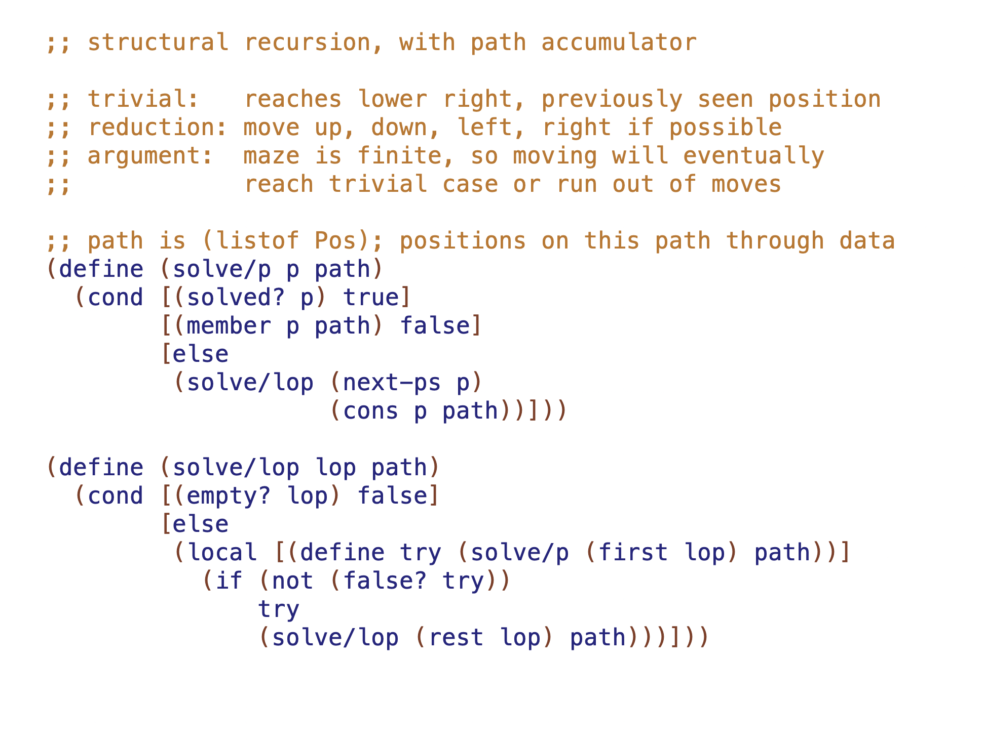

Slide 23
(define M7
(list O O O O O O O O O O
W W O W W O W W W O
O O O W W O W O O O
O W O O W O W O W W
O W W O W W W O O O
O W W O O O W W W O
O W W O W O W O O O
O W W O O O W O W W
O O O O W W W O O O
W W W W W O O W W O))
cycle
Would it also work with tail recursion and visited?

