Slide 1
For midterm 1
I know that the detailed instructions matter, and I will read them this week.
I know that the midterm will be mostly autograded.
I know that if I hand in files with “red errors” that file will receive a 0.
I know that if I comment out @tags I will lose many points.
I know that if I don’t follow a problem statement carefully I will lose many points.
I would like to get a good grade and will do all the above.
Nope, not gonna read the instructions, not going to pay attention to the details, my grade will be what it will be

Slide 2
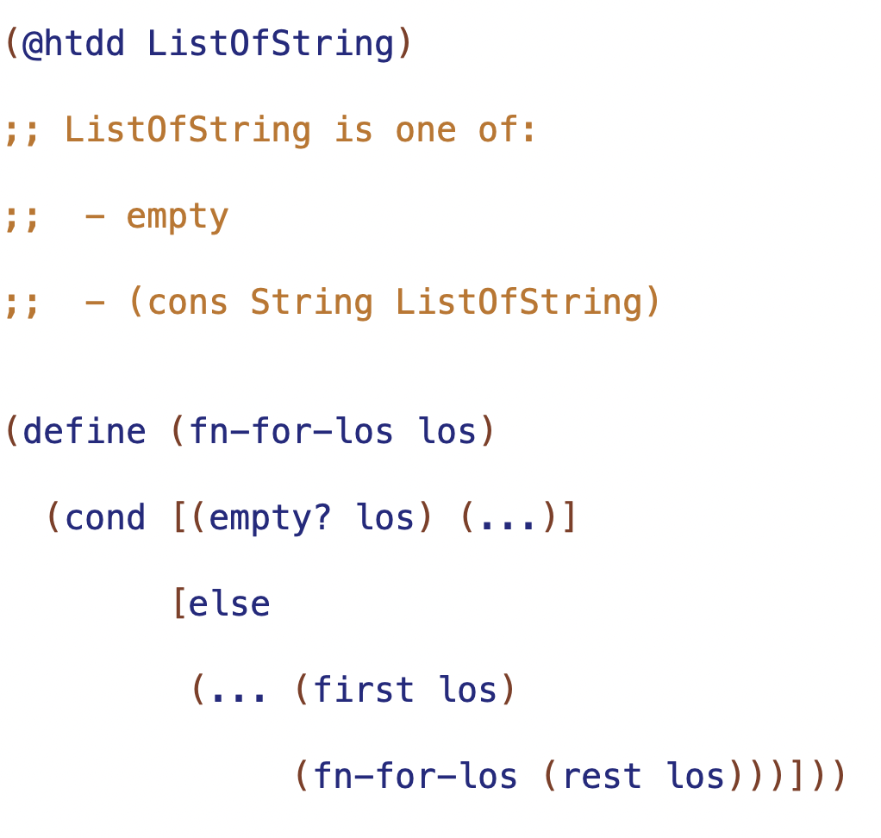

Slide 3
self reference
natural recursion

Slide 4
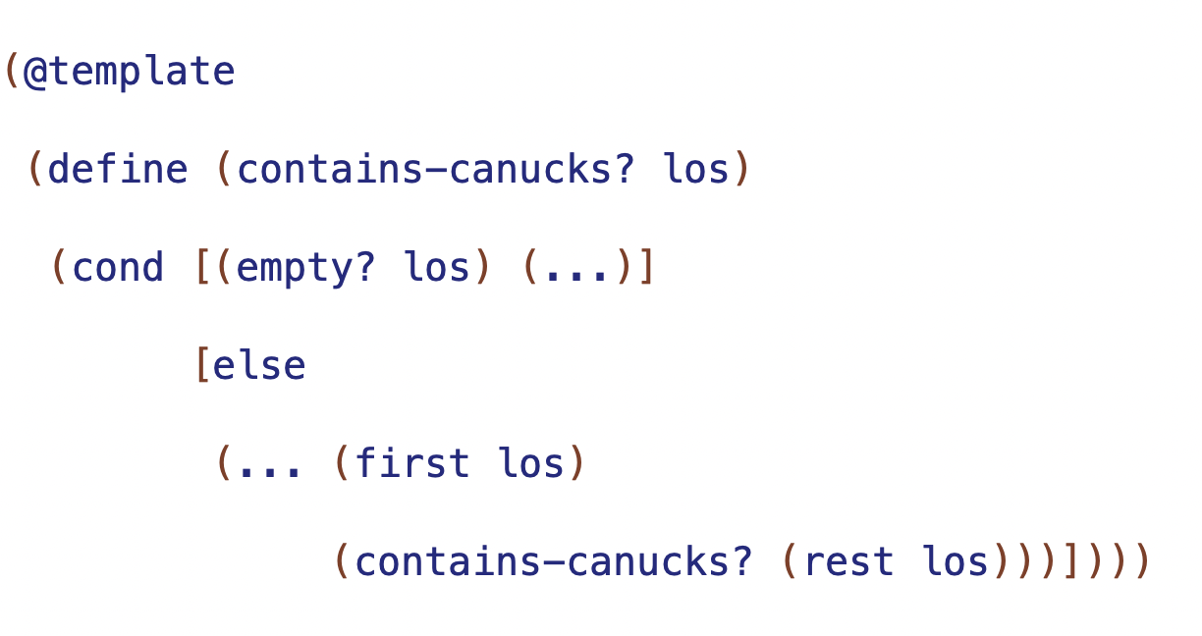

Slide 5
Trusting the Natural Recursion
result of natural recursion (RNR) will be correct if and only if
- correct base case result
- correct contribution of first
- correct combination of contribution and RNR
base case result
correct result for empty
combination
how to combine (first los) and result of natural recursion

Slide 6
arbitrary-sized information -> requires well-formed self-referential data definition
one of with:
one or more base subclass
one or more self-reference subclasses

Slide 7
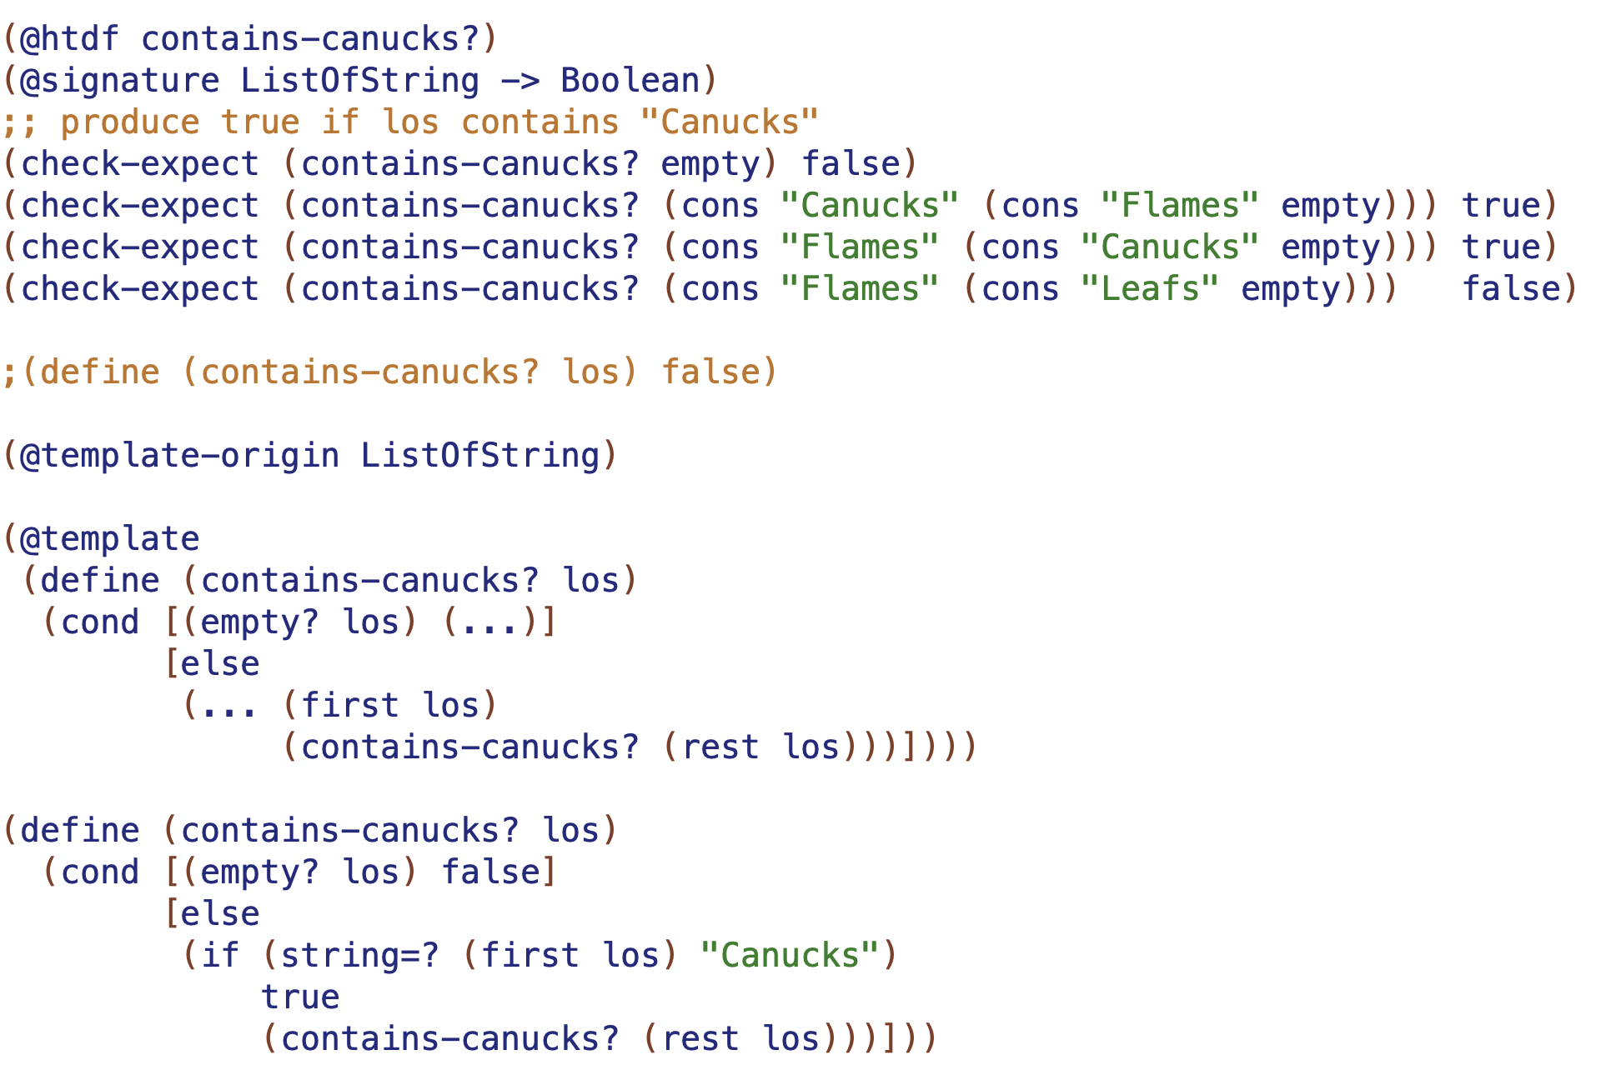
arbitrary-sized information -> requires self-referential data definition
test base case first
test 2 long
test recursion on both sides of conditional
rename natural recursion when templating
can "trust the natural recursion” if and only if: - correct base case result
- correct contribution of first
- correc combination

Slide 8
Function | Base case result | Combination

Slide 9
Function | Base case result | Combination
sum | 0 | (+ <first> RNR)
product | 1 | (* <first> RNR)
count | 0 | (+ 1 RNR)
doubles | empty | (cons (* 2 <first>) RNR)

