Slide 1
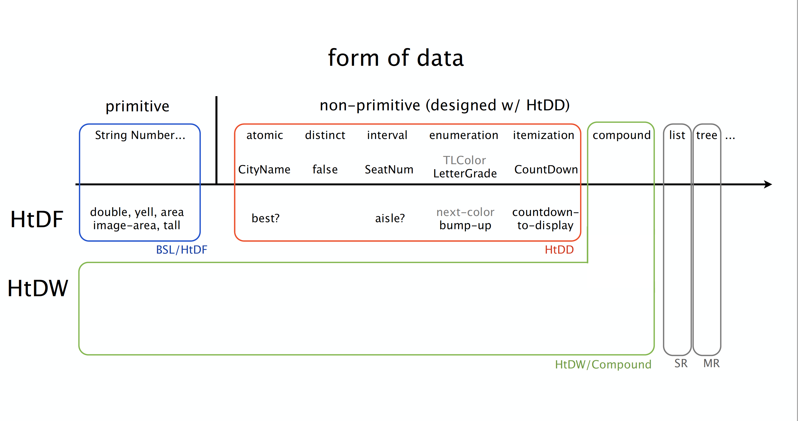

Slide 2
lecture 05 – 2 main topics
revising an existing program
in this case a world program
you will see this in problem sets 4 and 5, can also show up in exam problems
and is nearly all of the work developers do
as always, we will work systematically, re-running the recipes as needed
compound data
“2 or more items of information that naturally belong together”
also, variations on enumeration templating
large enumerations
enumerations where an additional parameter is complex

Slide 5
0
top = 0 + radius
Constant
Changing
BB options
width height center x
speed
spider radius
spider image
mts
spider y
on-tick to-draw on-key on-mouse
bot = height - 1 - radius
height - 1

Slide 6
0
top = 0 + radius
Constant
Changing
BB options
change direction at, and don’t go past top/bot
width height center x
speed
spider radius
spider image
mts
spider y
spider dy
on-tick to-draw on-key on-mouse
bot = height - 1 - radius
height - 1

Slide 7
boundary case analysis for tock
(BOT - 1) - SPEED
(BOT ) - SPEED
(BOT + 1) - SPEED
BOT
result is BOT - 1
result is BOT
result is BOT

Slide 8
boundary case analysis for tock
plus symmetric (mirror image) cases with TOP
(m-s (- BOT 3) 2)
(m-s (- BOT 3) 3)
(m-s (- BOT 3) 4)
BOT
result is y= BOT - 1, same dy
result is y= BOT, flip dy
result is y= BOT,
flip dy

