Slide 2
l20

Slide 3
Overview
The next three lectures
forms of data: trees and graphs
recursion: structural and tail
accumulators
rsf (path)
path in data: path, depth…
path in tail recursion: visited, count…
worklist
tandem worklist l20

Slide 4
Accumulators – 2 goals, 3 kinds
Goal | Kind of invariant
Preserve context from prior recursive calls | Context preserving parent house in same house… Result so far rsf in sum, product Work list (for TR on tree or graph) upper left fringe of unvisited tree
Achieve tail recursion

Slide 5
structural recursion
(find-path TOP “L2”) must produce (list “TOP” “M2” “L2”)
So what SHOULD BE value of path at each call to fn-for-lot?
TOP
1
22
2
21
9
10
M1
M2
3
11
20
8
4
12
19
7
15
16
L1
L2
L3
5
6
13
14
17
18

Slide 6
path; names of parents to here
With path accumulator
showing path at each call to fn-for-lot
empty
TOP
(list "TOP")
M1
M2
(list "TOP" "M1")
(list "TOP" "M2")
L1
L2
L3
(list "TOP" "M1" "L1")
(list "TOP" "M2" "L2" )
(list "TOP" "M2" "L3" )

Slide 7
[3 minutes]
Given the tree to the right,and given a TAIL-RECURSIVE traversal of the tree, as in find-tree last time, consider the call to fn-for-t with a first argument of L2. What will be the value of
tree-wl at that call?
(fn-for-t L2 (list M3))
(fn-for-t L2 (list TOP M1 L1 M2))
(fn-for-t L2 (list L2 M3))
(fn-for-t L2 (list L3 M3))
(fn-for-t L2 (list L2 L3 M3))
TOP
M1
M2
M3
L1
L2
L3
worklist is unvisited direct subs of visited nodes

Slide 8
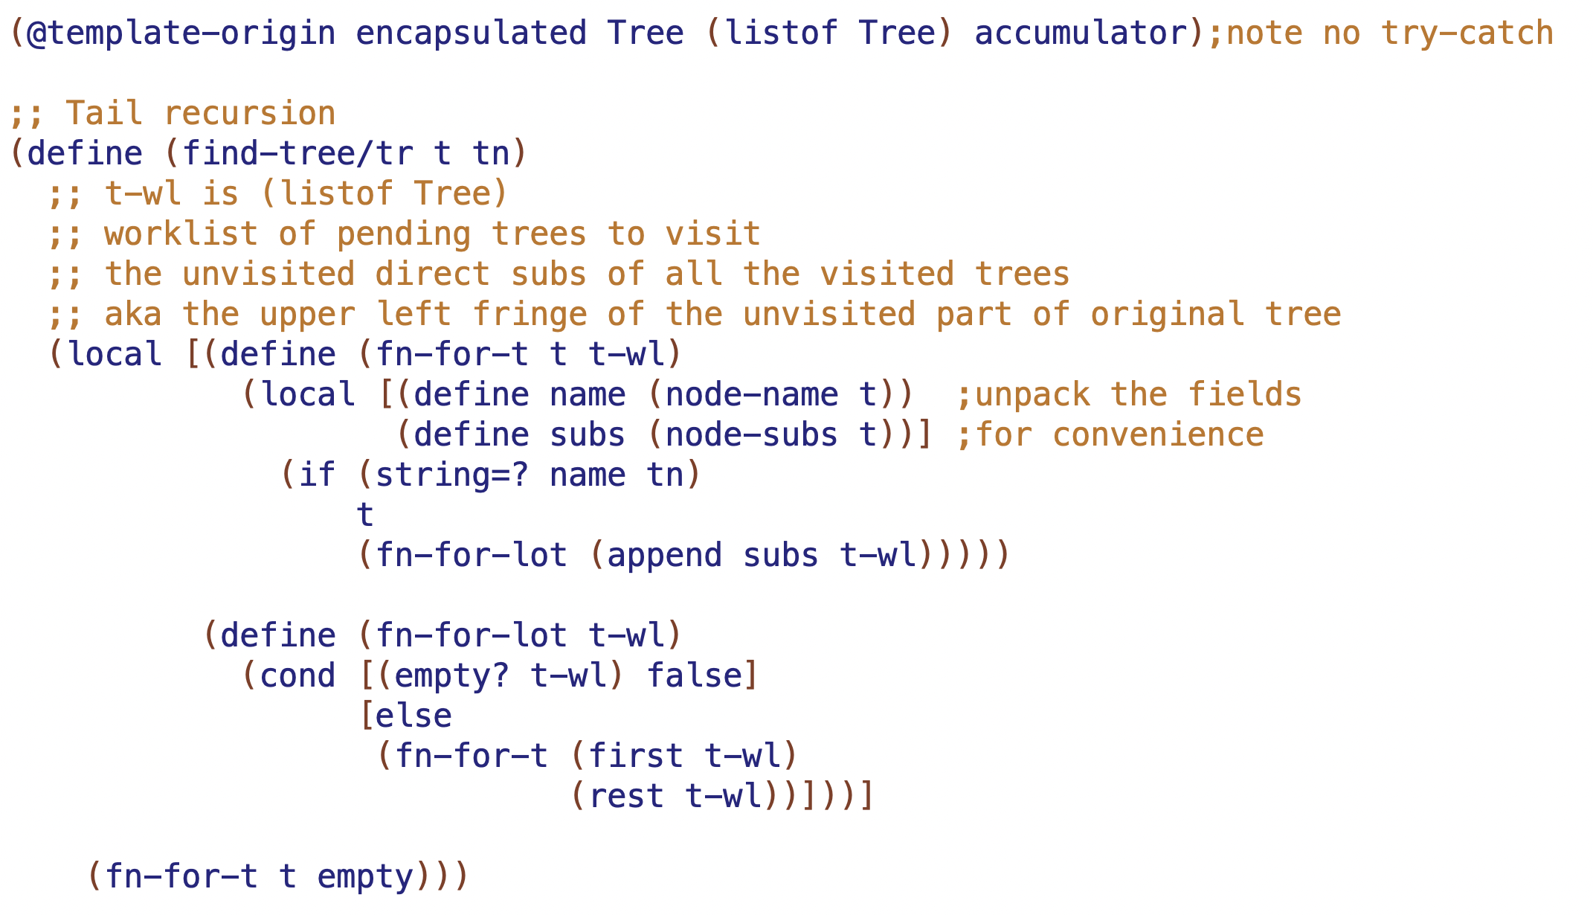

Slide 9
tail recursion with worklist
showing tree-wl at calls to fn-for-lot
tree worklist at fn-for-t and fn-for-lot
empty
TOP
1
(list M1 M2)
2
(list M2)
M1
M2
empty
3
7
(list L1 M2)
(list L2 L3)
4
8
6
(list M2)
(list L3)
empty
L1
L2
L3
5
9
10
11
(list M2)
(list L3)
empty

Slide 11
fill in ??? at calls to fn-for-t
can do fn-for-lot too if that helps
TOP
M1
M2
L1
L2
L3

Slide 12
fill in visited at calls to fn-for-t
()
TOP
("TOP" )
("TOP" )
M1
M2
("TOP” ”M1” ”L1" )
("TOP” ”M1" )
("TOP” ”M1” ”L1” “M2” )
("TOP” ”M1” ”L1" )
("TOP” ”M1" )
L1
L2
L3
("TOP” ”M1” ”L1” “M2” )
("TOP” ”M1” ”L1” “M2” “L2” “L3”)

Slide 13
fill in visited at calls to fn-for-t
()
TOP
("TOP" )
M1
("TOP" "M1" "L1")
M2
("TOP" "M1")
L2
L1
L3
("TOP" "M1" "L1" "M2")
("TOP" "M1" "L1" "M2" "L2")

Slide 14
TOP
…needs to have the path this call would have had
M1
M2
this call …
L1
L2
L3

Slide 15
TOP
("TOP")
…needs to have the path this call would have had
when we put M2 on the tree-wl,
we had a path of (“Top”)
("TOP")
("TOP" "M1" "L1")
M1
M2
this call …
L1
L2
L3

Slide 16
tail recursion with TANDEM WORKLISTS
each element of path worklist is the path for the corresponding element of the tree worklist
TOP
tree worklist:
(M1 M2)
1
path worklist:
(("TOP") ("TOP”))
2
M1
M2
(L1 M2)
3
(M2)
7
(L2 L3 )
((“TOP” “M1”) ("TOP”))
(("TOP”))
6
(("TOP” “M2”) ("TOP” “M2”))
4
8
5
( M2)
(("TOP”))
L1
L2
8
L3
(L3 )
9
(L3 )
(("TOP” “M2”))
(("TOP” “M2”))

Slide 17
arb arity tree structural recursion templates
TOP
(@template Tree (listof Tree) encapsulated)
(define (fn-for-tree t)
(local [(define (fn-for-t t)
(local [(define name (node-name t)) ;unpack the fields
(define subs (node-subs t))] ;for convenience
(... name (fn-for-lot subs))))
(define (fn-for-lot lot)
(cond [(empty? lot) (...)]
[else
(... (fn-for-t (first lot))
(fn-for-lot (rest lot)))]))]
(fn-for-t t)))
M1
M2
L1
L2
L3

Slide 18
find-path: structural recursion with path accumulator.
TOP
(@template Tree (listof Tree) accumulator)
(define (find-path t n)
;; path is (listof String); names of ... grandparent, parent trees
;; (builds along recursive calls)
(local [(define (fn-for-t t path)
(local [(define name (node-name t))
(define subs (node-subs t))
(define npath (append path (list name)))]
(if (string=? name n)
npath
(fn-for-lot subs npath))))
(define (fn-for-lot lot path)
(cond [(empty? lot) false]
[else
(local [(define try (fn-for-t (first lot) path))]
(if (not (false? try))
try
(fn-for-lot (rest lot) path)))]))]
(fn-for-t t empty)))
M1
M2
L1
L2
L3

Slide 19
find-tree: tail recursion with worklist
TOP
(@template backtracking Tree (listof Tree) accumulator)
(define (find-tree t to)
;; tree-wl is (listof Tree)
;; worklist of pending trees to visit
(local [(define (fn-for-t t tree-wl)
(local [(define name (node-name t)) ;unpack the fields
(define subs (node-subs t))] ;for convenience
(if (string=? name to)
t
(fn-for-lot (append subs tree-wl)))))
(define (fn-for-lot tree-wl)
(cond [(empty? tree-wl) false]
[else
(fn-for-t (first tree-wl)
(rest tree-wl))]))]
(fn-for-t t empty)))
M1
M2
L1
L2
L3

Slide 20
tail recursion with tandem worklists (tree and path), also visited
(@template Tree (listof Tree) accumulator)
(define (find-path t to)
;; tree-wl is (listof Tree)
;; worklist of trees to visit (unvisited subs of already visited trees)
;;
;; path-wl is (listof (listof String))
;; worklist of paths to corresponding trees in tree-wl
;;
;; visited is (listof String)
;; names of trees visited so far (builds along tail recursive calls)
(local [(define (fn-for-t t path tree-wl path-wl visited)
(local [(define name (node-name t))
(define subs (node-subs t))
(define npath (append path (list name)))
(define nvisited (append visited (list name)))]
(if (string=? name to)
npath
(fn-for-lot (append subs tree-wl)
(append (map (lambda (s) npath) subs) path-wl)
nvisited))))
(define (fn-for-lot tree-wl path-wl visited)
(cond [(empty? tree-wl) false]
[else
(fn-for-t (first tree-wl)
(first path-wl)
(rest tree-wl)
(rest path-wl)
visited)]))]
(fn-for-t t empty empty empty empty)))
TOP
M1
M2
L1
L2
L3

