Slide 1
TODAY
Another day of reaping the rewards of the work you have done so far
Two important new ideas
mutual reference / recursion
The hard parts won’t actually be very hard
just trusting natural recursions as usual
not blind trust - we have to get base, contribution and combination right!
The easy parts will require learning some new details
minor housekeeping changes with @htdf @htdd organization
Functions that can fail
or false in signatures
Try-catch template

Slide 2
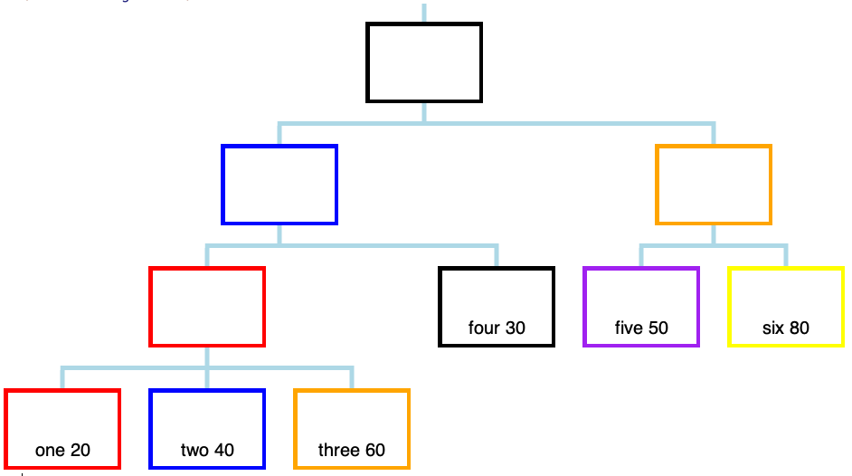
Some tree terminology:
- leaf nodes have no subs
- inner nodes do have subs

Slide 3
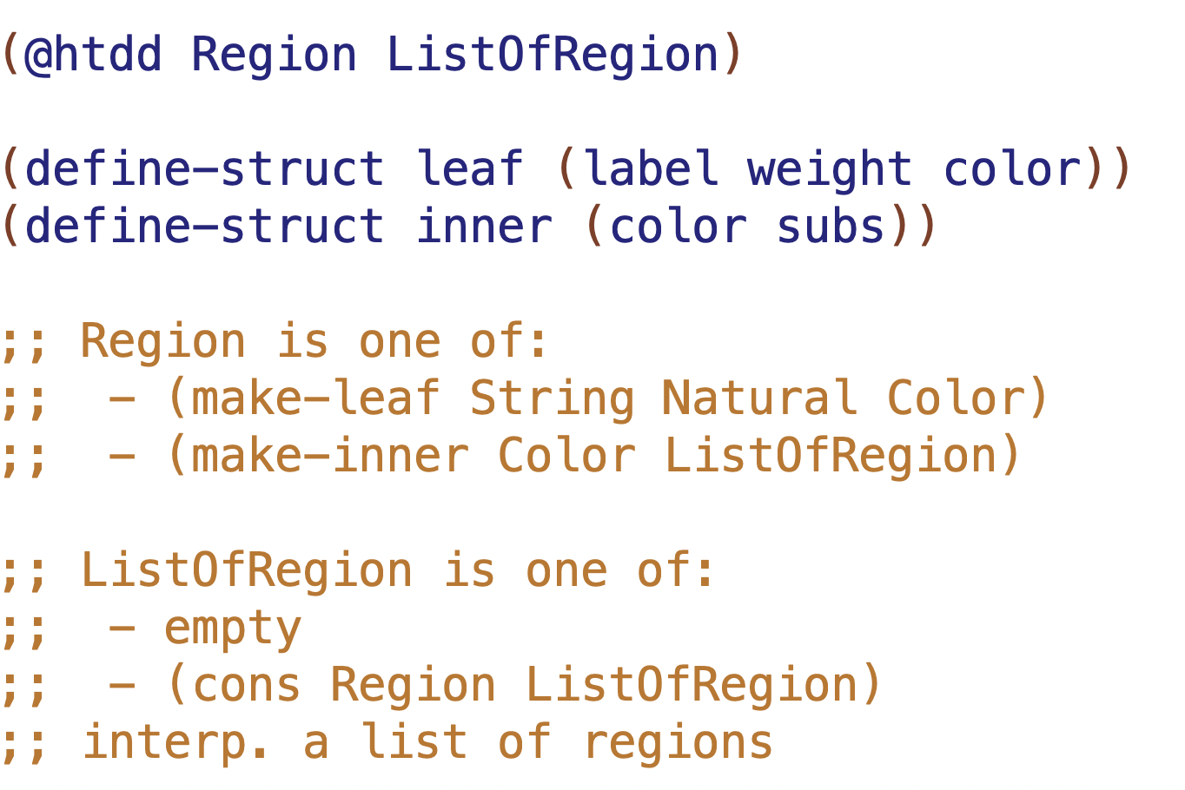

Slide 4
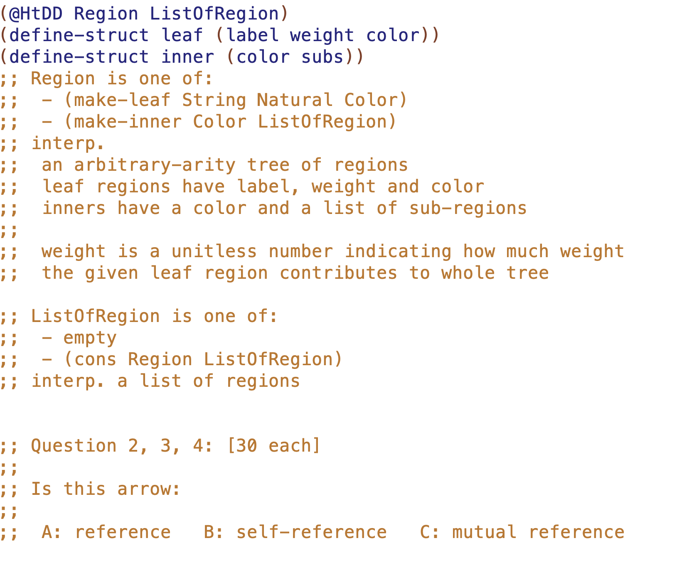

Slide 5
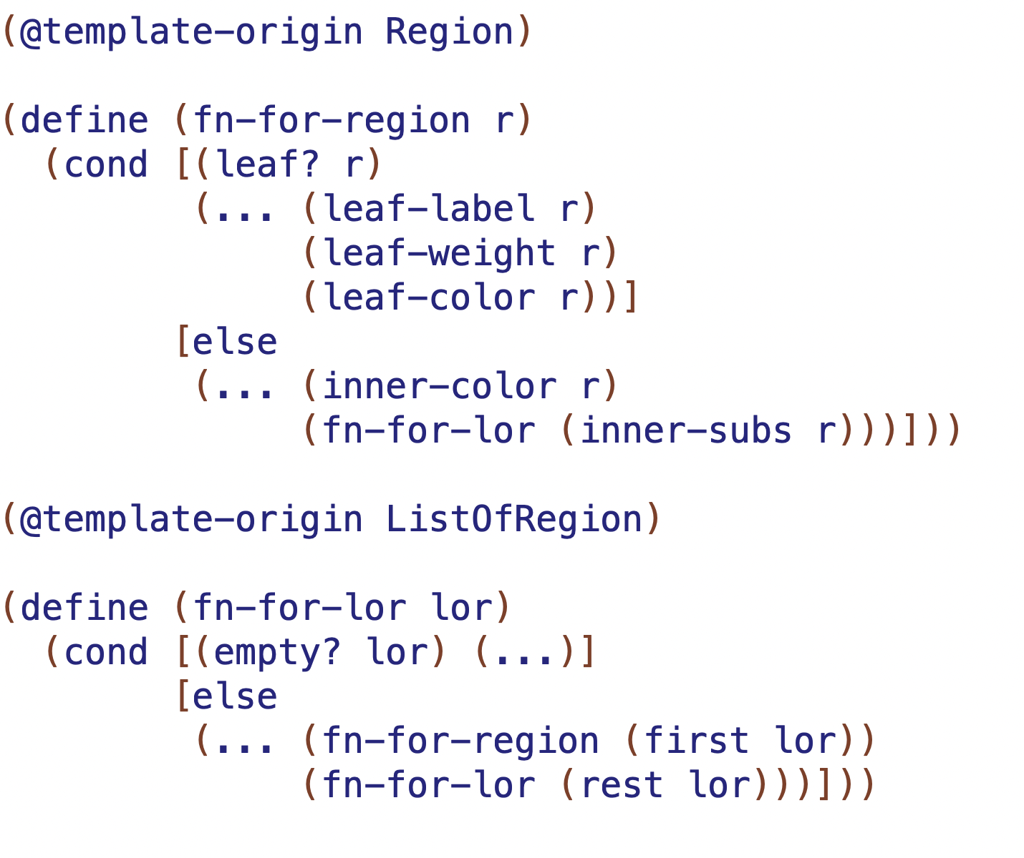
mutual recursion means these functions come in pairs (2 or more in general)
NMR
NMR
NR

Slide 6
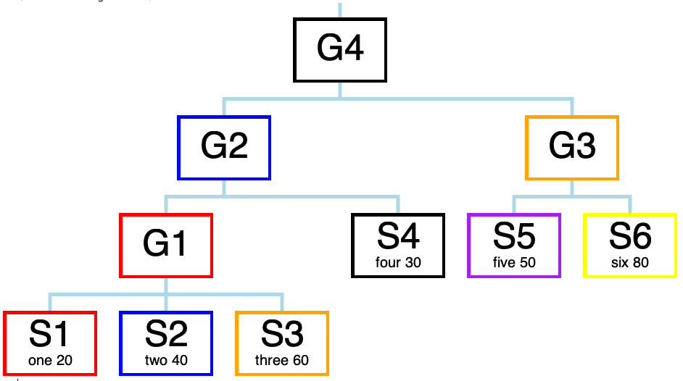
L1, L2, I4 etc. are the
NAMES OF THE CONSTANTS
I4
I2
I3
I1
L4
L5
L6
L1
L2
L3

Slide 7
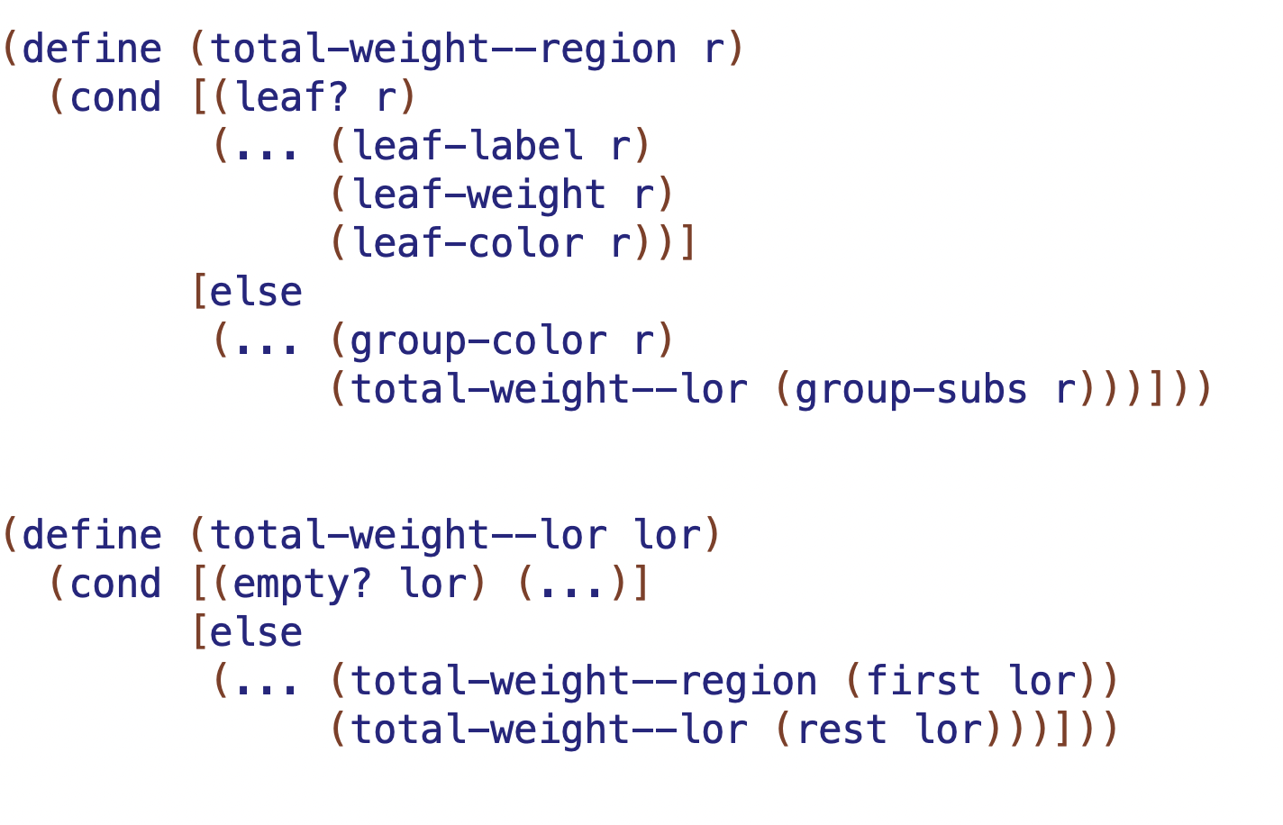

result will be?
result will be?
result will be?

Slide 8
L1, L2, I4 etc. are the
NAMES OF THE CONSTANTS
I4
I2
I3
I1
L4
L5
L6
L1
L2
L3

Slide 9
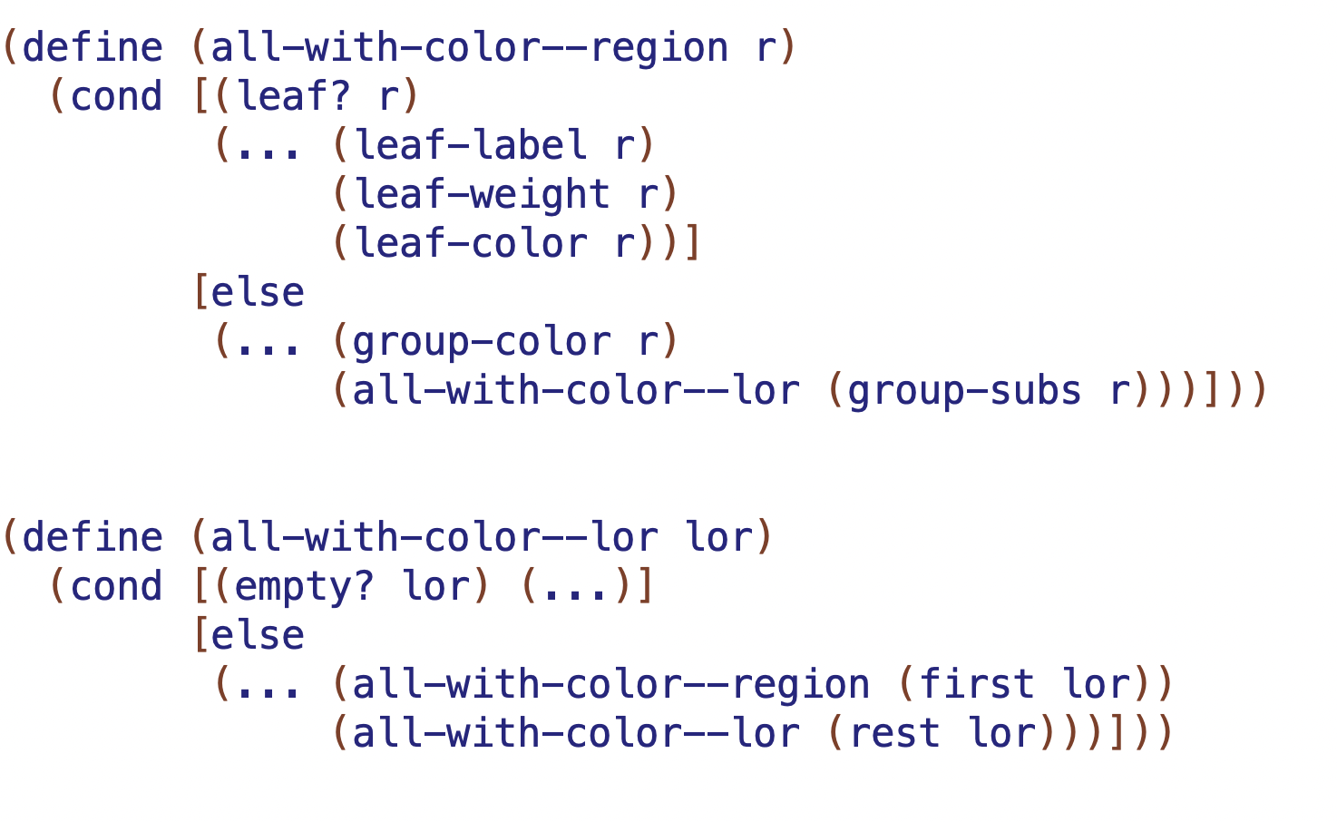
result will be?
result will be?
result will be?

Slide 10
L1, L2, I4 etc. are the
NAMES OF THE CONSTANTS
I4
I2
I3
I1
L4
L5
L6
L1
L2
L3

Slide 11
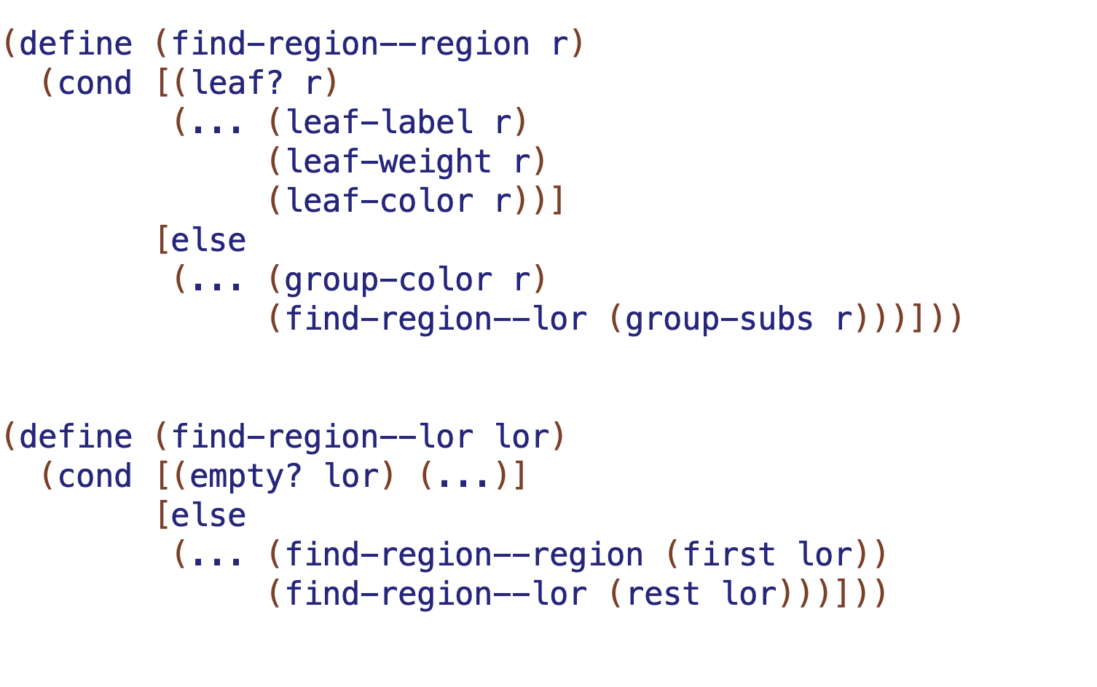
result will be?
result will be?
result will be?

