Slide 1
Lecture 21 mazes and graphs

Slide 2


Slide 3
(define M7
(list O O O O O O O O O O
W W O W W O W W W O
O O O W W O W O O O
O W O O W O W O W W
O W W O W W W O O O
O W W O O O W W W O
O W W O W O W O O O
O W W O O O W O W W
O O O O W W W O O O
W W W W W O O W W O))
The fine grained maze structure is pretty dense. Not complex really, but just dense.
But we can simplify…

Slide 4
(define M7
(list O O O O O O O O O O
W W O W W O W W W O
O O O W W O W O O O
O W O O W O W O W W
O W W O W W W O O O
O W W O O O W W W O
O W W O W O W O O O
O W W O O O W O W W
O O O O W W W O O O
W W W W W O O W W O))
The fine grained maze structure is pretty dense. Not complex really, but just dense.
But we can see that among the dense back and forth, some points are more interesting.

Slide 5
The fine grained maze structure is pretty dense. Not complex really, but just dense.
But we can see that among the dense back and forth, some points are more interesting.

Slide 6
two functions
solveable-no-revisits
given maze m, is it possible to go from 0,0 to lower right
function must not visit any position more than once
(it can come to the position, but not pass through it)
A) ordinary recursion B) tail recursion
distance-from
given maze m and positions and and b, if it is possible, starting at 0,0 to first reach a, and then reach b, produce distance from a to b
A) ordinary recursion B) tail recursion

Slide 7
solvable-no-revisits?
graph: yes → path or visited required
…

Slide 8
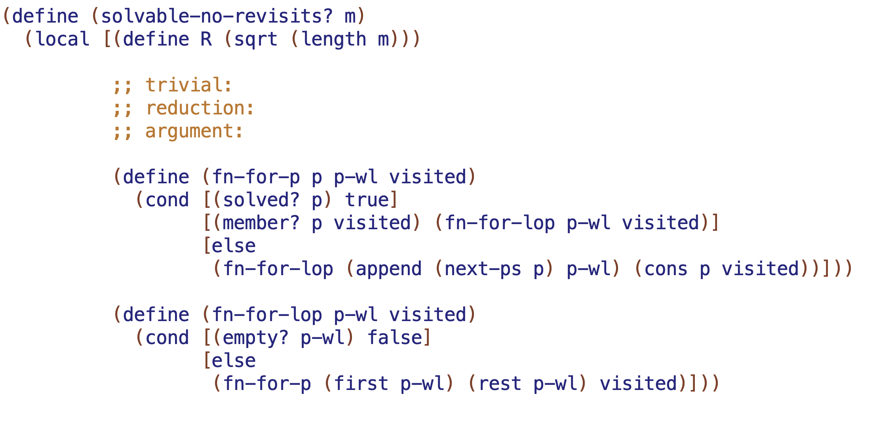

Slide 9
distance-from
graph: yes → path or visited required
…

Slide 10
