Slide 1
Lecture 23 and then we were done

Slide 2
Last song
Cassidy by Bob Weir and John Barlow
A song about comings and goings; especially about comings.
I’ll let you read the lyrics and see what they say to you, but…
“Wheel to the storm and fly”

Slide 3
Plan for rest of today
There will be clickers!
All answers will be correct, but not answering will not be correct. Leave your devices open.
How do you feel about final?
What have you learned?
What about other languages?
What’s next?
A few thoughts on generative AI
Student Survey

Slide 4
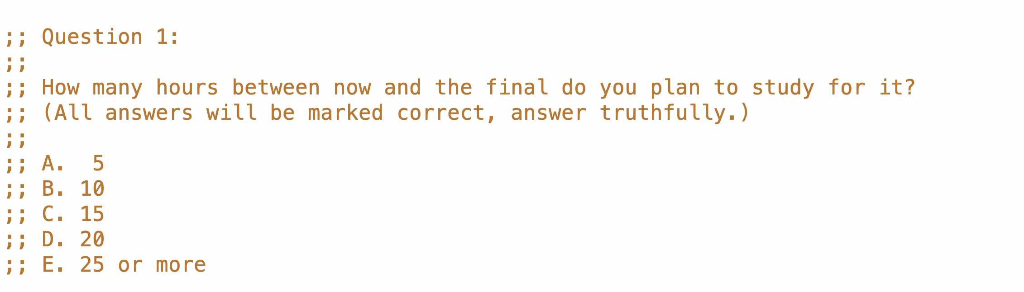

Slide 5
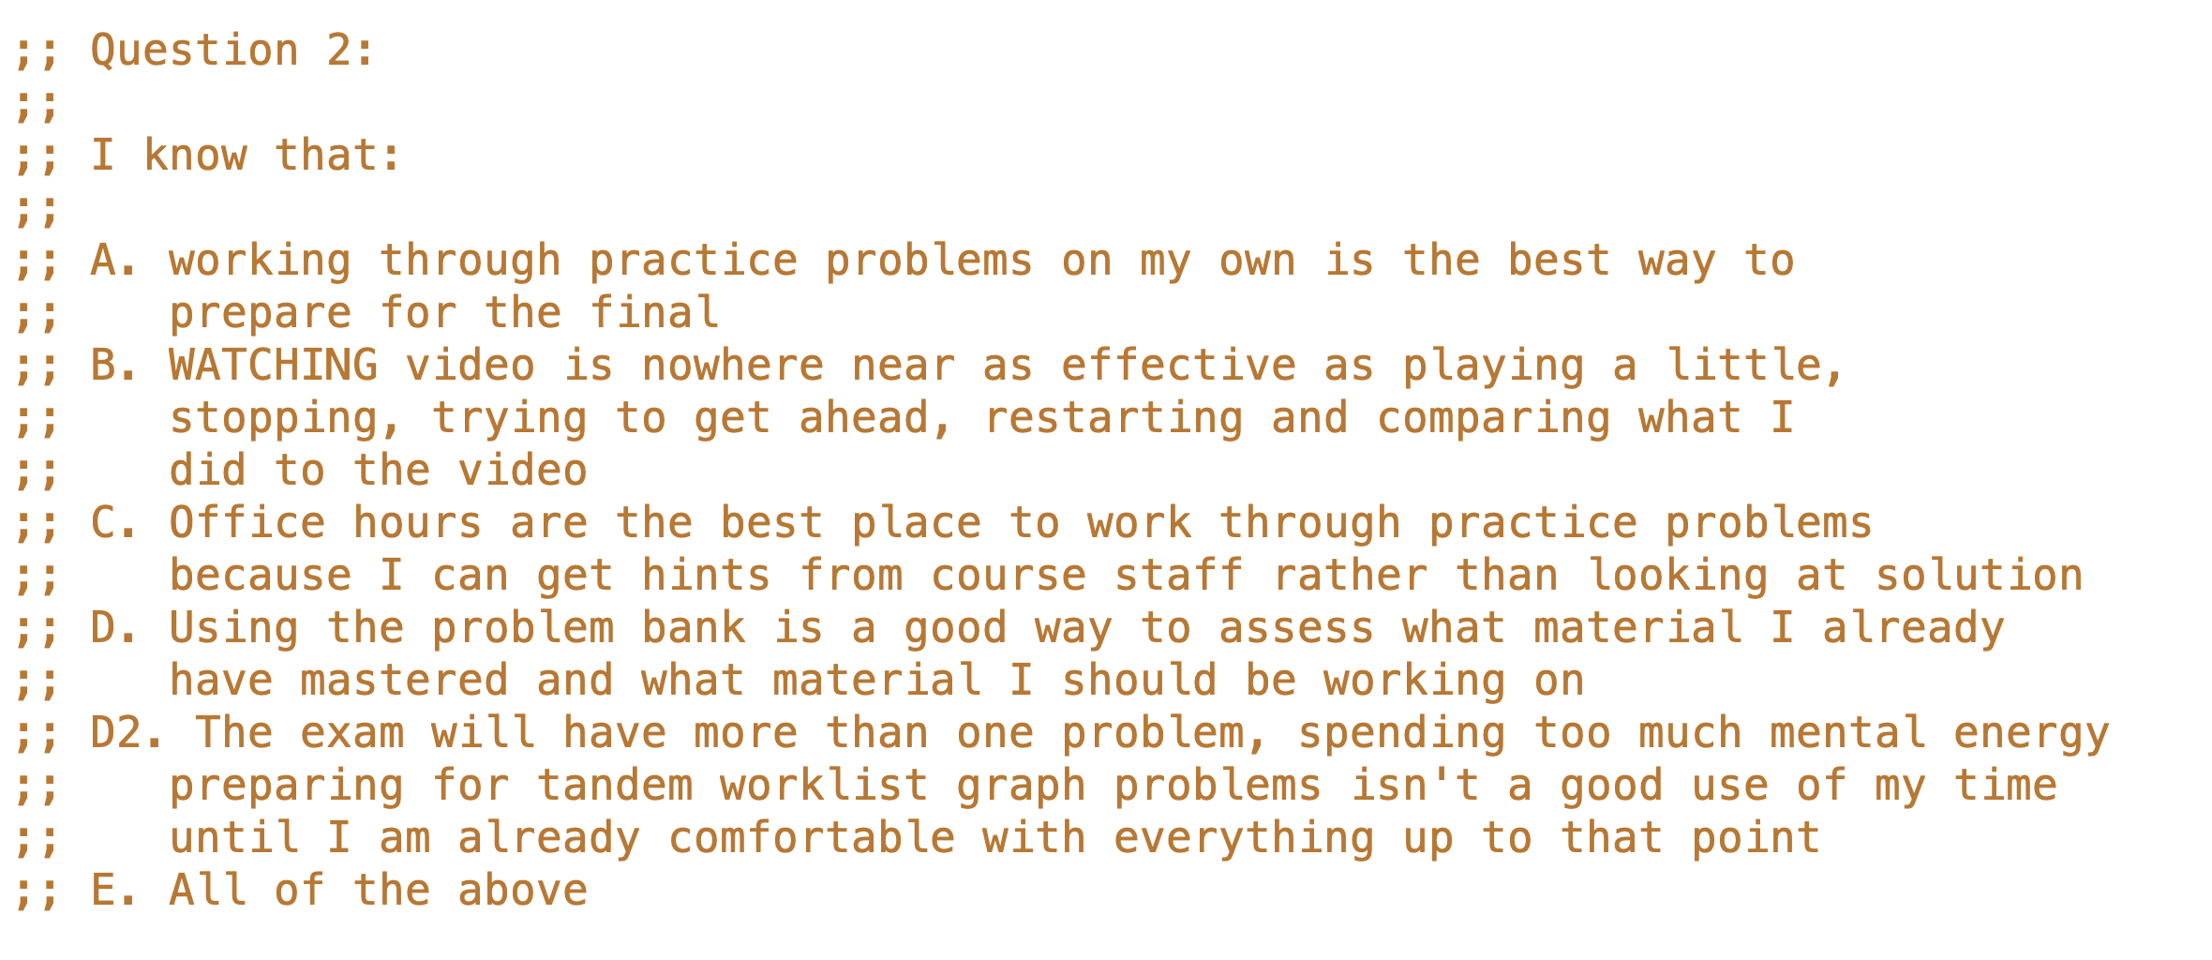

Slide 6
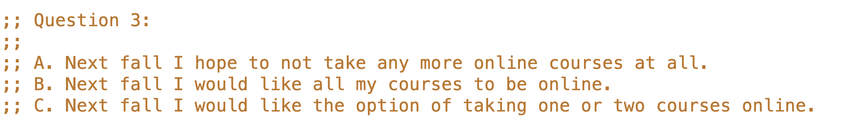

Slide 7
Lots of office hours will be posted. Instructor hours will be posted shortly. There are comments about the final in this lecture, but no “hidden hints”. The final covers everything but world programs.

Slide 8
What have you learned ... about design?
Figuring out what you actually want is half the battle
signature
purpose
examples (wrapped in check-expect)
information examples
interpretation

Slide 9
What have you learned ... about design?
then the structure of the solution
template origins
accumulator types and invariants
and the details
fill in … according to all above
debug
All 5 tests pass!

Slide 10
What have you learned ... about design?
but sometimes
despite your best efforts
what you end up with is not what you really wanted
go back and systematically revise the design, and learn from that error
50% of 50% Submitted tests: correct - all submitted test pass.
0% of 50% Additional tests: incorrect - 3 autograder internal additional tests failed.

Slide 11
Hopefully you also learned
that you can solve larger and harder problems than you thought
some of what it will take to solve harder and harder problems
patience, attention to detail, humility are important parts of it

Slide 12
Other languages
Everything you’ve learned in 110 works in other languages
data design, function design, tests, templates…
above all, working systematically to narrow the gap between problem and solution
Learn new languages by reading code
find code that “must do X”
use what you know to understand the chunks (the templates)
figure it out from there

Slide 13
Our last starter…
I feel like when the code is explained to me
I can see the parts of it and sort of understand it
I can see and understand only a small part of it
I have no idea what I’m reading when I look at the code

Slide 14
What have you learned ... about Computer Science?
foundations of software engineering
much more in 210, 310, 410
simple functional programming language
much more in 311, 312, 411
a bit about algorithms and data structures
trees, graphs, sorting, searching
much more in 221, 320, 420
a very little bit about systems and architecture (MVC)
much much more in 213, 313, 317
but there’s much much much much more beyond that

Slide 15
In the rest of my time at UBC
I plan to take more CS courses
I do not want to take another CS course

Slide 16
A B C D E
Which kind of course most interests you now?

Slide 17
Faculty In A Large Research University
exceptional subject matter expertise
exceptional teaching science and practice expertise
Professor
Associate Professor
Assistant Professor
Professor of Teaching
Associate Professor of Teaching
Assistant Professor of Teaching
Lecturer
Sessional
tenured
tenure-track
not tenure-track

Slide 18
Job Search Process Points
Jobs outside universities…
Build your own portfolio¹, get internships, COOP and/or work with faculty
Interviews are about what you can DO, not what you remember
A reference letter that helps must have all three of these properties:
comes from someone the committee will trust
comes from someone who has something specific to say about you
says specific things about you that compare favorably with rest of group
1. I wish this wasn’t good advice, it’s blatantly discriminatory.

Slide 19
Two summer interns
When faced with an underspecified task at work:
Intern A always goes to their manager to seek clarification before proceeding.
Intern B tries to make a reasonable decision about what is needed and proceeds.
At the end of the summer, which one gets a permanent job offer?

Slide 20
At work - FtR
“We are what we repeatedly do. Excellence, then, is not an act, but a habit.”
Managers don’t have time for employees who need to be given a detailed description of what to do
figure it out
do something reasonable
ask only very well developed questions
“It seems like there’s two different things we could do, one would look like this, the other would look like this…” (The examples step of the recipe!)
It’s easy to be fun to be around when you know what you are doing
teams want people who are fun to be around when they don’t know what they are doing
interview processes are in part trying to uncover that, they want to push you into uncomfortable territory to see how you handle that – they aren’t trying to intimidate or be macho (many of them aren’t anyways)

Slide 21
What About Generative AI?
All kinds of work is about to change – maybe a lot
Long term isn’t clear (issues go way beyond technology)
It does seem clear that in 2-3 years or less
software engineers (including interns) will need to be able to use tools like Copilot (or similar) to be more productive (produce more value per salary dollar)
produce/revise code faster
produce better code
…
One part of that will be quickly evaluating code an AI tool proposes
One part of that will be having a dialog with an AI tool about code you have written
We have tried to given you a foundation for that
by focusing on design level constructs that exist across all languages and tools

Slide 22
Final review
Monitor Piazza forum closely – ask well setup questions
Work through problems (as opposed to reviewing solutions)
Focus on WHY you type the code you do
What rule? What observation? What idea?
Work through them online
Practice getting RUNNING solutions
Work through being stuck, don’t just look at the solution
Work in office hours (hints are better than looking at solutions)
Work in 2.5 hour chunks w/o interruption
Several hours every day beats 24 hours the day before the exam

Slide 23
You are now bearers of IT sorcery…
Information technology is extraordinarily powerful
Protein folding
Self driving cars
…
Workday ☹
Try to do good things with that power
not everyone can work on cancer
not everyone can go to cool hot company (former students are at all of them)
we also need payroll systems, and traffic automation, and 10k+ other important systems
but some things are less good…, some questions to ask
where does the wealth go? where does it come from?
who has control over the information?
who has agency in how the system works?

Slide 24
Remember
“Wheel to the storm and fly”

Slide 25
The Recipes are about
Making systematic progress, bit by bit, to solve a complex problem.
Write down the easiest thing first
what is information in problem domain, form of information, type comment, examples, template
fn name, signature, purpose, examples, template, code rest of function body
Don’t jump to a solution too soon
information, form, DD, signature, purpose, template, fill in … vs. just start coding
Describe the goal in different forms.
types (signature), text (purpose), examples, template
Work it out, piece by piece, always writing down what you just figured out.
Using software engineering and computer science to structure the solution into separate parts
What’s the information? What’s the changing information?
What kind of problem is it? (Simple functional, World, Search…)
What‘s the basic function strategy? (structural, generative, search...)
What are the templates?

