Slide 2
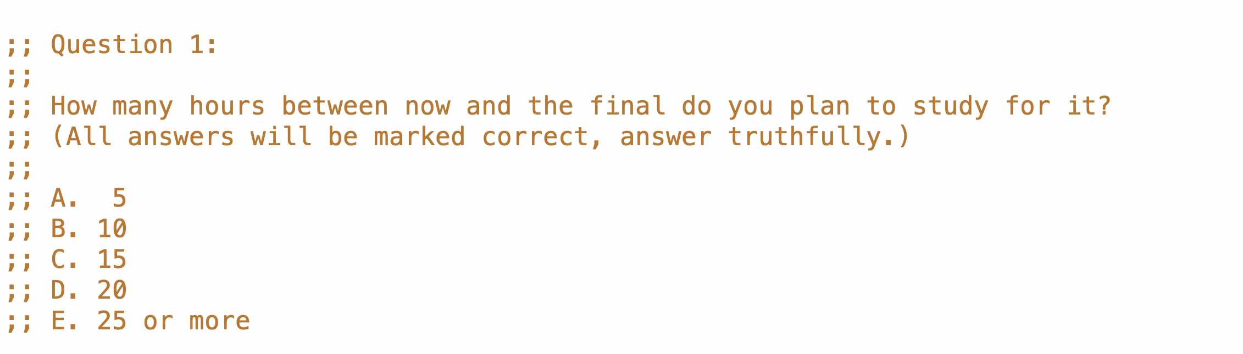

Slide 3
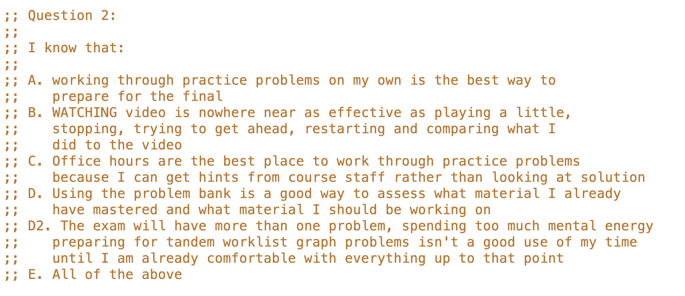

Slide 4
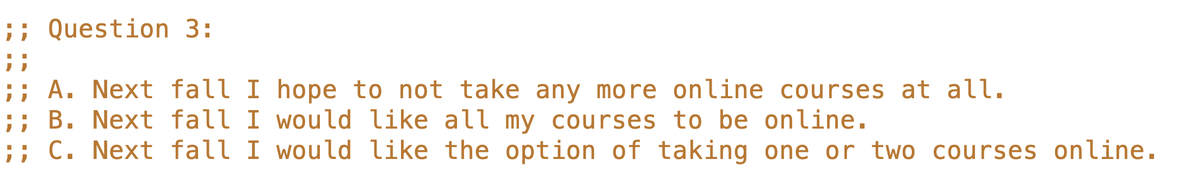

Slide 5
Lots of office hours will be posted. Instructor hours will be posted shortly. There are comments about the final in this lecture, but no “hidden hints”. The final covers the whole course.

Slide 6
Faculty In Your Future CS Courses
A diversity of specializations: programming languages, software engineering, systems, graphics, HCI, machine learning, algorithms, numerical computation, CS education, … and more
And lots of other diversity too
black, Asian… gay, straight… cisgender, trans… native, immigrant…
Respect every one of them
They are great people and great teachers

Slide 7
Plan for rest of today
What about other languages?
What have you learned?
How do we feel about the final?
What’s next?
Student Survey

Slide 8
What have you learned ... about design?
Figuring out what you actually want is half the battle
signature
purpose
examples (wrapped in check-expect)
information examples
interpretation

Slide 9
What have you learned ... about design?
then the structure of the solution
template origins
accumulator types and invariants
and the details
fill in … according to all above
debug
All 5 tests pass!

Slide 10
What have you learned ... about design?
but sometimes
despite your best efforts
what you end up with is not what you really wanted
go back and systematically revise the design, and learn from that error
50% of 50% Submitted tests: correct - all submitted test pass.
0% of 50% Additional tests: incorrect - 3 autograder internal additional tests failed.

Slide 11
Hopefully you also learned
that you can solve larger and harder problems than you thought
some of what it will take to solve harder and harder problems
patience, attention to detail, humility are important parts of it

Slide 12
Other languages
Everything you’ve learned in 110 works in other languages
data design, function design, tests, templates…
above all, working systematically to narrow the gap between problem and solution
Learn new languages by reading code
find code that “must do X”
use what you know to understand the chunks (the templates)
figure it out from there

Slide 13
Our last starter…
//@template (listof X) w/ acc
//@template [X, ..] w/ acc
def fn(lox):
res = ...
for x in lox:
res = res...x
return ...x

Slide 14
The Recipes are about
Making systematic progress, bit by bit, to solve a complex problem.
Write down the easiest thing first
what is information in problem domain, form of information, type comment, examples, template
fn name, signature, purpose, examples, template, code rest of function body
Don’t jump to a solution too soon
information, form, DD, signature, purpose, template, fill in … vs. just start coding
Describe the goal in different forms.
types (signature), text (purpose), examples, template
Work it out, piece by piece, always writing down what you just figured out.
Using software engineering and computer science to structure the solution into separate parts
What’s the information? What’s the changing information?
What kind of problem is it? (Simple functional, World, Search…)
What‘s the basic function strategy? (structural, generative, search...)
What are the templates?

Slide 15
“We are what we repeatedly do. Excellence, then, is not an act, but a habit.”
- Many
“Chance favours the prepared mind.”
- Louis Pasteur

Slide 16
What have you learned ... about Computer Science?
foundations of software engineering
much more in 210, 310, 410
simple functional programming language
much more in 311, 312, 411
a bit about algorithms and data structures
trees, graphs, sorting, searching
much more in 221, 320, 420
a very little bit about systems and architecture (MVC)
much much more in 213, 313, 317
but there’s much much much much more beyond that

Slide 17
203 Non-majors 2nd course in programming NEW
330 Non-majors machine learning NEW
210, 310, 410 Software Engineering
311, 411 Programming languages
213, 313, 317, 415 Systems…
304, 404 Databases
121, 221, 320, 420 Algorithms, data structures, theory
302, 303 Numerical computation +inf.0
322, 340 AI and machine learning speech, vision, “you may like”…
314, 424 Graphics movies
344, 444 Human Computer Interaction how do people interact with tech…
436 Visualization presenting complex information
…
DSCI Data science
Ask your TAs!!!
SE/PL
Systems
Theory

Slide 18
Jobs outside universities…
Build your own portfolio, get internships, COOP and/or work with faculty
Interviews are about what you can DO, not what you remember
A reference letter that helps must have all three of these properties:
comes from someone the committee will trust
comes from someone who has something specific to say about you
says specific things about you that compare favorably with rest of group

Slide 19
Final review
Monitor Piazza forum closely – ask well setup questions
Work through problems (as opposed to reviewing solutions)
Focus on WHY you type the code you do
What rule? What observation? What idea?
Work through them online
Practice getting RUNNING solutions
Work through being stuck, don’t just look at the solution
Work in office hours (hints are better than looking at solutions)
Work in 2.5 hour chunks w/o interruption
Several hours every day beats 24 hours the day before the exam

Slide 20
You are now bearers of IT sorcery…
Information technology is extraordinarily powerful
DeepMind protein folding
Self driving cars
…
UBC SSC
Try to do good things with that power
not everyone can work on cancer (former head TA S*** in NYC working on that now)
not everyone can go to cool hot company (former students are at all of them)
we also need payroll systems, and traffic automation, and 10k+ other important systems
but some things are less good…, some questions to ask
where does the wealth go? where does it come from?
who has the power over the information?
who has agency in how the system works?

