Slide 1
TODAY
Another day of reaping the rewards of the work you have done so far
One important new idea – mutual reference / recursion
The hard parts won’t actually be very hard
just trusting natural recursions as usual
not blind trust - we have to get base, contribution and combination right!
The easy parts will require learning some new details
minor housekeeping changes with @htdf organization

Slide 2
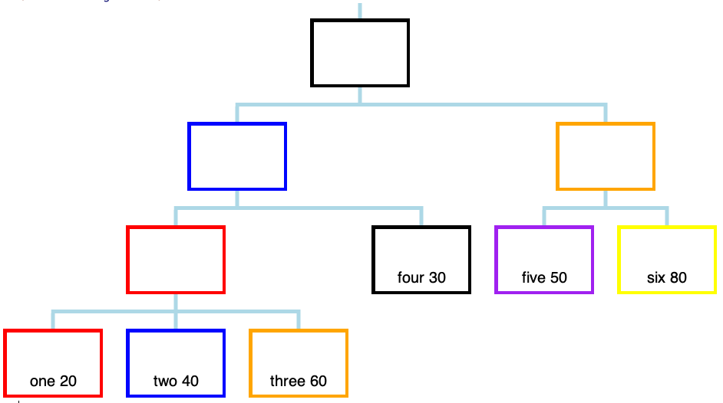
Some tree terminology:
- leaf nodes have no subs
- inner nodes do have subs

Slide 3
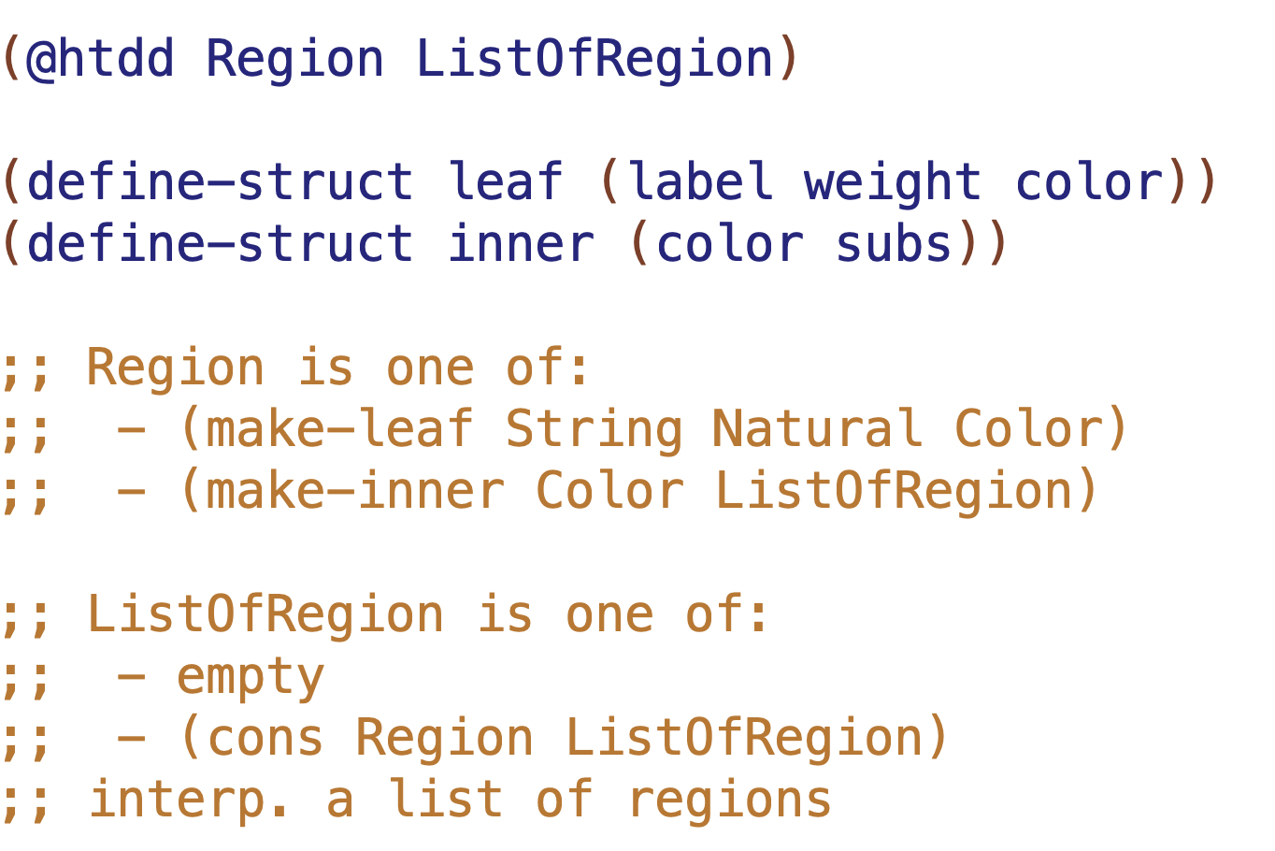

Slide 4
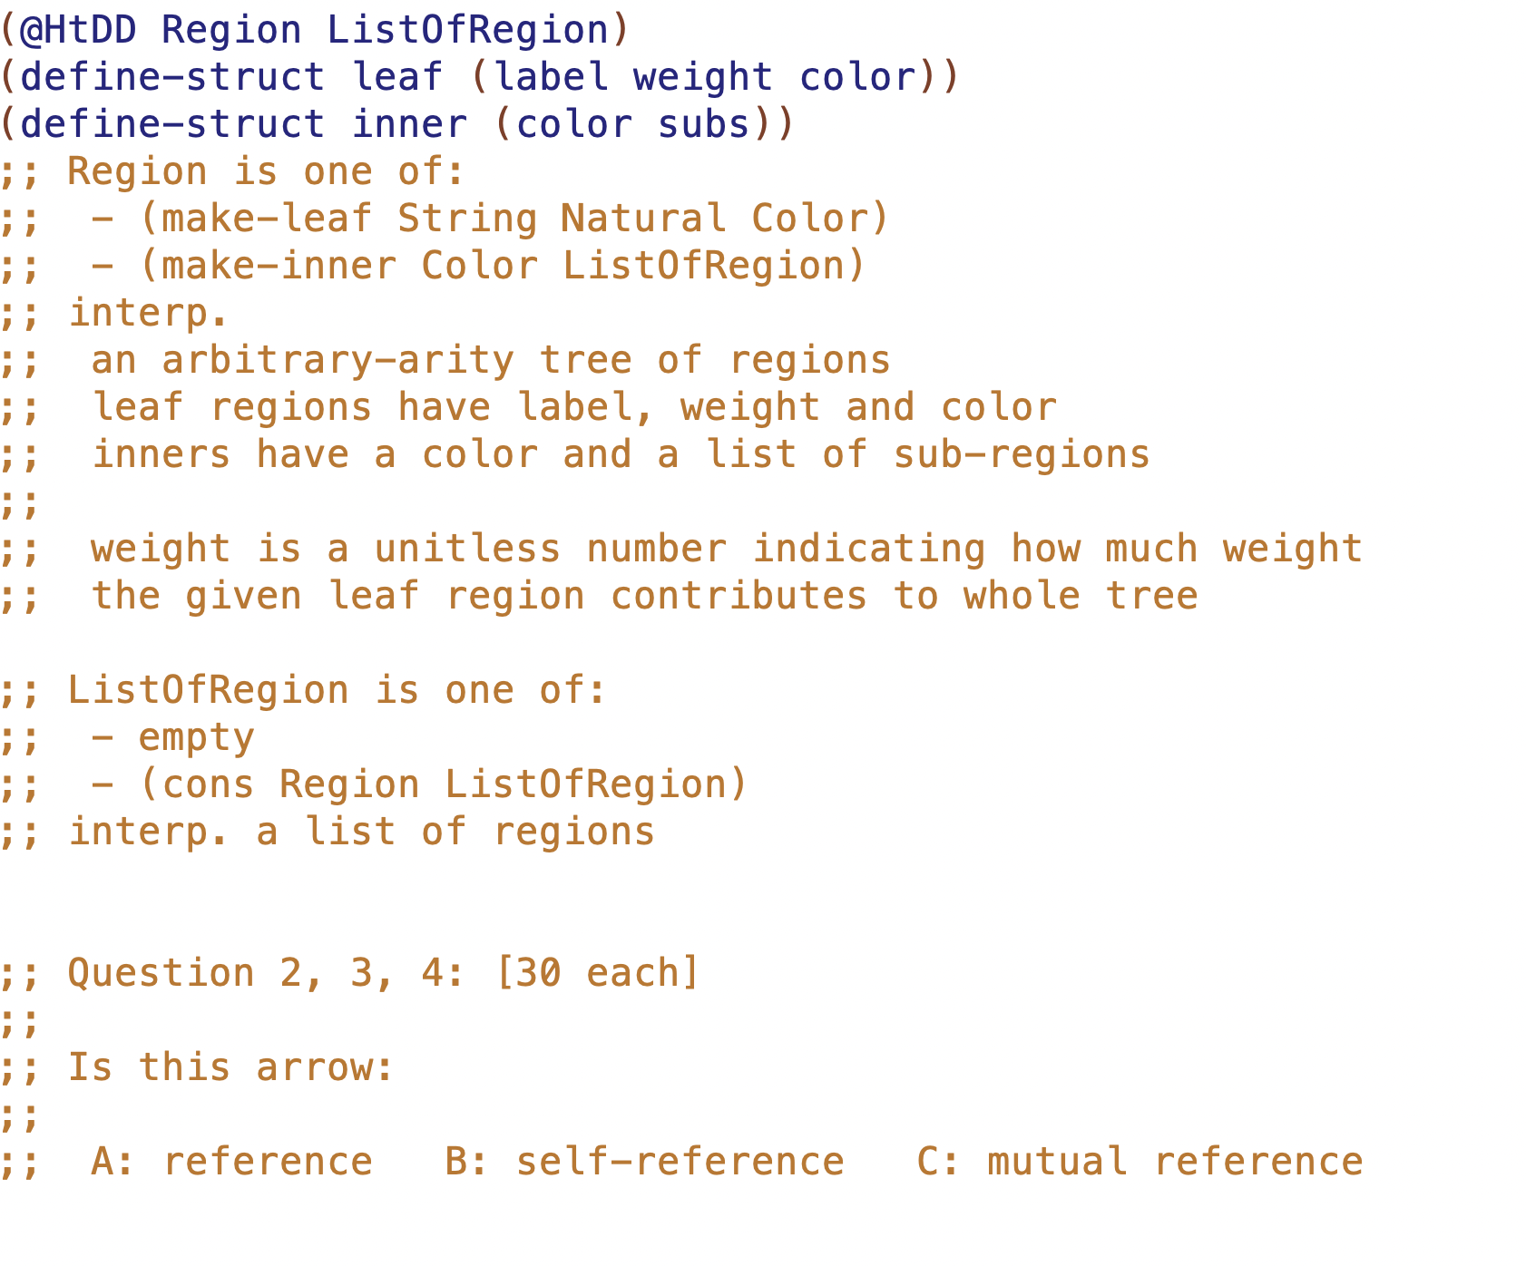

Slide 5
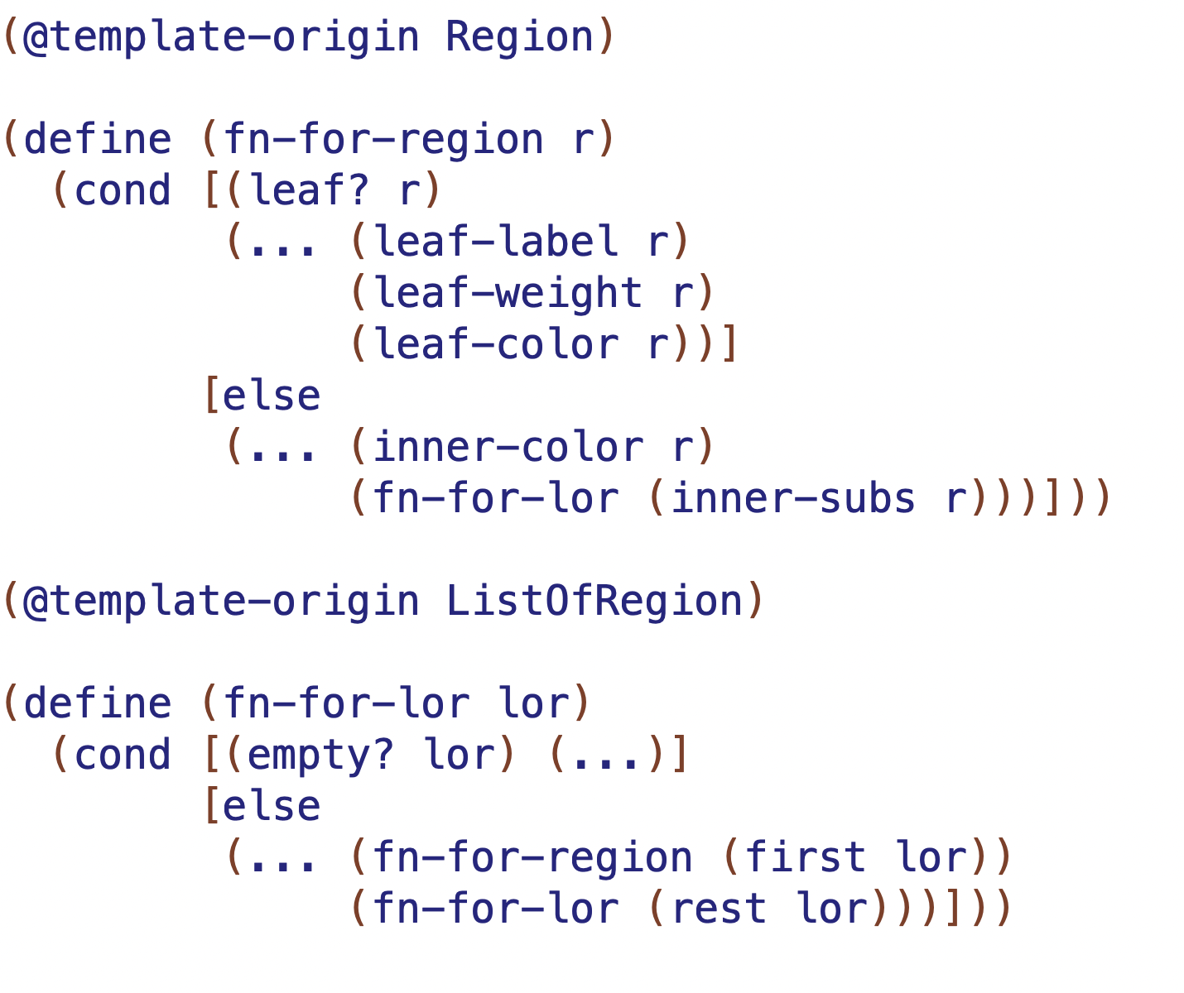
mutual recursion means these functions come in pairs (2 or more in general)
NMR
NMR
NR

Slide 6
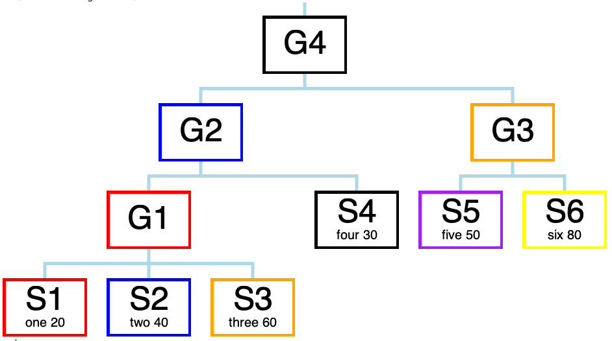
L1, L2, I4 etc. are the
NAMES OF THE CONSTANTS
I4
I2
I3
I1
L4
L5
L6
L1
L2
L3

Slide 7
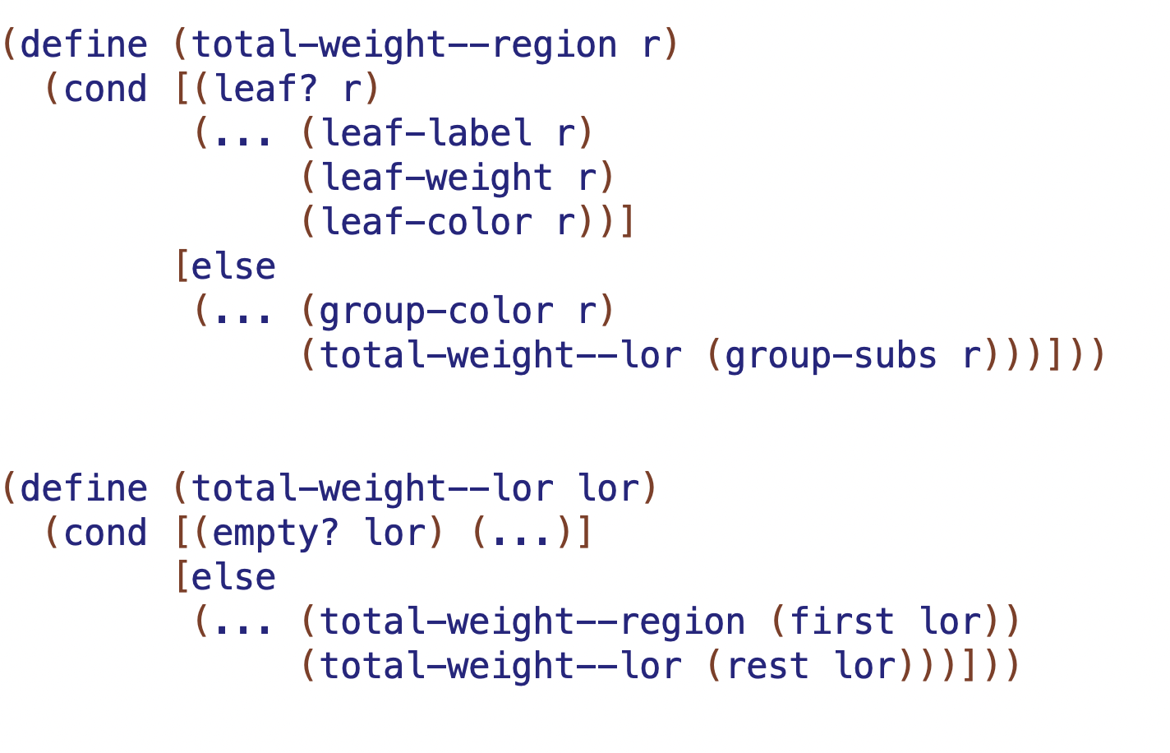

result will be?
result will be?
result will be?

Slide 8
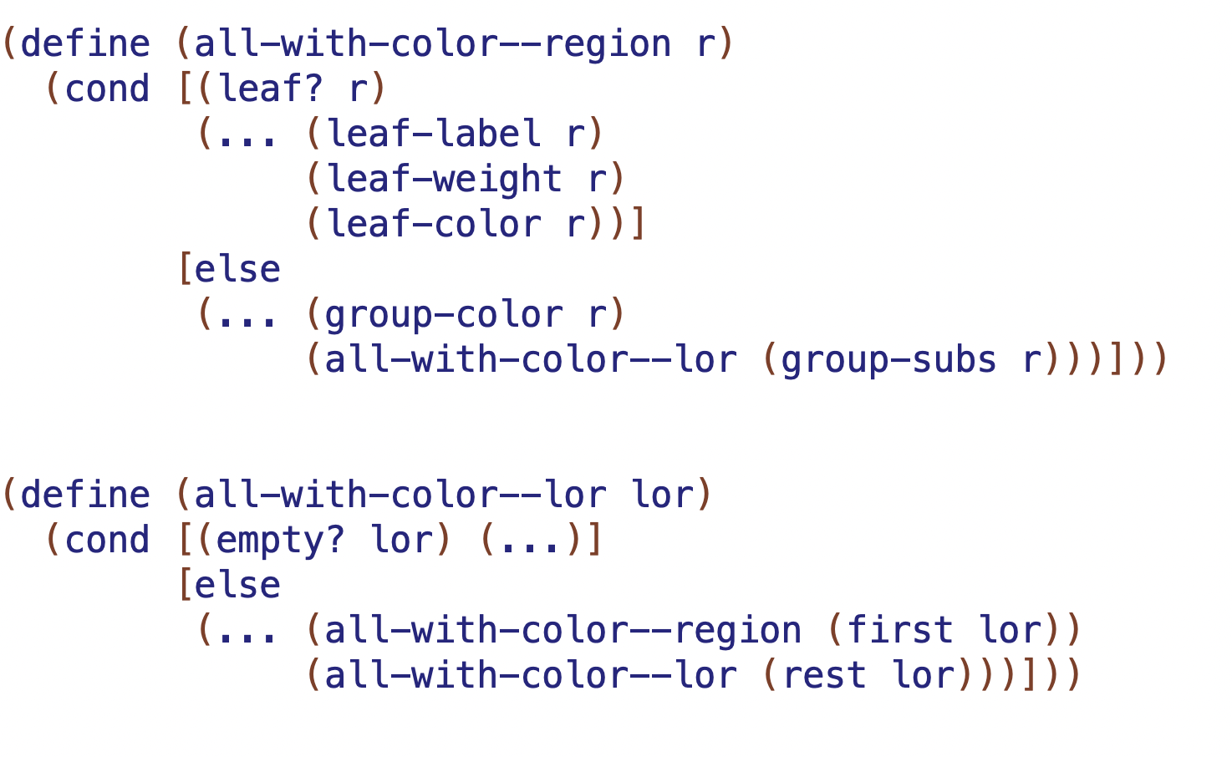
result will be?
result will be?
result will be?

Slide 9
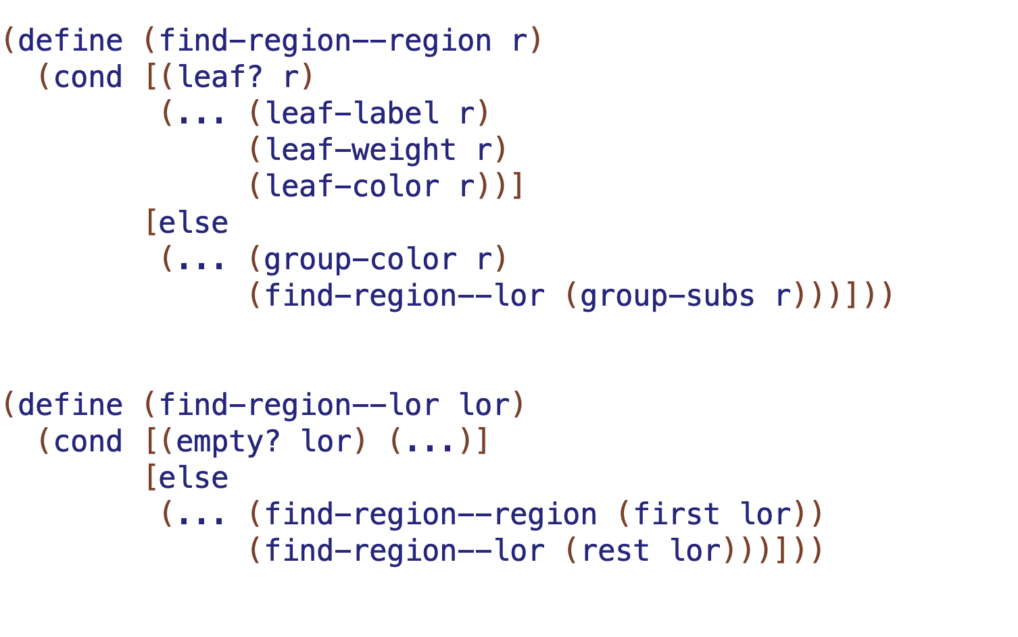
result will be?
result will be?
result will be?

