Slide 1
Stimulation & Recording auf Dell Notebook
Oz @ 5.45 Hz
Oz @ 8.57 Hz

Slide 2
Stimulation PC, Recording Dell Notebook
Oz @ 5.45 Hz
Oz @ 8.57 Hz

Slide 3
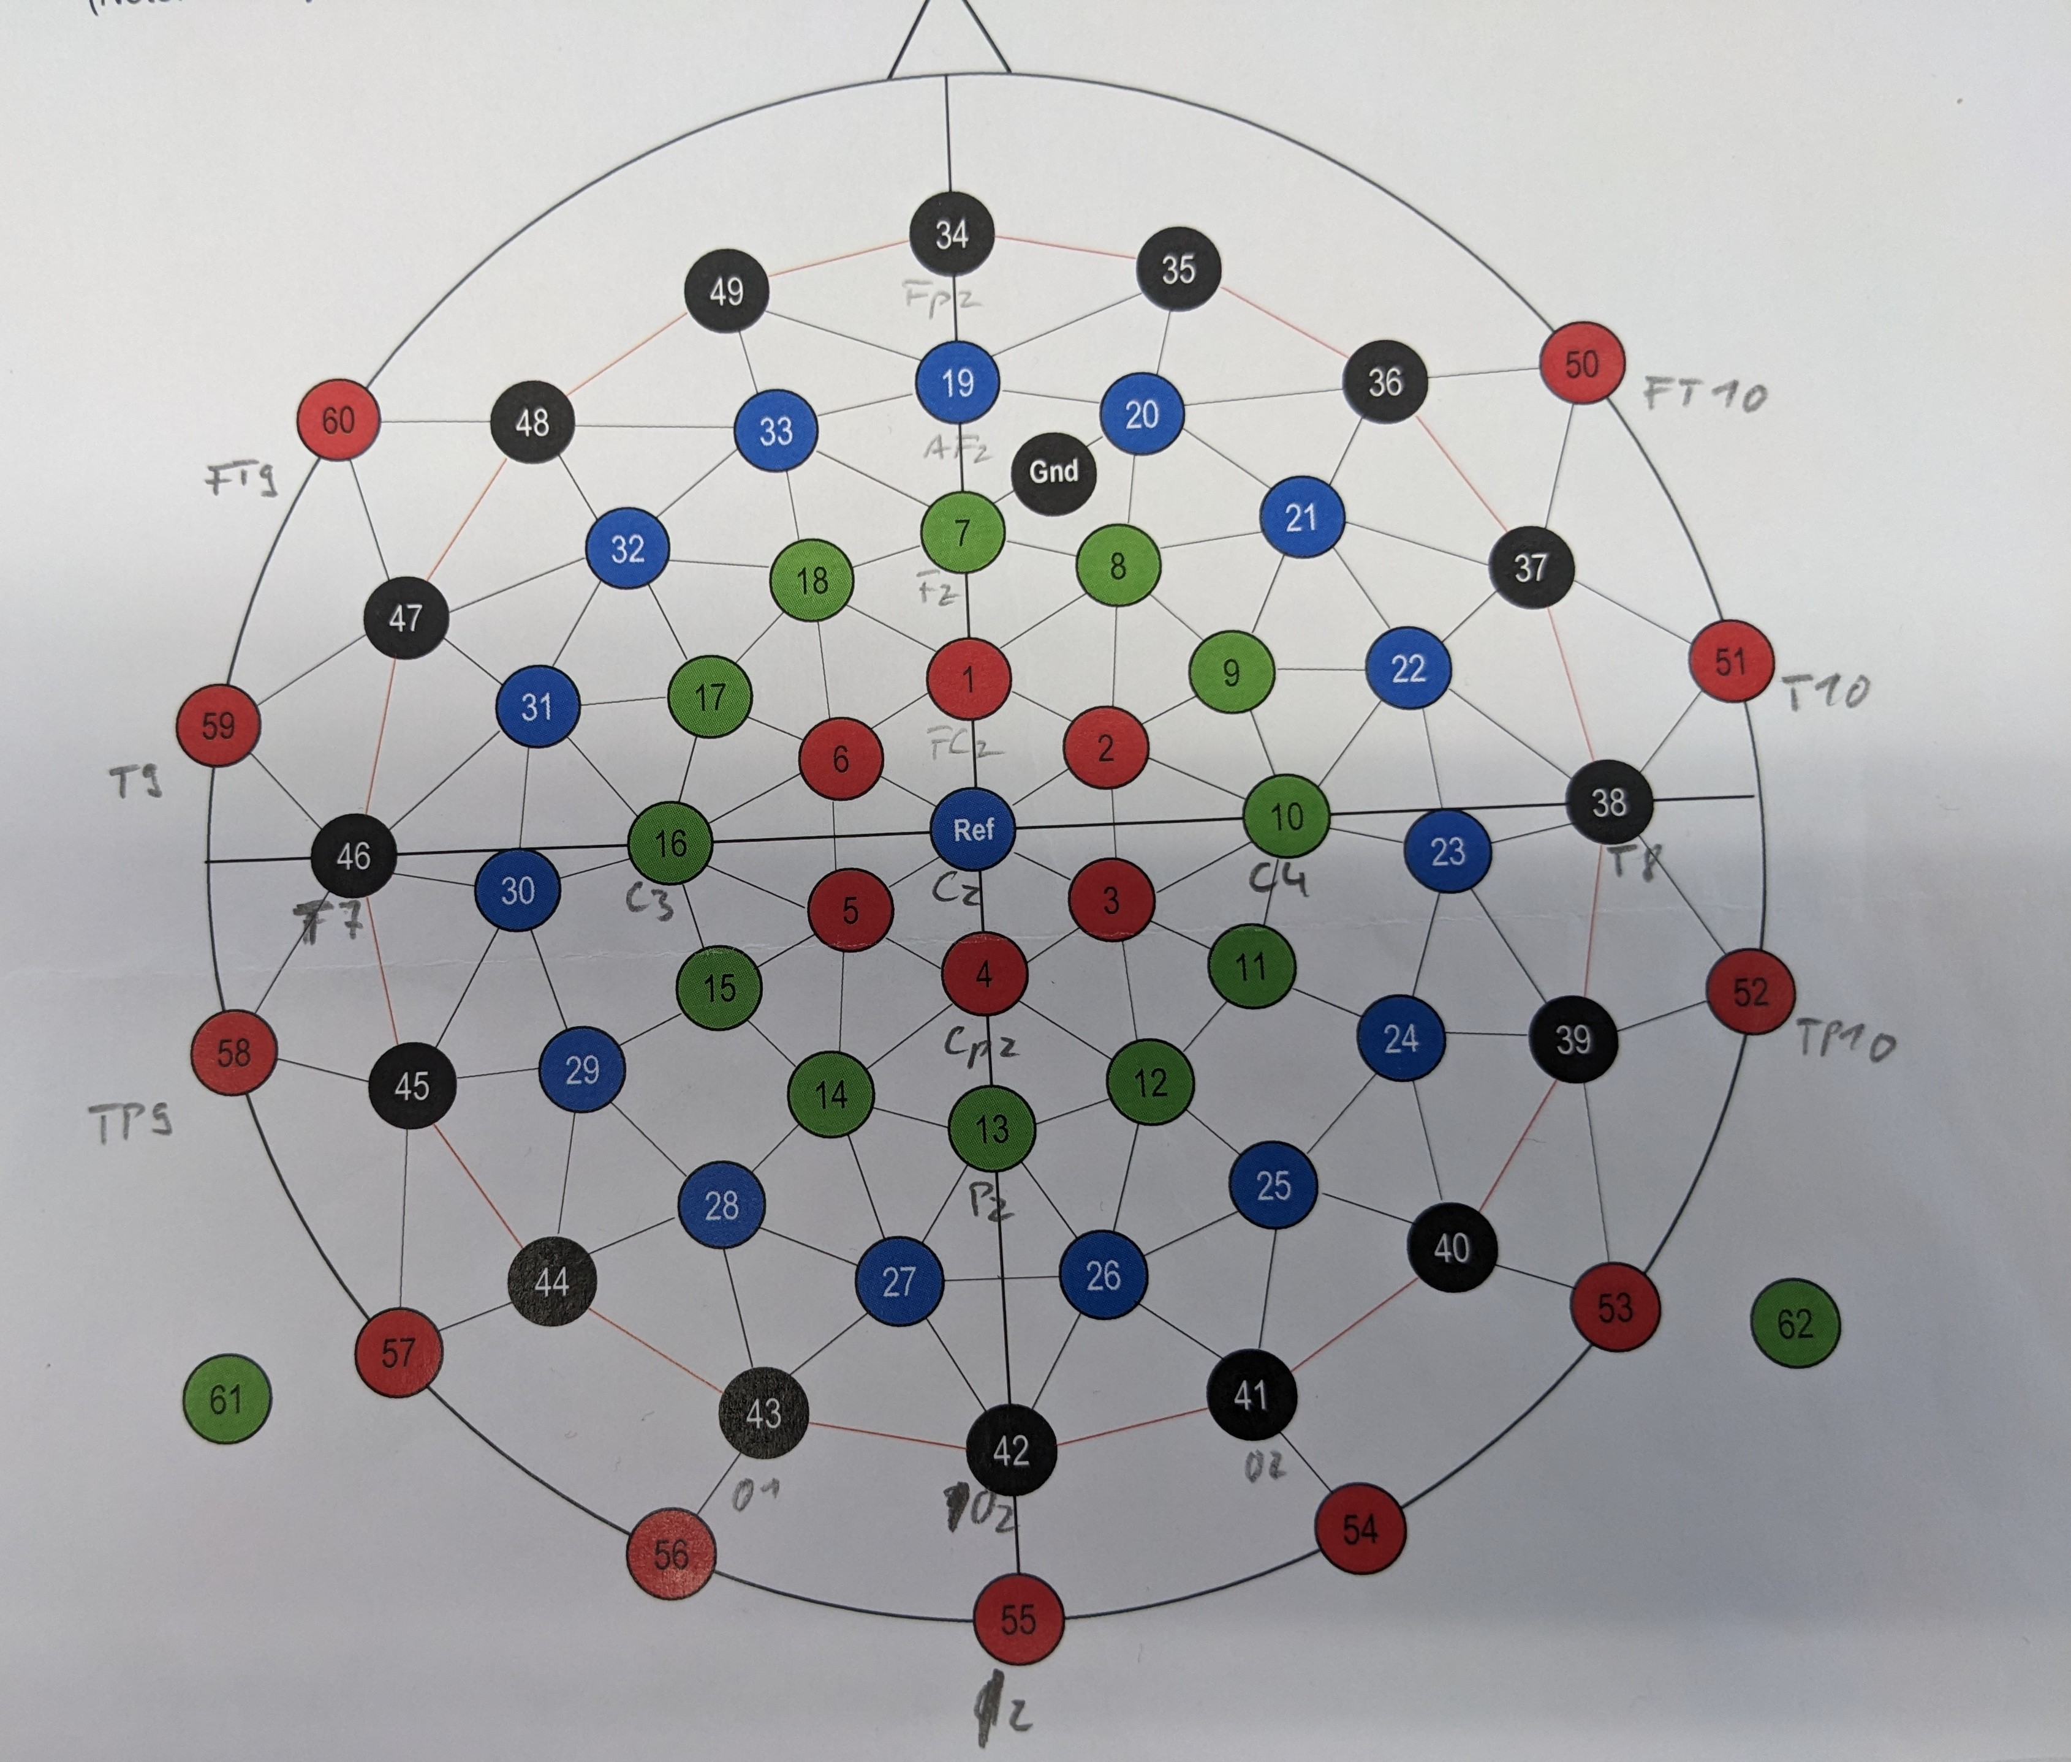
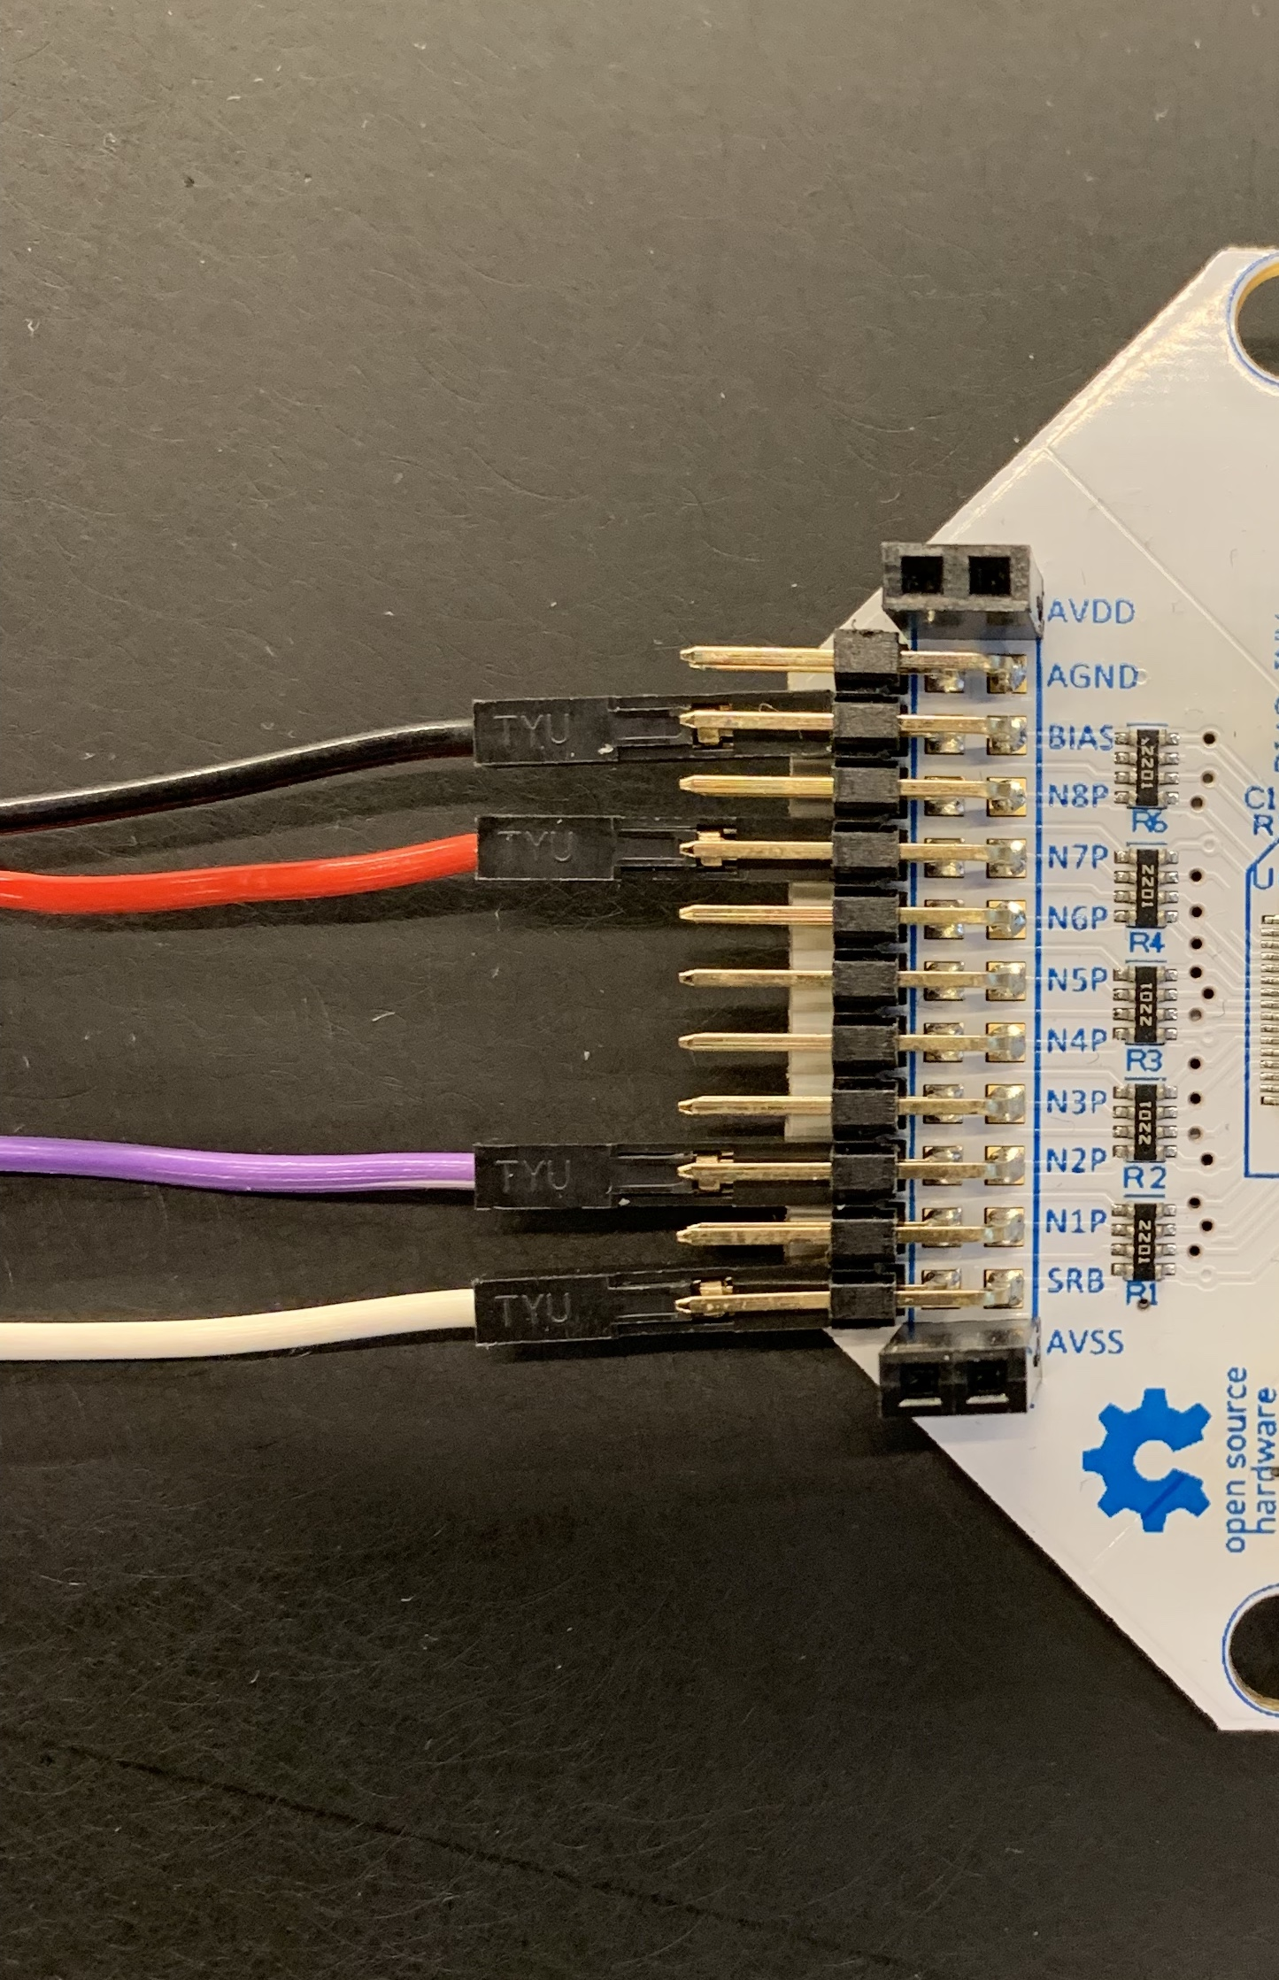
Electrode setup
bottom pins!
Nr. | Name | Pin
Gnd | Gnd | BIAS
43 | O1 | N8P
41 | O2 | N7P
44 | O3 | N6P
40 | O4 | N5P
27 | PO1 | N4P
26 | PO2 | N3P
28 | PO3 | N2P
29 | PO4 | N1P
Ref | Ref | SRB

