Slide 2
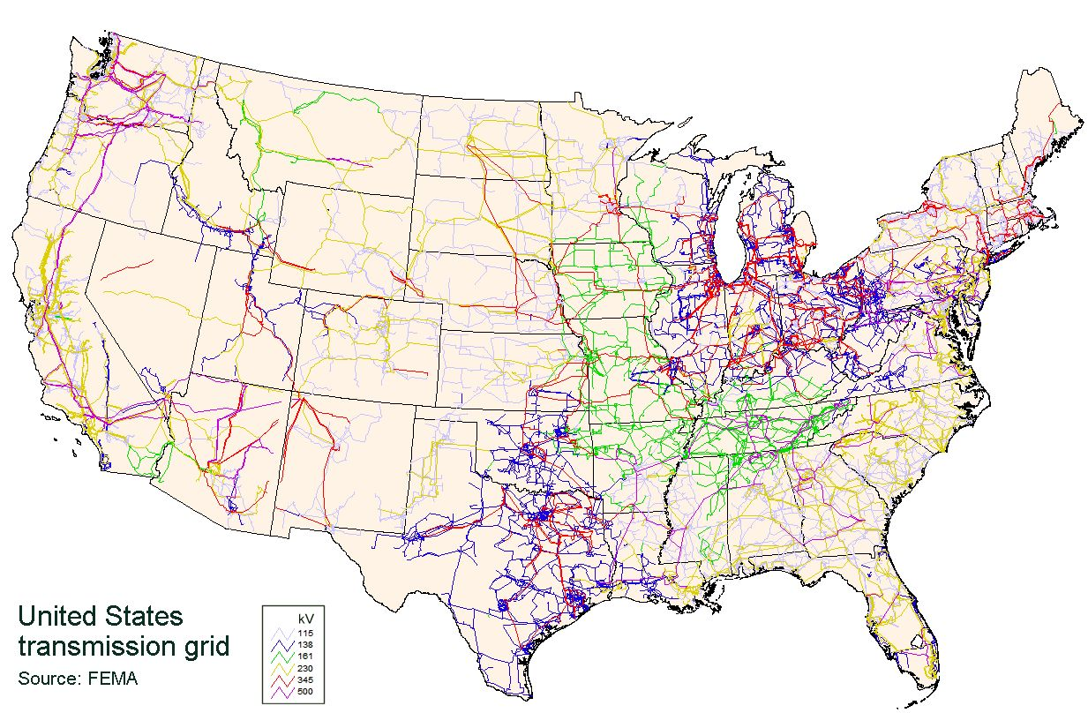
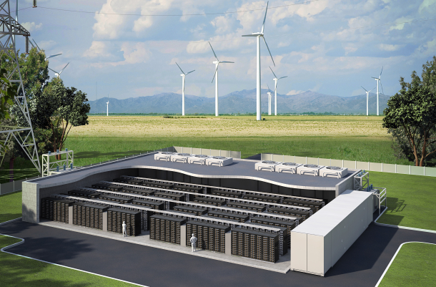
Expected Revenue
Energy Balance
Discharge
[MW]
Charge
[MW]
Nonanticipativity Constraints
Bounds
Energy Stored [MWh]

