Slide 1
Latent Space Optimization
Gregory Nothnagel

Slide 2
Introduction
Given image samples, we want a SIMPLE way to generate new samples that MATCH OUR SPECIFICATIONS
A model like this would be useful for image generation

Slide 3
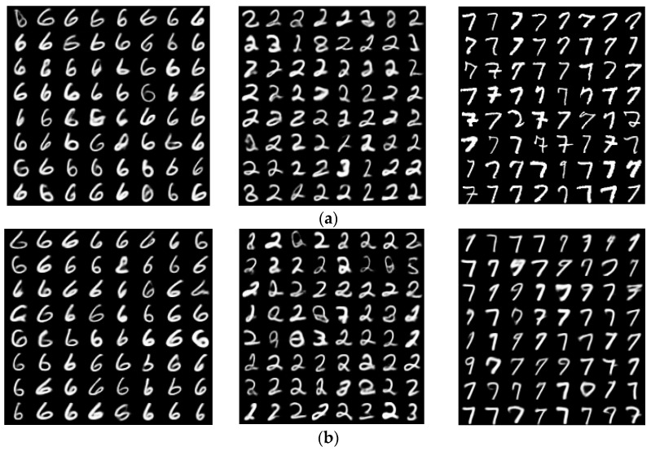
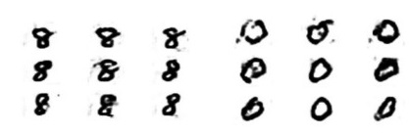
Related Work
Application of Variational AutoEncoder (VAE) Model and Image Processing Approaches in Game Design (PMID 37050517)
VAEs – Generative and clustering capabilities
Generative adversarial network based synthetic data training model for lightweight convolutional neural networks (PMID 37362646)
GANs – Great generative ability, but can’t specify desired features of output
These are two separate models

Slide 4
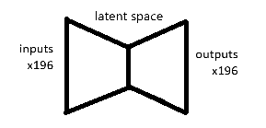
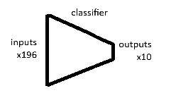
Approach
Train a simple autoencoder
Train classifier separately

Slide 5
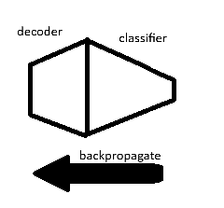
Approach
Append decoder to classifier and optimize for specified output.
Limited by quality of decoder and classifier.

Slide 6
Experiments
Inception Score / FID

Slide 9
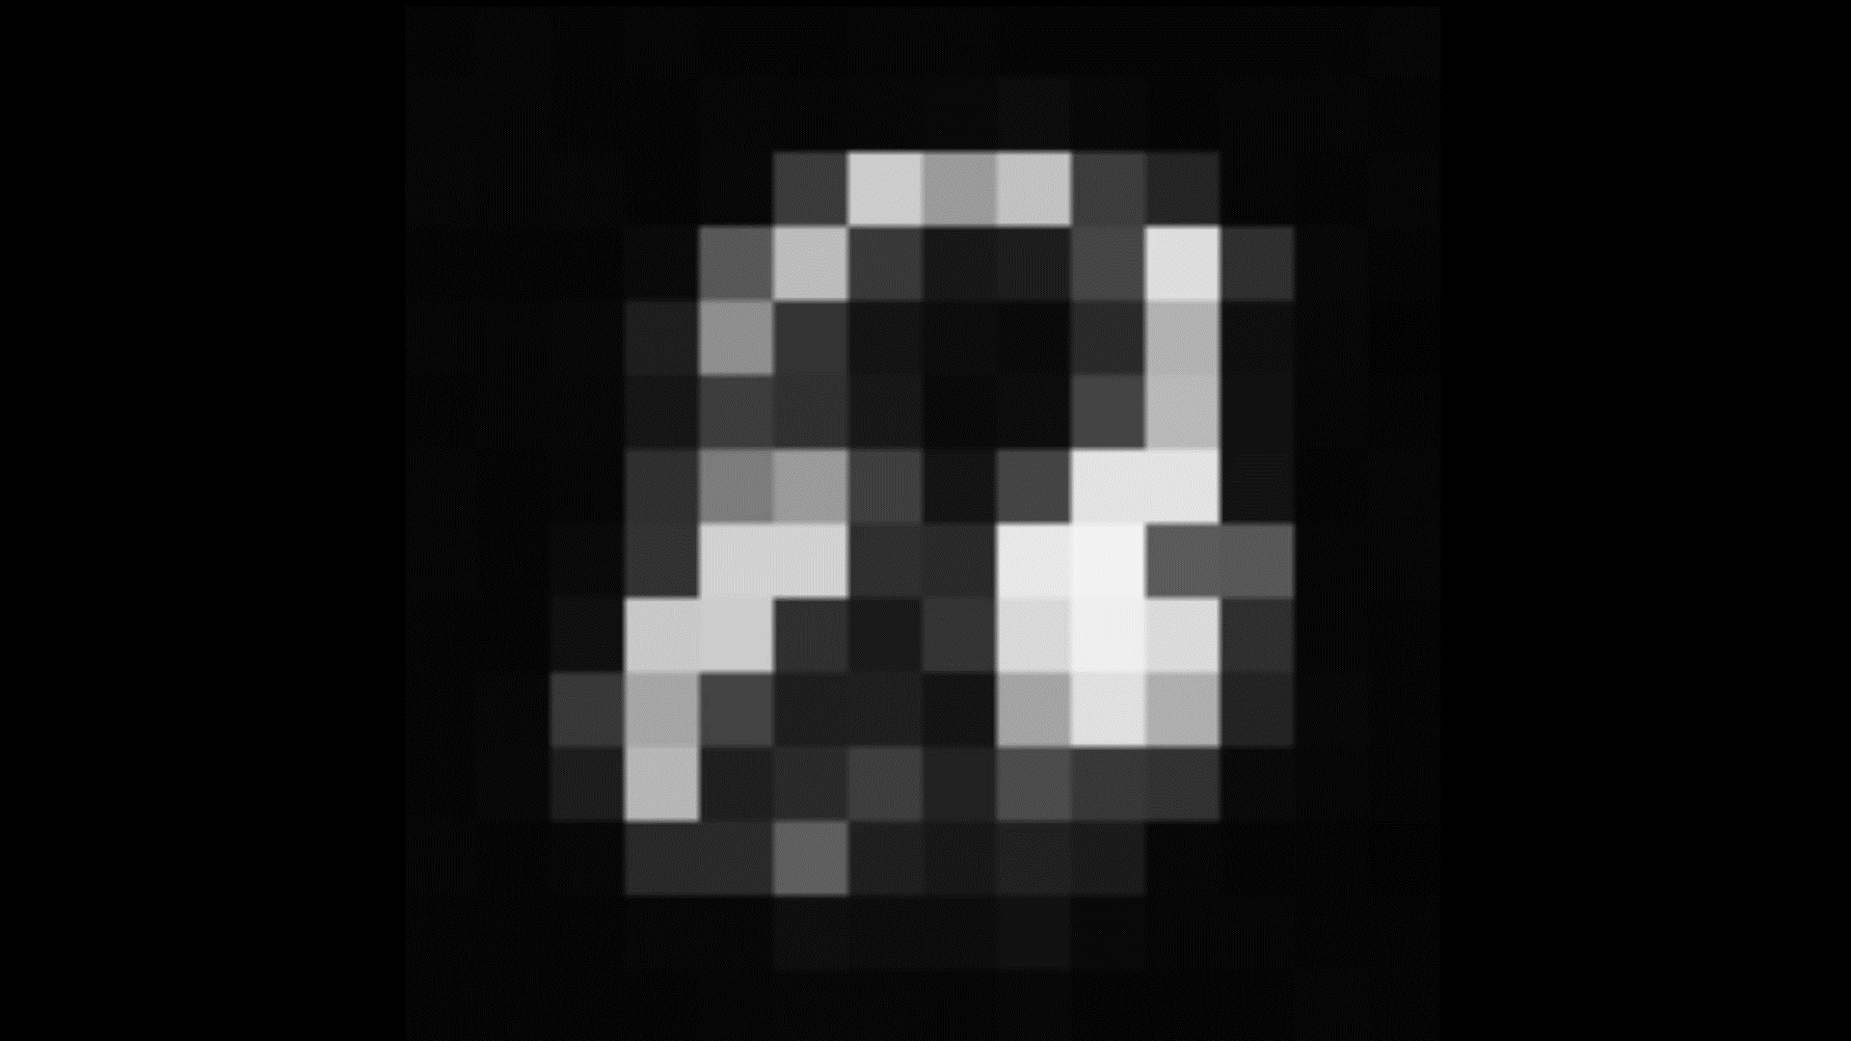
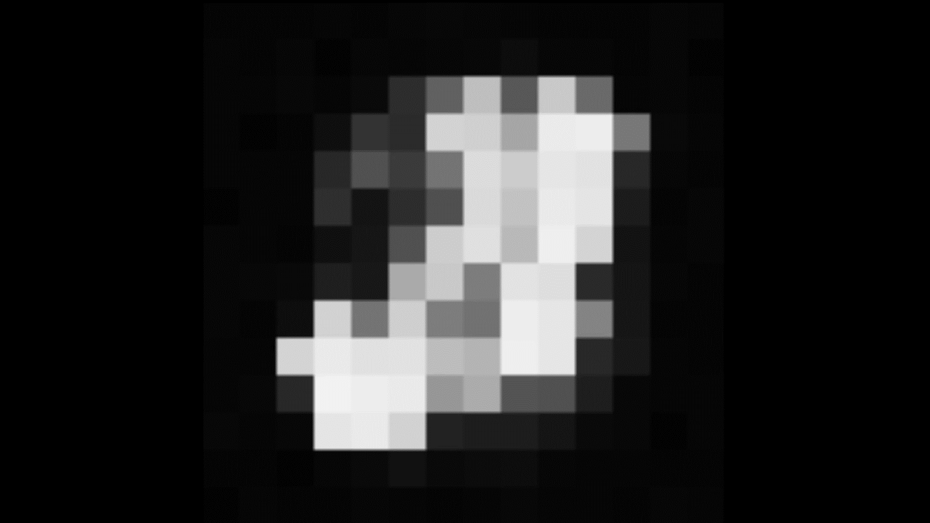
Results

Slide 10
Conclusion
Output generated with this technique using a simple autoencoder’s decoder does not produce GAN-quality results, but this technique is adaptable to any latent space decoder.
Since the latent space appears to be the limiting factor, using the decoder from a generator or VAE may result in better generations using this technique.

