Slide 1
Characterizing the Transcriptomic Recurrence Signature of Glioblastoma Following Laser Interstitial Thermal Therapy
Gregory J. Schwing, MD, PhD¹ · Tavarekere N. Nagaraja, PhD²
Indrani Datta, DHI² · Ian Y. Lee, MD²
¹ Department of General Surgery, Detroit Medical Center and Wayne State University, Detroit, MI
² Department of Neurosurgery, Hermelin Brain Tumor Center, Henry Ford Health, Detroit, MI
CNS 2026 Annual Meeting, Washington, DC
Presentation SSTU02 (Abstract 418) · Sunrise Science Session, Tumor 2
Monday 2 November 2026, 7:00–7:06 AM
Room 147B, Walter E. Washington Convention Center
Notes:
0:00–0:10 Title. Name, institutions, a rat model of MRI-guided LITT. Do not read the title.
Disclosures, read aloud (CNS displays the list; no disclosure slide per the ACCME speaker guidelines): I.Y.L. has consulting agreements with Medtronic, Inc. (Minneapolis, MN) and Monteris Medical, Inc. (Plymouth, MN). All other authors declare no conflicts of interest. Supported by a Henry Ford Health Physician Scientist Award A20050 (I.Y.L.). No commercial support was received for this analysis. Drug candidates discussed here are computational predictions. None is approved for glioblastoma and none has been tested in this model.
Timing: 14 slides in six minutes, about 25 s each (slide 3, the design, adds 20 s: everything after it runs 10 s later, taken back on slide 5); seven backups follow the acknowledgments (B7, the rat host, is preliminary). If running long, shorten slide 5 (PCA and volcano) to one sentence.

Slide 2
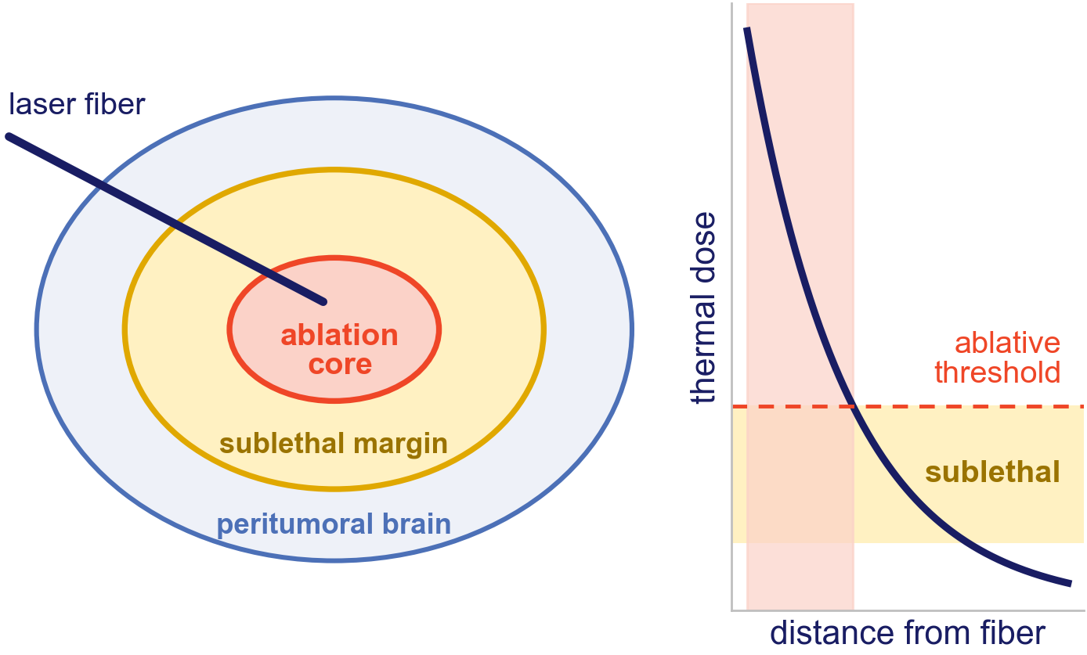
LITT kills the core; glioblastoma returns from the margin
LITT is increasingly used for deep and recurrent glioblastoma.¹
Past the ablative threshold lies a sublethal margin.
Recurrence is thought to grow from the cells that survive there.
Does the tumor that regrows after LITT carry its own program, and does that program point to a drug?
1. Chen C, et al. J Neurooncol 2021;151:429–442. Diagram: thermal dose falls with distance from the fiber; schematic, not to scale.
Notes:
0:10–0:35 The one idea: LITT kills the core, but the cells that come back sat in the sublethal margin. A first-pass analysis of these libraries (Nagaraja 2026, next slide) found cell-cycle, motility and inflammatory genes up in recurrence. What is new here: the reads are sorted from the host, read gene-set-wide, stress-tested, and taken to a drug. End on the question.

Slide 3
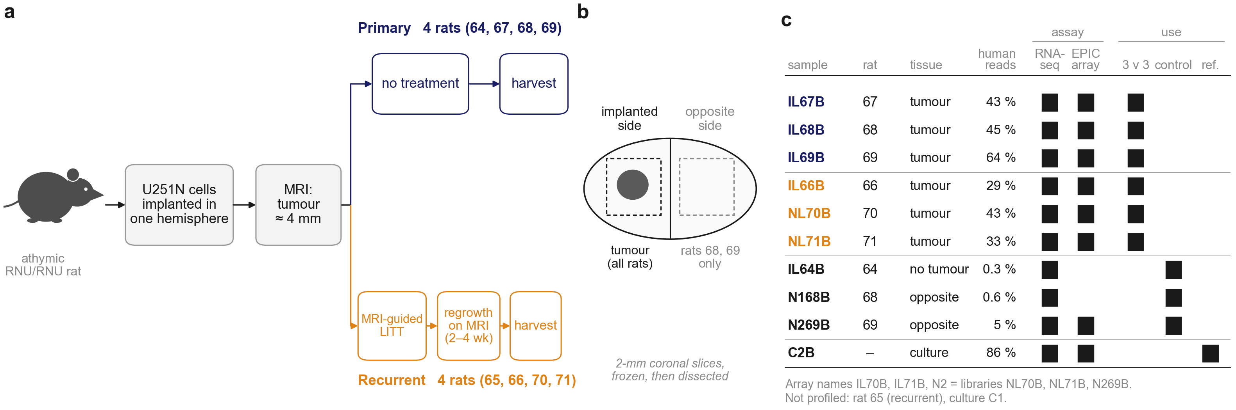
The design: eight rats, RNA and methylation
Three primaries (rats 67, 68, 69) are compared with three recurrences (66, 70, 71). Rat 64's sample held almost no tumor and rat 65 has no library.
The two brain controls are the opposite hemispheres of rats 68 and 69, not separate animals.
Eight samples were also run on one EPIC methylation array: the six tumors, rat 69's opposite hemisphere and the culture.
Nagaraja lab sample key (2023) and methylation-array sample sheet. The sequencing files call rats 70 and 71 NL70B and NL71B; the lab records call them IL-70 and IL-71.
Notes:
0:35–0:55 The design, because it is easy to misread. Eight rats, all implanted. Four primaries, never ablated; four ablated with LITT and allowed to regrow. We compare three against three: rat 64's primary sample had almost no tumor in it, and there is no library for rat 65. The two brain controls come from the other side of the brain of two primary rats, 68 and 69, so they are not independent animals. The culture is a reference only.
Why 3 v 3 when Nagaraja 2026 reports 4 v 4: rat 64 (no tumor in the sample) and rat 65 (no library). Harvest time after LITT (2 or 4 weeks) for each recurrence is not in the records we have.

Slide 4
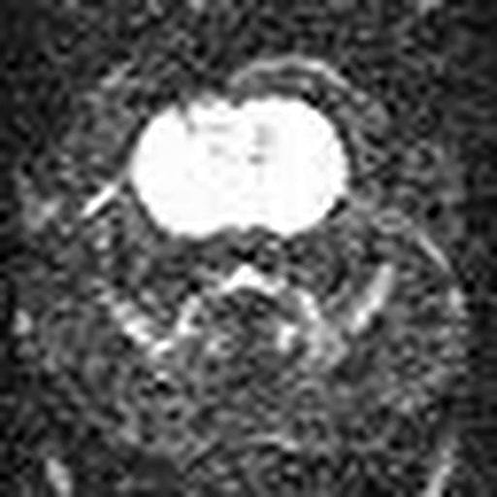
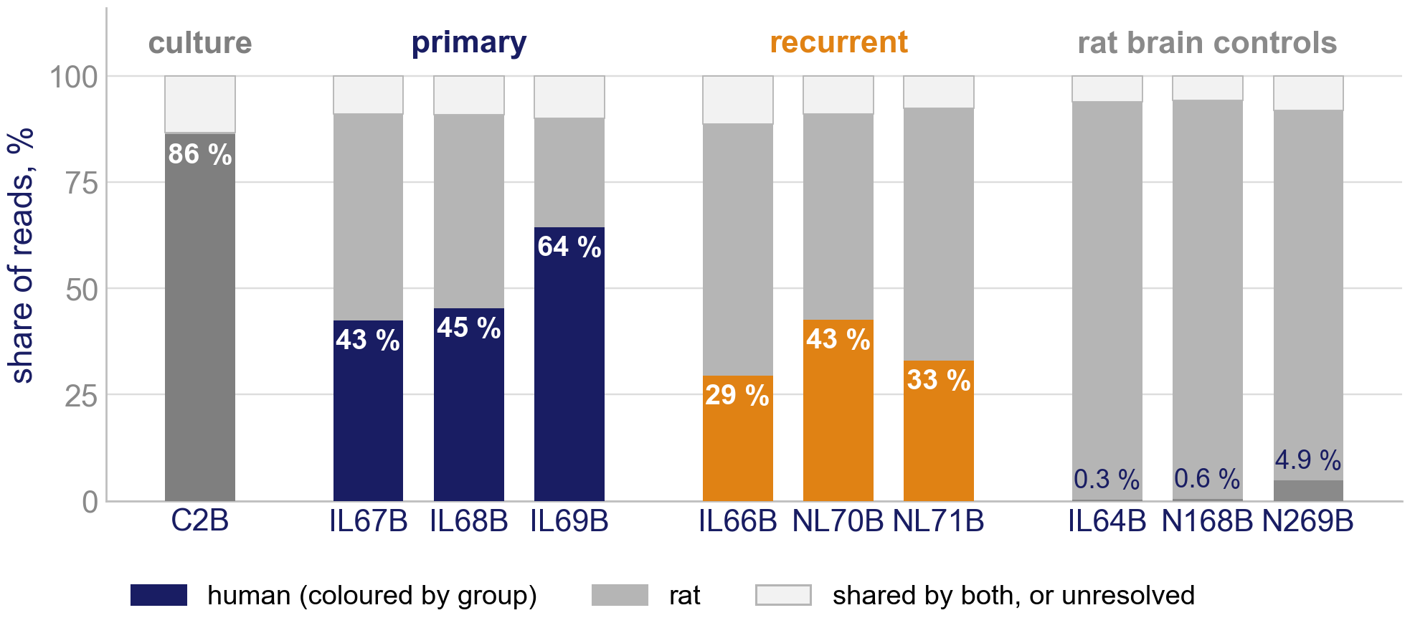
A human tumor in a rat brain, so the tumor can be read on its own
MRI-guided LITT in this model, diffusion-weighted MRI (from Nagaraja 2021²); click to play.
Reads sorted by species³: 89–92 % go to one species, 7–10 % are shared by both and kept with the human reads, under 2.1 % are unresolved.
Recurrent tumors are less human on average (35 % against 51 %; ranges overlap): a confound, tested on slide 8.
2. Nagaraja TN, et al. Acta Neurochir 2021;163:3455–3463. 3. Zentgraf J, Rahmann S. Algorithms Mol Biol 2021;16:2. 4. Nagaraja TN, et al. J Neurosurg 2026;145:364–377. Orthotopic U251N glioblastoma xenograft in the athymic rat, MRI-guided LITT; bulk RNA-seq of primary and recurrent tumors, n = 3 per arm; GEO GSE338105.
Notes:
0:55–1:10 The model the Henry Ford group built (Nagaraja 2026): U251N in the athymic rat, MRI-guided LITT (design on the previous slide). The graft is human and the host is rat, so xengsort sorts every read by species before anything is counted; human reads plus the shared reads enter the analysis.
If asked why three per arm when Nagaraja 2026 describes four and four: the libraries come from animals numbered 64 to 71; IL64B's sample holds almost no tumor (it is used only as a control) and there is no library for animal 65 (a recurrence in the lab's key).
Numbers to reconcile before the talk: the J Neurosurg paper reports four per arm for RNA-seq; this analysis has three per arm plus IL64B, recorded by the lab as a primary but with almost no tumor in its sample (0.3 % human reads), used as a control. The lab's sample key lists IL-65 as the fourth recurrence; no library for it exists in the data.
The two other controls are the contralateral hemispheres of tumor-bearing rats 68 and 69 (lab key: 'Contralateral'; array sheet: '69B control N2'), not separate animals. N269B, from rat 69, the most tumor-rich animal, carries human Y-linked reads, so it holds some tumor cells.

Slide 5
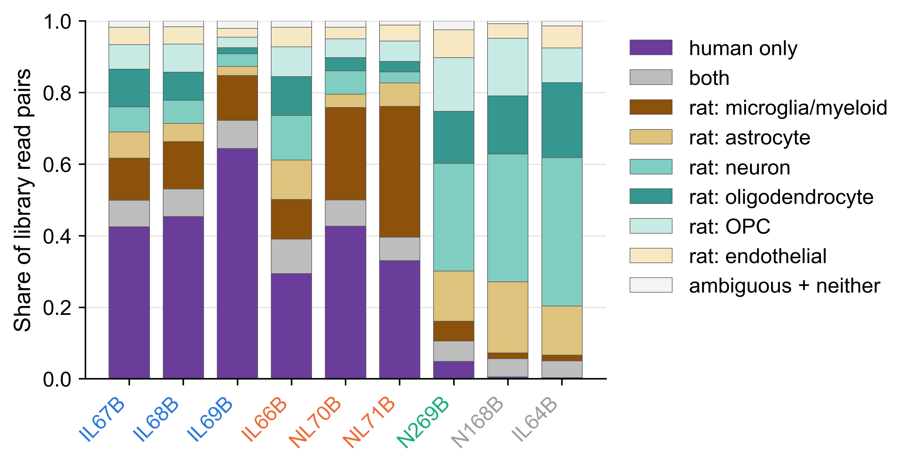
What each lesion is actually made of
Each library as tumor share plus the host cell types the rat reads name, scaled to the whole library.
Three published methods agree on rank for all six cell types; the athymic control rejects any method that finds T cells.
BRETIGEA, NeuroExpresso marker-gene profiles and CIBERSORT with a brain signature, on the rat read stream. Orthotopic U251N glioblastoma xenograft in the athymic rat, MRI-guided LITT; bulk RNA-seq of primary and recurrent tumors, n = 3 per arm; GEO GSE338105.
Notes:
PROMOTED from backup in v6. 15 s. The point: 'less tumor' is not an abstraction - here is what fills the rest of the lesion, and in the two NL recurrences it is mostly myeloid cells.

Slide 6
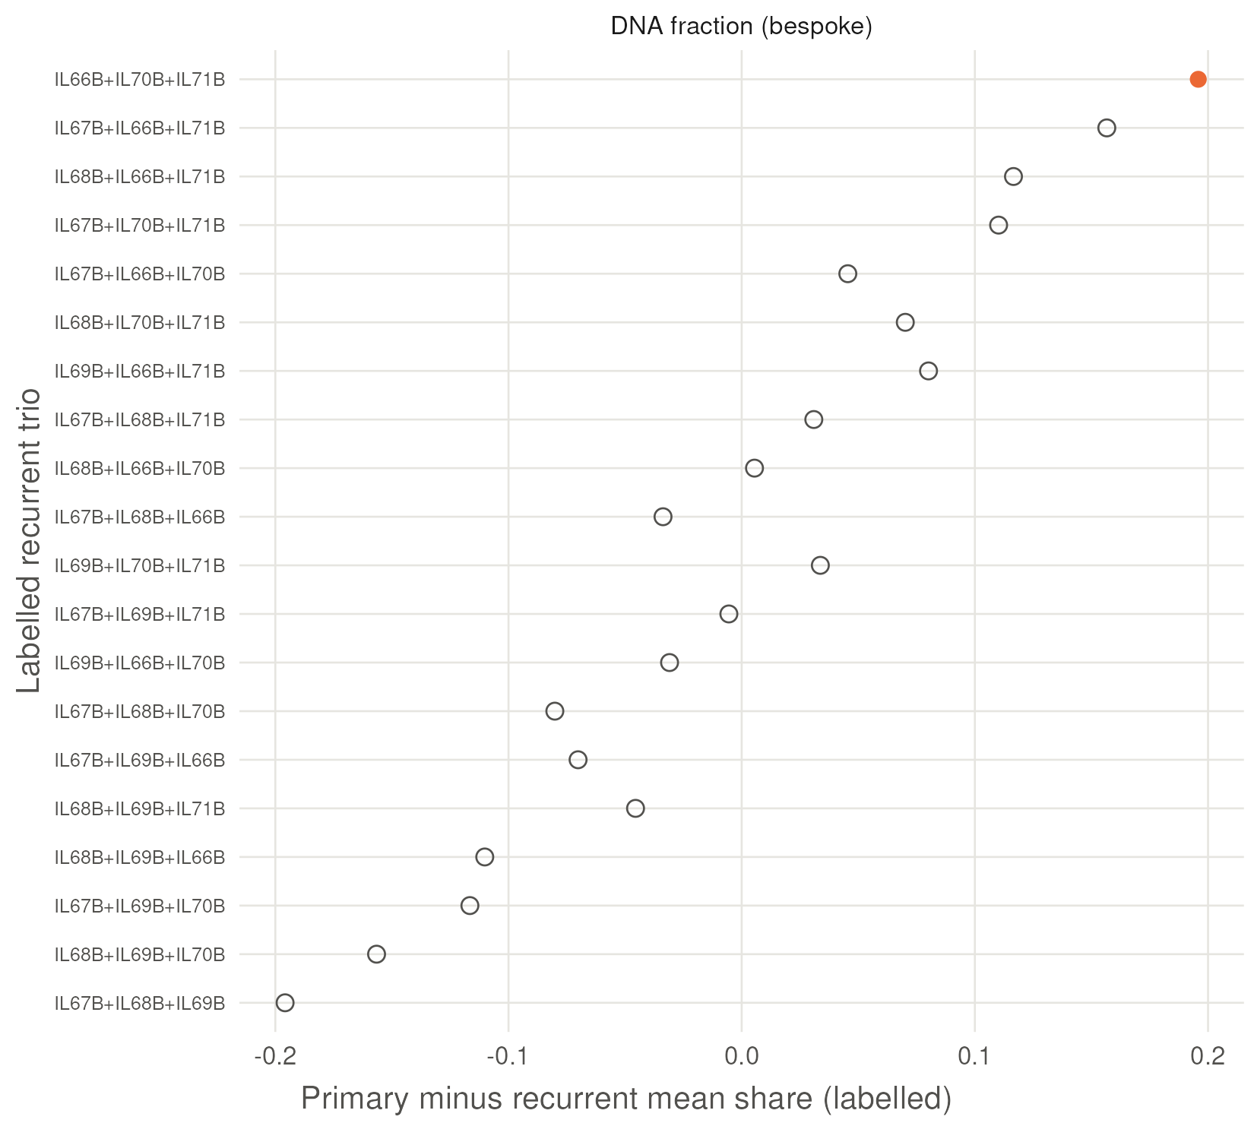
Recurrent lesions hold less tumor - on both platforms
DNA: recurrent minus primary -0.20 (90 % -0.34 to -0.06), the true labelling first of twenty - p = 0.05, the floor of a three-against-three design.
RNA agrees and ranks second of twenty. Every DNA fraction here is uncalibrated.
Twenty balanced three-against-three labellings of the six tumors; the true labelling is filled. Orthotopic U251N glioblastoma xenograft in the athymic rat, MRI-guided LITT; bulk RNA-seq of primary and recurrent tumors, n = 3 per arm; GEO GSE338105.
Notes:
PROMOTED in v6. 20 s. Say: whatever else differs, the recurrent lesions have less tumor in them, and that is the confound the next three slides deal with. The twenty-labelling floor means p = 0.05 is the smallest number this design can produce - quote it as a floor, never as significance.

Slide 7
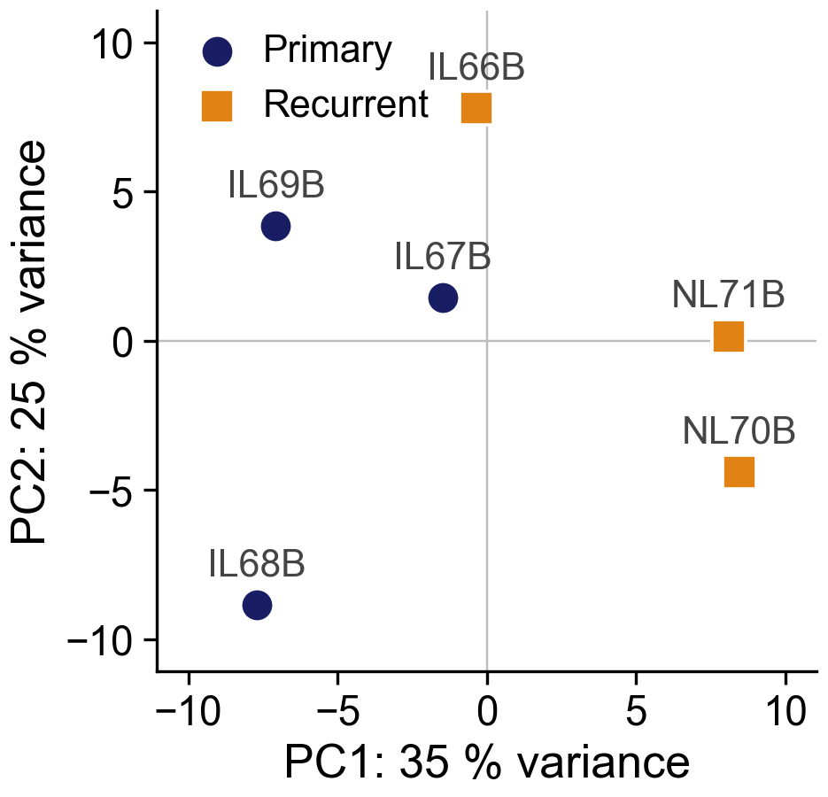
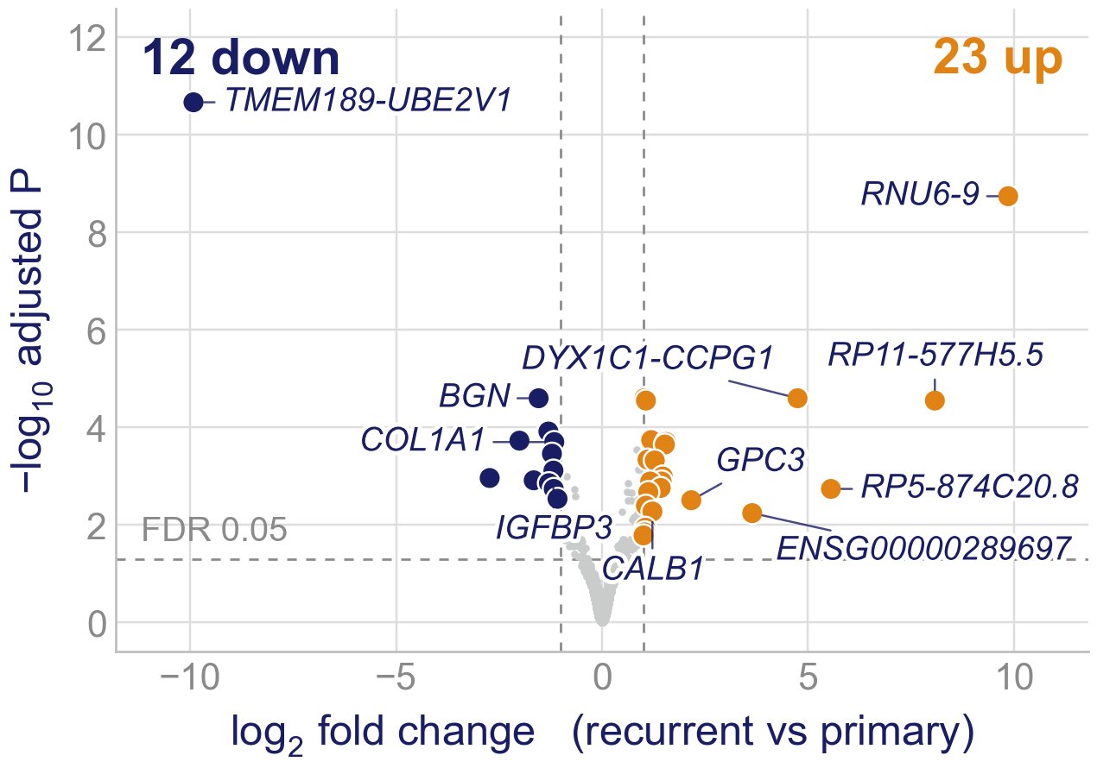
The arms separate modestly, and few single genes move
The recurrent tumors lie to the right on PC1, IL66B only just; clustering does not separate the arms (backup B5). DESeq2⁵: 35 genes at FDR < 0.05 and two-fold. So we read whole programs.
5. Love MI, et al. Genome Biol 2014;15:550. PCA of the 500 most variable rlog genes (DESeq2 plotPCA); PERMANOVA on all genes R² 0.28, p = 0.10, the smallest 3 v 3 allows; Wald test with ashr shrinkage. Orthotopic U251N glioblastoma xenograft in the athymic rat, MRI-guided LITT; bulk RNA-seq of primary and recurrent tumors, n = 3 per arm; GEO GSE338105.
Notes:
Printed abstract: PC1 41.8 % / PC2 26.2 % came from the May figure script (vst); this plot uses rlog (35 % / 25 %). PERMANOVA R2 0.278 and 35 genes (23 up, 12 down) are unchanged; the abstract omits p = 0.10. Its hubs (BGN, COL1A1, IGFBP3, CALB1): only 11 of the 35 genes connect, and CALB1 has one interaction (SLIDES/ABSTRACT_VS_TALK.md).
1:00–1:25 Global structure in one breath. PC1 carries 35 % of the variance in the 500 genes; the recurrent tumors sit to the right, the closest (IL66B) 1.1 units past the nearest primary on a 16-unit axis. PC1 also splits the NL animals from the IL animals (R² 0.83 against 0.71 for arm): find out what the prefix denotes before the talk. With three per arm, ten splits exist, so PERMANOVA cannot go below 0.10. Only 35 genes pass, mostly readthrough and non-coding loci, most of them zero in one arm.

Slide 8
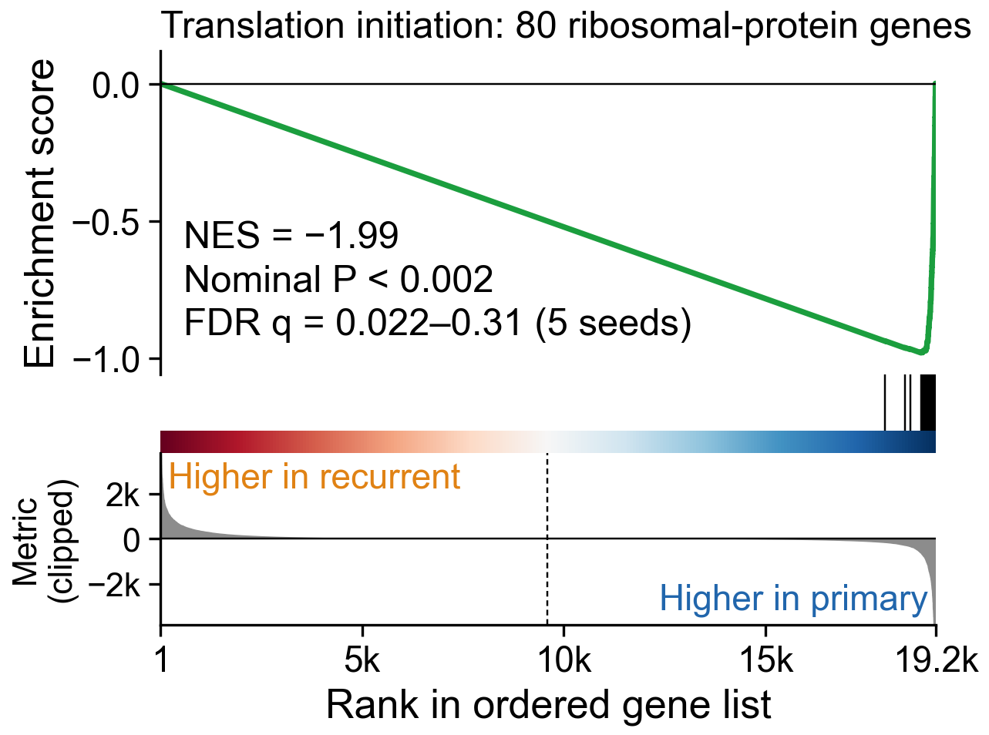
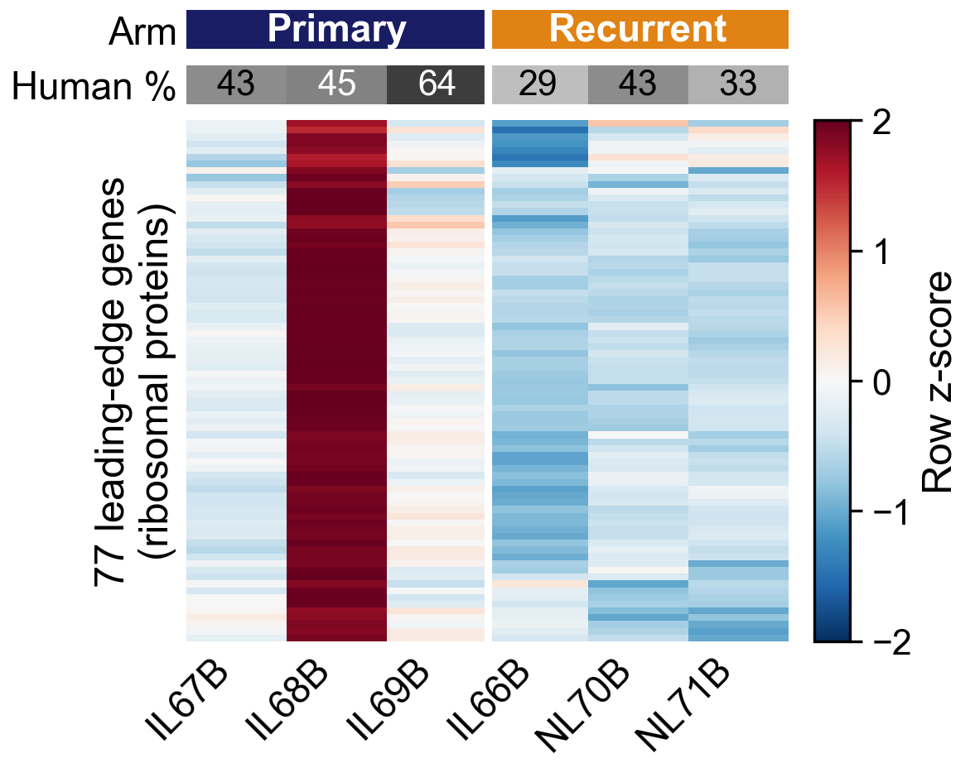
After LITT, the regrown tumor turns its ribosomal-protein genes down
Of 8,869 gene sets⁶, six reach q < 0.25, all down in recurrence and all built on the same 76 ribosomal-protein genes; only this set is below 0.05 (q = 0.022). No up-regulated set gets below q = 0.61.
The heatmap shows the catch: one primary, IL68B, is the highest of the six on all 77 leading-edge genes.
6. Subramanian A, et al. Proc Natl Acad Sci USA 2005;102:15545–15550. Broad GSEA, gene-set permutation; metric Diff_of_Classes on normalised counts (lower panel clipped at the 99.5th percentile); leading edge = core-enrichment genes, rlog row z-scores; n = 3 per arm.
Notes:
Printed abstract: elongation NES -3.17, FDR 1.6e-26 came from a first-pass gene-permutation test (clusterProfiler/fgsea, 25 May report). The pipeline's Broad GSEA (gene-set permutation) gives the same direction, NES near -2, and one set at q = 0.022. Its 'integrated stress' sets are the same ribosomal-protein genes (85 of 99 in GCN2). If asked: 'the abstract's FDR came from a first-pass test that treats genes as independent; the permutation test gives the same direction'.
1:25–2:05 The core result. Say 'ribosomal-protein genes', not 'translation initiation': the KEGG MEDICUS set of that name is 80 of 80 cytosolic ribosomal-protein genes (RPL, RPS, FAU, UBA52) with no initiation factor; the other five sets are the same block counted again (their leading edges share 76 genes, union 86);. Whether translation itself falls is the puromycin / polysome experiment on slide 13.
Left, the standard GSEA plot: genes ranked from higher in recurrent (left) to higher in primary (right); the 80 genes are the ticks, NES −1.99. The ranking is a difference of means on counts, which weights abundant genes; on a log-scale ranking all 80 are still in the lower half and 74 % in the last 6.6 %, so the direction does not depend on the metric.
Right, the leading edge per tumor. Say it plainly: IL68B is high on every gene, the other two primaries sit near the middle, and the three recurrences sit below them on average. The direction is shared; the size leans on one tumor. Next slide asks whether it survives without it.

Slide 9
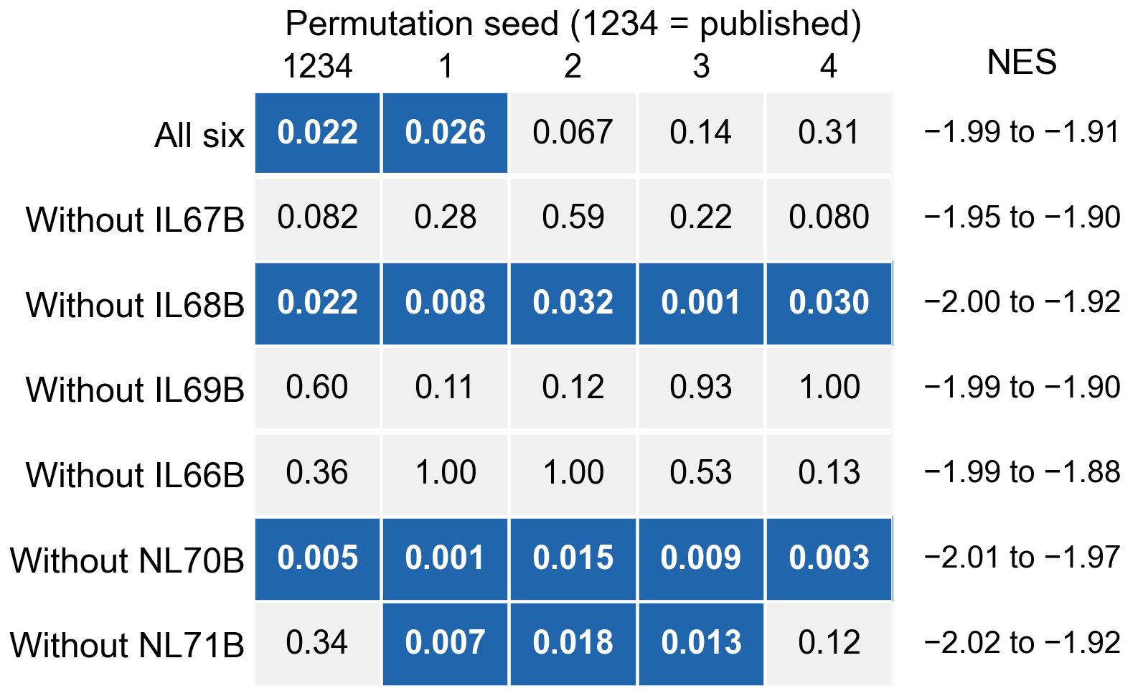
Leave any tumor out: the direction holds, the FDR does not
The published GSEA re-run 35 times: each tumor left out, five permutation seeds.
Every run: NES −1.88 to −2.02, nominal p < 0.002.
FDR q < 0.05 in 15 of 35; with all six it moves with the seed alone (0.022–0.31).
Dropping IL68B keeps q < 0.05 at every seed: it carries the size of the fall, not its direction.
ANALYSIS/gsea_leave_one_out: the published command, gene filter re-applied after each drop; seed 1234 reproduces the published report exactly; blue cells q < 0.05; NES range over the five seeds.
Notes:
Printed abstract: its FDR is not a Broad GSEA q; here q runs 0.022-0.31 with all six tumors, depending on the seed alone.
2:05–2:35 Robustness, stated honestly. The direction (NES) never moves. FDR is fragile: with gene-set permutation and six tumors, q depends on the random seed. With the filter re-applied, q never clears 0.05 without IL67B, IL69B or IL66B, and always does without IL68B or NL70B. Six further runs skip the re-filtering (seed 1234): q < 0.05 in 4 of 6, including without IL66B (q = 0.029). Without IL68B the set is no longer the top-ranked one; a stromal set leads.

Slide 10
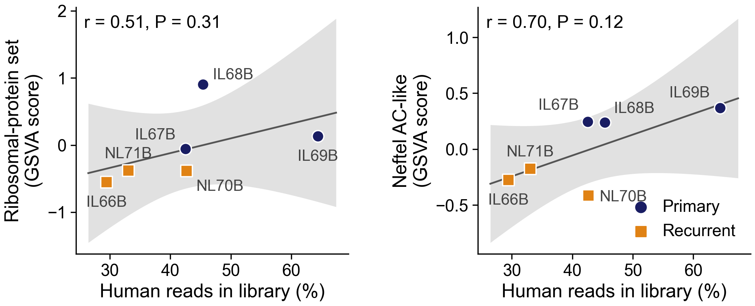
Recurrence after LITT, or less tumor in the sample?
Both scores rise with the human share (r = 0.51 and 0.70; P = 0.31, 0.12), and arm and share are correlated (r = −0.70): six tumors cannot fully separate the two.
IL67B and NL70B have the same share (42.5 and 42.7 %) yet differ on the astrocyte-like score (+0.25 against −0.42). Rat reads could shift the ribosomal-protein genes by about 0.01 log2; they fall 0.40.
GSVA on DESeq2 variance-stabilised counts; OLS fit with 95 % confidence band; human share from xengsort; contamination bound: every shared read treated as rat. Orthotopic U251N glioblastoma xenograft in the athymic rat, MRI-guided LITT; bulk RNA-seq of primary and recurrent tumors, n = 3 per arm; GEO GSE338105.
Notes:
2:35–3:10 The confound, head on. Adjusting for human share leaves the ribosomal-protein score's arm difference at p = 0.18 (from 0.06); the gene-level estimate does not shrink (−0.40 to −0.57 log2), though at n = 6 the adjusted estimate is unstable (it leans on IL69B; without IL68B it reverses).
The matched pair: IL67B (primary) and NL70B (recurrent) are both 43 % human. On the astrocyte-like score they differ by 0.66, far beyond the spread within either arm. On the ribosomal-protein score the gap (−0.33) is within the spread among the primaries, so the pair says nothing there. One pair, not a test.
Contamination: counting every shared read as rat, with the two tumor-free controls, gives +0.001; with N269B (the contralateral hemisphere of rat 69, which holds tumor cells) -0.009, so under 0.01 log2 either way. A second estimate from the controls' shared-read ratio puts the worst case near 0.05 (ANALYSIS/human_cohorts/PLAN.md), an eighth of the fall. Backup B1.

Slide 11
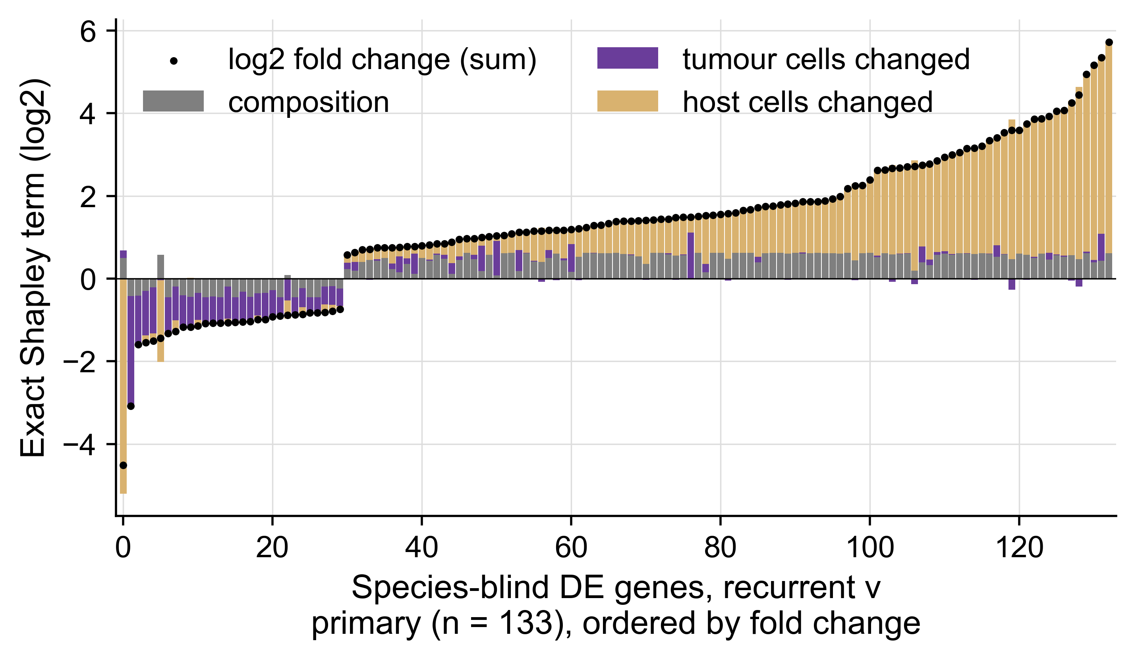
How much of the difference is simply less tumor?
A human graft in a rat host: every read is assigned by species, so each gene's fold change splits exactly into composition, tumor-cell and host-cell terms.²¹
Composition is the largest single term and still under half: 0.47 (0.45-0.47 across four sensitivities).
Of the 133 genes a species-blind analysis calls differential, 13 % are composition-dominant.
21. Shen-Orr SS, et al. Nat Methods 2010;7:287-289. Per-sample mixing identity, then Shapley attribution; the three terms sum to the fold change to 1e-15. Ensembl Compara one-to-one orthologs. Orthotopic U251N glioblastoma xenograft in the athymic rat, MRI-guided LITT; bulk RNA-seq of primary and recurrent tumors, n = 3 per arm; GEO GSE338105.
Notes:
NEW in v5, kept in v6 as the centre of the talk. 28 s.
The idea in one breath: in a xenograft the mixture is measured, not estimated, so 'recurrence or less tumor?' has an exact answer per gene. The pre-registered threshold was 0.50 and it FAILED: composition is the biggest single term and still under half, and the genes a bulk analysis picks out are disproportionately the ones where cells actually changed.
If asked how it behaves: across the ten balanced splits the composition share rises with the split's difference in tumor content (Spearman 0.85) and the true split is highest of the ten. Noise at n = 3 inflates the two cell-change terms, so 0.47 is conservative.

Slide 12
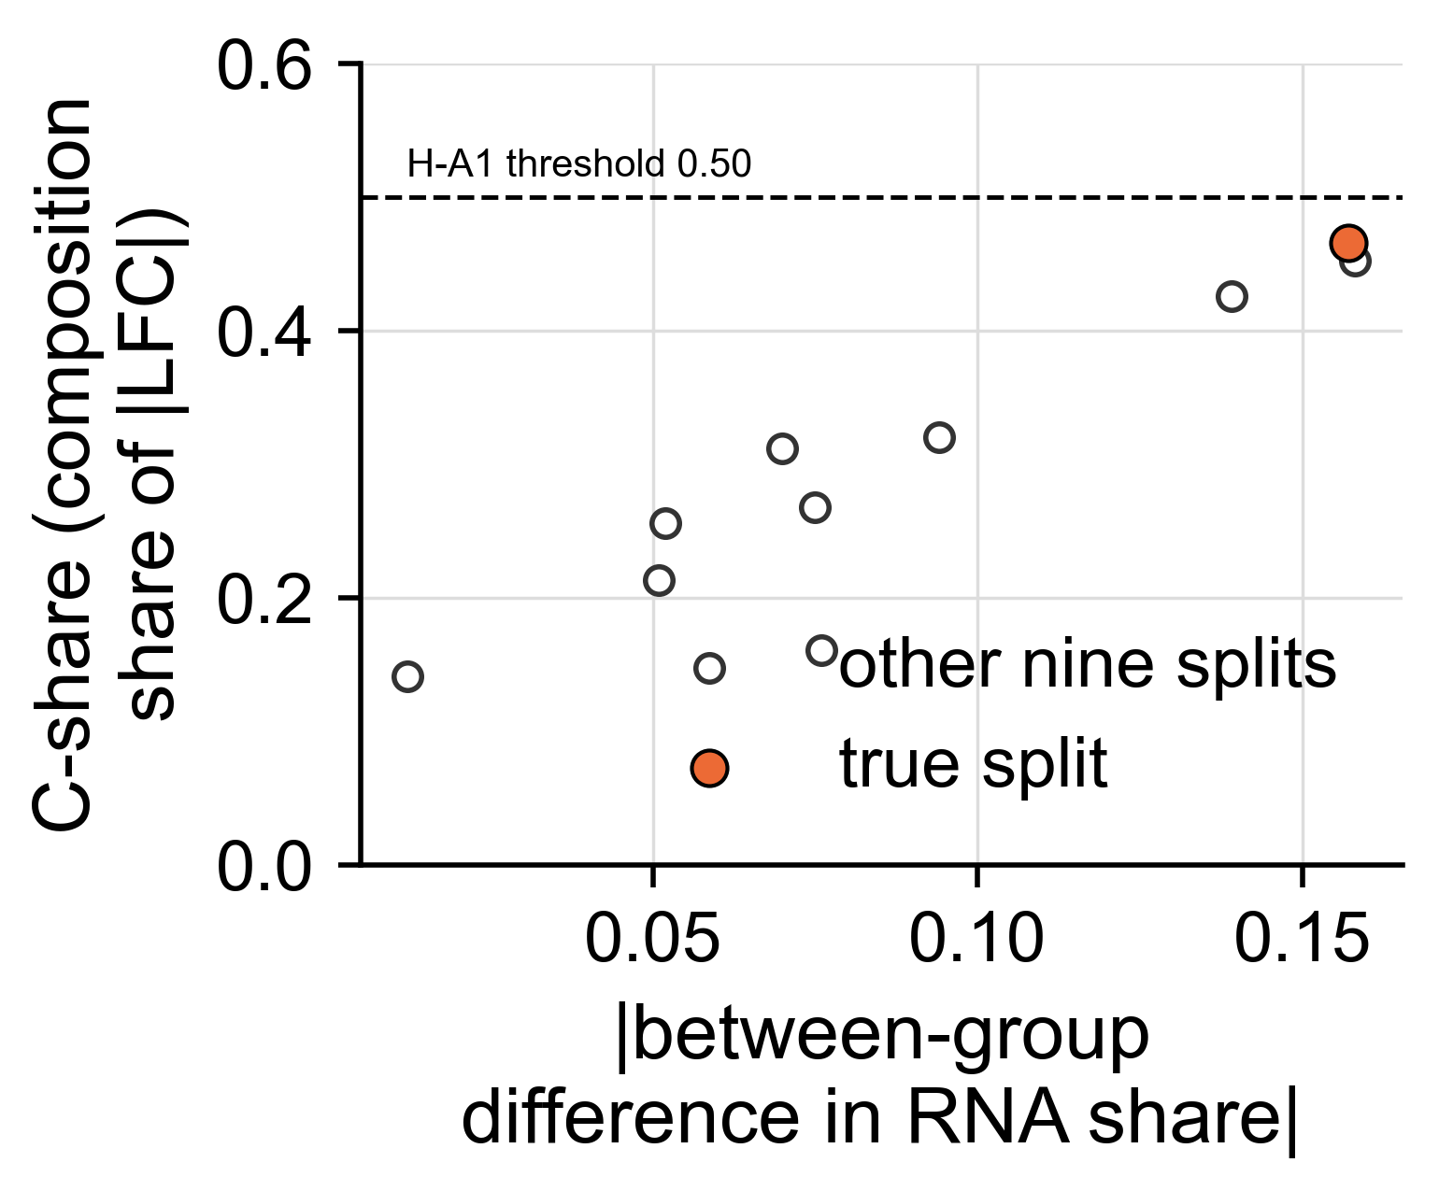
The composition term behaves as a real term should
Across all ten balanced splits of the six tumors, the composition share rises with the split's difference in tumor content (Spearman 0.85).
The true split is the highest of the ten, and sits inside the band predicted from the other nine.
Ten balanced three-against-three splits; the true split is orange. Orthotopic U251N glioblastoma xenograft in the athymic rat, MRI-guided LITT; bulk RNA-seq of primary and recurrent tumors, n = 3 per arm; GEO GSE338105.
Notes:
PROMOTED in v6. 15 s. This is the check that the composition term is not an artefact of the method: it tracks the thing it claims to measure.

Slide 13
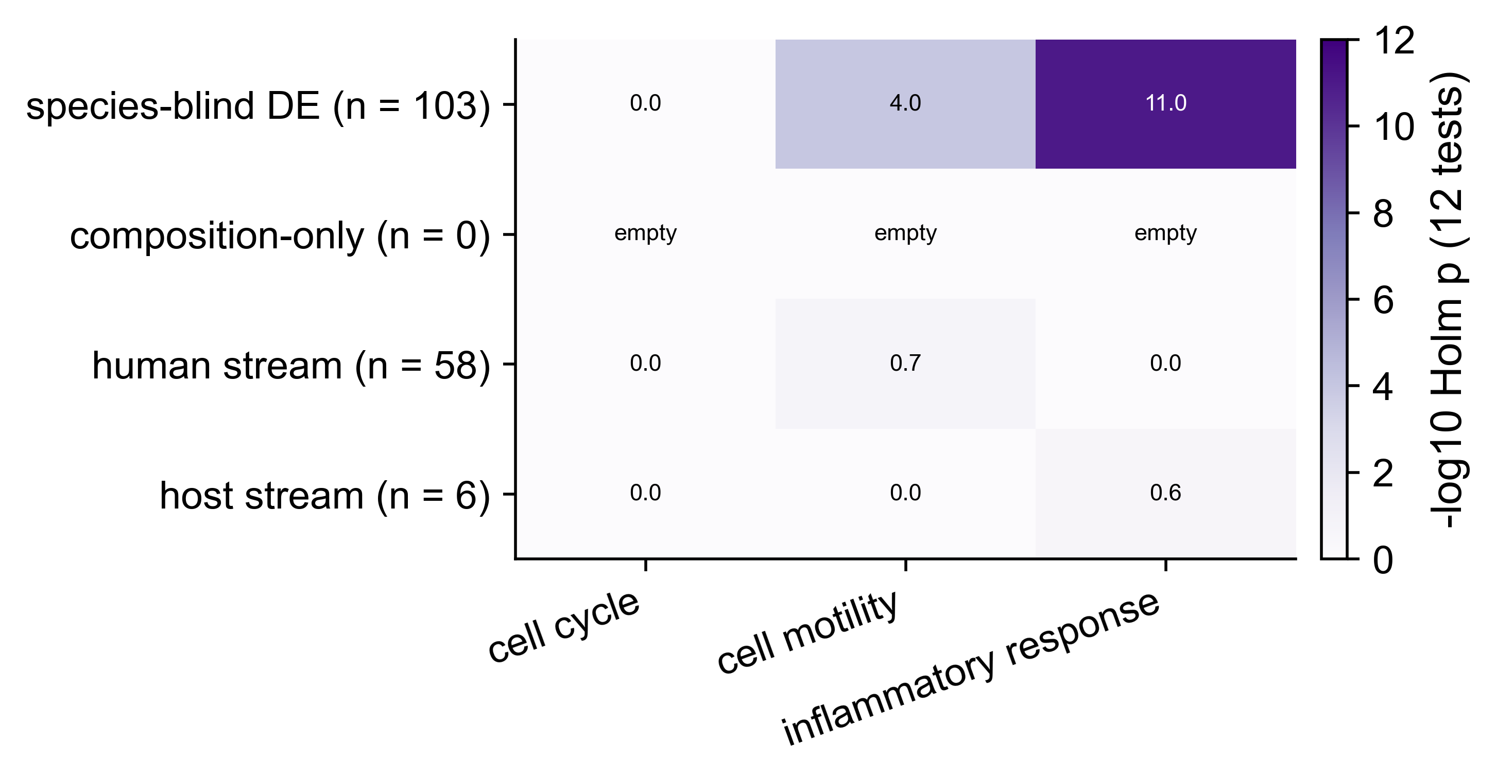
Motility and inflammation live in the bulk view only
Cell motility and inflammatory response are enriched among the genes up in the species-blind (bulk) reading - the categories reported for this model.
Neither appears in the tumor cells' own reading. Cell cycle appears in no view.
g:Profiler on three fixed GO terms, Holm across three categories by four views. Orthotopic U251N glioblastoma xenograft in the athymic rat, MRI-guided LITT; bulk RNA-seq of primary and recurrent tumors, n = 3 per arm; GEO GSE338105.
Notes:
PROMOTED in v6. 18 s. A neurosurgeon's version: the programs people report for recurrent tumors are, here, in the mixture rather than in the tumor cells.

Slide 14
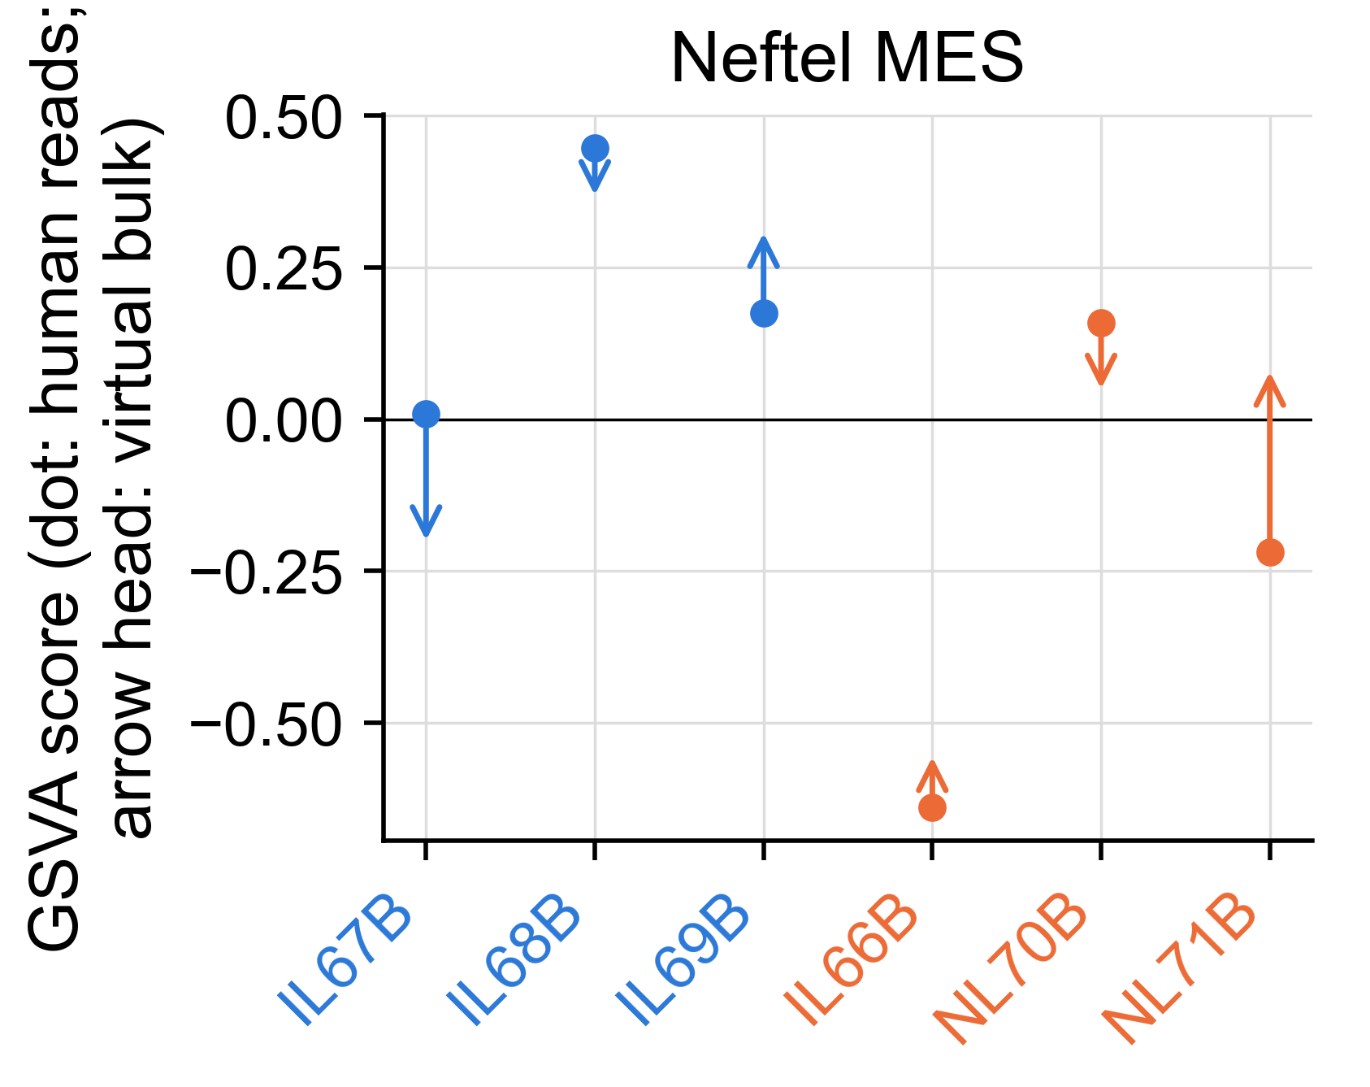
Where the mesenchymal shift at recurrence comes from
In the tumor cells alone the mesenchymal score FALLS at recurrence⁷ - below every one of 1,000 draws of a dilution null.
The rat-only score tracks myeloid content (Spearman 0.66), so the bulk mesenchymal signal here is host tissue.²²
7. Neftel C, et al. Cell 2019;178:835-849. 22. Spitzer A, et al. Nat Genet 2025;57:1168-1178. GSVA on TMM log-CPM; dot, human reads; arrow head, the same sample read as bulk. Orthotopic U251N glioblastoma xenograft in the athymic rat, MRI-guided LITT; bulk RNA-seq of primary and recurrent tumors, n = 3 per arm; GEO GSE338105.
Notes:
NEW in v5, kept in v6. 22 s. 'Mesenchymal shift at recurrence' is the most repeated statement about recurrent glioblastoma; where tumor and host can be told apart exactly, the shift is in the host compartment and the tumor cells move the other way. The composition-generated shift itself ranks 5 of 20, so we say 'not shown', not 'absent'.

Slide 15
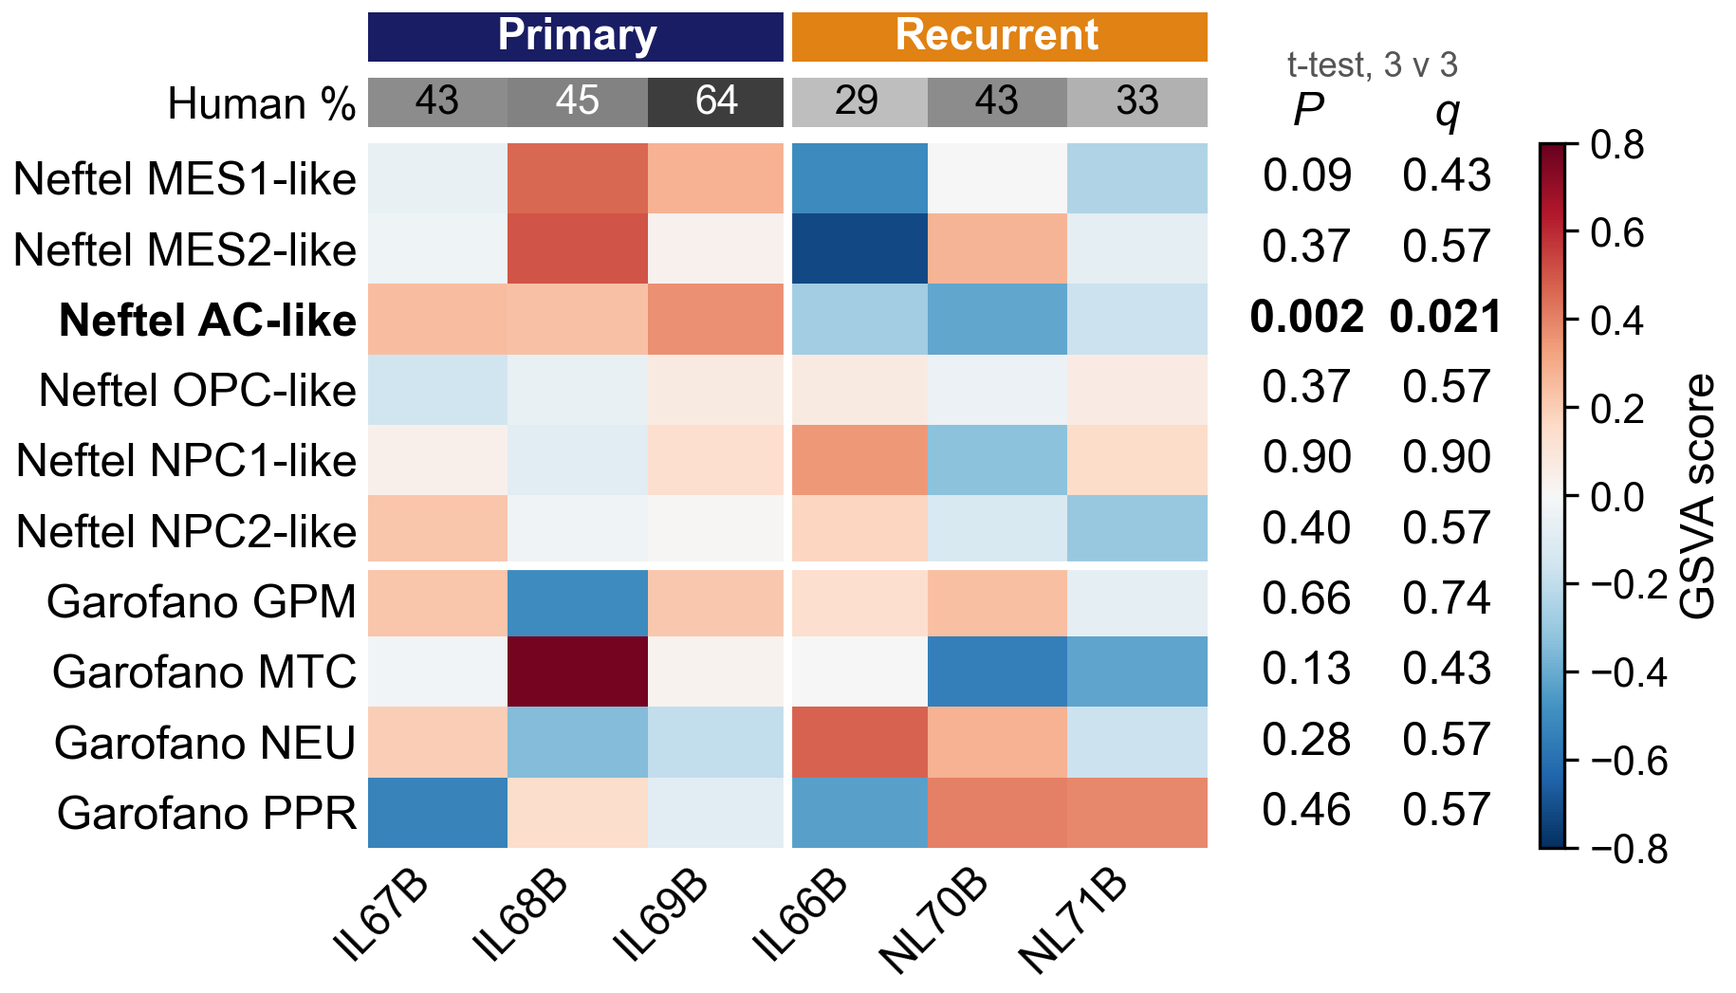
Of ten published subtype signatures, only the astrocyte-like score separates the arms
Neftel⁷ and Garofano⁸ signatures, scored per tumor by GSVA⁹.
AC-like: +0.28 → −0.29, every recurrent below every primary (t-test P = 0.002, q = 0.021; exact floor 0.10); direction kept after adjusting for human share.
MES1 is lower in recurrence (P = 0.09) but tracks human share as closely (r = 0.77, P = 0.08).
CIBERSORT¹⁰ with the Neftel reference fits these cells poorly (r 0.19–0.26; backup B3).
7. Neftel C, et al. Cell 2019;178:835–849. 8. Garofano L, et al. Nat Cancer 2021;2:141–156. 9. Hänzelmann S, et al. BMC Bioinformatics 2013;14:7. 10. Newman AM, et al. Nat Methods 2015;12:453–457. GSVA on variance-stabilised counts; two-sample t per signature, Benjamini–Hochberg across the ten. Orthotopic U251N glioblastoma xenograft in the athymic rat, MRI-guided LITT; bulk RNA-seq of primary and recurrent tumors, n = 3 per arm; GEO GSE338105.
Notes:
Printed abstract: 'toward Garofano mitochondrial, away from AC/NPC' came from May mean z-scores of hand-picked 5-6-gene lists (mitochondrial = CS, ACO2, IDH2, IDH3A, OGDH, SDHA), not GSVA. With the published signatures the mitochondrial score falls (not significant); AC-like agrees; NPC does not move. If asked: 'the mitochondrial shift did not survive the published signatures; the astrocyte-like fall did'.
3:10–3:40 One state transition: the astrocyte-like program score falls, and every recurrent tumor is below every primary. Call it the strongest group difference and exploratory: 3 v 3 cannot give an exact permutation p below 0.10.
Adjusted for human share, P = 0.024 on these counts; across other normalised inputs 0.024 to 0.12, and the adjustment leans on IL69B (graft_relation/SUMMARY.md). The manuscript's run scored TPM (p = 0.007, q = 0.075); 7SK/7SL/Y RNA and rRNA take 40 to 65 % of TPM and the share varies by library, which variance-stabilised counts remove.
CIBERSORT puts AC slightly higher in recurrence (0.22 to 0.27), the opposite direction; at this fit neither is a composition.
Whole pipeline without IL68B or IL66B (TPM run, from 0.007 with all six): AC p = 0.044 and 0.066 (backup B2).

Slide 16
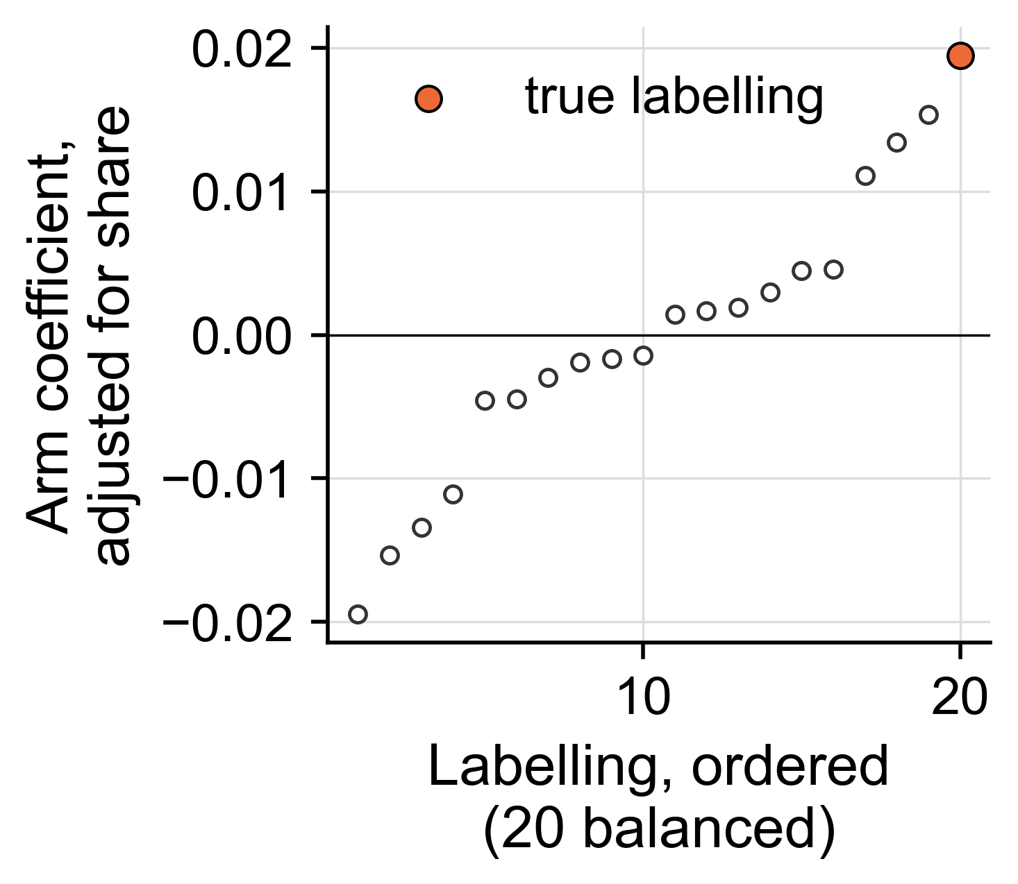
One tumor-cell program survives the adjustment
A published distal-invasion program scores higher in the recurrences after adjusting for tumor content: first of twenty labellings (p = 0.05).
One labelling of twenty, in a model where the recurrent arm is also the later-harvested arm. A hypothesis for the next study, not a finding.
Chanoch-Myers 2026 distal-invasion gene sets, frozen by hash; score ~ arm + tumor share, refitted for each of the twenty labellings. Orthotopic U251N glioblastoma xenograft in the athymic rat, MRI-guided LITT; bulk RNA-seq of primary and recurrent tumors, n = 3 per arm; GEO GSE338105.
Notes:
PROMOTED in v6. 18 s. The pre-registration expected this to fail and it did not. Say the ceiling out loud: twenty labellings floor the p at 0.05.

Slide 17
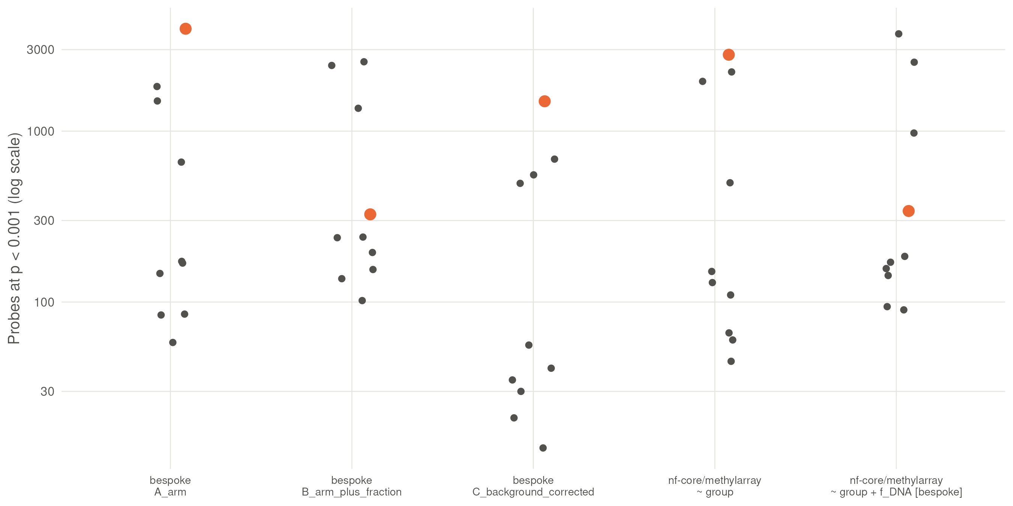
Methylation: nothing survives correction
No probe reaches FDR < 0.05 in any design, on 866,238 probes at three against three.
What differs is tumor content: the true split ranks 1 of 10 without a fraction covariate and 4 of 10 with it - in two independent pipelines and under all 14 published cross-species exclusion lists.
Probes at p < 0.001 for all ten balanced splits, per pipeline and design; the true split is orange. Orthotopic U251N glioblastoma xenograft in the athymic rat, MRI-guided LITT; bulk RNA-seq of primary and recurrent tumors, n = 3 per arm; GEO GSE338105.
Notes:
NEW in v5, kept in v6. 22 s. The pertinent negative: an array on the same six tumors finds nothing that survives multiple testing, and the difference that looks real before correction is the same tumor-content confound as on the RNA side - replicated in a second, independently written pipeline and under every published list of rat-cross-hybridising probes.

Slide 18
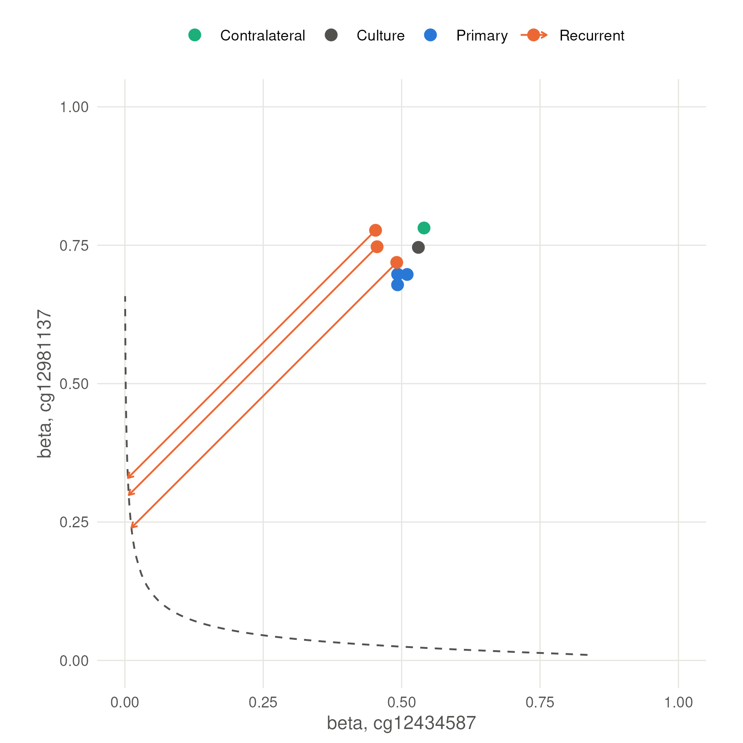
MGMT status does not move
MGMT-STP27²⁶ calls every array methylated (0.995-0.998).
The shift that would change a call is 0.45-0.48 beta; the observed recurrent-minus-primary shifts are -0.03 and +0.06.
No animal received an alkylating agent: this is a stability readout, not a resistance result.
26. Bady P, Delorenzi M, Hegi ME. J Mol Diagn 2016;18:350-361. Dashed line, the model's decision boundary; each arrow is the shift that would change that recurrence's call. Orthotopic U251N glioblastoma xenograft in the athymic rat, MRI-guided LITT; bulk RNA-seq of primary and recurrent tumors, n = 3 per arm; GEO GSE338105.
Notes:
PROMOTED in v6, and the slide this audience will ask about. 15 s.

Slide 19
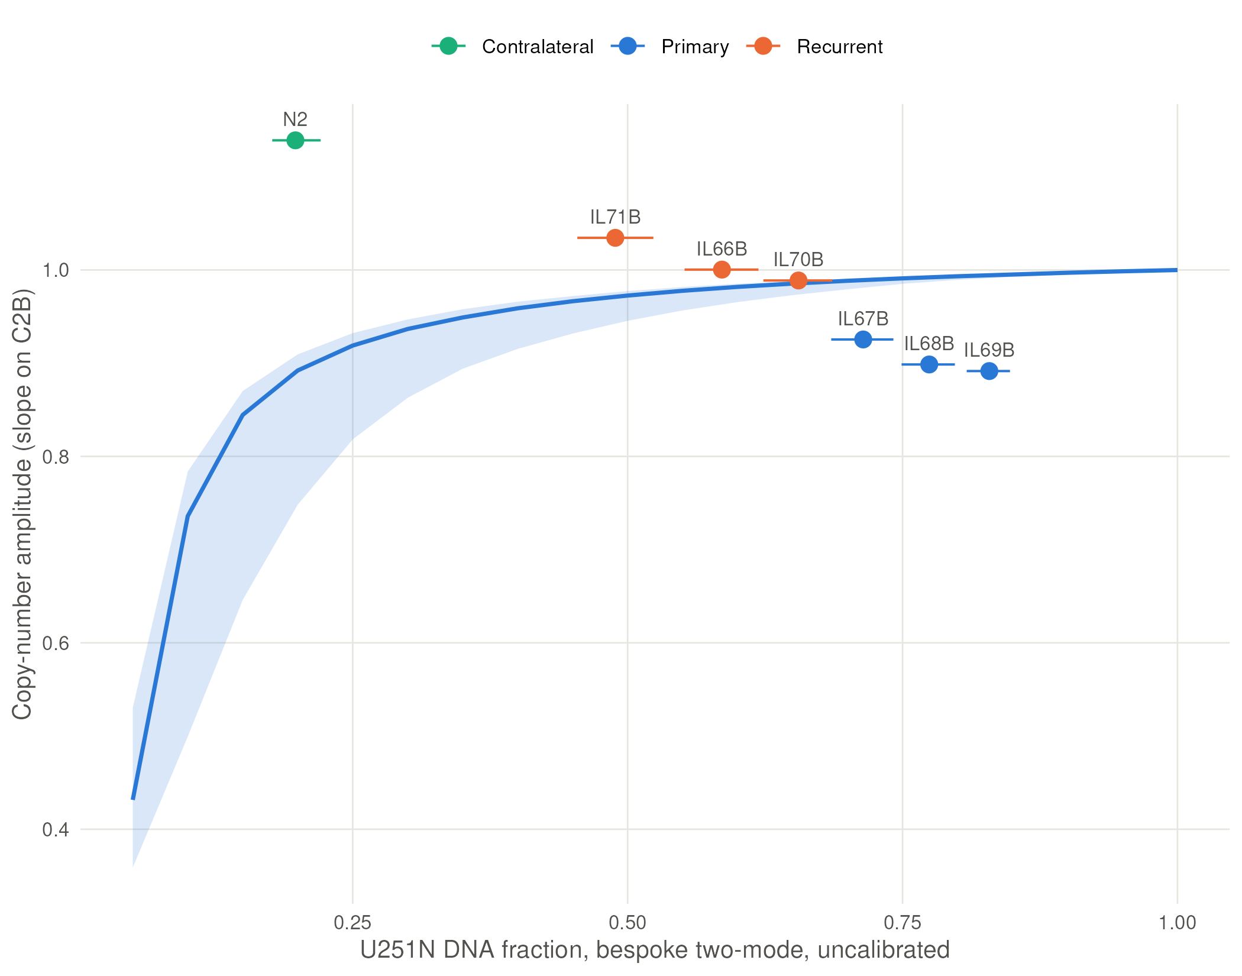
One DNA signal dilution does not explain
Diluting the parental culture in silico with rat DNA barely lowers its copy-number amplitude, so dilution alone does not put the primaries below the curve.
Recurrent minus primary 0.115 (90 % 0.067 to 0.166), first of twenty labellings.
The null behind the band is unvalidated - the titration that would validate it failed - so this is reported as unexplained by dilution and nothing is claimed from it.
Amplitude = slope of an array's copy-number bins on the parental culture's; line and band, the culture diluted in silico with ten rat reference arrays. Orthotopic U251N glioblastoma xenograft in the athymic rat, MRI-guided LITT; bulk RNA-seq of primary and recurrent tumors, n = 3 per arm; GEO GSE338105.
Notes:
PROMOTED in v6. 18 s. Say the caveat in the same breath as the result; it is why this is on a slide and not in the abstract.

Slide 20
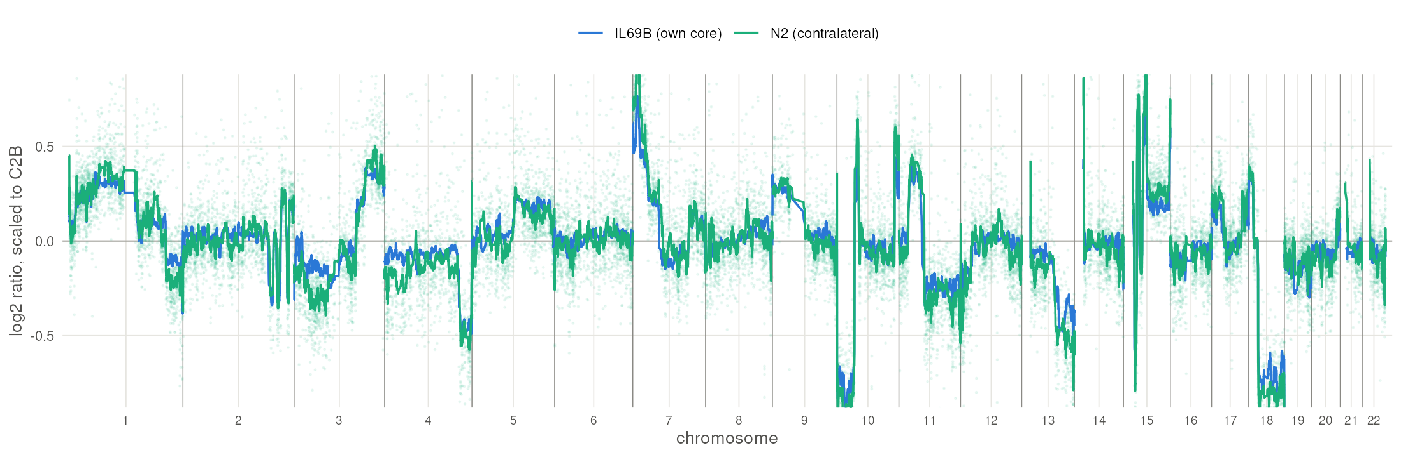
U251N in the opposite hemisphere
Rat 69's contralateral hemisphere: 4.9 % of reads human, the donor genotype at 56 of 59 identity probes, Y-chromosome dose 0.88, and the line's copy-number profile (r = 0.72).
Three measurements, two platforms, no shared failure mode. The other animal's contralateral hemisphere reads 0.5 %.
Copy number on human-specific probes with rat cross-hybridising probes removed, scaled to the parental culture; 31-bin running medians. One animal.
Notes:
KEPT IN THE TALK at Greg's instruction. 25 s.
Establish the identity first and slowly: this is not a statistical whisper, it is the cell line's own genotype, sex chromosome and copy-number profile in tissue from the other side of the brain, on an array handled separately from the libraries.
Do not say anything yet about how it got there - that is the next slide but one.

Slide 21
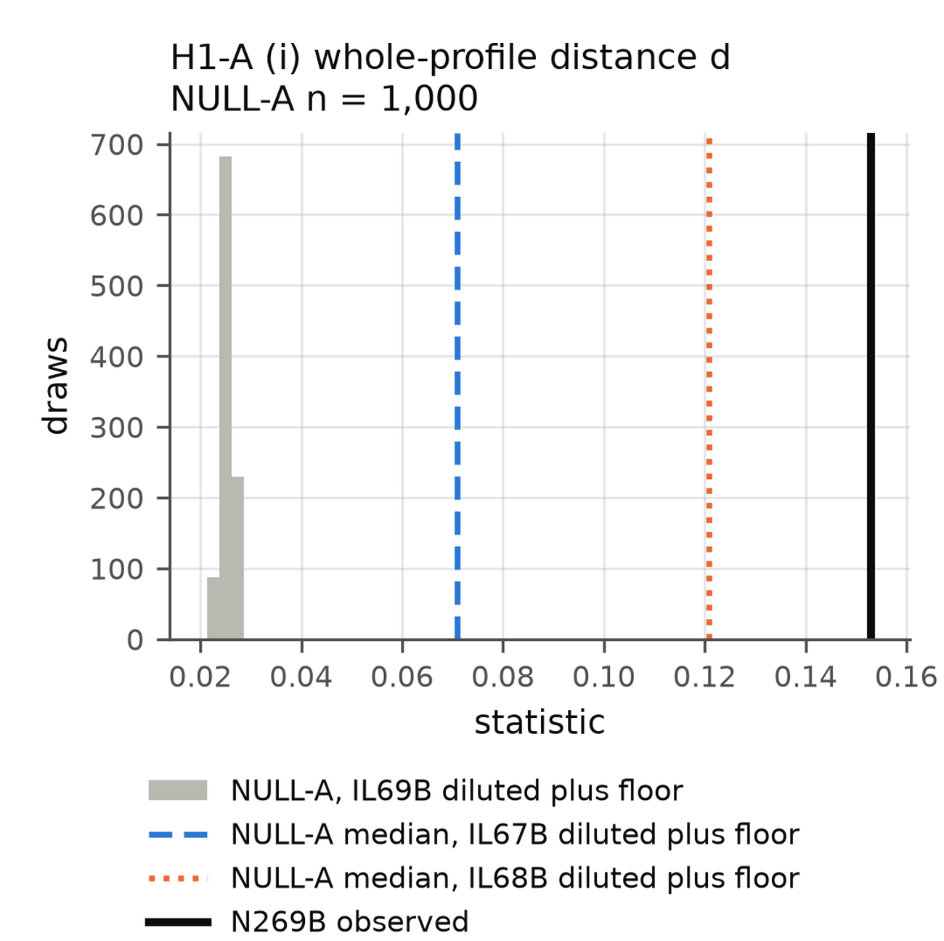
It is not simply the core, sampled thinner
The null: that animal's own tumor subsampled to the contralateral sample's depth, plus the measured assignment floor, 1,000 draws.
Whole-profile distance 0.153 against a null 99.5th percentile of 0.028, and larger than another animal's tumor gives against the same reference.
Dashed and dotted lines: the same construction from two other animals' tumors. One animal.
Notes:
PROMOTED in v6. 18 s. Two of three pre-registered statistics reject; the third, the only one with a direction named in advance, does not (P = 0.56) and moves the other way. Say that if asked.

Slide 22
Two readings, and what a surgeon can take from it
Either U251N cells reached the opposite hemisphere in life, or core tissue was carried across on the blade when the frozen slice was cut. This design cannot separate them, and I am not going to rank them.
What does not depend on which: tumor material is measurable at a site remote from the implant, by two platforms, at a level routine histology of that piece would miss.
For scale, someone else's measurement: malignant cells were recovered from gloves or instruments in 14 of 47 canine cancer operations (30 %), and in 57 % when margins were involved.²³
If it was carried, then one pass of an instrument moved tumor centimetres - which is a question this method can answer, and the next study answers it with a naive hemisphere cut straight after a tumor-bearing one.
23. Orjefelt E, et al. J Small Anim Pract 2026;67:528-533. 24. Steinmetz MP, et al. J Neurooncol 2001;55:167-171. 25. Bekar A, et al. World Neurosurg 2010;73:719-721. Those are other groups' measurements of instrument contamination, not ours. Both contralateral samples come from animals that were never ablated.
Notes:
NEW in v6, and the slide to be careful on. 25 s.
Greg, 2026-09-27: do NOT say definitively that instrument contamination is what we measured. It is not established. Say the two readings, say we cannot separate them, and put the instrument sentence in the conditional - the bar on this slide is phrased that way on purpose.
What is unconditionally true: the material is there, three independent measurements on two platforms say it is U251N, and its transcriptome is not the core diluted.
What is not: which reading is right; any rate (one animal of two sampled, exact interval 1.3 % to 98.7 %); anything about LITT (both contralateral samples come from animals that were never ablated); anything about human resections.
The record does not say whether a fresh blade was used between pieces. If asked, say that plainly.
The fix is in the next study: a naive hemisphere cut with the same blade and slide immediately after a tumor-bearing one, read out by species assignment. 29 such pieces with no positive bound the false-positive rate at 10 %.

Slide 23
A candidate drug against the recurrent state: ciclopirox
Rank | Compound | NES | BBB probability | Both BBB models
1 | ciclopirox | −2.26 | 0.96 | yes
2 | pentetrazol | −1.95 | 0.99 | no
3 | nilutamide | −1.88 | 0.95 | no
4 | primidone | −1.87 | 0.96 | no
5 | pyrantel | −1.79 | 0.98 | yes
DSigDB drug signatures¹¹ against the recurrence ranking, used as a ranking: the 100 most opposing name 92 compounds; 62 have a clinical-phase ChEMBL record; 22 pass both barrier models¹²˒¹³.
Ciclopirox ranks first with the barrier weight (second without it); first without IL68B, third without IL66B. Another group's reversal screen also nominated it.¹⁴
Approved as a topical antifungal; an oral form completed phase 1 in hematologic cancer.¹⁵
Without the barrier weight, deferoxamine, another approved iron chelator, leads (NES −2.39); the barrier models disagree on it (ADMET-AI 0.53, borderline; BOILED-Egg, no). Ranks 2–5 share one ribosomal-protein gene set: one signal, not four candidates.
Computational predictions: nothing here has been dosed in this model.
11. Yoo M, et al. Bioinformatics 2015;31:3069–3071. 12. Swanson K, et al. Bioinformatics 2024;40:btae416. 13. Daina A, Zoete V. ChemMedChem 2016;11:1117–1121. 14. Sun S, et al. J Transl Med 2025;23:25. 15. Minden MD, et al. Am J Hematol 2014;89:363–368. Rank among the 62 compounds with a clinical-phase ChEMBL record (exact-name matching, audited) by |NES|^1.5 × ADMET-AI BBB probability; BBB models ADMET-AI and BOILED-Egg; supersedes Online Resource 1, S12.
Notes:
3:40–4:15 The drug. Each compound's DSigDB gene set is tested for sitting among the genes that fall in recurrence, then weighted by predicted barrier penetration. Ciclopirox scores 3.27 against 2.35 for pyrantel, the next compound both barrier models pass. Without IL66B it is third, 16th without the barrier weight: say so if asked.
What changed since the manuscript's S12: compound names are now matched to ChEMBL by exact name or synonym and mapped to the parent molecule, with every changed or unresolved name audited (ANALYSIS/drug_rematch). The old pipeline took the first free-text search hit, which dropped approved drugs (deferoxamine, vandetanib, mefloquine, bromocriptine) and used salt records whose counterions made escitalopram, paroxetine, metoprolol, trimipramine and propantheline look barrier-impermeable. Clinical compounds 54 -> 62; both barrier models 13 -> 22 (same software, same day). Ciclopirox's rank with the barrier weight did not move in any of the three runs. The manuscript's S12 and prior-art table need the same update.
Deferoxamine: first without the barrier weight (score 3.69 against ciclopirox's 3.40), 13th with it; ADMET-AI 0.53 (just over the 0.5 cut) and BOILED-Egg 'out', so the models disagree. Two approved iron chelators at the top of the unweighted list is itself worth saying.
New entries to the top twenty since the prior-art audit (backup B4): deferoxamine, L-citrulline, Lysergide, Toluidine Blue O.
Caveats if asked: scored per tumor by GSVA, the ciclopirox gene set does not separate the arms (P = 0.89), so the rank rests on the whole-list ordering; its DSigDB sets hold at most one ribosomal-protein gene, so the rank is not the ribosomal block again. Brain pharmacokinetics of ciclopirox have not been measured; the barrier call is a model prediction.
What carries ciclopirox's rank: its induced genes are HIF/hypoxia targets (21 of 36 leading-edge genes are hallmark hypoxia; without them NES -1.57, p 0.005). Ranks 2-5 (pentetrazol, nilutamide, primidone, pyrantel) share one leading edge of ribosomal-protein genes plus PGK1 and ENO1 (pairwise Jaccard 0.55-0.86): the ribosomal block counted four times (ANALYSIS/gsc_drugs/REVIEW_2026-09-26.md).
Stem-cell programs: restricted to six published glioma stem-cell gene sets, ciclopirox's induced genes fall in recurrence only within the radial-glia-like program (Bhaduri 2020; first of 2,212 drug sets, NES -2.08), and those genes are hypoxia targets, not stem-cell genes. No drug opposed recurrence inside the stem-specific sets. Consistent with this slide, not independent of it.
The printed abstract: its 3.40 for ciclopirox is this enrichment with a rule-of-thumb barrier score capped at 1.0; with ADMET-AI it is 3.27 and still first. DMOG and LY-294002, named in the abstract, have no clinical-phase record and drop out. The drug NES come from gene-permutation GSEA, so they are quoted as a ranking, not with FDRs (SLIDES/ABSTRACT_VS_TALK.md).

Slide 24
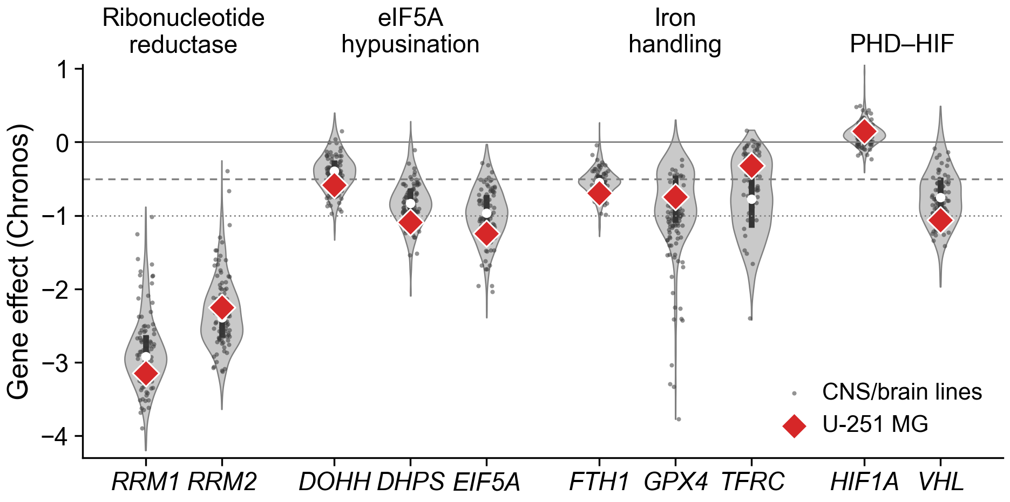
Why ciclopirox: U-251 is past the threshold on the axis it inhibits
Ciclopirox chelates iron and inhibits DOHH, which activates eIF5A for translation elongation. In DepMap¹⁶, U-251 MG is past the dependency threshold for DOHH (−0.58), more dependent than 69 % of 90 CNS lines (median −0.46).
In mice, LITT opens the barrier around the ablation for one to three weeks¹⁷: a possible delivery window.
16. DepMap 24Q4 (depmap.org), Chronos gene effect, U-251 MG (ACH-000232); Dempster JM, et al. Genome Biol 2021;22:343. 17. Cleary RT, et al. Neuro Oncol 2026;28:1649–1661. Violins: all screened lines (n per gene 1,043–1,178); dots, CNS/brain lines; bar, interquartile range; white dot, median; dashed, −0.5; dotted, −1 (median common-essential gene).
Notes:
4:15–4:45 The mechanism argument, kept modest. DHPS and EIF5A are needed by most lines (85 % and 91 % below −0.5), so they are not selective; DOHH is the step most lines can do without (35 % below −0.5), and U-251 needs it more than the typical glioma line, by a modest margin. U-251 is broadly dependent, so a percentile like this is ordinary for it. Ribonucleotide reductase (RRM1 −3.14, RRM2 −2.25) is needed by nearly every line. HIF1A is not a dependency (+0.15). A public screen of the line in culture, not our data.
Barrier window, from Cleary 2026 in SB28 mouse glioma: tight junctions open for 7 days up to 100 µm from the ablation; transcytosis peaks at day 14 and is back to baseline by day 21. No human post-LITT time course exists.

Slide 25
What this means
After LITT, the regrown tumor carries a program of its own: lower ribosomal-protein genes and a lower astrocyte-like score.
Its direction holds with any tumor left out; its size leans on one tumor, its FDR on the seed, and tumor content is not yet separated from it.
It ranks first a topically approved iron chelator predicted to cross the barrier (third without one recurrent tumor), on an axis this line depends on.
A hypothesis with a mechanism and a window, from six tumors: worth the experiments on the next slide.
Evidence status: one cell line (U251N) in one rat xenograft model, n = 3 per arm; drug candidates are computational predictions; GEO GSE338105.
Notes:
Say, if time allows: 'Three things differ from the printed abstract: lower ribosomal-protein genes rather than translational shutdown; the mitochondrial shift did not survive the published signatures; and of its three drugs only ciclopirox is clinically available.'
4:45–5:15 Three sentences, then the bar. Do not add numbers here.

Slide 26
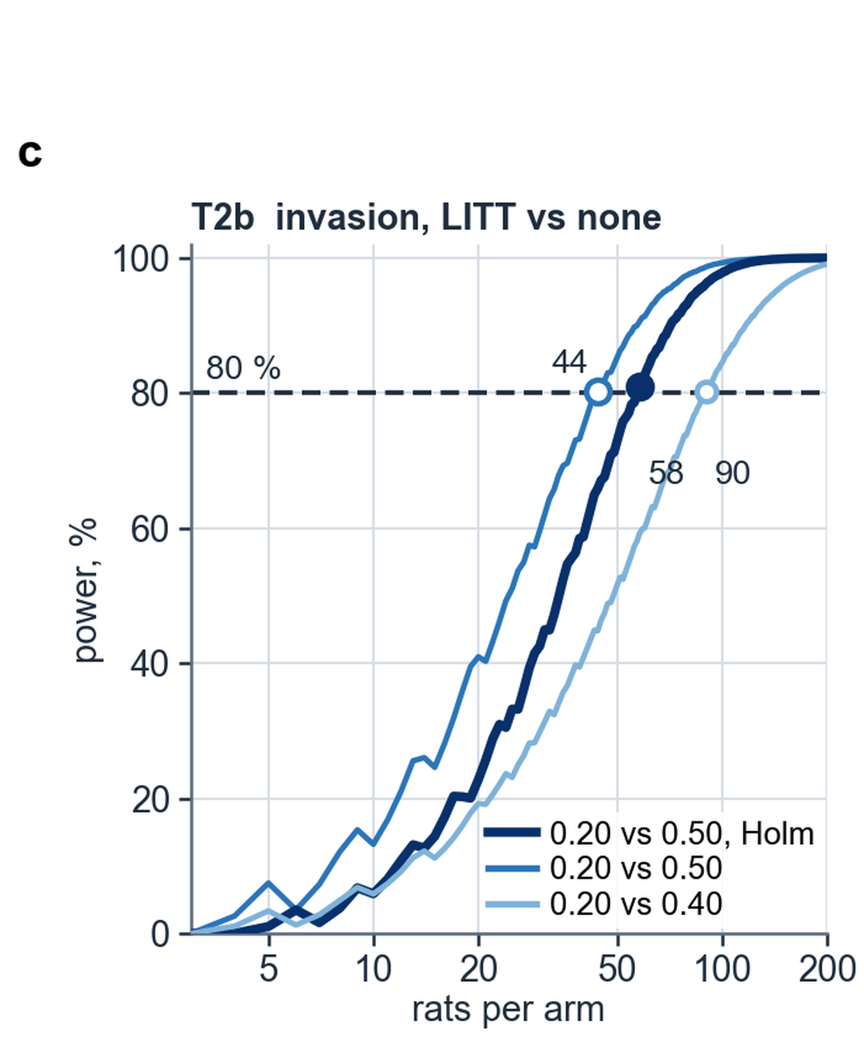
What the next experiment costs, decided in advance
Targets were fixed and hashed before any pilot number entered a calculation.²⁸
The binding constraint is the per-animal endpoint: 44 rats per arm to move invasion frequency 0.20 to 0.50, 27 for a 15-point difference in tumor content, 29 control pieces to bound transfer at dissection at 10 %.
The clone-level test - are the cells that grew back the ones that had already left? - needs 9 to 16 barcoded animals, because the unit becomes the clone.²⁷
27. Barthel FP, et al. Nature 2019;576:112-120. 28. Browne RH. Stat Med 1995;14:1933-1940. Power against animals; dashed line, the pre-stated target; filled mark, the conservative sizing; open marks, the two other contrasts. Panels for the genome-wide targets are pending.
Notes:
NEW in v5, one panel in v6. 25 s. The point is not 'we need more animals': every number was fixed before the pilot was allowed to speak, in the same form as the power figure in my imaging work.

Slide 27
Limitations, and the experiments that answer them
Limitations
Next
Three tumors per arm; the size of the ribosomal-protein fall leans on one.
Lower ribosomal-protein mRNA is not yet lower translation.
Arm and human share are partly collinear; no sham or non-thermal regrowth arm.
One cell line in an athymic rat: no T cells, no patient tissue.
Burden-matched primaries, sham-fiber and non-thermal cytoreduction arms, more animals.
Puromycin incorporation and polysome profiling: is translation suppressed?
Paired IDH-wild-type primary and recurrent glioblastoma (GLASS¹⁸): does it recur in patients?
Ciclopirox dosed into the post-LITT barrier window, survival as the endpoint.
18. Varn FS, et al. Cell 2022;185:2184–2199. Orthotopic U251N glioblastoma xenograft in the athymic rat, MRI-guided LITT; bulk RNA-seq of primary and recurrent tumors, n = 3 per arm; GEO GSE338105.
Notes:
Printed abstract: its 'translational shutdown' is what the puromycin / polysome experiment tests; it has not been shown.
5:15–5:45 Say the limitations as the reason for each experiment. GLASS recurrences follow standard therapy, not LITT, so it tests whether the signature accompanies recurrence in general. Bulk RNA: the margin is inferred, not isolated. Methylation on the same six tumors (EPIC, 866,238 probes) found no probe past FDR; with purity and arm confounded it cannot separate the two. If asked: host (rat) reads are being analysed separately for the microenvironment; not in this talk.

Slide 28
Acknowledgments and data availability
Co-authors Tavarekere N. Nagaraja, PhD, Indrani Datta, DHI, and Ian Y. Lee, MD, Hermelin Brain Tumor Center, Henry Ford Health: the model, the ablations, the tissue and the study design.
Supported by a Henry Ford Health Physician Scientist Award A20050 (I.Y.L.).
Henry Ford Health IACUC protocol #1509; ARRIVE guidelines.
Sequencing data: GEO GSE338105.
Questions
go2432@wayne.edu
Notes:
5:45–6:00 Thanks. Leave the GEO accession on screen during questions. Indrani Datta's credential is DHI (confirmed by Greg, 2026-09-26). The JNS 2026 author list prints PhD; do not copy it.

Slide 29
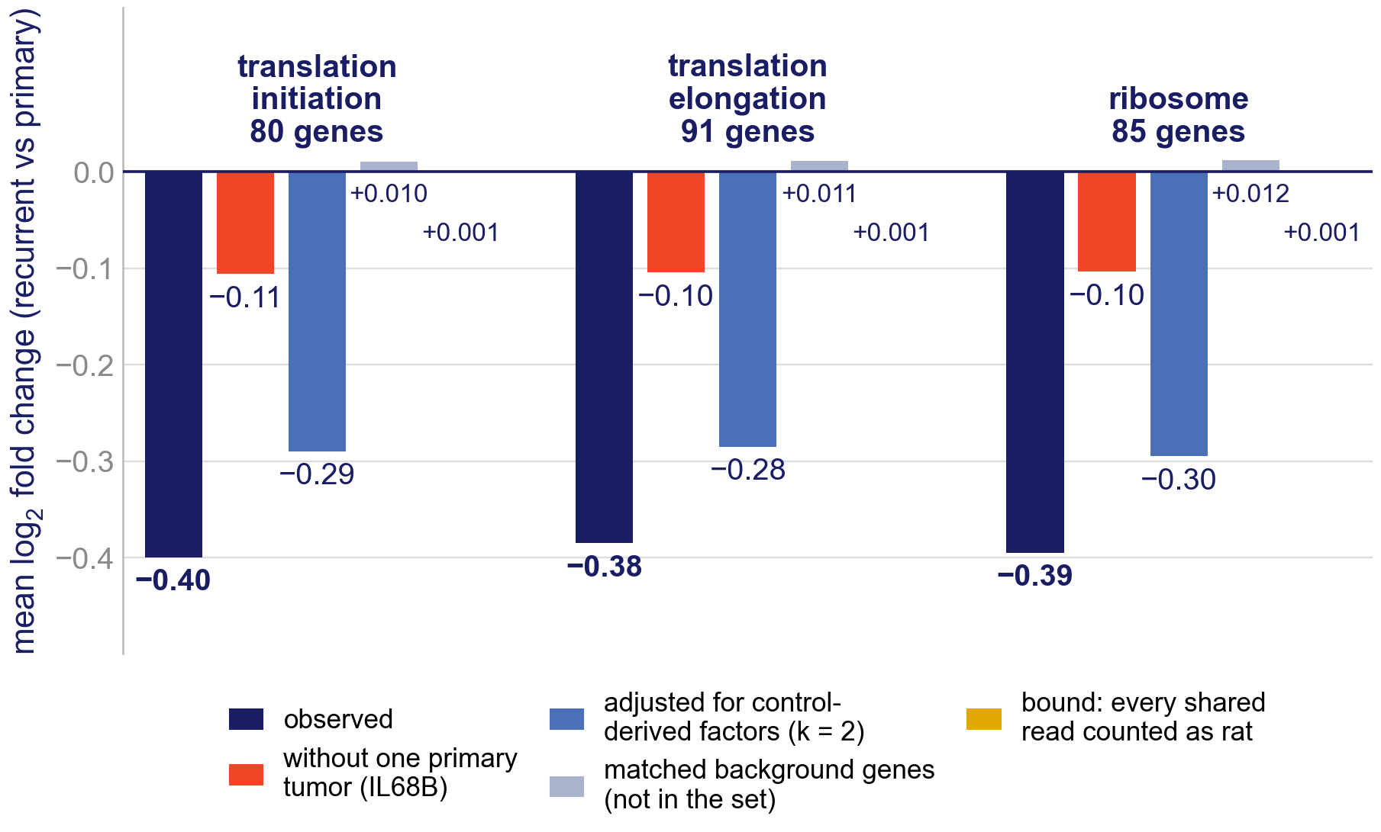
Backup B1. Is the fall rat contamination?
Counting every shared read as rat would move the ribosomal-protein sets by under 0.01 log2 (+0.001; the two tumor-free controls).
They fall −0.40; background genes matched on abundance and control/tumor ratio move +0.01.
Without IL68B the fall is −0.11.
19. Risso D, et al. Nat Biotechnol 2014;32:896–902. Controls: IL64B (no tumor in its sample) and N168B (opposite hemisphere of rat 68); N269B holds tumor cells and is left out. RUVSeq¹⁹ factors (k = 2, from the three control libraries; rerun on the two tumor-free ones pending) also separate the arms.
Notes:
If the printed abstract is the docx version: its claim that contamination 'would bias ribosomal genes upward' does not match this bound. The size argument holds; the direction depends on N269B, the contralateral hemisphere of rat 69 that holds tumor cells.
Sensitivity, N269B among the controls: bound -0.009, matched background -0.13, excess -0.26 (tumor-free controls: -0.41); contamination_magnitude_ctrl3.json.
Backup. Mean log2 fold change (recurrent vs primary) of each set under each analysis; the bound is a model ceiling, not an observed change.

Slide 30
Backup B2. The whole pipeline re-run without one tumor
 | DE genes | Ribosomal-protein set q | Ciclopirox rank (weighted / not) | AC-like change | AC-like p
All six | 35 | 0.022 | 1 / 2 | −0.53 | 0.007
Without IL68B | 43 | 0.027 | 1 / 2 | −0.57 | 0.044
Without IL66B | 140 | 0.309 | 3 / 16 | −0.50 | 0.066
Every step re-run from counts: differential expression, GSEA (seed 1234), subtype scoring, drug ranking. IL68B was chosen because it carries the ribosomal-protein fall; IL66B because it is the library-QC outlier. Both choices were made after seeing the data.
ANALYSIS/holdout_IL68B and holdout_IL66B, comparison.json; ciclopirox ranks from the exact-name ChEMBL rerun (ANALYSIS/drug_rematch). Subtype p here is the published TPM-based GSVA run.
Notes:
Backup. Post hoc holdouts: say so.

Slide 31
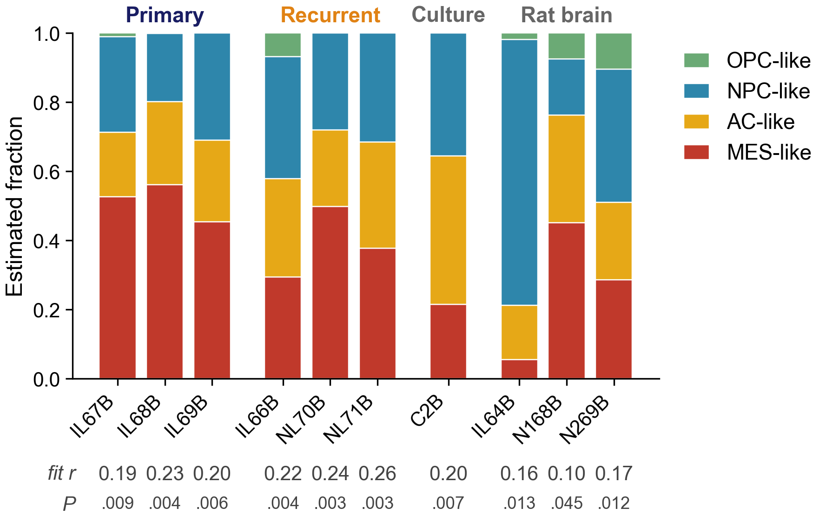
Backup B3. CIBERSORT deconvolution of the Neftel states
CIBERSORT v1.04¹⁰, signature built from Neftel⁷ single-cell profiles. P < 0.05 in every library, but fit r 0.19–0.26 in the tumors and the culture: significant against random mixtures, poor as a description.
The rat-brain controls, almost no human reads, get fractions too (fit r 0.10–0.17).
AC-like 0.22 → 0.27, opposite to the GSVA score; MES-like 0.51 → 0.39.
Across the five runs with tumor-state columns (three Neftel builds, two GLASS), no state differs at P < 0.05; GLASS proliferating stem-like is higher in all three recurrences (P 0.06–0.08).
7. Neftel C, et al. Cell 2019;178:835–849. 10. Newman AM, et al. Nat Methods 2015;12:453–457. Relative mode, 1,000 permutations, no quantile normalisation; Ivy GAP, glioma atlas, LM22 and BayesPrism references have no tumor-state columns; ANALYSIS/cibersort.
Notes:
Backup. CIBERSORT estimates the share of each state in a bulk sample; it does not sort reads.

Slide 32
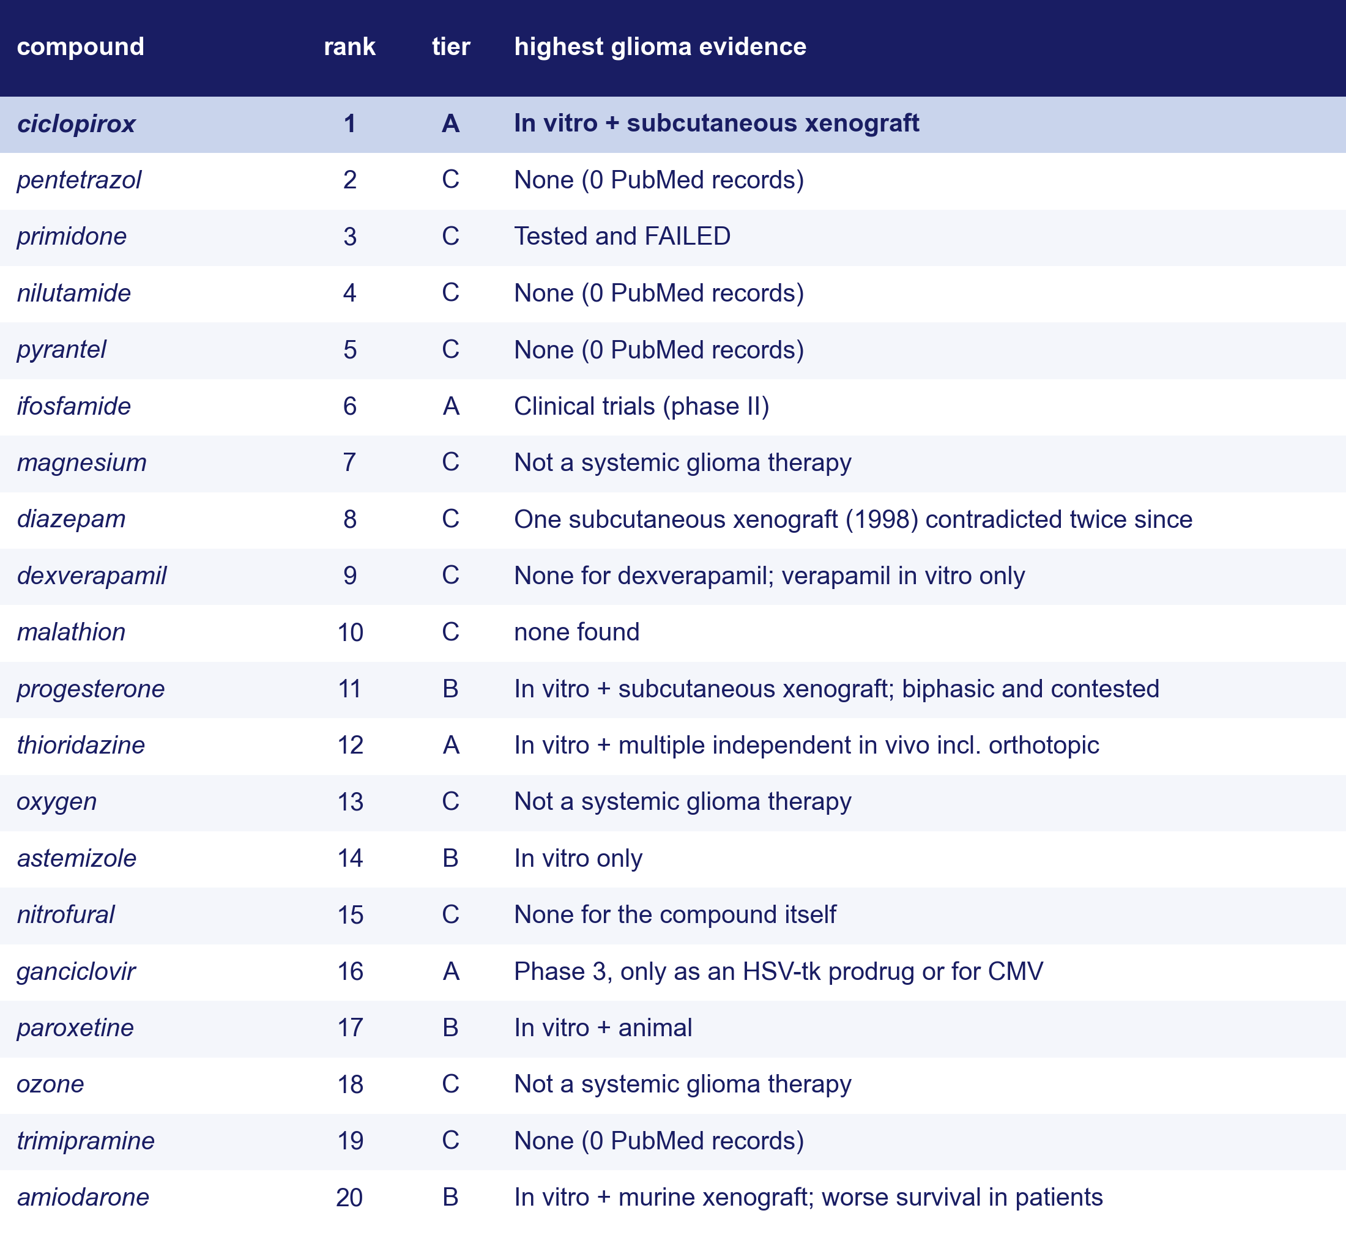
Backup B4. What is already known about the top twenty
20. Su Z, et al. Cell Death Dis 2021;12:251. Tier A: in vivo or clinical glioma evidence (ciclopirox²⁰); B: in vitro or contested; C: none, failed or not a therapy. PubMed per compound.
Notes:
Backup. Prior-art audit of the top twenty of the 54 in the September ranking (S15); the exact-name rerun changes the top twenty (see slide 10 notes), so new entrants have no audit yet. Known inconsistency to fix in the manuscript: paroxetine and amiodarone have in vivo evidence but sit in B; diazepam's evidence is contested but sits in C.

Slide 33
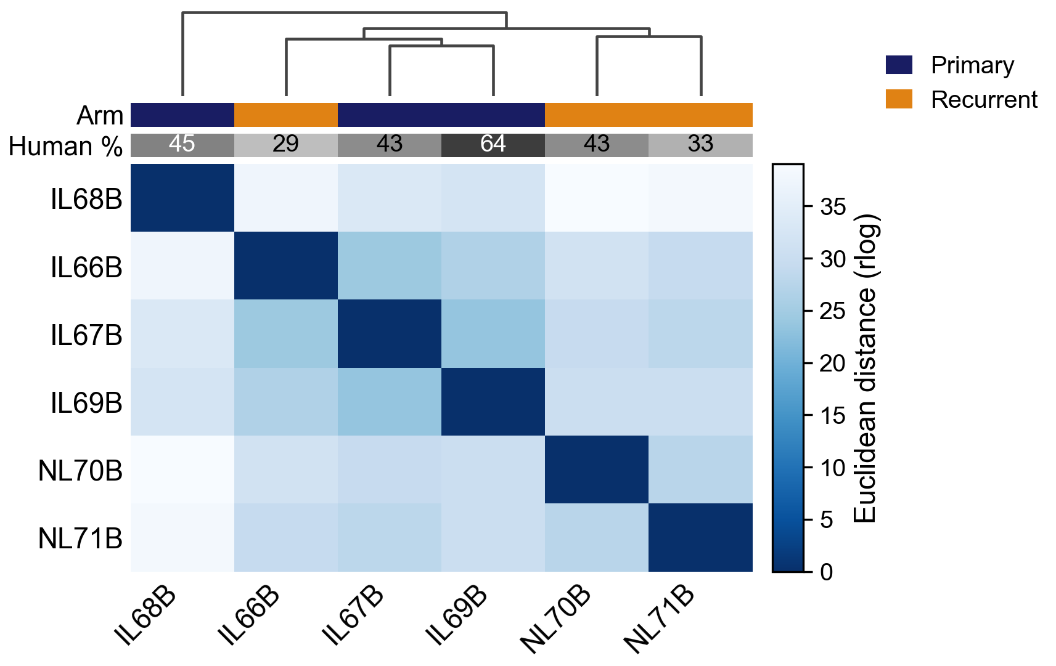
Backup B5. Sample-to-sample distances
Euclidean distance on rlog expression, all genes, hierarchical clustering (the DESeq2 quality-control view).
The two NL recurrences pair; IL68B stands apart from everything; IL66B joins the other two primaries.
Unsupervised clustering does not recover the arms: whatever separates them is a few coordinated programs, not the whole transcriptome.
Orthotopic U251N glioblastoma xenograft in the athymic rat, MRI-guided LITT; bulk RNA-seq of primary and recurrent tumors, n = 3 per arm; GEO GSE338105.
Notes:
Backup. Show if asked whether the arms separate globally.

Slide 34
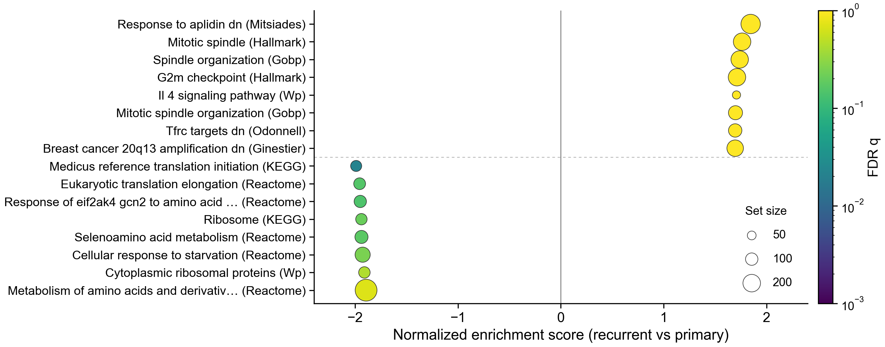
Backup B6. The strongest gene sets in each direction
Down in recurrence: the ribosomal-protein block (six sets at q < 0.25). Up: mitotic and cell-cycle sets lead, none below q = 0.61.
6. Subramanian A, et al. Proc Natl Acad Sci USA 2005;102:15545–15550. Broad GSEA⁶, 8,869 sets; point size, set size; colour, FDR q.
Notes:
Backup. The standard GSEA summary: eight strongest sets each way.

Slide 35
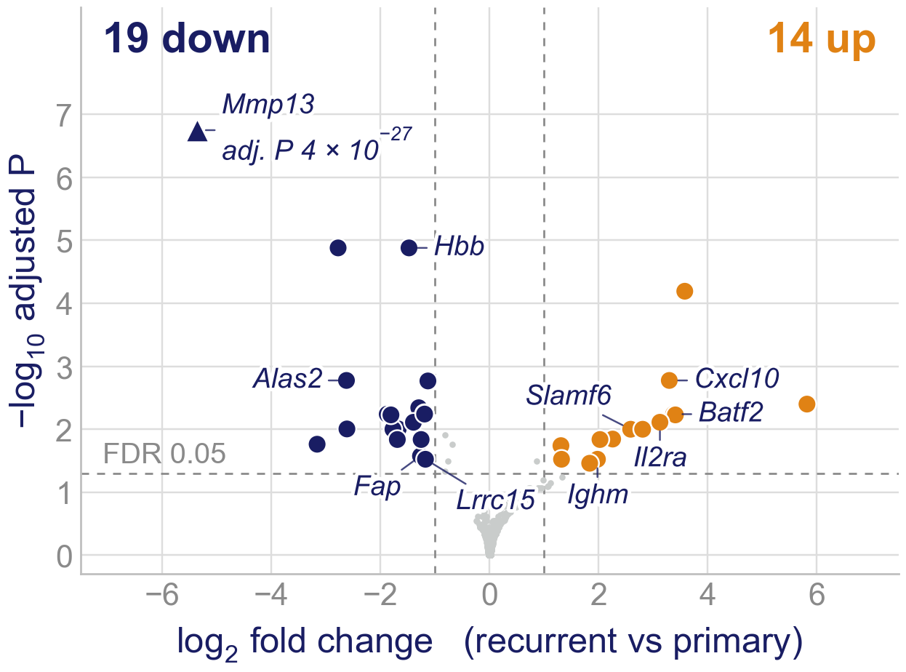
Backup B7. The rat host tissue in recurrence (preliminary)
Rat reads only, 3 v 3, the tumor's rule (FDR < 0.05 and two-fold): 33 genes, 19 down and 14 up.
Holds when any tumor is left out: Mmp13, Ceacam4, Hbb down (Mmp13 about 41-fold), Ocstamp up. Not human reads: human MMP13 at most 7 reads per tumor.
The rest is unstable: leaving out one tumor keeps 8–19 of the 38; no gene set passes FDR 0.25 (4,843 sets, lowest 0.33).
The true grouping ranks 2 of the 10 possible 3 v 3 splits; the largest (rats 69, 70, 71 against the rest, 2,752 genes) follows immune infiltration, not treatment. The interferon/lymphocyte rise comes from rats 70 and 71.
5. Love MI, et al. Genome Biol 2014;15:550. Preliminary: different rats per arm; LITT, time and the ablation wound cannot be separated. Broad GSEA from the pipeline; leave-one-out and relabelling from a rerun that reproduces the pipeline's 38 genes. DESeq2⁵.
Notes:
Backup, preliminary; show only if asked about the host. What holds: Mmp13, Ceacam4, Hbb lower in every recurrence and in every leave-one-out fit (Mmp13 is also not human-read leakage: human MMP13 at most 7 reads per tumor against at least 180 rat reads per primary). What does not: the 38-gene list (FDR < 0.05) shrinks to 8–19 when a primary or rat 70 or 71 is left out; leaving IL66B out raises it to 424 (the tumor side does the same, 102 to 349), so IL66B is the recurrence most like a primary in both species. The true grouping gives 38 genes; the other nine splits give a median of 9; the largest, rats 69, 70, 71 against the rest (2,752 genes), is an immune-infiltration (Ptprc, Cd68, Aif1) against white-matter/neuron (Mbp, Plp1, Pcp4) axis that cuts across treatment. Cxcl10, Batf2, Il2ra, Ighm barely move in IL66B.
Broad GSEA (the pipeline's run, gene-set permutation): 4,843 sets, none at FDR < 0.25. By nominal p, up: antigen presentation, allograft rejection, interferon gamma; down: KEGG ribosome and translation initiation (NES about -2.0, nominal p about 0.04). The rat host's ribosomal-protein genes point the same way as the tumor's; their share tracks the human read share (Spearman 0.83 over six tumors), which fits read leakage but does not prove it.
Host cell-type deconvolution (CIBERSORT; LM22, Zhang 2014, Bowman 2016 myeloid, and a combined signature): no cell type differs between primaries and recurrences. Tumor-associated bone-marrow macrophages are high in rats 70 and 71 (0.43, 0.50) and not in 66 (0.07): the same rats-70-71 pattern, found after looking, exploratory only.
The 'NL' in the file names of rats 70 and 71 is not a group: the lab's sample key calls them IL-70 and IL-71 and its methylation-array sheet IL70B and IL71B; all ten RNA libraries ran on one lane. Why 70 and 71 differ from 66 (for example time after LITT) is not recorded. The host is the athymic RNU/RNU rat: do not describe a T-cell response. Rat reads are the xengsort host bin; nf-core/rnaseq 3.22.2 on mRatBN7.2 (Ensembl 110); nf-core/differentialabundance DESeq2. Tumor vs control brain (contralateral hemispheres of rats 68 and 69, and IL64B): 9,378 genes differ.

Slide 36
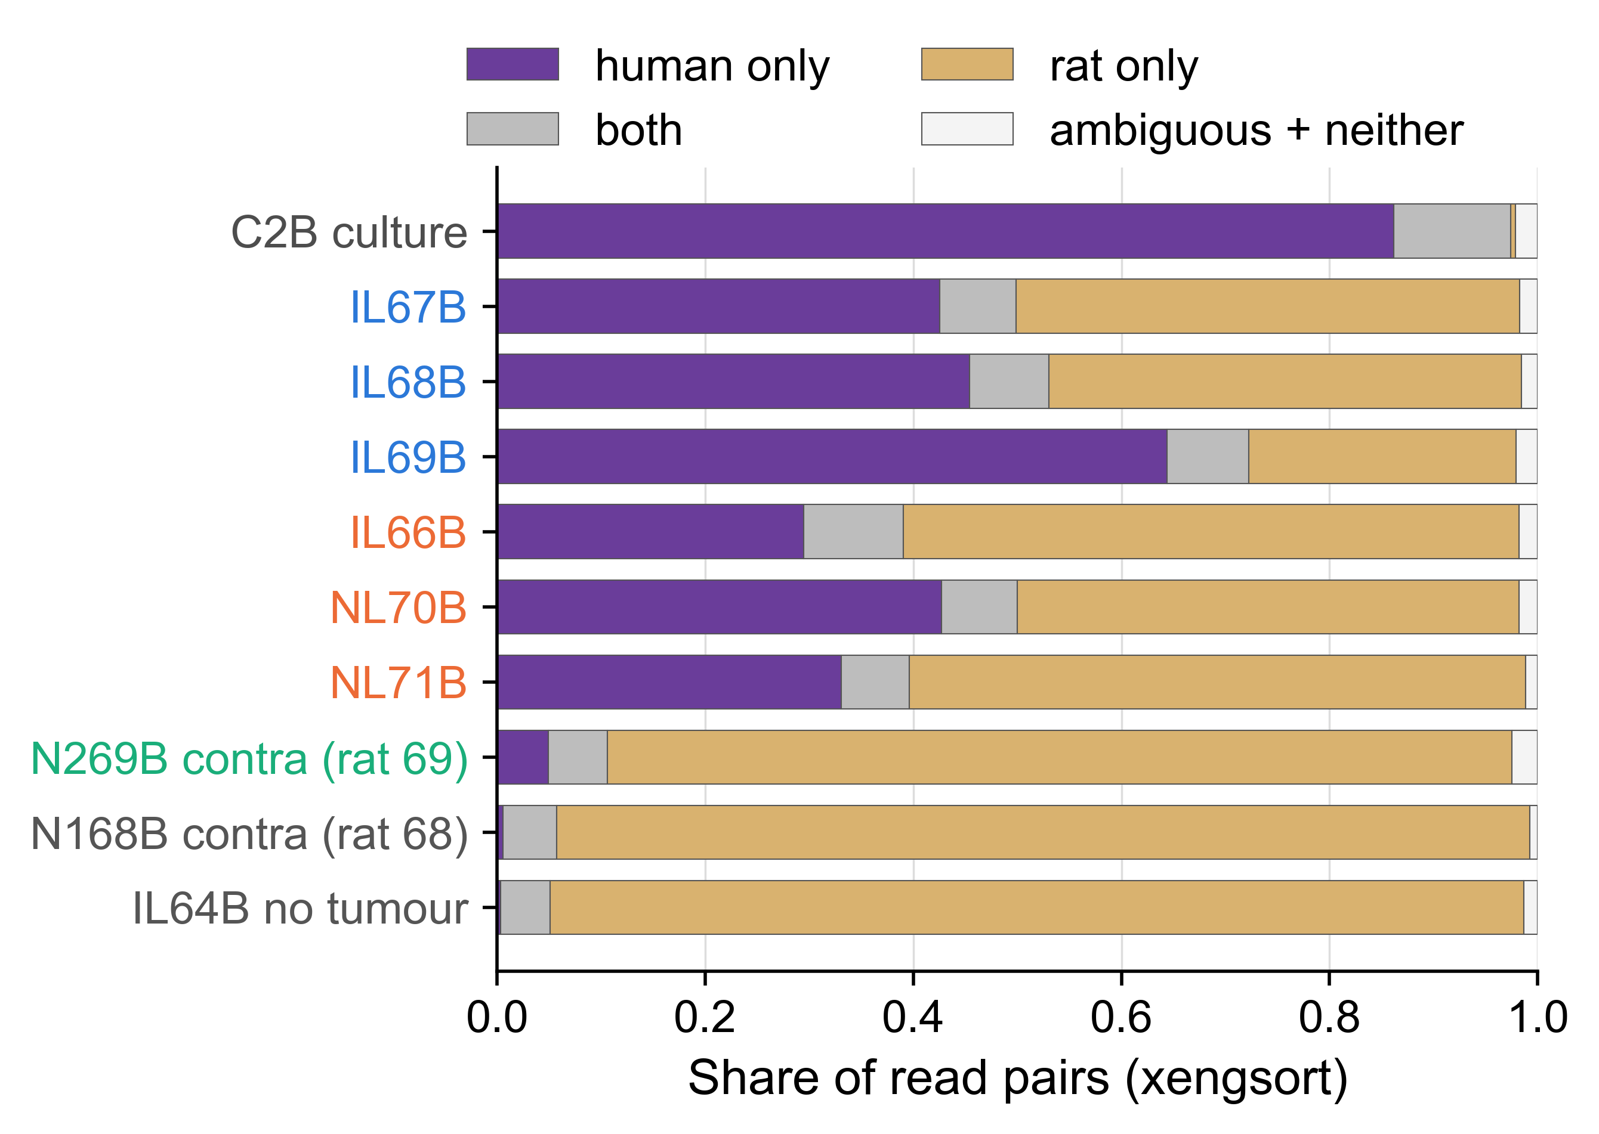
Backup. What each library is made of
Every read pair assigned by species before anything is counted.
The three floor libraries: IL64B, an implanted hemisphere with no tumor in the piece (0.3 % human), and the two contralateral hemispheres (0.5 % and 4.9 %).
Human Y-linked transcripts per million human counts: 177-209 in the six tumors, 2.9 in the tumor-free library.
xengsort (k = 25) against GRCh38 and mRatBN7.2; shares of all classified read pairs. Orthotopic U251N glioblastoma xenograft in the athymic rat, MRI-guided LITT; bulk RNA-seq of primary and recurrent tumors, n = 3 per arm; GEO GSE338105.
Notes:
NEW in v6. Backup: show only if asked.

Slide 37
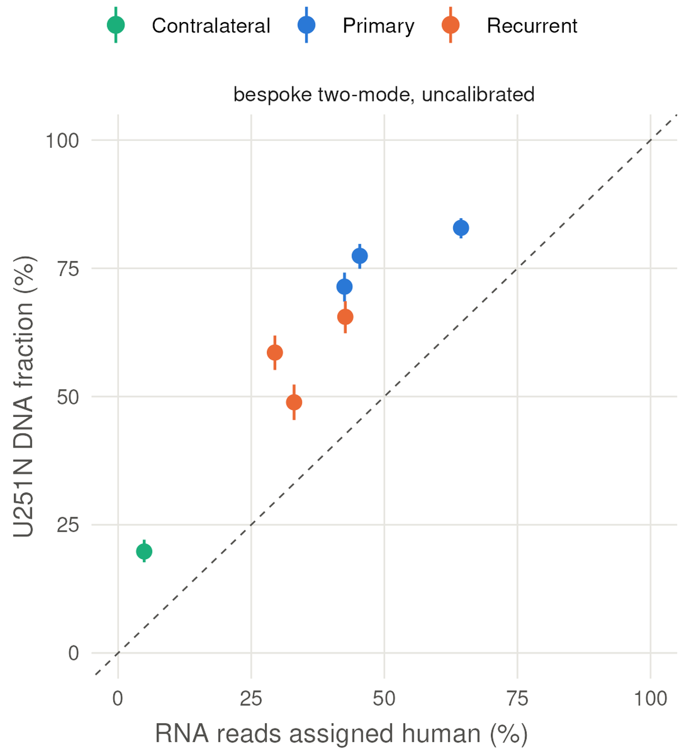
Backup. Tumor content, three estimators
DNA fraction against RNA human share; the registered estimator is uncalibrated, so no cell percentage is quoted from either platform.
The order agrees: Spearman 0.89 over the six tumors.
Bars: the estimator's own interval. Dashed: equality, for reference only. Orthotopic U251N glioblastoma xenograft in the athymic rat, MRI-guided LITT; bulk RNA-seq of primary and recurrent tumors, n = 3 per arm; GEO GSE338105.
Notes:
NEW in v6. Backup: show only if asked.

Slide 38
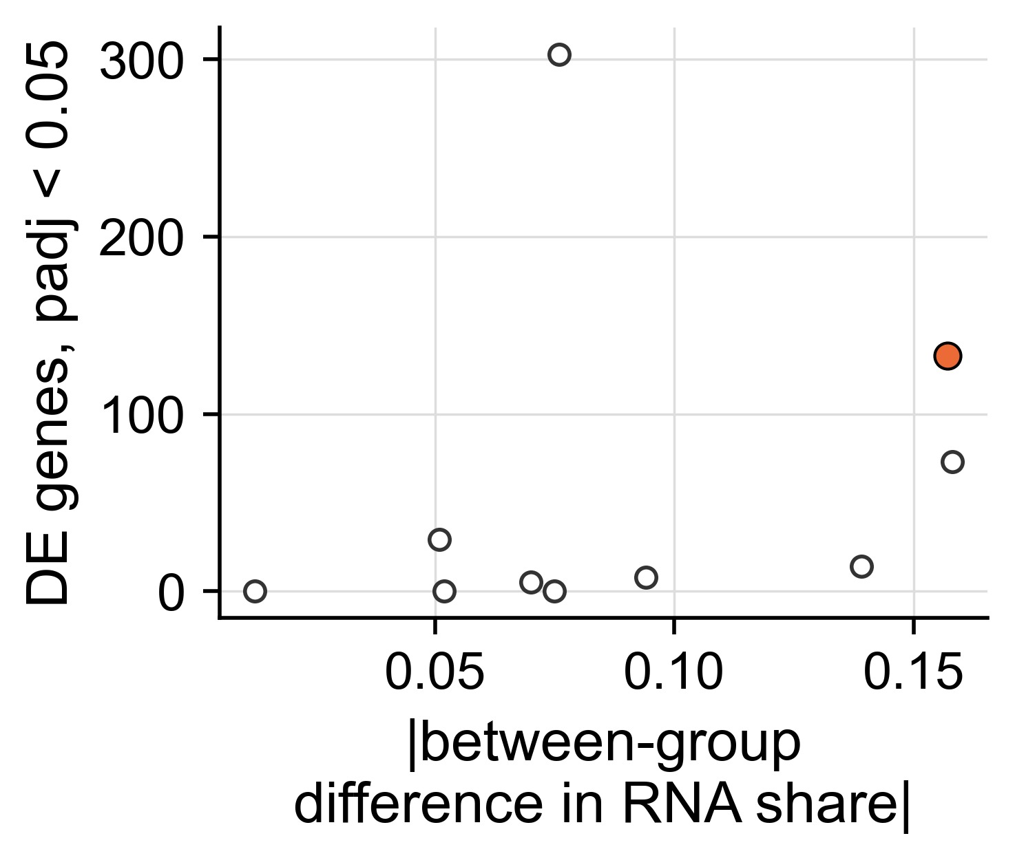
Backup. Differentially expressed genes across the ten splits
The true split gives 133 genes; the ten splits range from 0 to 303.
DE count rises with the split's difference in tumor content, as the composition share does.
nf-core/differentialabundance (DESeq2) on the species-blind matrix, identical parameters for all ten splits. Orthotopic U251N glioblastoma xenograft in the athymic rat, MRI-guided LITT; bulk RNA-seq of primary and recurrent tumors, n = 3 per arm; GEO GSE338105.
Notes:
NEW in v6. Backup: show only if asked.

Slide 39
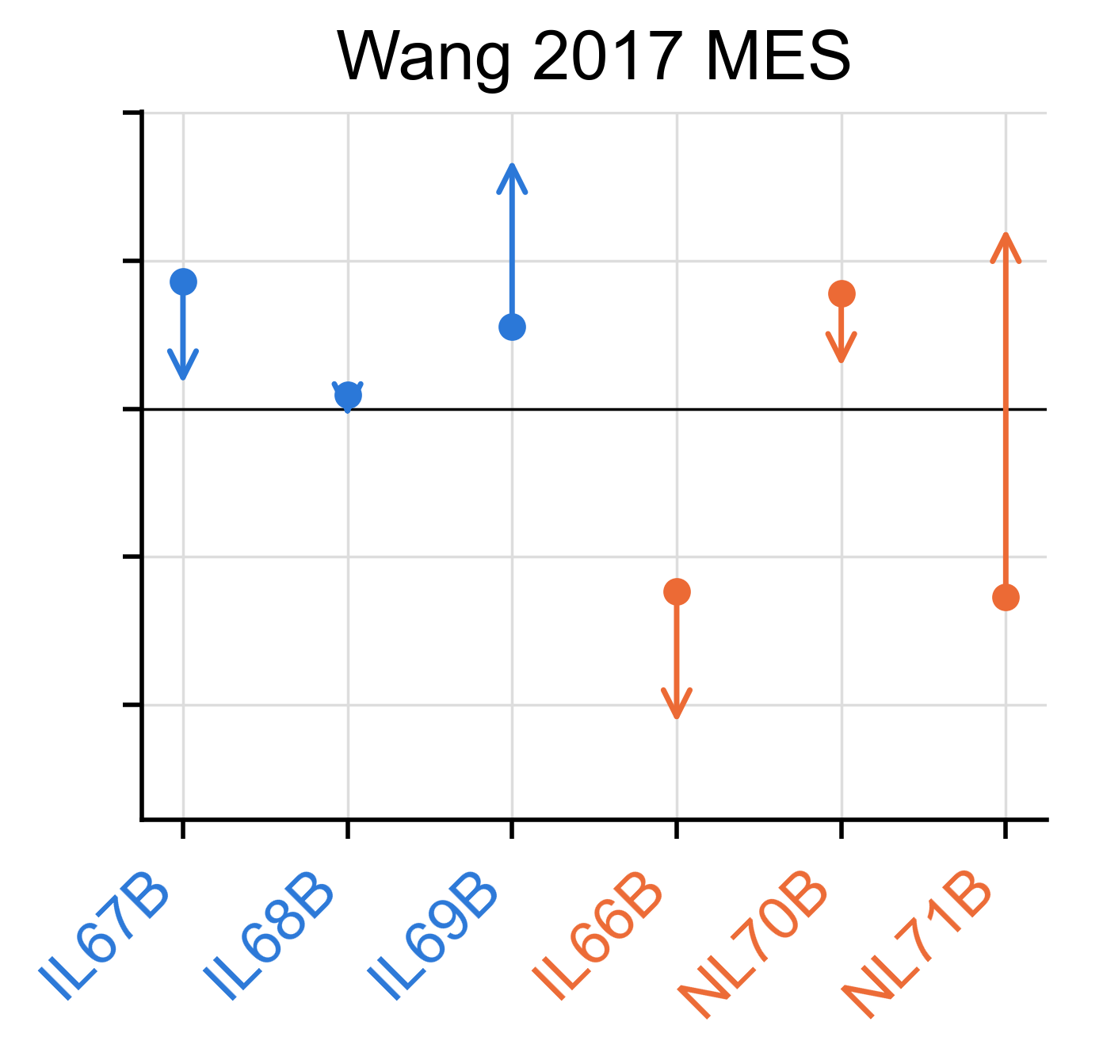
Backup. The second mesenchymal signature
Wang 2017 mesenchymal: the human-only fall is below 99.3 % of 1,000 dilution-null draws.
The composition-generated difference ranks 9 of 20.
GSVA on TMM log-CPM; dot, human reads; arrow head, the same sample read as bulk. Orthotopic U251N glioblastoma xenograft in the athymic rat, MRI-guided LITT; bulk RNA-seq of primary and recurrent tumors, n = 3 per arm; GEO GSE338105.
Notes:
NEW in v6. Backup: show only if asked.

Slide 40
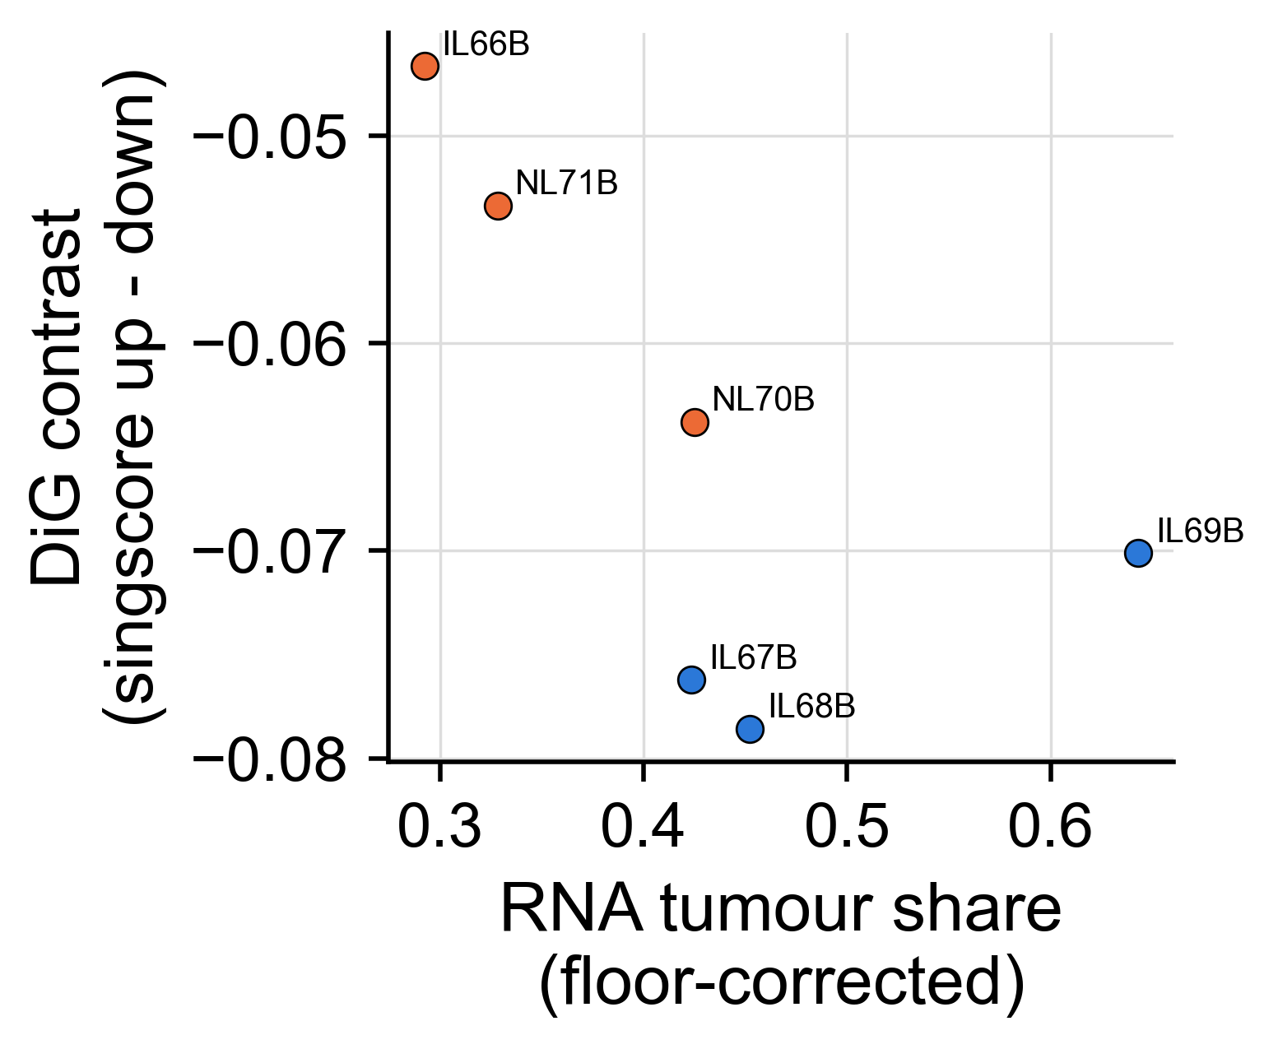
Backup. The invasion score against tumor content
Each tumor's distal-invasion score against its tumor share; the arm difference is what the model fits.
Two scoring packages agree on the rank.
Chanoch-Myers 2026 gene sets, frozen by hash; singscore on floor-corrected human log-CPM. Orthotopic U251N glioblastoma xenograft in the athymic rat, MRI-guided LITT; bulk RNA-seq of primary and recurrent tumors, n = 3 per arm; GEO GSE338105.
Notes:
NEW in v6. Backup: show only if asked.

Slide 41
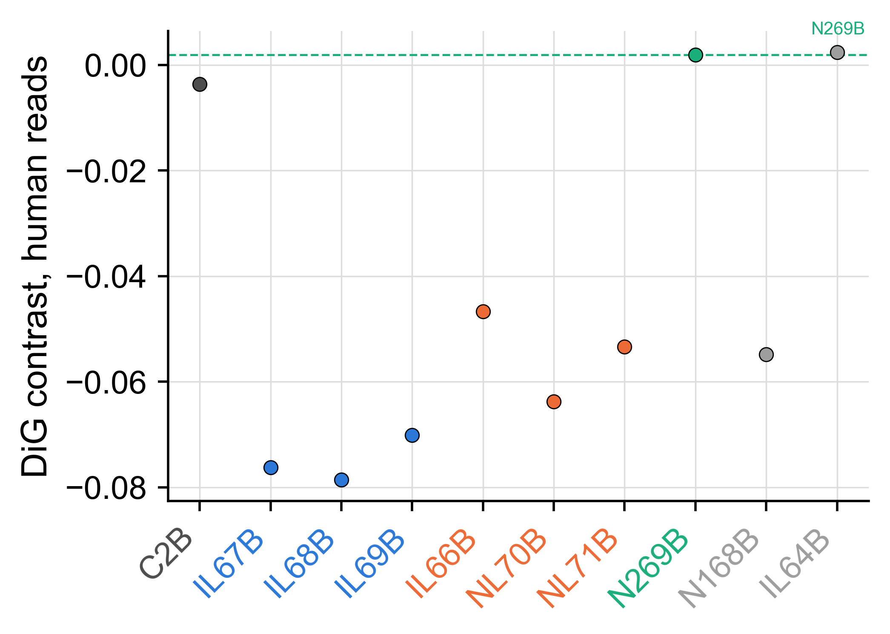
Backup. The gate that stopped the contralateral invasion test
The pre-registered case test asked whether the contralateral human cells sit further along the invasion axis than their own core.
Its gate failed first: the assignment floor scores as high as the contralateral sample, so the contrast would measure mis-assignment. The test was abandoned and is reported as abandoned.
Same score as the arm test, on every human-bearing profile plus the two floor libraries. Orthotopic U251N glioblastoma xenograft in the athymic rat, MRI-guided LITT; bulk RNA-seq of primary and recurrent tumors, n = 3 per arm; GEO GSE338105.
Notes:
NEW in v6. Backup: show only if asked.

Slide 42
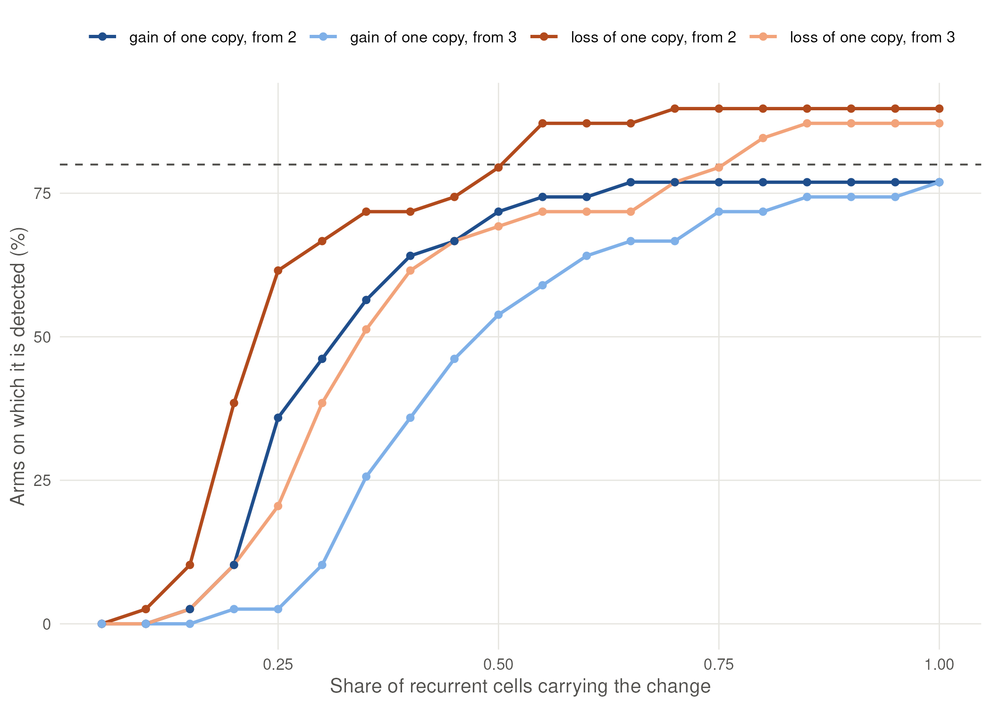
Backup. The smallest shared change this design could see
Recurrences do not share derived arm-level copy-number changes the primaries lack (statistic 0.081, rank 5 of 20) - the pre-stated expected null.
A single-copy loss carried by fewer than 0.55 of recurrent cells would not have been flagged on 80 % of arms.
The registered rule applied unchanged to simulated shared changes added to the observed recurrent bins. Orthotopic U251N glioblastoma xenograft in the athymic rat, MRI-guided LITT; bulk RNA-seq of primary and recurrent tumors, n = 3 per arm; GEO GSE338105.
Notes:
NEW in v6. Backup: show only if asked.

Slide 43
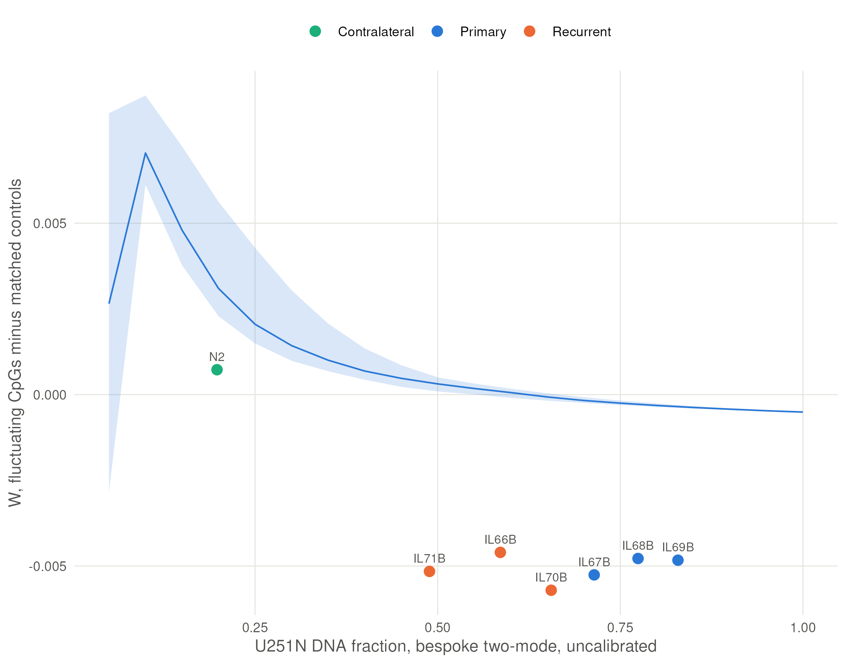
Backup. Fluctuating CpGs: uninformative, and why
The homogeneity readout was pre-registered with two gates. The second failed: the parental culture is already multimodal at the published fluctuating-CpG sets.
So no homogeneity claim is made anywhere in this work.
Gabbutt 2022 and 2025 lists, frozen by hash; ten matched control CpGs per site; the band is the dilution model. Orthotopic U251N glioblastoma xenograft in the athymic rat, MRI-guided LITT; bulk RNA-seq of primary and recurrent tumors, n = 3 per arm; GEO GSE338105.
Notes:
NEW in v6. Backup: show only if asked.

Slide 44
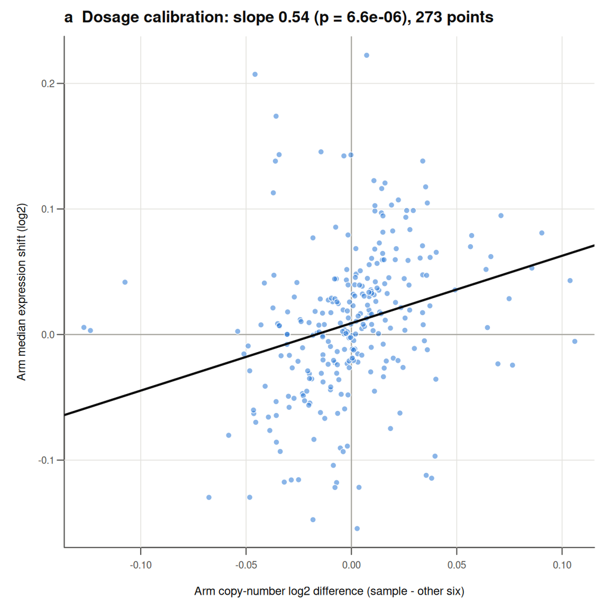
Backup. Array against RNA: expression follows copy number
Where the RNA is tumor-rich, expression follows copy number: slope 0.54 (p = 7e-06).
The CDKN2A/B deletion every array calls is silent in every library, as it must be.
Arm-level copy number against arm-median expression shift; nulls matched on expression decile. Orthotopic U251N glioblastoma xenograft in the athymic rat, MRI-guided LITT; bulk RNA-seq of primary and recurrent tumors, n = 3 per arm; GEO GSE338105.
Notes:
NEW in v6. Backup: show only if asked.

Slide 45
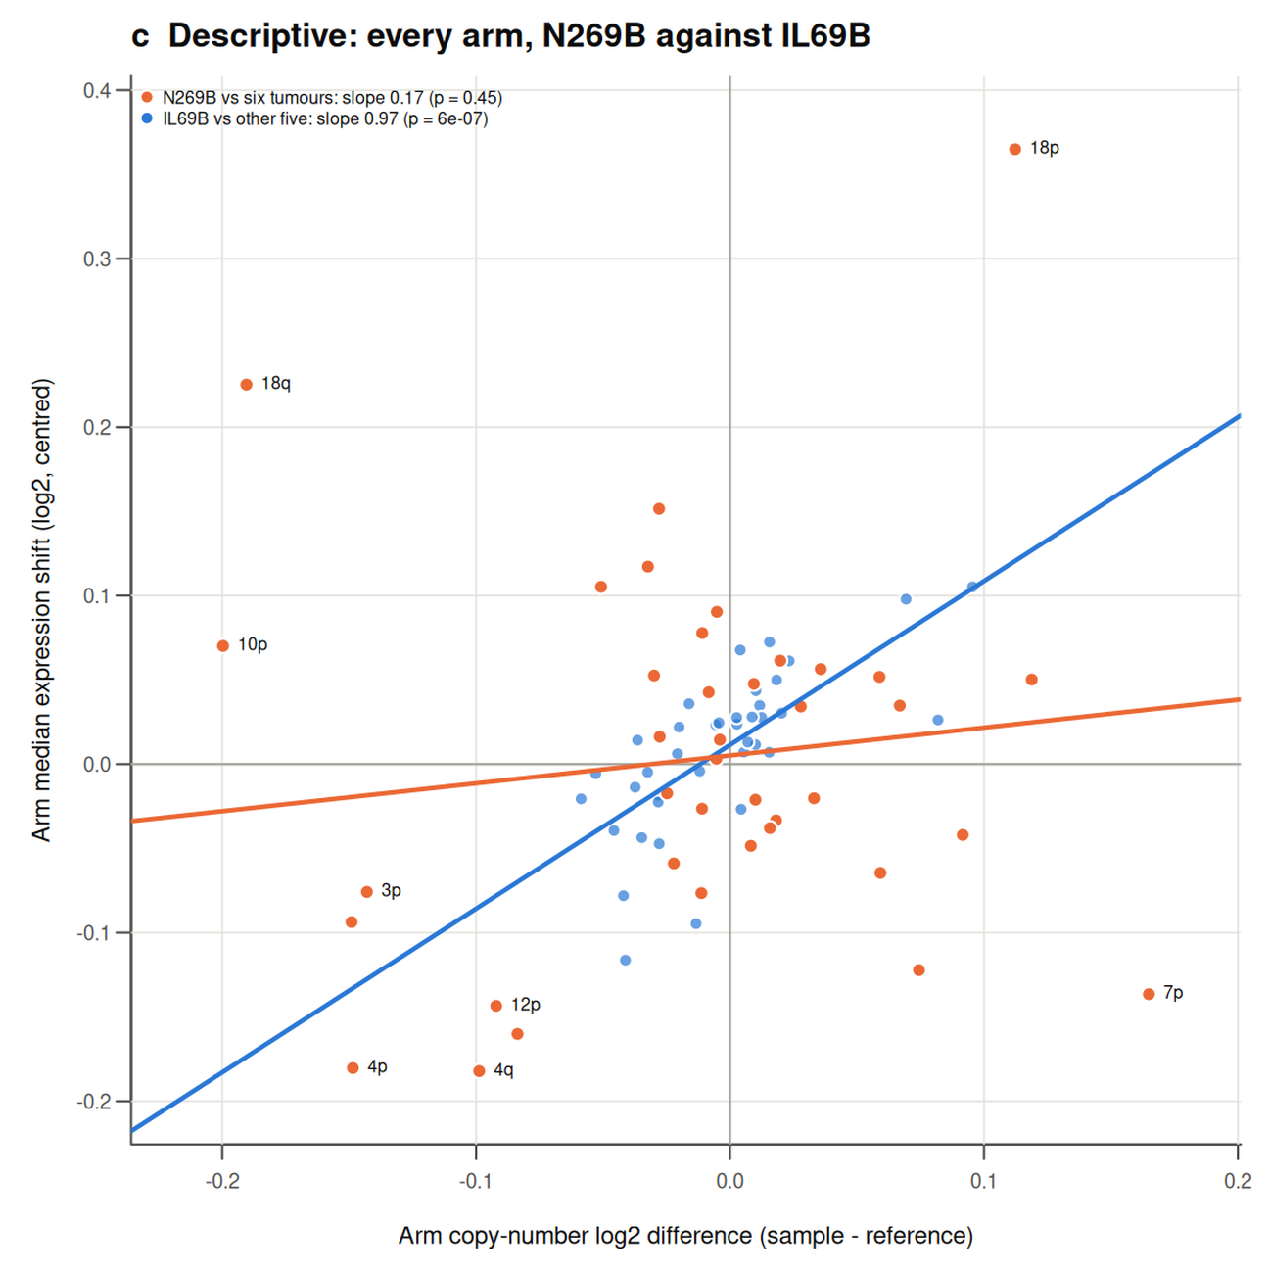
Backup. Why the contralateral copy-number losses stay unresolved
In the contralateral sample, arm-level expression does not follow its copy number anywhere in the genome (slope 0.17, p = 0.45), against 0.97 for its own core.
So its deeper losses stay array-only: the assay has no demonstrated dosage sensitivity there.
Arm copy number against arm-median expression shift, per sample. Orthotopic U251N glioblastoma xenograft in the athymic rat, MRI-guided LITT; bulk RNA-seq of primary and recurrent tumors, n = 3 per arm; GEO GSE338105.
Notes:
NEW in v6. Backup: show only if asked.

Slide 46
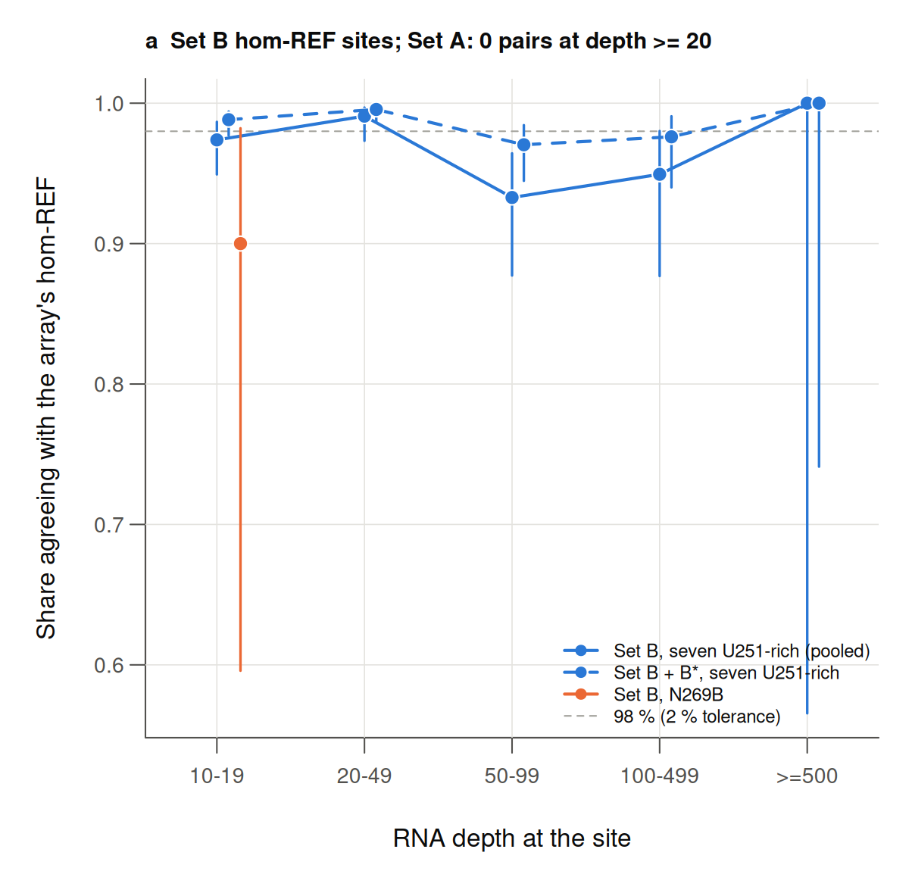
Backup. Array against RNA: genotype
At expressed CpG-SNP positions the RNA genotype agrees with the array in 527 of 543 pairs (97.1 %).
The sixteen disagreements sit at five common germline sites carried by every sample: line-wide, not subclonal.
bcftools pile-up at the array's probe positions; genotype cut-offs fixed in the pre-registration. Orthotopic U251N glioblastoma xenograft in the athymic rat, MRI-guided LITT; bulk RNA-seq of primary and recurrent tumors, n = 3 per arm; GEO GSE338105.
Notes:
NEW in v6. Backup: show only if asked.

Slide 47
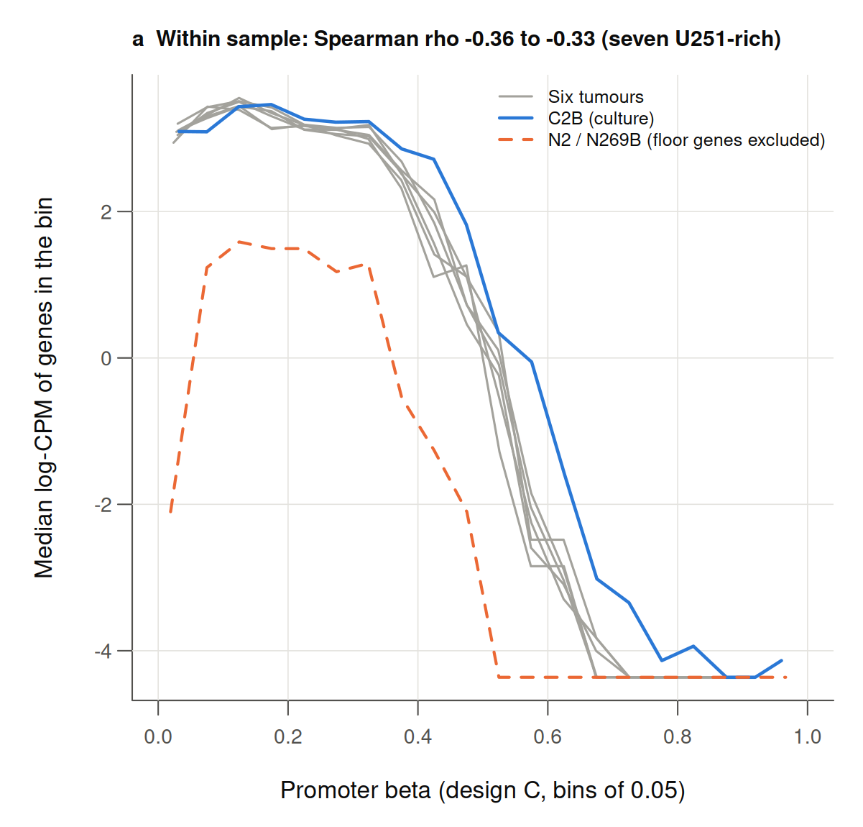
Backup. Array against RNA: promoter methylation
Within every sample, promoter methylation and expression anticorrelate (Spearman -0.31 to -0.36).
Across the recurrence contrast they do not move together (-0.003), and the ribosomal-protein fall has no promoter or copy-number support.
Promoter beta against log-CPM per sample; 10,000 gene-pairing shuffles as the null. Orthotopic U251N glioblastoma xenograft in the athymic rat, MRI-guided LITT; bulk RNA-seq of primary and recurrent tumors, n = 3 per arm; GEO GSE338105.
Notes:
NEW in v6. Backup: show only if asked.

Slide 48
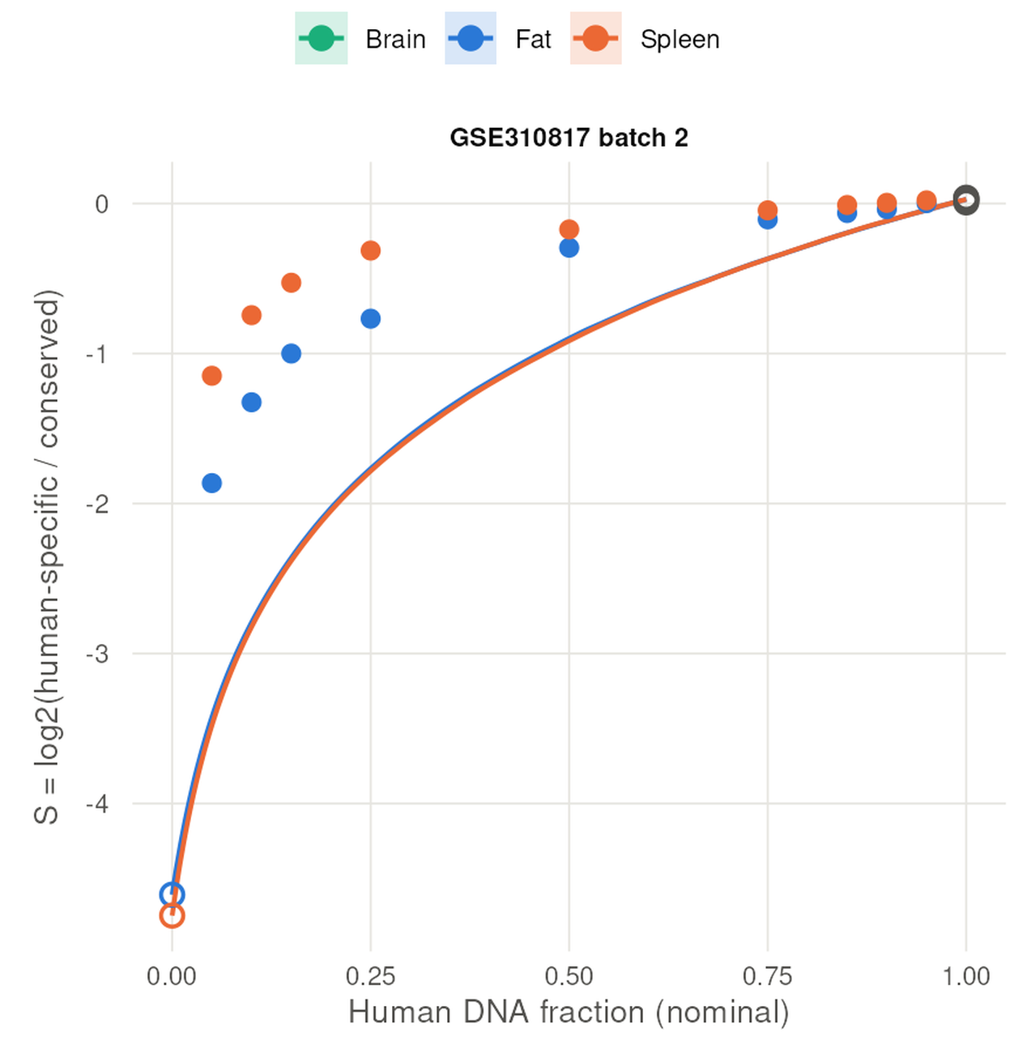
Backup. The calibration that failed
Mixing two pure arrays in silico does not reproduce real DNA mixtures: mean absolute error 0.242 against a pre-set bar of 0.05, every real mixture reading high.
So every tumor-fraction value here is uncalibrated and every dilution null is labelled unvalidated. No published human:rat titration on a human methylation array exists.
GSE310817 human:mouse titrations (EPIC v1) as the validation set; points, real mixtures; line, in silico. Orthotopic U251N glioblastoma xenograft in the athymic rat, MRI-guided LITT; bulk RNA-seq of primary and recurrent tumors, n = 3 per arm; GEO GSE338105.
Notes:
NEW in v6. Backup: show only if asked.

Slide 49
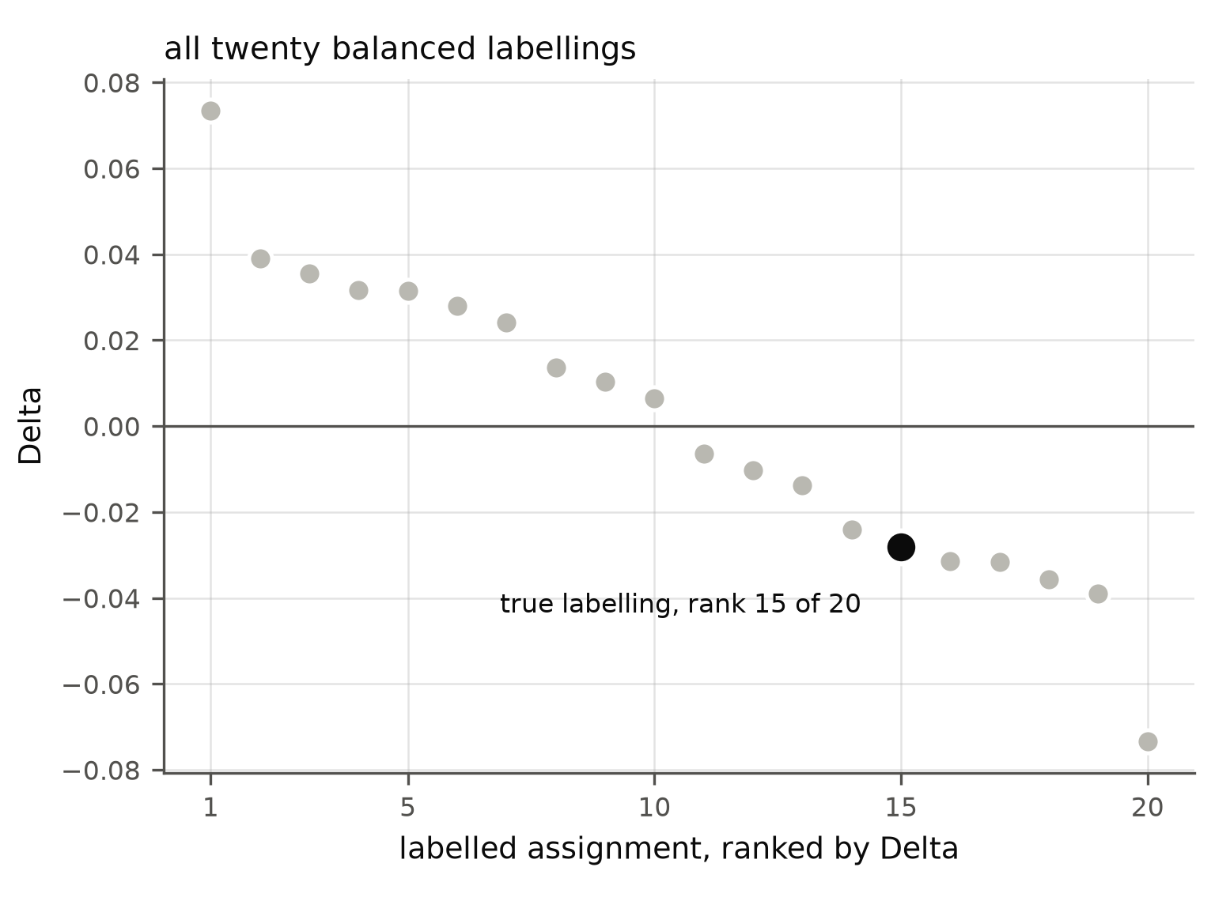
Backup. Does the contralateral population look like the recurrences?
No: the true arm labelling ranks fifteenth of twenty.
A variant-sharing test looked strongly positive until the variants a tumor-free library also carries were removed; then 0.830 against 0.828. Host reads in the graft stream manufacture that signal.
All libraries subsampled to one depth before the comparison; twenty balanced labellings. Orthotopic U251N glioblastoma xenograft in the athymic rat, MRI-guided LITT; bulk RNA-seq of primary and recurrent tumors, n = 3 per arm; GEO GSE338105.
Notes:
NEW in v6. Backup: show only if asked.

Slide 50
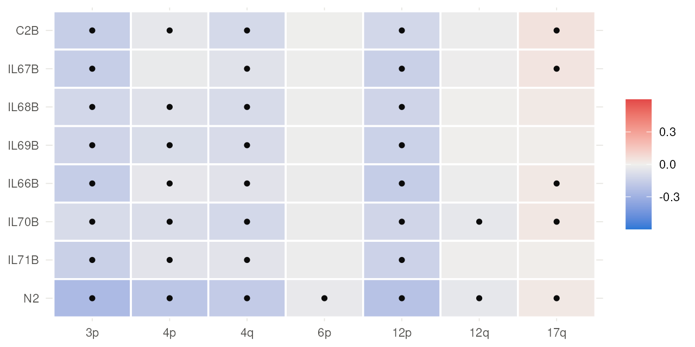
Backup. The four arms named before the analysis
None is a contralateral-only copy-number event: the animal's own core carries all four, and so does the parental culture.
Along the genome the contralateral profile is the core's profile with the same breakpoints.
Colour: amplitude-scaled log2 ratio; a dot marks a value beyond the noise bound measured on thirteen normals. Orthotopic U251N glioblastoma xenograft in the athymic rat, MRI-guided LITT; bulk RNA-seq of primary and recurrent tumors, n = 3 per arm; GEO GSE338105.
Notes:
NEW in v6. Backup: show only if asked.

Slide 51
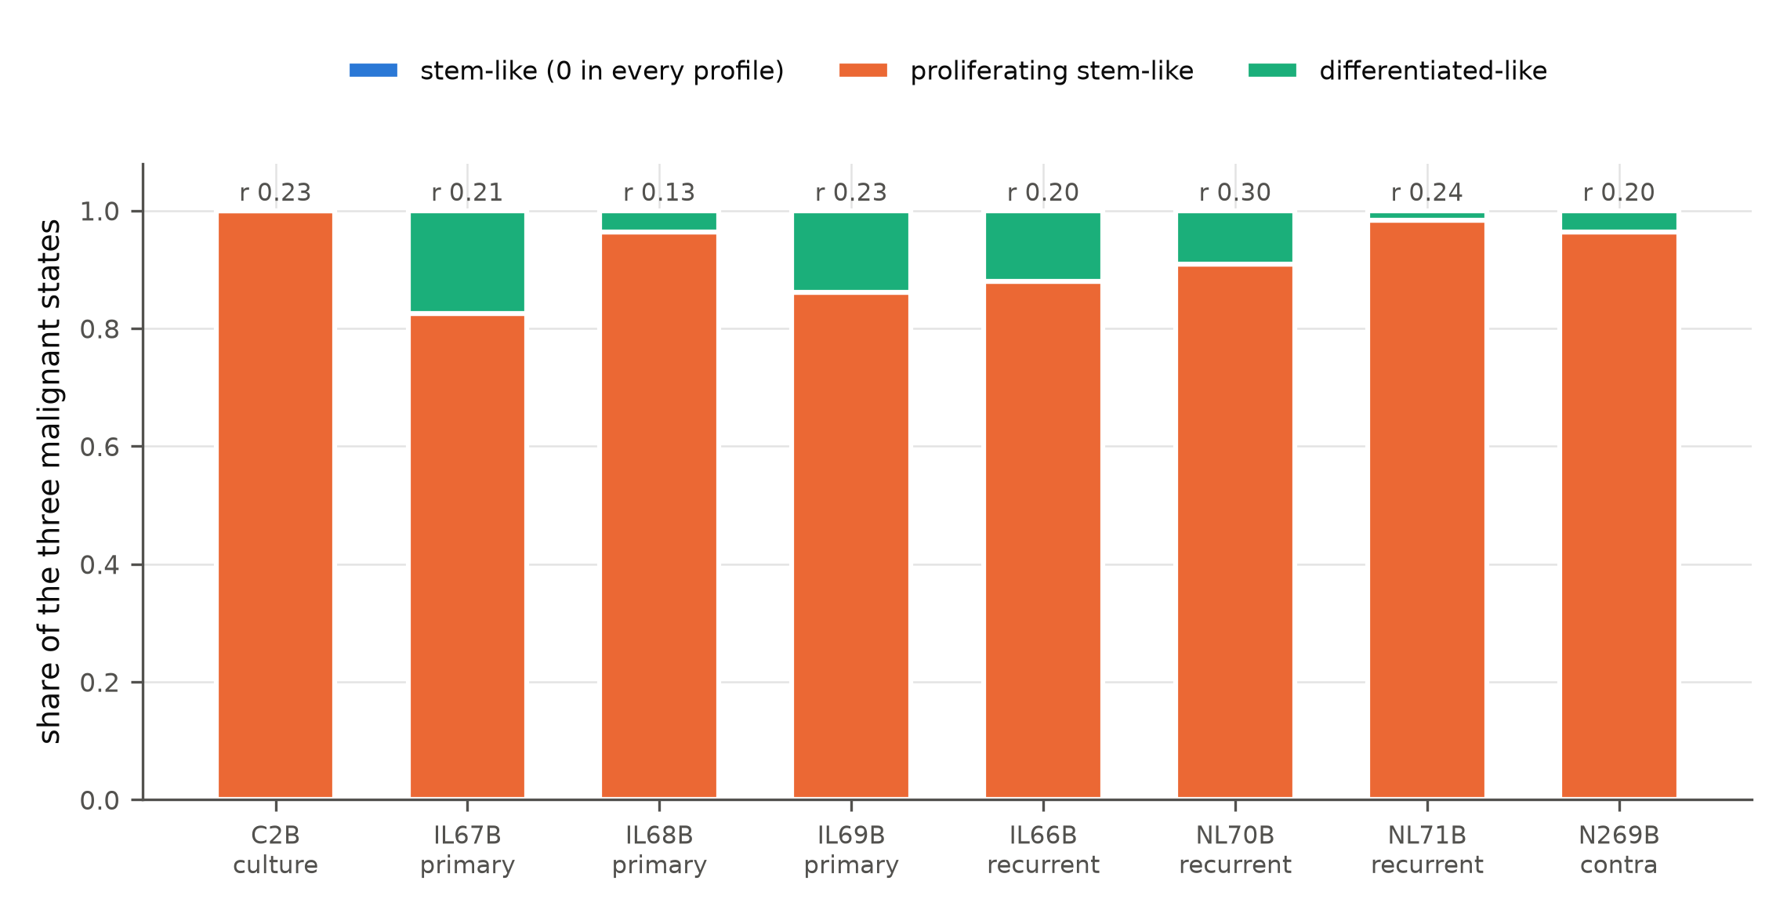
Backup. Malignant-state composition of the human reads
The contralateral sample has fewer differentiated-like cells than its own core (0.037 against 0.139).
Weighted lightly: another animal's tumor differs by the same distance, and the method assigns 36 % of a pure human culture to cell types a human-only read stream cannot contain.
CIBERSORT with a published single-cell reference; fit correlation printed above each bar. Orthotopic U251N glioblastoma xenograft in the athymic rat, MRI-guided LITT; bulk RNA-seq of primary and recurrent tumors, n = 3 per arm; GEO GSE338105.
Notes:
NEW in v6. Backup: show only if asked.

Slide 52
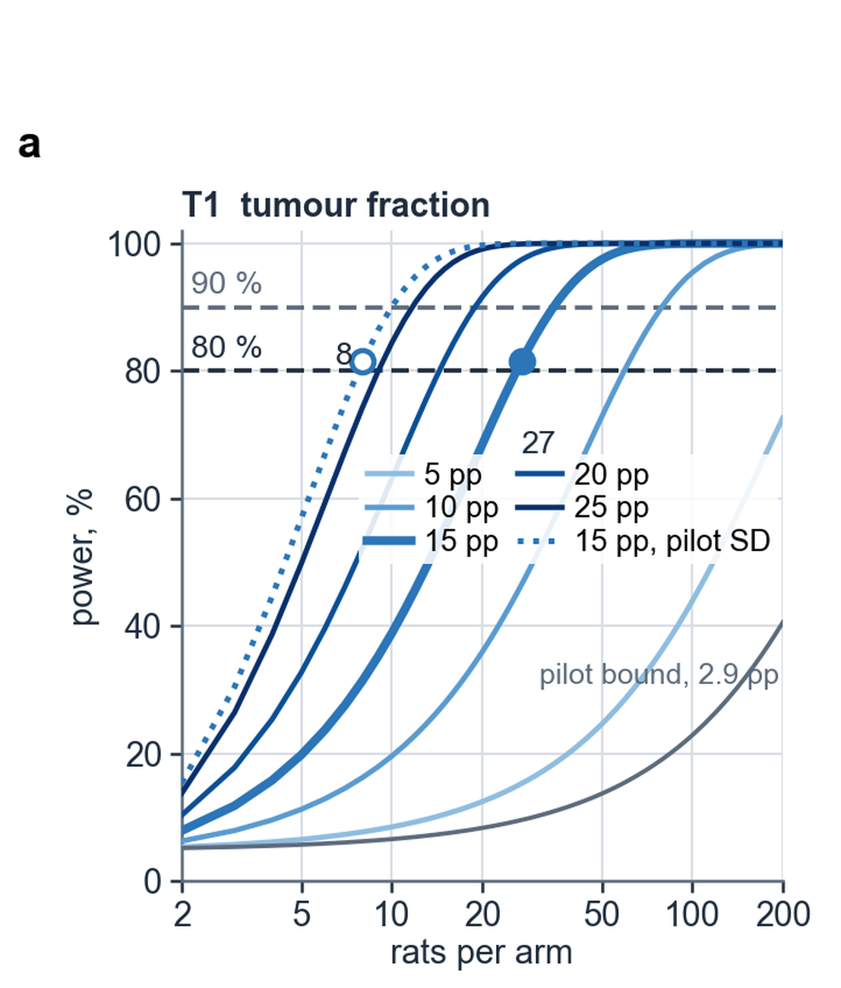
Backup. Sizing the tumour-content endpoint
27 rats per arm for a 15-point difference in tumor content at 80 % power, 35 under Holm; the pilot's own spread sets the variance.
The dotted curve is the optimistic reading at the pilot's variance; the study is sized on the pessimistic one.
28. Browne RH. Stat Med 1995;14:1933-1940. Power against rats per arm at effects of 5 to 25 points. Orthotopic U251N glioblastoma xenograft in the athymic rat, MRI-guided LITT; bulk RNA-seq of primary and recurrent tumors, n = 3 per arm; GEO GSE338105.
Notes:
NEW in v6. Backup: show only if asked.

Slide 53
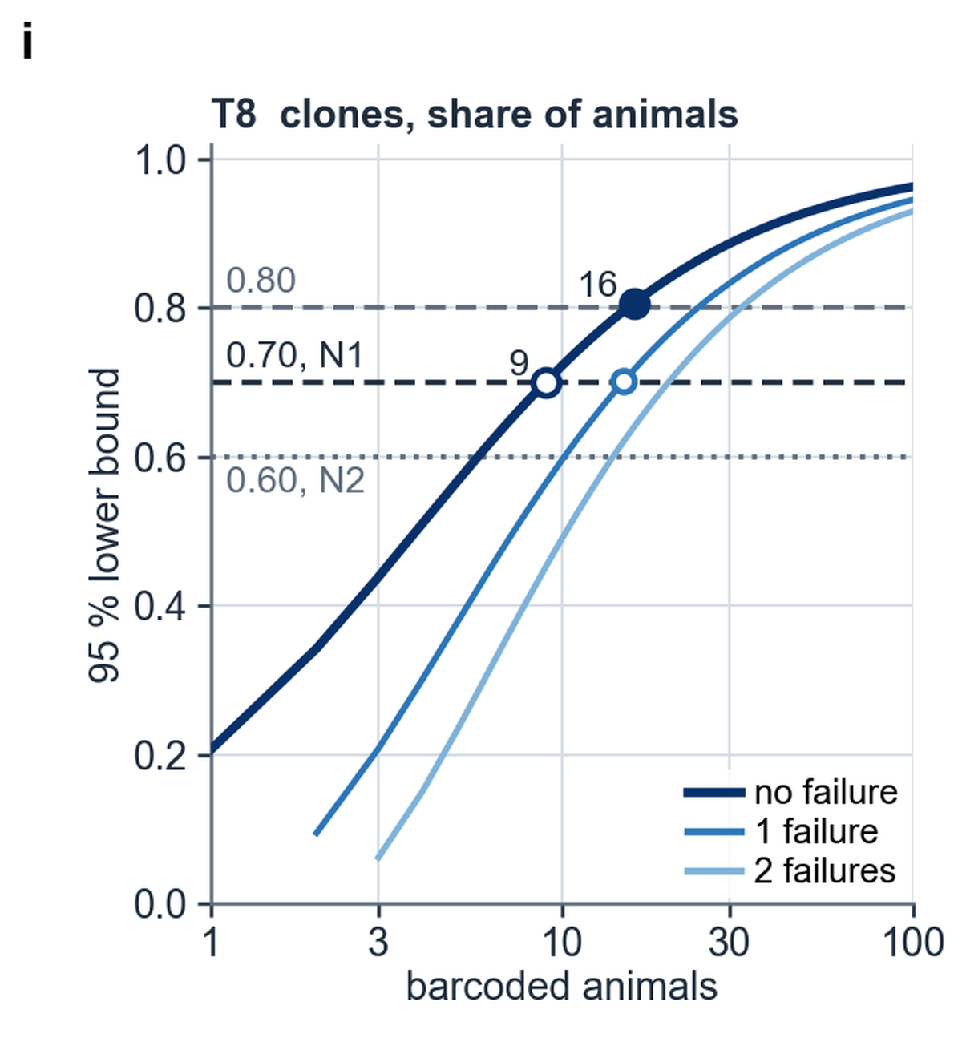
Backup. Sizing the clone-level test
Wilson lower bound on the share of barcoded animals rejecting in the pre-stated direction: 9 animals with no failure reach 0.70, 16 reach 0.80.
The unit of inference is the clone, which is how single digits suffice.
The SchwingNet Figure 5a construction: a Wilson lower bound against the number of units. Orthotopic U251N glioblastoma xenograft in the athymic rat, MRI-guided LITT; bulk RNA-seq of primary and recurrent tumors, n = 3 per arm; GEO GSE338105.
Notes:
NEW in v6. Backup: show only if asked.

