Slide 1



Detroit Medical Center / Wayne State University · Henry Ford Health
Characterizing the Transcriptomic Recurrence Signature of Glioblastoma Following Laser Interstitial Thermal Therapy
Gregory J. Schwing, MD, PhD¹ · Tavarekere N. Nagaraja, PhD² · Indrani Datta, DHI² · Ian Y. Lee, MD²
¹ Department of General Surgery, Detroit Medical Center / Wayne State University, Detroit, MI
² Department of Neurosurgery, Hermelin Brain Tumor Center, Henry Ford Health, Detroit, MI
Abstract 418 · Sunrise Science Session – Tumor 2
Monday, November 2, 2026 · 7:00 AM
CNS 2026 · Washington, DC · Abstract 418
Notes:
0:00-0:12 Title. Name, institutions, and that this is a rat model of MRI-guided LITT. Do not read the title aloud.

Slide 2

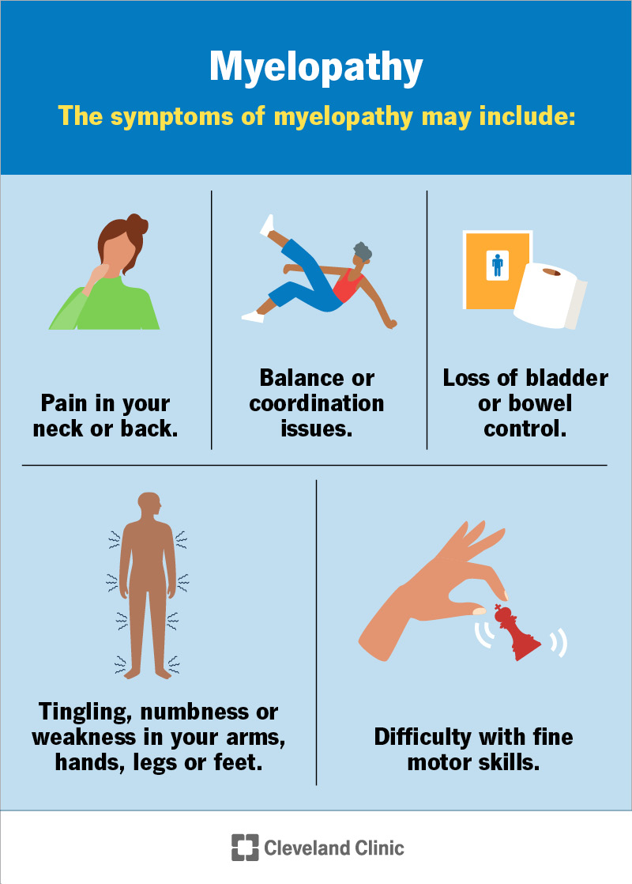
Disclosures
Disclosures
I.Y.L. has consulting agreements with Medtronic, Inc. (Minneapolis, MN) and Monteris Medical, Inc. (Plymouth, MN).
All other authors declare no conflicts of interest.
Supported by a Henry Ford Health Physician Scientist Award A20050 (I.Y.L.). No commercial support was received for this analysis.
Drug candidates discussed here are computational predictions. No agent named in this talk is approved or under study for this indication.
CNS 2026 · Washington, DC · Abstract 418
Notes:
0:12-0:22 Disclosures. Read Dr Lee's Medtronic and Monteris agreements out loud - Monteris makes the LITT system, so the room will want to hear it named.

Slide 3
Overview
Where this is going
1
The problem — LITT kills the core; the cells that come back sat in the sublethal margin
2
The model — MRI-guided LITT in an orthotopic rat xenograft, primary and recurrent tumors matched
3
The finding — the recurrent transcriptome switches protein synthesis off
4
The convergence — subtype scores and network hubs point the same way
5
The opening — which existing, brain-penetrant drugs oppose that state
CNS 2026 · Washington, DC · Abstract 418
Notes:
0:22-0:40 Roadmap. Five beats, ten seconds. Do not linger.

Slide 4
Background
LITT ablates the core; recurrence starts at the margin
LITT is increasingly used for deep-seated and recurrent glioblastoma, where open resection carries high morbidity.¹
Thermal dose falls off with distance from the fiber. Beyond the ablative threshold lies a sublethal margin.
The cells that seed recurrence are the ones that survive there.
peritumoral brain
sublethal margin
ablation core
1. Chen C, et al. J Neurooncol 2021;151:429–442.
CNS 2026 · Washington, DC · Abstract 418
Notes:
0:40-1:10 Background. The one idea to land: LITT kills the core, but the cells that come back sat in the sublethal margin. Point at the diagram once.

Slide 5
Background
What that margin is known to do — and what it is not
Already described
Not described
Peri-ablation vessels transiently open the blood–brain barrier after ablation.²
The immune microenvironment of the sublethal zone has been profiled in a rodent model.³
The cell-intrinsic transcriptional state of the residual tumor cells that survive ablation and repopulate the lesion.
That is the gap this analysis addresses.
Does post-LITT recurrence carry its own transcriptional program — and does that program point to a drug?
2. Cleary RT, et al. Neuro Oncol 2026;28:1649–1661. 3. Tao R, et al. J Immunol 2026;215:vkaf327.
CNS 2026 · Washington, DC · Abstract 418
Notes:
1:10-1:35 The gap. The vessels and the immune side of that margin have been described; the tumor cells' own state has not. End on the question and pause.

Slide 6
Methods
The model
An orthotopic U251N glioblastoma xenograft in the athymic RNU/RNU rat, ablated under MRI guidance — a model our group established and characterized previously.⁴˒⁵
Orthotopic
U251N xenograft
MRI-guided
LITT
Matched tumors
re-harvested
human glioblastoma line
in the athymic RNU/RNU rat
thermal ablation of the
primary tumor under
real-time MR thermometry
primary (pre-LITT) and
recurrent (post-LITT)
n = 3 per arm
The graft is human and the host is rat, which is the point: every read can be assigned to a species, so the tumor compartment can be read on its own.
4. Nagaraja TN, et al. Acta Neurochir 2021;163:3455–3463. 5. Nagaraja TN, et al. J Neurosurg 2026:1–14.
CNS 2026 · Washington, DC · Abstract 418
Notes:
1:35-2:00 The model. Move fast. The one thing to stress is that the graft is human and the host is rat, which is what makes the tumor compartment separable.

Slide 7
Methods
The analysis
xengsort
DESeq2
Broad GSEA · subtypes
STRING · DSigDB
human graft reads sorted
from rat host reads, k = 25
Wald test, ashr shrinkage
FDR < 0.05, |log₂FC| > 1
enrichment, subtypes,
network and drug ranking
Enrichment was permuted on gene-set membership, not on samples. At n = 3 per arm there are too few sample permutations to estimate significance, and gene-set permutation is substantially more reproducible at this size.⁶
Repurposing screened DSigDB, ranking each compound by how strongly its own signature countered the tumor signature (|NES|¹˙⁵), weighted by predicted blood–brain barrier permeability.
Raw sequencing data are public: GEO accession GSE338105.
6. Maleki F, et al. Hum Genomics 2019;13(Suppl 1):42.
CNS 2026 · Washington, DC · Abstract 418
Notes:
2:00-2:25 The analysis. Enrichment was permuted on gene-set membership, not on samples, because n = 3. If someone challenges the statistics later, this slide is the answer. Mention the GEO accession is already public.

Slide 8
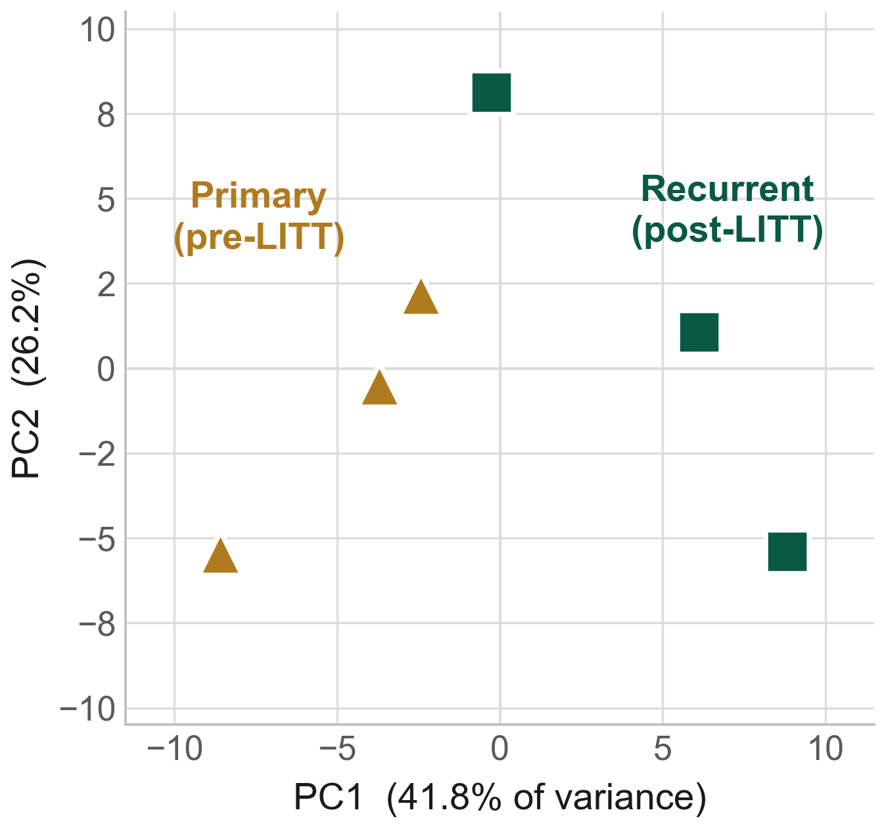
Results
Primary and recurrent tumors separate globally
The two arms sit on opposite sides of PC1. 41.8% of the variance is on that axis and 26.2% on PC2.
PERMANOVA attributes R² = 0.278 of transcriptome-wide variance to recurrence (F = 1.54, p = 0.10).
A large effect that three animals per arm cannot make formally significant. Worth saying out loud rather than leaving in the supplement.
CNS 2026 · Washington, DC · Abstract 418
Notes:
2:25-2:50 Global structure. The arms separate on PC1. Say the PERMANOVA p = 0.10 out loud - do not let someone find it in the supplement. Frame it as: the effect is large, the sample is small.

Slide 9
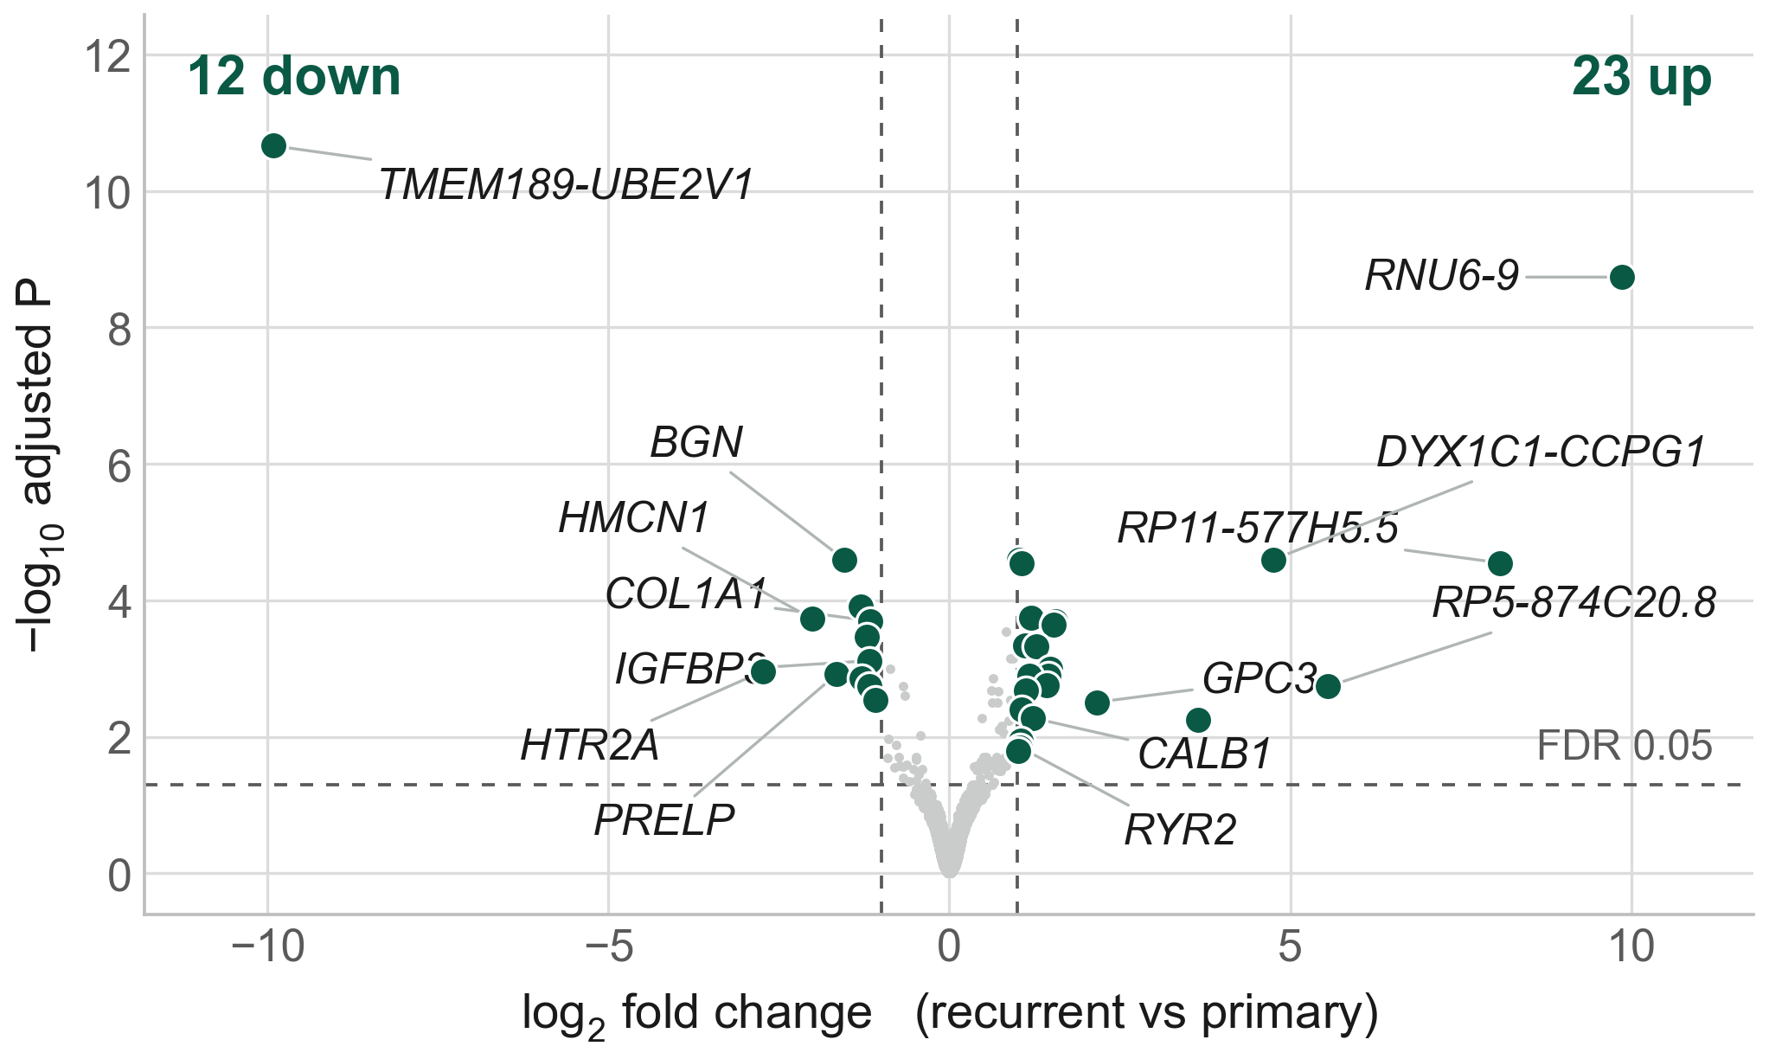
Results
Only 35 genes move
35 genes clear FDR < 0.05 with |log₂FC| > 1 — 23 up, 12 down; 27 are protein coding.
Largest fold changes | log₂FC | what the locus is
TMEM189-UBE2V1 | −9.9 | readthrough transcript
RNU6-9 | +9.9 | small nuclear RNA
RP11-577H5.5 | +8.1 | readthrough transcript
RP5-874C20.8 | +5.6 | unclassified locus
DYX1C1-CCPG1 | +4.8 | readthrough transcript
ENSG00000289697 | +3.6 | unclassified locus
Every one of the six is a readthrough transcript, a small nuclear RNA or an unannotated locus, on 14–111 mean counts against a median of 232 — where a handful of reads makes a large ratio.
A list this short does not carry the biology. The rest of the talk asks what the whole transcriptome is doing.
CNS 2026 · Washington, DC · Abstract 418
Notes:
2:50-3:10 Differential expression. Only 35 genes. Walk the table once, do not read it: the six biggest fold changes are readthrough transcripts, a U6 snRNA and two unannotated loci, all on double-digit counts. That is what justifies the pivot to gene sets, and it pre-empts the reviewer who asks why you did not chase the top hit. Do not dwell on individual genes.

Slide 10
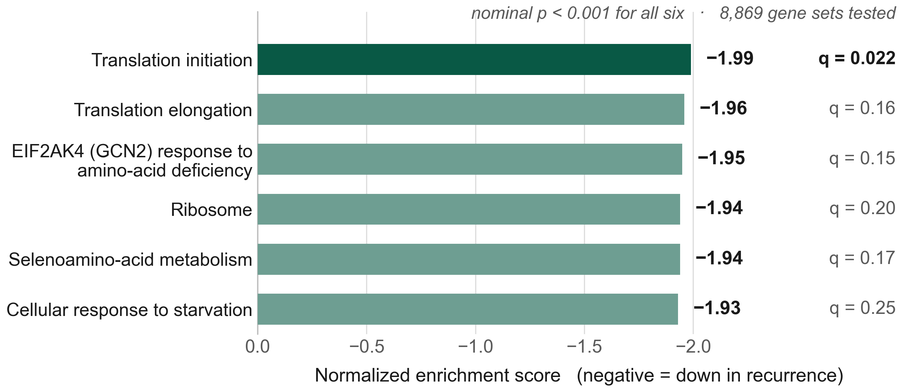
Results
One dominant theme: translation is switched off
Every leading down-regulated set is a translation or amino-acid-stress set.
The same direction runs across the whole anabolic programme: mTORC1 −1.46, MYC −1.29, ribosome biogenesis −1.62, glycolysis −1.57, OXPHOS −1.45.
The TCA cycle is unchanged (−0.67) — this is the biosynthetic machinery, not core carbon flux.
Broad GSEA, gene-set permutation, 1000 permutations, Diff_of_Classes. Nominal p is reported alongside FDR q because n = 3 per arm.
CNS 2026 · Washington, DC · Abstract 418
Notes:
3:10-3:45 The core result. Every leading down-regulated set is translation or amino-acid stress. The top set clears FDR; the next five are nominally significant and directionally identical. Say both halves. Then the right-hand panel: the same direction runs across mTORC1, MYC, ribosome biogenesis, glycolysis and OXPHOS, while the TCA cycle does not move. The point to land is that this is the biosynthetic machinery being switched off, not core carbon flux - a cell that has stopped building, not one that has stopped burning.

Slide 11
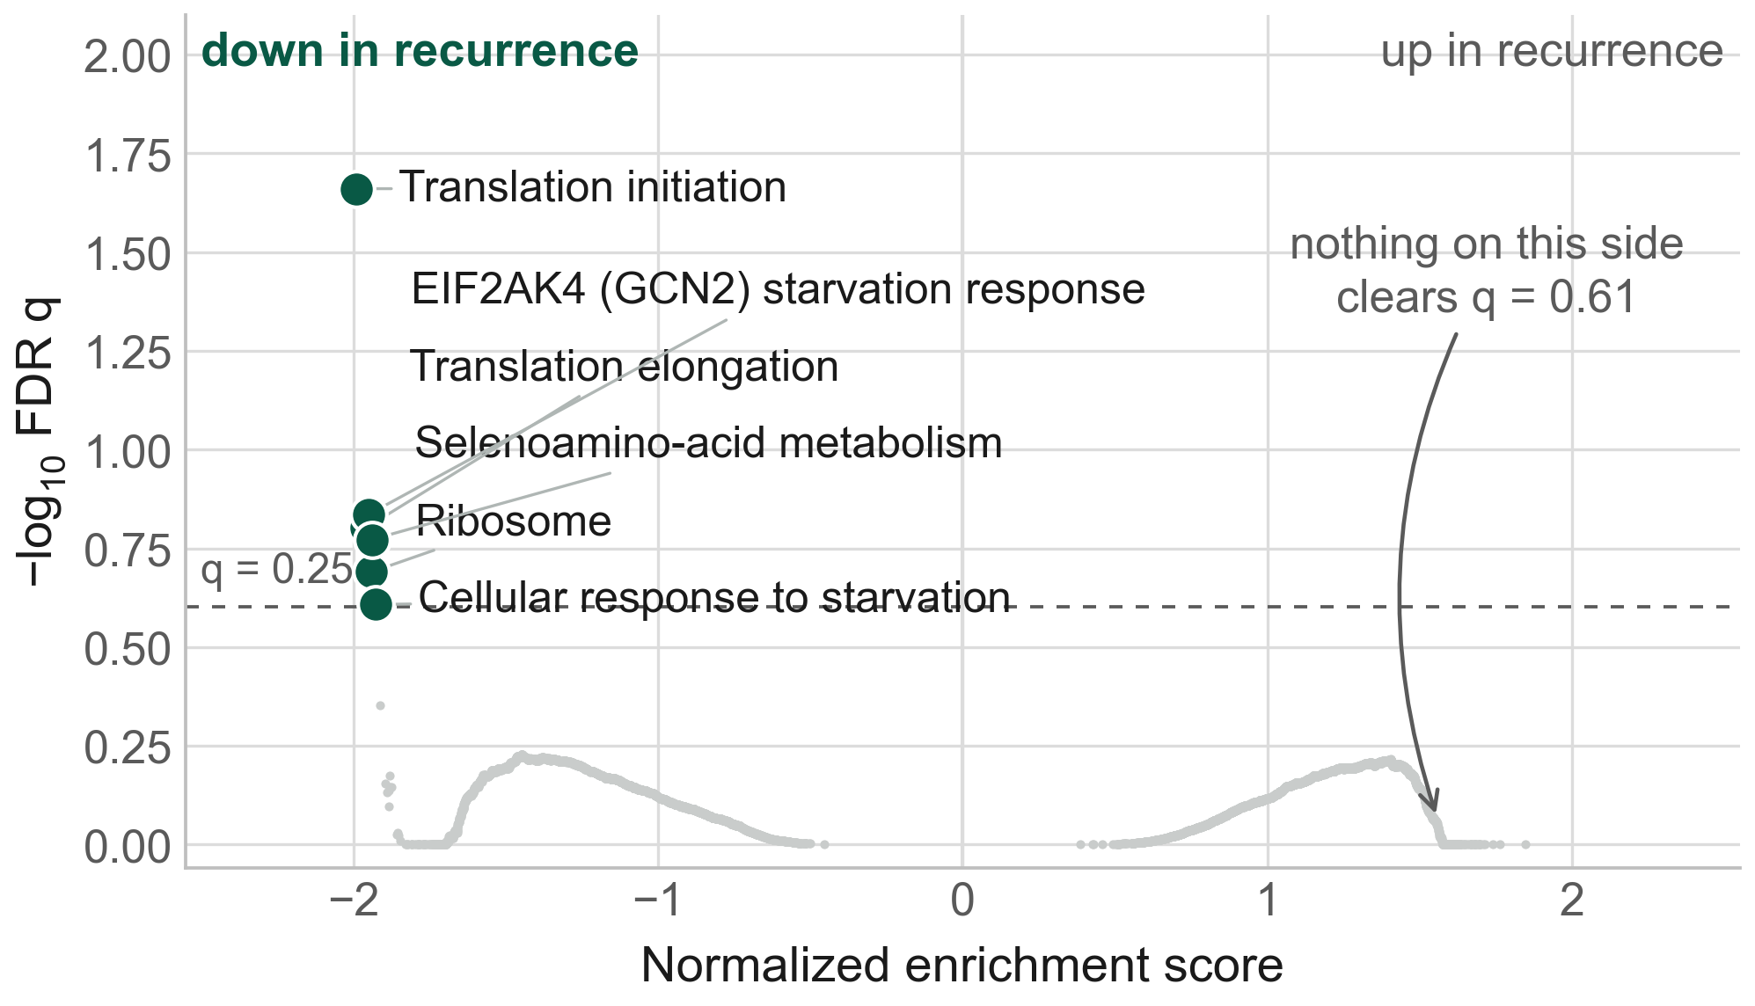
Results
The effect is strikingly one-sided
Across 8,869 gene sets, six reach q < 0.25. All six are down-regulated, and all six are translation or stress sets.
Nothing on the up-regulated side survives correction (best q = 0.61) or forms an interpretable group.
The recurrent state is defined by what it switches off, not by a new program it switches on.
CNS 2026 · Washington, DC · Abstract 418
Notes:
3:45-4:10 The one-sidedness. This is the strongest slide - 8,869 sets tested, six clear q < 0.25, all six on the same side and all six the same theme. Nothing on the up side is interpretable.

Slide 12
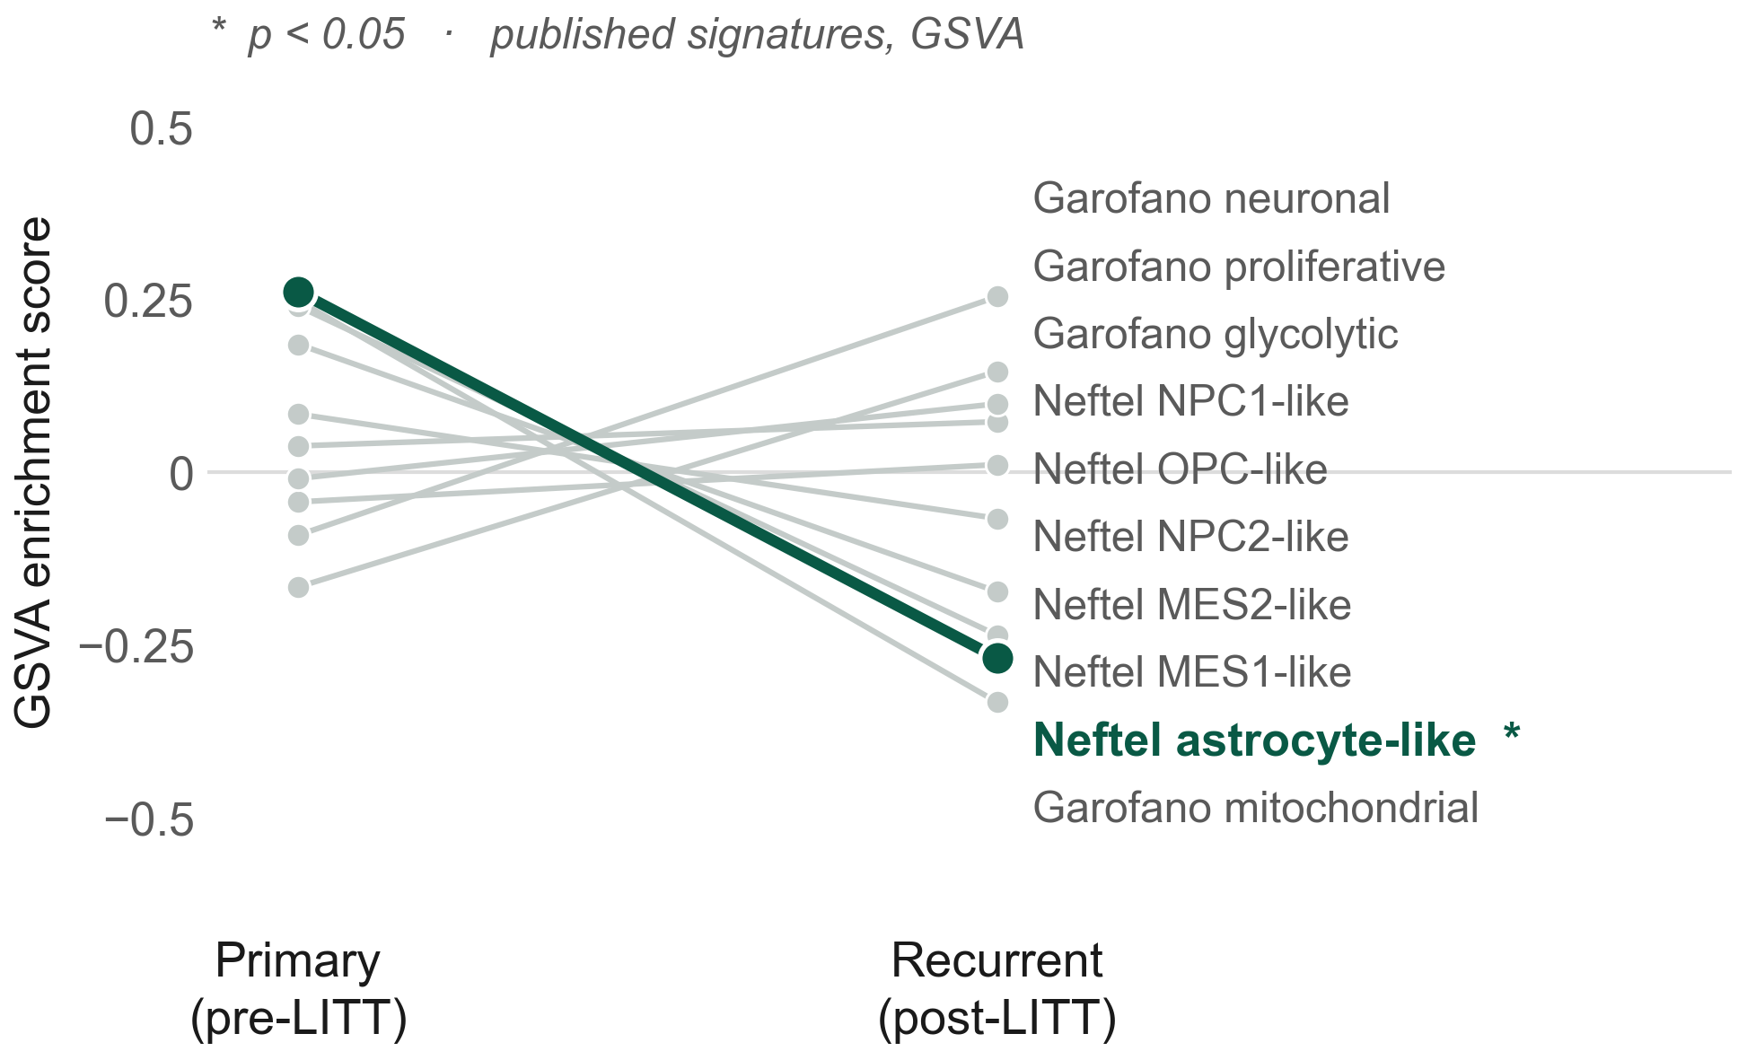
Results
Scored against the published classifiers
Ten published Neftel and Garofano signatures, scored by GSVA — 39 to 50 genes each.
One transition reaches significance: loss of the astrocyte-like state (+0.26 → −0.27, p = 0.007).
The mitochondrial signature moves with them (−0.58) — the same direction as the fall in OXPHOS and mitochondrial translation, and 34 of its 35 measurable genes are lower in recurrence.
7. Garofano L, et al. Nat Cancer 2021;2:141–156. 8. Neftel C, et al. Cell 2019;178:835–849.
CNS 2026 · Washington, DC · Abstract 418
Notes:
4:10-4:35 Subtypes. These are the ten published Neftel and Garofano signatures, scored per sample by GSVA over the full 39-to-50-gene sets - say that, because using the published definitions rather than a hand-picked panel is the defence. One transition is significant: loss of the astrocyte-like state, p = 0.007. The mitochondrial signature moves the same way as the OXPHOS and mitochondrial-translation sets on the enrichment slide - point back to that slide, because two independent computations agreeing is the argument. If pressed on the mitochondrial call: 34 of its 35 measurable genes are lower in recurrence, and the result is stable across three levels of symbol mapping, 35/50 up to 49/50.

Slide 13
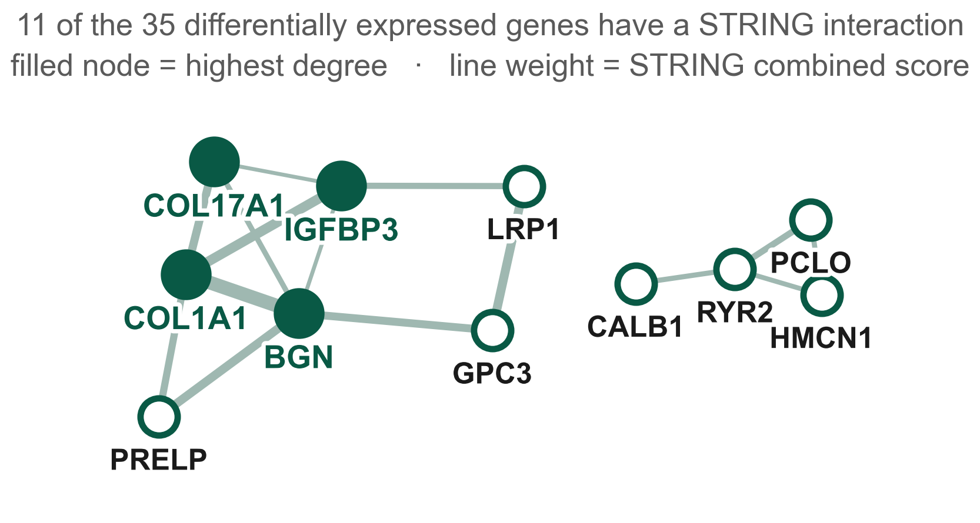
Results
The hubs: matrix genes down, calcium genes up
Hub gene | log₂FC | what it is
HMCN1 | −2.01 | hemicentin 1
PRELP | −1.66 | prolargin
BGN | −1.54 | biglycan
LRP1 | −1.22 | LDL-receptor–related protein 1
IGFBP3 | −1.18 | IGF-binding protein 3
COL1A1 | −1.16 | collagen type I α1
GPC3 | +2.17 | glypican 3
COL17A1 | +1.45 | collagen type XVII α1
CALB1 | +1.22 | calbindin 1
PCLO | +1.17 | presynaptic cytomatrix protein
RYR2 | +1.03 | ryanodine receptor 2
Down: the structural matrix. Up: neuronal calcium handling and the presynaptic scaffold.
Whether that echoes the neuron–glioma synapse described in high-grade glioma⁹˒¹⁰ — or only reflects which cells survived — six animals cannot tell us.
9. Venkatesh HS, et al. Nature 2019;573:539–545. 10. Venkataramani V, et al. Nature 2019;573:532–538.
CNS 2026 · Washington, DC · Abstract 418
Notes:
4:35-4:55 Hubs. Do not read the table - point at the sign column. Everything structural in the matrix goes down; the calcium and presynaptic genes (CALB1, RYR2, PCLO) go up. Offer the neuron-glioma synapse as a question, not a claim, and say plainly that six animals cannot separate it from a change in which cells survived. This is the slide most likely to draw a question, so know the two Nature 2019 papers. CUT THIS SLIDE FIRST if you are running long.

Slide 14
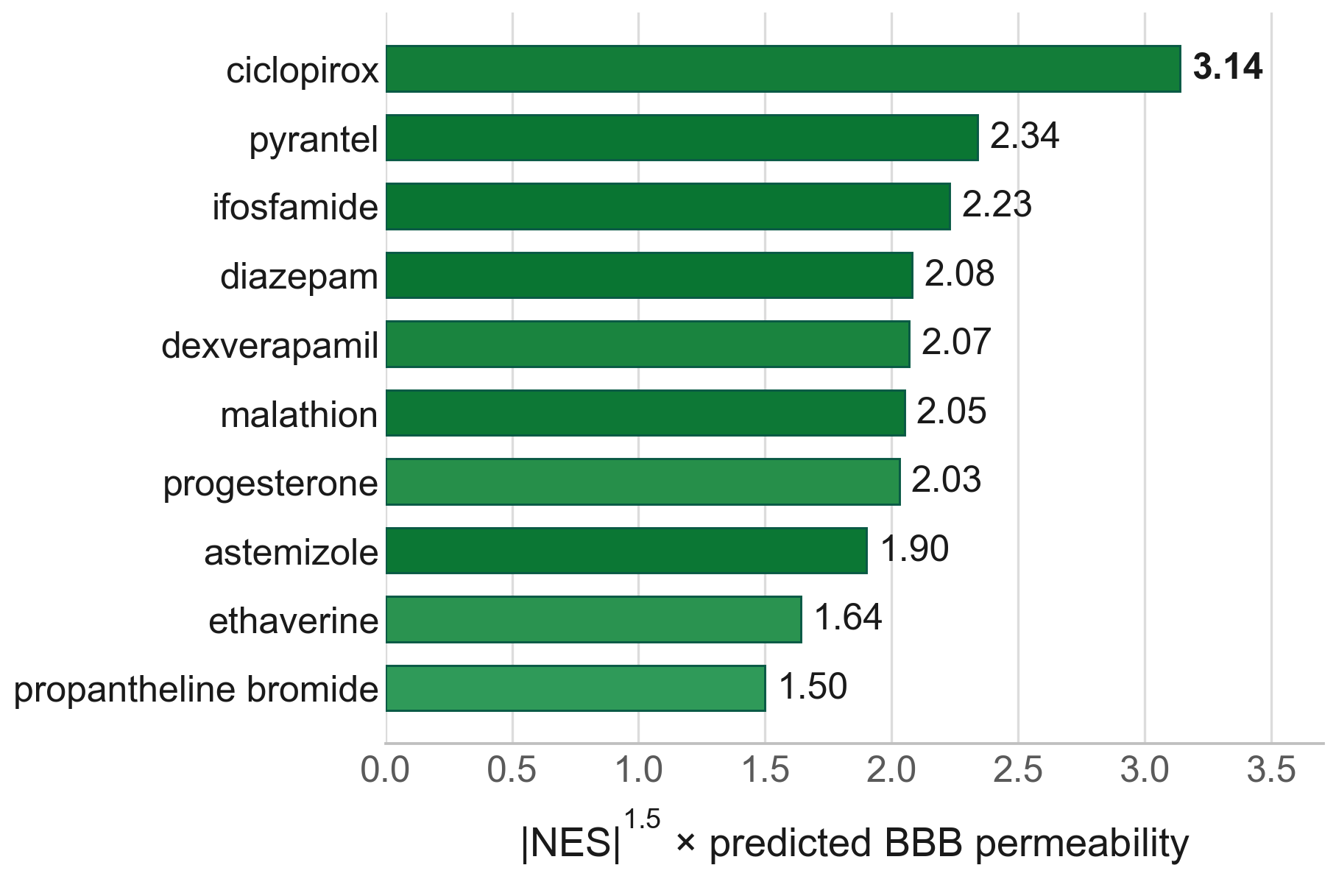
Results
One candidate survives every filter
# | Compound | Phase | |NES| | BBB | Score
1 | ciclopirox | 4 | 2.26 | 0.92 | 3.14
2 | pyrantel | 2 | 1.79 | 0.98 | 2.34
3 | ifosfamide | 4 | 1.73 | 0.98 | 2.23
4 | diazepam | 4 | 1.65 | 0.98 | 2.08
5 | dexverapamil | 2 | 1.78 | 0.87 | 2.07
6 | malathion | 4 | 1.66 | 0.96 | 2.05
Only 54 of 93 DSigDB hits carry a clinical phase — the rest include phosphine, tributyltin and a flame retardant.
Ciclopirox ranks first with or without the permeability weight, is approved, has completed phase 1 in cancer patients, and both BBB models agree.
Prior art was audited for every hit. Seven have no glioma literature; pentetrazol induces seizures. Amiodarone and diazepam carry published evidence of harm.
11. Swanson K, et al. Bioinformatics 2024;40:btae416. 12. Daina A, Zoete V. ChemMedChem 2016;11:1117–1121. 13. Boursi B, et al. Pharmacoepidemiol Drug Saf 2016;25:1179–1185.
CNS 2026 · Washington, DC · Abstract 418
Notes:
4:55-5:25 Therapeutics. Explain the score in one sentence: how strongly the drug signature reverses the tumor signature, weighted by predicted BBB penetration from ADMET-AI. Lead with the filter, because it is the honest part: only 54 of 93 DSigDB hits carry a clinical phase - the rest include phosphine, tributyltin and a flame retardant. Then own its limits before anyone asks: it keeps things that are not systemic therapies (oxygen, ozone, magnesium) and it drops approved drugs ChEMBL has no phase for, including deferoxamine. Ciclopirox is what survives: approved, ranked first with and without the permeability weight, both BBB models agree, and it chelates iron. If asked why it should work on a cell that has stopped building: the hypusination targets DOHH, DHPS and EIF5A are selective CRISPR dependencies in U251 in DepMap - that is independent of our signature. Then the delivery point: LITT opens the barrier at the margin for weeks. Deliver the caveat sentence exactly as written; this is where a reviewer will push.

Slide 15
Conclusions
Conclusions
Post-LITT recurrence carries a coordinated shutdown of biosynthesis — translation initiation, elongation, the ribosome and the GCN2 stress arm, with ribosome biogenesis, mTORC1 and MYC output falling alongside them.
It extends to energy metabolism on both arms — glycolysis and OXPHOS, and mitochondrial translation — while the TCA cycle is untouched.
Hypoxic signalling collapses (HIF targets, hypoxia metagene both −1.79). Ablation removes the hypoxic core; what regrows is better perfused.
Of the ten published subtype signatures, only loss of the astrocyte-like state reaches significance. Ciclopirox survives every filter — approved, phase 1 complete in cancer, and independently nominated by another group's screen.
This is the phenotype you would predict of a thermally stressed, reperfused margin — recovering it from an unbiased transcriptome is a positive control, and it is why the drug output of the same pipeline is worth acting on.
CNS 2026 · Washington, DC · Abstract 418
Notes:
5:25-5:45 Conclusions. Four beats, then the convergence line. No new material. The closing argument is the internal consistency - translational, anabolic, respiratory and hypoxic arms all moving together - not any single q value. Say that sentence and stop.

Slide 16
Limitations
Limitations and next steps
Limitations
n = 3 per arm. Gene-set results are best read as directional, which is why nominal p is reported alongside FDR q.
A single cell line (U251N) in a single xenograft model — no patient tissue and no immune compartment.
Bulk RNA-seq averages the ablation margin with whatever else was harvested; the persister state is inferred, not isolated.
Every drug candidate is a computational prediction. None has been tested in this model.
Next steps
Spatial or single-cell profiling of the sublethal margin, to test whether the persister state sits where we think it does.
Puromycin incorporation and polysome profiling, to confirm that translation is genuinely suppressed and not only transcriptionally down.
Ciclopirox and LY-294002 dosed into the post-ablation barrier window, with survival as the endpoint.
Validation in an immunocompetent model, and in patient tissue from the peri-ablation zone.
CNS 2026 · Washington, DC · Abstract 418
Notes:
5:45-5:55 Limitations and next steps. SECOND SLIDE TO CUT - the limitations are already stated on the results slides. Anticipated questions: why not more animals; why gene-set permutation; has any drug been tested (no).

Slide 17
Thank you
Acknowledgments and data availability
Tavarekere N. Nagaraja, PhD, Indrani Datta, DHI, and Ian Y. Lee, MD — Hermelin Brain Tumor Center, Henry Ford Health, who built and characterized the model this analysis rests on.
Supported by a Henry Ford Health Physician Scientist Award A20050 (I.Y.L.).
Animal procedures were approved by the Henry Ford Health IACUC (protocol #1509) and conducted in accordance with the ARRIVE guidelines.
Sequencing data: GEO GSE338105. Differential-expression, enrichment and drug-ranking tables are released as Supplementary Data.
Questions
go2432@wayne.edu
CNS 2026 · Washington, DC · Abstract 418
Notes:
5:55-6:00 Thanks. Name the Henry Ford group. Leave the GEO accession on screen during questions.

