Slide 1

Mobile Development Project 2 : Weatherly
Georgia State University - 04/18/25
Group Members: Gregory Vaughan, Andres Cuervo

Slide 2
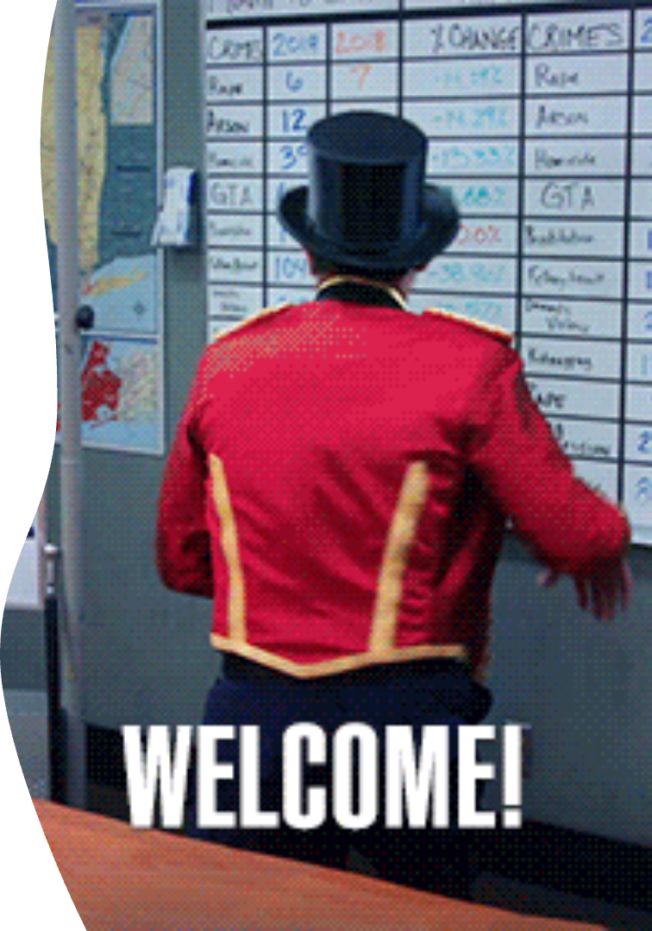
Project Summary
Weather Services
Personalized Alerts
Hourly and 7-day forecasts for local city
Warns users of preferred or disliked weather
Customization & Social
Backgrounds, message board, weather postcards
GitHub Link
Notes:
x

Slide 3
Proposed Wireframe
Key Screens
Social Features
Login & Registration
Message Board & Chat
Home & Profile Hubs
Community Notes
Theme & Insert City
Postcard Maker
Forecast & Map

Slide 4





Functionality & User Experience
User Flow
Login → Registration → Main Hub → Profile → City Input
Weather Interaction
Forecast → Map with zoom and filters
Social Interaction
Message Board → Notes → Postcard Maker → Post
UX Highlights
Valid email/password registration
Manual city selection or search
Hourly and 7-day forecasts
Map with weather types

Slide 5

Iterative Design Approach
1
Incremental Development
2
Continuous Testing
Test heavily before moving on
Build features in small chunks
3
Weekly Reviews
Update progress and discuss issues
Real-Time Testing: Login, Forecast Display, Profile settings … etc

Slide 6

Proposed APIs
OpenWeatherMap API
Provides weather data and forecasts
Leaflet
Interactive maps with weather overlays

Slide 7
User Interface Overview
City Selection & Forecast
Main Hub & Profile
Manual or search-based city input to display hourly and 7-day weather.
Login & Registration
Central navigation to access forecasts, profile settings, and customization.
Secure login with email and password or quick registration for new users.

Slide 8
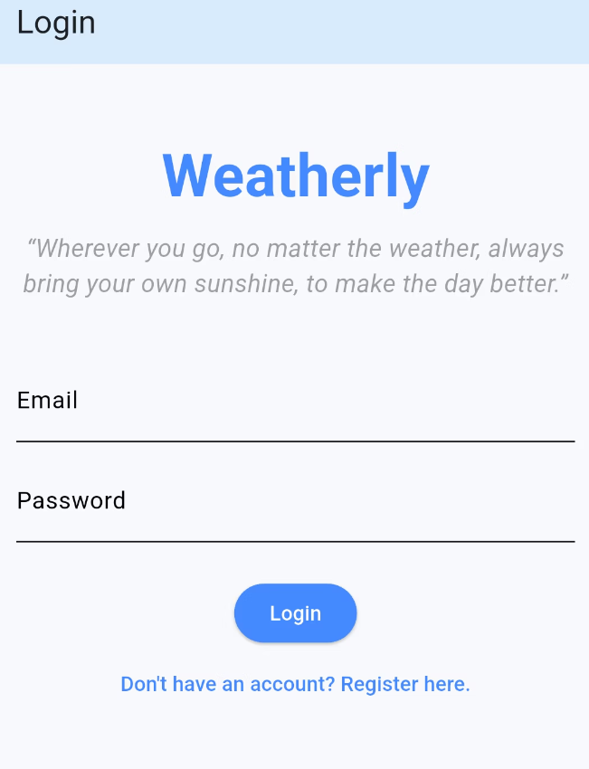
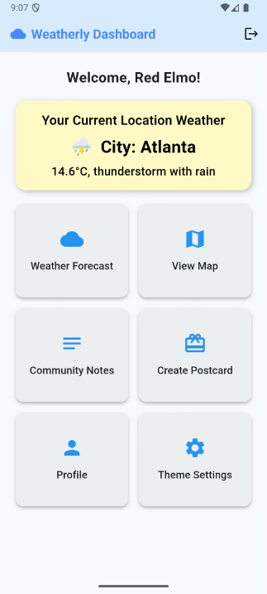
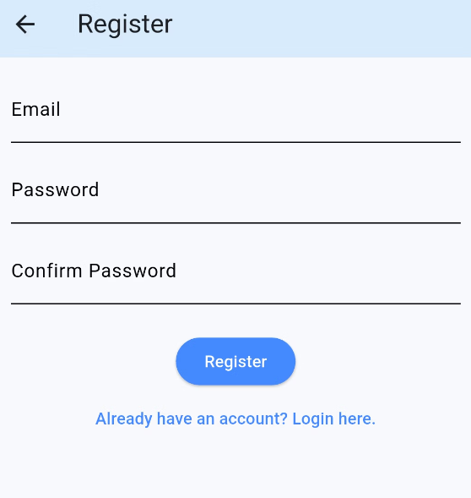
User Interface Screenshots
1) Login Screen
2) Dashboard
3) Registration

Slide 9
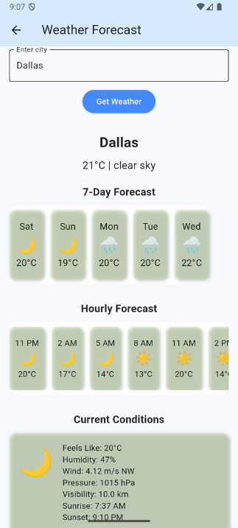
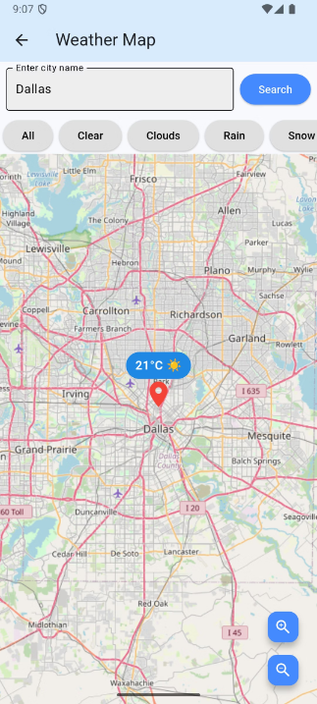
User Interface Screenshots
4) Weather Forecast
5) Map screen

Slide 10
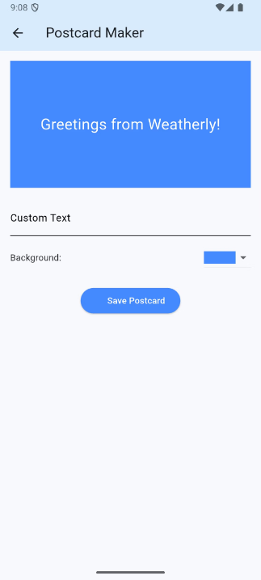
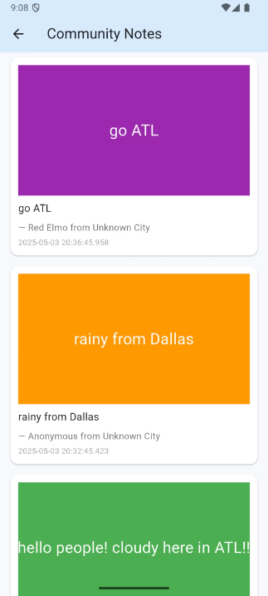
User Interface Screenshots
6) Create Postcard Window
5) Community Notes

Slide 11
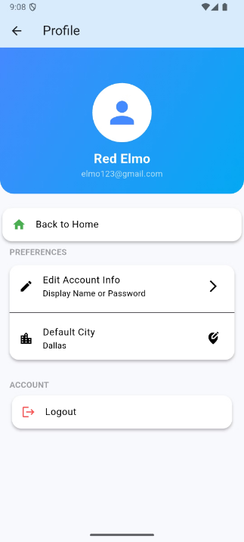
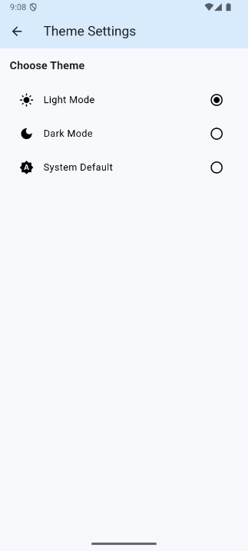
User Interface Screenshots
6) Profile Window
5) Themes Window

Slide 12

Testing Demo
We will now show what our app can do in a live demonstration!

Slide 13
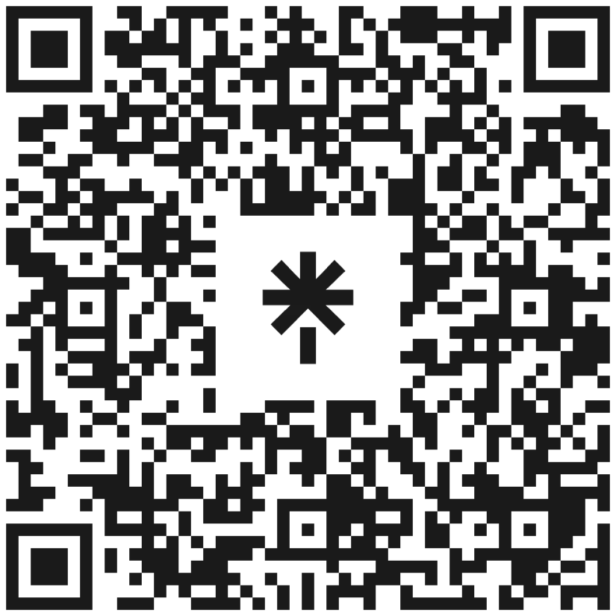
Thank you!!
Feel free to review our LinkTree for more information about us and this project.

