Slide 1

Washington
Price
Gregory Gonzalez & Jackson Nguyen
CIS 4321
Dr. Salehan

Slide 2

Introduction
Airbnb is a rental vacation online marketplace
Hosts are in full control of availability, price, and rules
Why are Airbnbs priced a certain way?
How can we group the Airbnbs?

Slide 3

Data Collection and Variable Description
Room_type- private room, apt, shared room
City - which city in WA
Reviews - number of reviews
Overall_satisfaction - rated from 0-5
Accommodates - how many people can come
Bedrooms - number of bedrooms
Bathrooms - number of bathrooms
Price - cost per night or day

Slide 4
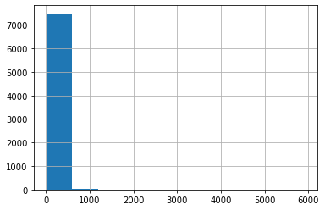
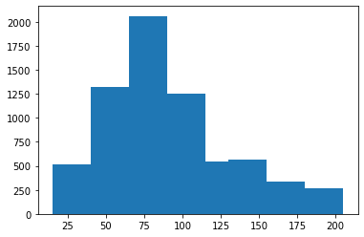
Descriptive analysis
Original Price Histogram
Adjusted Price Histogram

Slide 5
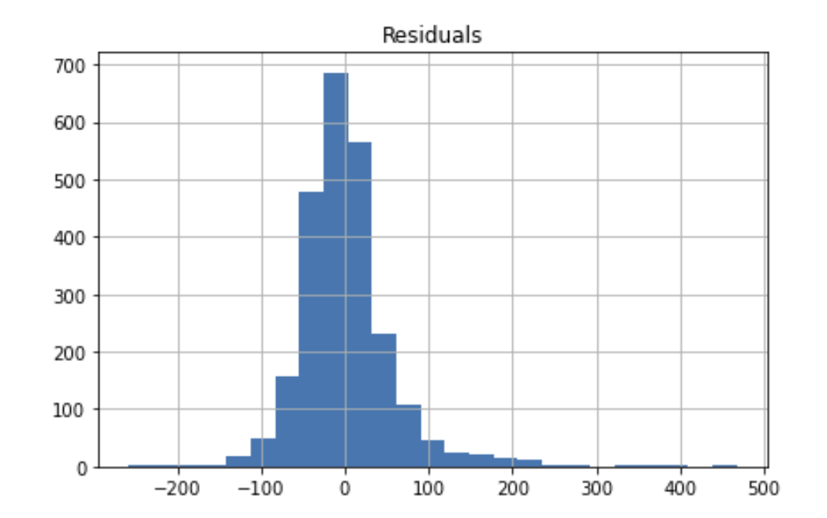
Regression
Predictors:
Reviews (-$0.10)
Overall_satisfaction (+$18.55)
Accommodates (+$7)
Bedrooms (+$27.59)
Bathrooms (+$24.97)
Outcome:
Price

Slide 6
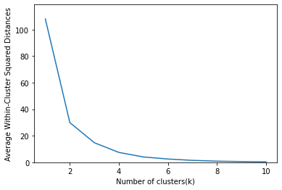
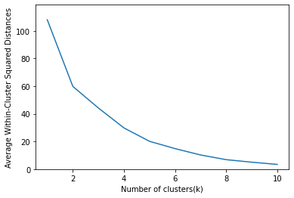
Cluster Analysis
Elbow Chart
Elbow Chart without dividing n_clusters

Slide 7
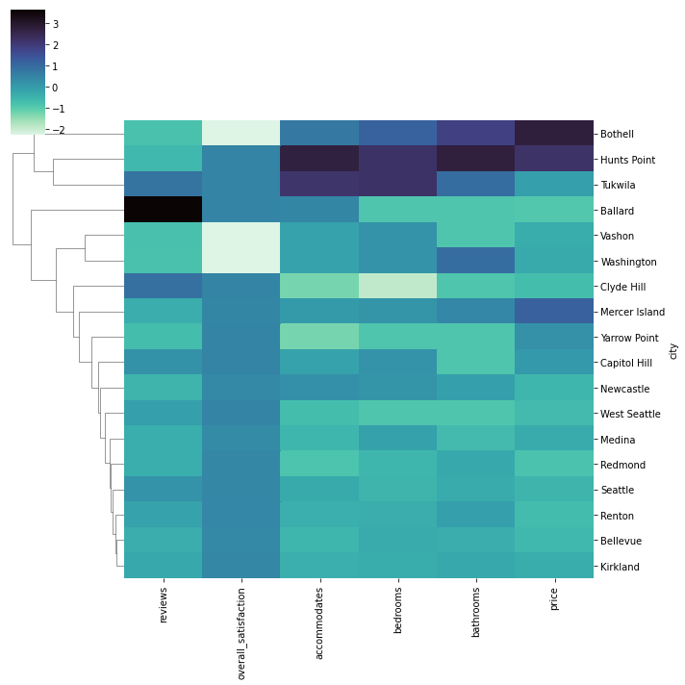
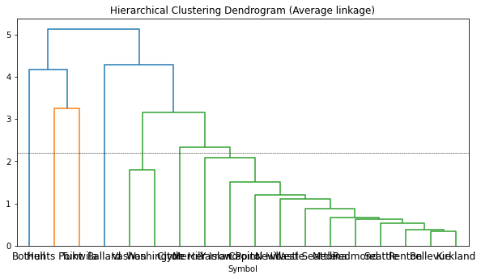
Cluster Analysis
Dendrogram - Average
HeatMap

Slide 8
Summary of Findings
Explanatory Modeling
Predictive Modeling
Overfitting
Backward elimination
Elbow Chart
Dendrogram
Heat Map

Slide 9

Implications
Biggest factors that apply to pricing of Airbnbs
Location for future entrants

Slide 10
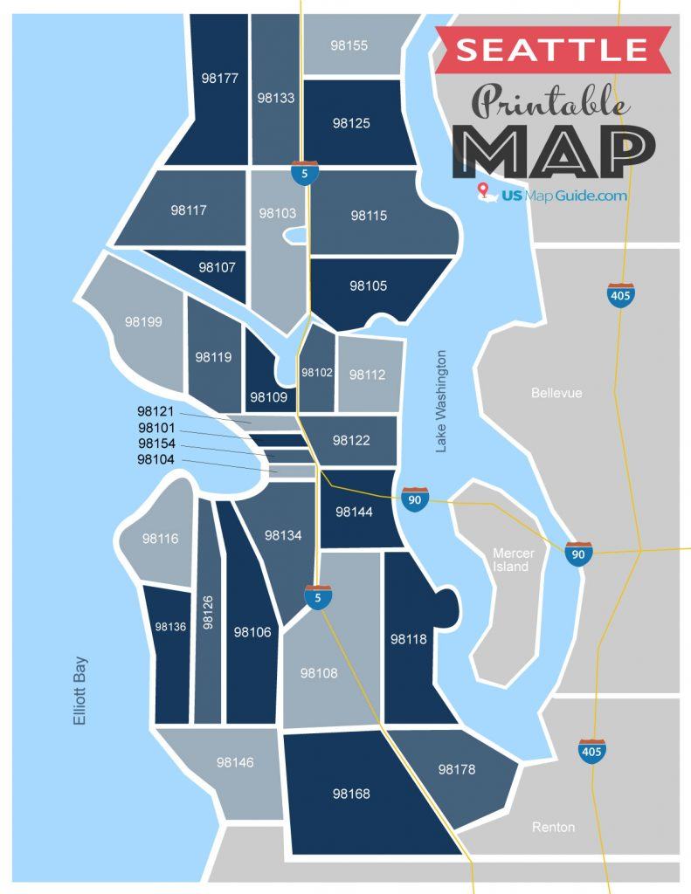
Limitations
Zip Codes
Geopy and reverse geocode

