Slide 1
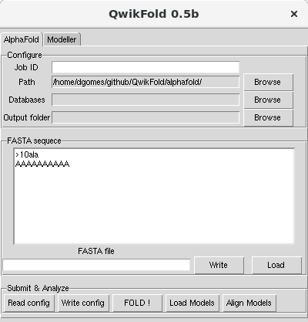
Job ID
Path to AlphaFold
Enter an unique
identifier for your job.
Make sure to use the version
installed at QwikFold folder
1
AlphaFold Databases
2
Output results
Path to Alphafold Databases:
bfd, mgnify, params, pdb70
pdb_mmcif, uniclust30, uniref90
3
4
Choose a folder to write the
models, alignments, and log
Type a sequence
5
Load a sequence
Copy & Paste is DISABLED !
You may “Load a sequence”
Load a FASTA file containing
only ONE sequence to model
Write config file
5
Load and Aling models
(FOLD! will do it in the future)
By default 5 models are
created, using 5 different
AI-methods.
Models are ranked by quality
6
7
8
FOLD !
Run AlphaFold !

