Slide 1

The Complete Experience
A ux data analytics solution
Team No Soliciting
Members: Greg Mitchell, Ivan Kuadey, Jensen Lee

Slide 2
Project Description
For our Patriot Hacks project we decided to undertake the task of creating a database that can easily record product listings and their reviews. In our demo we wrote a scraper to gather data from Amazon, however the process is applicable to other sources. The purpose of this product is to create a system where a user only needs to input a product listing in order to obtain user experience data from customer reviews.

Slide 3
Why?
This product would allow companies to easily gain large amounts of user experience data with minimal effort using a semi-automated system, only requiring a user to enter the desired product listing. The collected data is automatically onboarded into Splunk, a widely used tool that is able to process large amounts of machine data. We built dashboards and searches within Splunk to quickly find correlations in user experience data and present them in a way that is succinct and easy to understand.

Slide 4
How we built the project
The project was built in two steps:
The data collection tool was written in python and is currently able to scrape customer review data from Amazon. The scraper takes the URL of a product listing and is able to bring back thousands of customer reviews which are forwarded to the Splunk server.
The Splunk dashboards were then written in Splunk search language to create understandable and relevant user experience overviews based on the collected data. In addition to the dashboard overviews, data can be searched at any time to investigate further information about how customers feel.

Slide 5
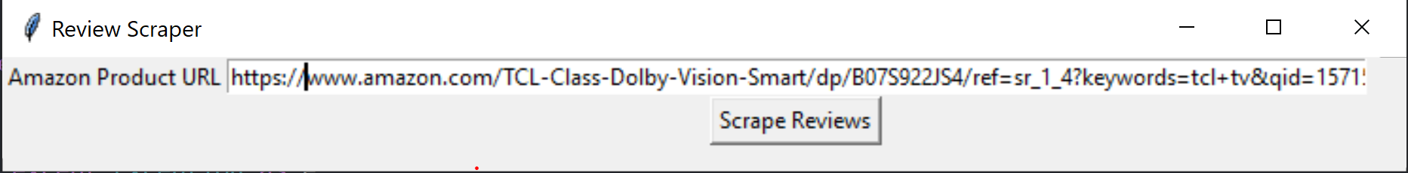
Data Collection User Interface

Slide 6
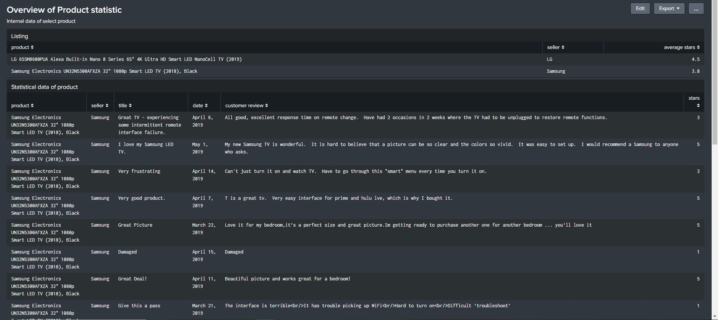
Overview/landing page

Slide 7
Overview page Description
Page is meant to outline and format the general aspects of an amazon listing.
Information is listed in two statistical tables. The first table details the products, sellers, and average star rating of the product.
The second table is a full listing of each review that the product has including the star rating given from 1-5

Slide 8
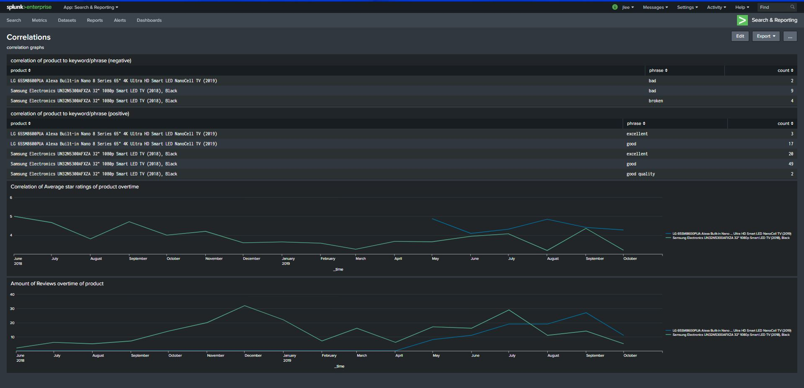
Correlations page

Slide 9
Correlations page description
Correlations page gives In depth graphs on trends between different products which allows companies to gain data on trends
The first table is a search that finds how many times a negative keyword or phrase appears within customer reviews
The second table does the same as the first but for positive keywords or phrases.
The third graph illustrates the average star rating of a certain product over time
The fourth graph illustrates the average amount of reviews a certain product receives over time

Slide 10
Why did we use Splunk?
Splunk offers a fast, reliable, and highly configurable method of creating and organizing a database that has the capability to create a plethora of graphs and comparisons
Splunk is also extremely modular and easy to add to if necessary

Slide 11
Future additions/revisions
If given the means to do so we would want to be able to scrape the sales data of each Amazon product and create a sales chart overtime which we believe is a major graph companies would want
We would also like to gather user experience data from other sources such as YouTube by analyzing review video subtitles as well as by scraping data such as user preferences or watch history.

