Slide 1
PPI audit slides
Dr Greig Russell

Slide 2
Slide 1
The total number of patients in this point prevalence audit is 218 of which 89 or 40.83% are currently prescribed a Proton Pump Inhibitor (PPI)

Slide 3
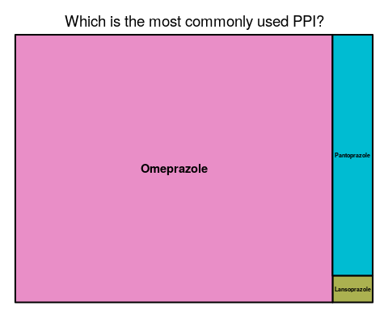
Slide 2

Slide 4
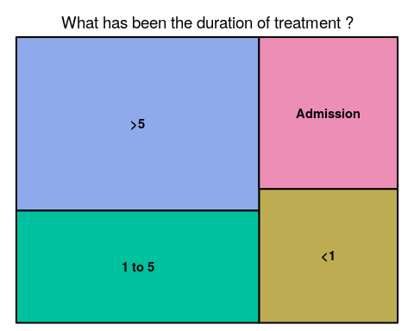
Slide 3

Slide 5
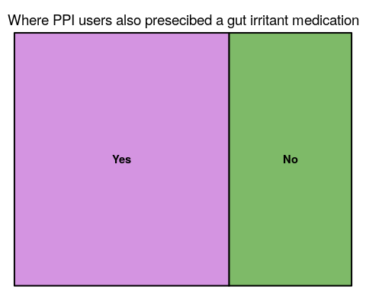
Slide 4

Slide 6
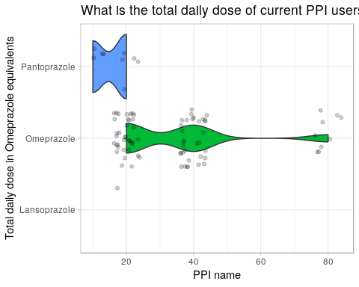
Slide 5

Slide 7
Slide 6
Please note “Yes” & “No” have an identical frequency, and the discontinued block is causing a visual distortion.

Slide 8
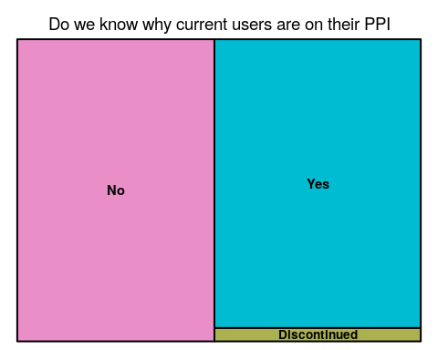

Slide 9
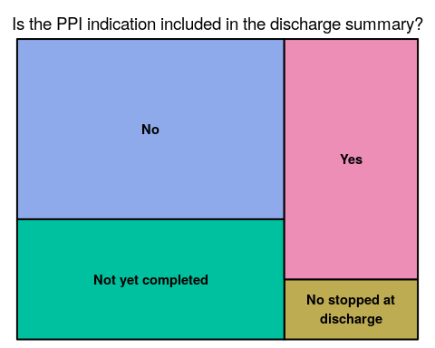
Slide 7

Slide 10
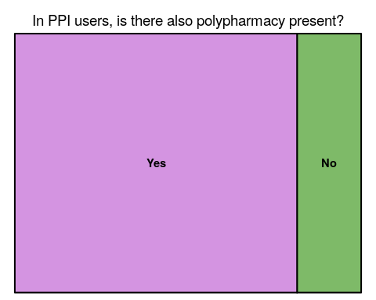
Slide 8

Slide 11
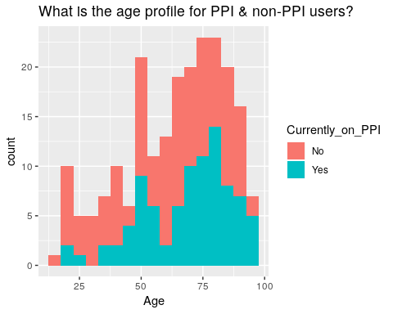
Slide 9

Slide 12
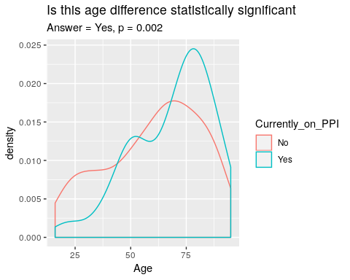
Slide 10

Slide 13
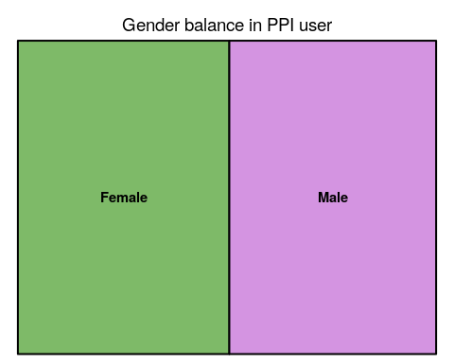
Slide 11

Slide 14
Slide 12
No significant difference is seen (p = 0.16)
## Speciality No Yes ## CARD 2 (2%) 2 (2%) ## ELDER CARE 0 (0%) 1 (1%) ## INT 58 (45%) 47 (53%) ## MED 1 (1%) 1 (1%) ## MENT 20 (16%) 4 (4%) ## REHAB 19 (15%) 10 (11%) ## SURG 28 (22%) 24 (27%) ## <NA> 1 (1%) 0 (0%) ## Total 129 (100%) 89 (100%)

Slide 15
NHI | Age | Gender | Discharge_destination | Ward | Speciality | PPI | Total_daily_dose | Duration | Started_this_admission | Concurrent_gi_irritant_therapy | Indication_recorded | If_new_on_admission_indication_in_discharge_summary | Polypharmacy | Ethnicity | Ethnicity_long | Locality | Currently_on_PPI
FYP8918 | 68 | Male | HOME | ICU | SURG | Omeprazole | 40 | Admission | Yes | Yes | No | Not yet completed | No | NZ European | European | Palmerston North City | Yes
CPS8149 | 53 | Female | HOME | CCU | CARD | Lansoprazole | 20 | >5 | NA | Yes | No | NA | Yes | NZ European | European | Palmerston North City | Yes
AND0480 | 77 | Male | HOME | CCU | CARD | Omeprazole | 20 | Admission | Yes | Yes | No | No | Yes | NZ European | European | Palmerston North City | Yes
NQQ8700 | 79 | Male | ARC | CCU | MED | NA | NA | NA | NA | Yes | NA | NA | NA | NZ European | European | Palmerston North City | No
CMT5006 | 60 | Male | HOME | CCU | CARD | NA | NA | NA | NA | No | NA | NA | NA | Maori | Maori | Kapiti Coast District | No
DJN7613 | 88 | Male | HOME | CCU | MED | Omeprazole | 20 | >5 | NA | Yes | No | NA | Yes | NZ European | European | Palmerston North City | Yes
FGQ95680 | 83 | Female | HOME | CCU | CARD | NA | NA | NA | NA | No | NA | NA | NA | NA | NA | NA | No
EYY3385 | 73 | Male | HOME | MAPU | INT | NA | NA | NA | NA | No | NA | NA | NA | Maori | Maori | Horowhenua District | No
MSF3038 | 40 | Female | HOME | MAPU | INT | NA | NA | NA | NA | No | NA | NA | NA | Maori | Maori | Tararua District | No
BLZ7364 | 90 | Female | HOME | MAPU | INT | Omeprazole | 20 | Admission | Yes | Yes | Yes | No | Yes | NZ European | European | Palmerston North City | Yes
MPG2843 | 39 | Male | HOME | MAPU | MENT | NA | NA | NA | NA | No | NA | NA | NA | NA | NA | NA | No
CVV9238 | 65 | Male | HOME | MAPU | INT | Omeprazole | 40 | >5 | NA | Yes | No | NA | Yes | NZ European | European | Manawatu District | Yes
CQY3365 | 32 | Male | HOME | MAPU | INT | NA | NA | NA | NA | No | NA | NA | NA | NZ European | European | Palmerston North City | No
ANC839 | 76 | Female | HOME | MAPU | INT | NA | NA | NA | NA | No | NA | NA | NA | NA | NA | NA | No
NJD7137 | 21 | Female | HOME | MAPU | INT | NA | NA | NA | NA | No | NA | NA | NA | NZ European | European | Palmerston North City | No
BJE6497 | 95 | Female | HOME | MAPU | INT | Omeprazole | 40 | >5 | NA | Yes | Yes | NA | No | NZ European | European | Palmerston North City | Yes
CBL6866 | 77 | Female | HOME | MAPU | INT | NA | NA | NA | NA | Yes | NA | NA | NA | NZ European | European | Horowhenua District | No
EVC3340 | 83 | Female | HOME | MAPU | INT | Pantoprazole | 20 | <1 | NA | Yes | Yes | NA | Yes | NZ European | European | Palmerston North City | Yes
DQR3816 | 73 | Male | HOME | MAPU | INT | NA | NA | NA | NA | No | NA | NA | NA | NZ European | European | Palmerston North City | No
BUH9480 | 46 | Male | HOME | MAPU | INT | Omeprazole | 80 | <1 | NA | Yes | Yes | NA | Yes | NZ European | European | Palmerston North City | Yes
fdx0493 | 28 | Female | HOME | 21 | MENT | NA | NA | NA | NA | No | NA | NA | NA | NA | NA | NA | No
ATR262 | 52 | Female | HOME | 21 | MENT | NA | NA | NA | NA | No | NA | NA | NA | NA | NA | NA | No
MJV0128 | 22 | Female | HOME | 21 | MENT | NA | NA | NA | NA | No | NA | NA | NA | NZ European | European | Tararua District | No
MVX6098 | 29 | Female | HOME | 21 | MENT | NA | NA | NA | NA | Yes | NA | NA | NA | NA | NA | NA | No
NSF9757 | 21 | Female | HOME | 21 | MENT | Omeprazole | 20 | 1 to 5 | NA | No | No | NA | No | NZ European | European | Palmerston North City | Yes
FBQ3096 | 28 | Female | SUPP | 21 | MENT | NA | NA | NA | NA | No | NA | NA | NA | NZ European | European | Palmerston North City | No
MBX2235 | 29 | Female | HOME | 21 | MENT | NA | NA | NA | NA | No | NA | NA | NA | Maori | Maori | Palmerston North City | No
AVF6685 | 63 | Male | SUPP | 21 | MENT | NA | NA | NA | NA | No | NA | NA | NA | NZ European | European | Palmerston North City | No
CCR4105 | 34 | Male | HOME | 21 | MENT | NA | NA | NA | NA | No | NA | NA | NA | NZ European | European | Tararua District | No
UGP5964 | 38 | Male | HOME | 21 | MENT | NA | NA | NA | NA | No | NA | NA | NA | Other European | European | Palmerston North City | No
NGS4373 | 51 | Male | HOME | 21 | MENT | NA | NA | NA | NA | No | NA | NA | NA | NA | NA | NA | No
QVE2537 | 41 | Male | HOME | 21 | MENT | Omeprazole | 20 | 1 to 5 | NA | No | No | NA | No | European - not further defined | European | Palmerston North City | Yes
LTB5404 | 40 | Male | HOME | 21 | MENT | NA | NA | NA | NA | No | NA | NA | NA | NZ European | Maori | Palmerston North City | No
MQR5346 | 22 | Male | HOME | 21 | MENT | NA | NA | NA | NA | No | NA | NA | NA | NZ European | European | Horowhenua District | No
MNM7682 | 22 | Male | SUPP | 21 | MENT | NA | NA | NA | NA | No | NA | NA | NA | NZ European | European | Upper Hutt City | No
RJE2247 | 21 | Male | HOME | 21 | MENT | NA | NA | NA | NA | No | NA | NA | NA | Maori | Maori | Horowhenua District | No
EMM4993 | 54 | Female | HOME | 21 | MENT | NA | NA | NA | NA | No | NA | NA | NA | NZ European | Maori | New Plymouth District | No
DCV9617 | 47 | Female | HOME | 21 | MENT | NA | NA | NA | NA | No | NA | NA | NA | Maori | Maori | Palmerston North City | No
CQZ0825 | 56 | Female | HOME | 21 | MENT | Omeprazole | 20 | <1 | NA | No | No | NA | Yes | Maori | Maori | Horowhenua District | Yes
LZB9911 | 23 | Male | HOME | 21 | MENT | NA | NA | NA | NA | No | NA | NA | NA | NZ European | European | Palmerston North City | No
AKR8695 | 58 | Female | HOME | 21 | MENT | NA | NA | NA | NA | No | NA | NA | NA | NZ European | European | Palmerston North City | No
BEC2123 | 44 | Male | HOME | 21 | MENT | Omeprazole | 40 | >5 | NA | Yes | Yes | NA | Yes | Maori | Maori | Palmerston North City | Yes
FAT3977 | 64 | Male | HOME | 21 | MENT | NA | NA | NA | NA | No | NA | NA | NA | NZ European | European | Areas Outside Territorial Authorities | No
AJJ7351 | 85 | Male | HOME | STAR 2 | REHAB | Pantoprazole | 10 | >5 | NA | Yes | Yes | NA | Yes | NZ European | European | Palmerston North City | Yes
GND3529 | 71 | Male | HOME | STAR 2 | REHAB | Omeprazole | 40 | Admission | Yes | Yes | No | Not yet completed | Yes | NZ European | European | Tararua District | Yes
EVJ9065 | 53 | Female | HOME | STAR 2 | REHAB | NA | NA | NA | NA | No | NA | NA | NA | NZ European | European | Manawatu District | No
AFE1064 | 50 | Female | HOSPICE | STAR 2 | REHAB | NA | NA | NA | NA | No | NA | NA | NA | NZ European | European | Tararua District | No
AES4471 | 95 | Female | HOME | STAR 2 | REHAB | Pantoprazole | 10 | 1 to 5 | NA | Yes | No | NA | Yes | Other European | European | Palmerston North City | Yes
QNK7356 | 19 | Male | HOME | STAR 2 | REHAB | NA | NA | NA | NA | Yes | NA | NA | NA | NZ European | Maori | Horowhenua District | No
CZN0508 | 52 | Male | HOME | STAR 2 | REHAB | Pantoprazole | 20 | Admission | Yes | Yes | Yes | No | Yes | Maori | Maori | Palmerston North City | Yes
CEJ4513 | 68 | Male | HOME | STAR 2 | REHAB | NA | NA | NA | NA | Yes | NA | NA | NA | NZ European | European | Tararua District | No
FCW8583 | 75 | Male | HOME | STAR 2 | REHAB | Omeprazole | 20 | >5 | NA | Yes | No | NA | Yes | NZ European | European | Palmerston North City | Yes
BHG8887 | 57 | Female | HOME | STAR 2 | REHAB | NA | NA | NA | NA | Yes | NA | NA | NA | NZ European | European | Palmerston North City | No
EGL3204 | 52 | Male | HOME | STAR 2 | REHAB | NA | NA | NA | NA | No | NA | NA | NA | NZ European | European | Palmerston North City | No
JKK0071 | 67 | Male | HOME | STAR 2 | REHAB | NA | NA | NA | NA | Yes | NA | NA | NA | NA | NA | NA | No
AUZ5542 | 63 | Male | HOME | STAR 2 | REHAB | Omeprazole | 40 | >5 | NA | No | No | NA | Yes | NZ European | European | Palmerston North City | Yes
NQQ4259 | 62 | Male | HOME | STAR 2 | REHAB | NA | NA | NA | NA | Yes | NA | NA | NA | Maori | Maori | Palmerston North City | No
AKR7419 | 78 | Male | HOME | STAR 2 | REHAB | Omeprazole | 20 | 1 to 5 | NA | No | Yes | NA | Yes | NZ European | European | Palmerston North City | Yes
AHC9993 | 91 | Male | ARC | STAR 2 | REHAB | NA | NA | NA | NA | Yes | NA | NA | NA | NZ European | European | Palmerston North City | No
QRL0911 | 75 | Male | HOME | STAR 2 | REHAB | NA | NA | NA | NA | Yes | NA | NA | NA | Maori | Maori | Manawatu District | No
CTT1261 | 70 | Male | HOME | STAR 2 | REHAB | NA | NA | NA | NA | No | NA | NA | NA | NZ European | European | Palmerston North City | No
NEN9033 | 87 | Male | HOME | STAR 2 | REHAB | NA | NA | NA | NA | Yes | NA | NA | NA | NZ European | European | Palmerston North City | No
BFJ8153 | 70 | Female | HOME | STAR 2 | REHAB | Omeprazole | 40 | Admission | Yes | Yes | No | Not yet completed | Yes | Maori | Maori | Tararua District | Yes
CTU9543 | 77 | Female | HOME | 24 | SURG | NA | NA | NA | NA | Yes | NA | NA | NA | NZ European | European | Manawatu District | No
AJW4757 | 39 | Female | HOME | 24 | SURG | NA | NA | NA | NA | No | NA | NA | NA | Maori | Maori | Palmerston North City | No
AFV3581 | 69 | Female | HOME | 24 | SURG | Omeprazole | 40 | 1 to 5 | NA | Yes | No | NA | No | NZ European | European | Manawatu District | Yes
CBQ8887 | 48 | Female | HOME | 24 | SURG | NA | 20 | >5 | NA | No | No | NA | No | NZ European | European | NA | No
GJE3933 | 37 | Female | HOME | 24 | SURG | Omeprazole | 40 | Admission | Yes | No | Yes | No stopped at discharge | No | NZ European | European | Manawatu District | Yes
DKP6191 | 79 | Female | HOME | 24 | SURG | NA | NA | NA | NA | Yes | NA | NA | NA | NA | NA | NA | No
BTG3228 | 59 | Female | HOME | 24 | SURG | Omeprazole | 40 | >5 | NA | Yes | No | NA | Yes | NZ European | European | Palmerston North City | Yes
BYN6141 | 61 | Male | HOME | 24 | SURG | NA | NA | NA | NA | Yes | NA | NA | NA | NZ European | European | Tararua District | No
DEC 4026 | 58 | Male | HOME | 24 | SURG | NA | NA | NA | NA | Yes | NA | NA | NA | NA | NA | NA | No
GKG9848 | 26 | Male | HOME | 24 | SURG | NA | NA | NA | NA | Yes | NA | NA | NA | NZ European | European | Horowhenua District | No
NFJ1167 | 48 | Male | HOME | 24 | SURG | NA | NA | NA | NA | No | NA | NA | NA | NZ European | European | Palmerston North City | No
LKP4890 | 71 | Male | HOME | 24 | SURG | Omeprazole | 20 | NA | NA | No | Yes | NA | Yes | NZ European | European | Rangitikei District | Yes
MYG9284 | 68 | Male | HOME | 24 | SURG | Pantoprazole | 10 | 1 to 5 | NA | Yes | Yes | NA | Yes | NZ European | European | Manawatu District | Yes
FKF0175 | 78 | Female | HOME | 24 | SURG | Omeprazole | 40 | >5 | NA | No | Yes | NA | Yes | NZ European | European | Palmerston North City | Yes
DTZ5492 | 94 | Female | HOME | 24 | SURG | Omeprazole | 20 | Admission | Yes | Yes | Yes | Yes | Yes | NZ European | European | Palmerston North City | Yes
BHJ4831 | 52 | Female | HOME | 24 | SURG | NA | NA | NA | NA | No | NA | NA | NA | NZ European | European | Horowhenua District | No
CES5963 | 71 | Female | HOME | 24 | SURG | Pantoprazole | 20 | >5 | NA | Yes | Yes | NA | Yes | NZ European | European | Manawatu District | Yes
HHG9478 | 25 | Female | HOME | 24 | SURG | NA | NA | NA | NA | No | NA | NA | NA | NZ European | European | Palmerston North City | No
CXW9909 | 65 | Female | ARC | 24 | SURG | NA | NA | NA | NA | Yes | NA | NA | NA | Maori | Maori | Horowhenua District | No
FXK2425 | 88 | Male | ARC | 24 | SURG | NA | NA | NA | NA | No | NA | NA | NA | NZ European | European | Palmerston North City | No
LVA8962 | 87 | Female | HOME | 24 | SURG | NA | NA | NA | NA | Yes | NA | NA | NA | NZ European | European | Tararua District | No
DJG5154 | 91 | Female | HOME | 24 | SURG | NA | NA | NA | NA | Yes | NA | NA | NA | NZ European | European | Tararua District | No
LWC5071 | 91 | Male | HOME | 24 | SURG | Omeprazole | 20 | >5 | NA | Yes | Yes | NA | Yes | NZ European | European | Horowhenua District | Yes
LQG6803 | 78 | Male | HOME | 25 | INT | Omeprazole | 40 | <1 | NA | Yes | Yes | NA | Yes | Other European | European | Palmerston North City | Yes
DKT7089 | 39 | Male | unknown | 25 | INT | Omeprazole | 20 | >5 | NA | No | No | NA | Yes | NZ European | European | Palmerston North City | Yes
CWJ2734 | 51 | Male | HOME | 25 | INT | Omeprazole | 80 | >5 | NA | No | Yes | NA | Yes | NZ European | European | Tararua District | Yes
FJL1646 | 61 | Female | HOME | 25 | INT | NA | NA | NA | NA | No | NA | NA | NA | NZ European | European | Horowhenua District | No
GDQ9719 | 70 | Male | HOME | 25 | INT | NA | NA | NA | NA | No | NA | NA | NA | NA | NA | NA | No
NFE7767 | 93 | Female | ARC | 25 | INT | Omeprazole | 40 | Admission | Yes | Yes | Yes | No | Yes | NZ European | European | Manawatu District | Yes
VMP6070 | 83 | Female | HOME | 25 | INT | Omeprazole | 20 | <1 | NA | No | No | NA | Yes | Other European | European | Palmerston North City | Yes
ESN9373 | 86 | Female | HOME | 25 | INT | Omeprazole | 40 | >5 | NA | Yes | Yes | NA | Yes | Other European | European | Palmerston North City | Yes
BXG8767 | 81 | Male | ARC | 25 | INT | NA | NA | NA | NA | Yes | NA | NA | NA | NZ European | European | Kapiti Coast District | No
BVK4173 | 76 | Female | HOME | 25 | INT | Omeprazole | 40 | <1 | NA | Yes | Yes | NA | Yes | Maori | Maori | Palmerston North City | Yes
BST6974 | 50 | Female | HOME | 25 | INT | NA | NA | NA | NA | No | NA | NA | NA | Maori | Maori | Tararua District | No
QGY0126 | 19 | Female | HOME | 25 | INT | NA | NA | NA | NA | No | NA | NA | NA | NZ European | European | Palmerston North City | No
BPY5011 | 91 | Male | ARC | 25 | INT | NA | NA | NA | NA | No | NA | NA | NA | NA | NA | NA | No
BEH8102 | 84 | Female | HOME | 25 | INT | Omeprazole | 20 | >5 | NA | Yes | No | NA | Yes | NZ European | European | Manawatu District | Yes
DPE0634 | 94 | Female | HOME | 25 | INT | NA | NA | NA | NA | Yes | NA | NA | NA | NZ European | European | Tararua District | No
LHJ6691 | 69 | Female | HOME | 25 | INT | NA | NA | NA | NA | No | NA | NA | NA | NZ European | European | Kapiti Coast District | No
AMR7418 | 66 | Female | HOME | 25 | INT | Omeprazole | 20 | 1 to 5 | NA | Yes | Yes | NA | Yes | NZ European | European | Horowhenua District | Yes
AGP5128 | 71 | Female | HOME | 25 | INT | NA | NA | NA | NA | No | NA | NA | NA | NZ European | European | Palmerston North City | No
CSL4403 | 80 | Male | ARC | 25 | INT | Pantoprazole | 20 | 1 to 5 | NA | Yes | No | NA | Yes | NZ European | European | Horowhenua District | Yes
DDD9789 | 50 | Female | HOME | 25 | INT | Omeprazole | 20 | 1 to 5 | NA | Yes | NA | NA | NA | Maori | Maori | Palmerston North City | Yes
FDW3551 | 41 | Female | HOME | 25 | INT | NA | NA | NA | NA | Yes | NA | NA | NA | NZ European | European | Tararua District | No
EXJ7614 | 83 | Female | HOME | 25 | INT | NA | NA | NA | NA | Yes | NA | NA | NA | NZ European | European | Palmerston North City | No
AEZ2477 | 87 | Male | HOME | 25 | INT | NA | NA | NA | NA | Yes | NA | NA | NA | NZ European | European | Palmerston North City | No
LMA5819 | 47 | Female | HOME | 25 | INT | NA | NA | NA | NA | Yes | NA | NA | NA | Maori | Maori | Palmerston North City | No
MYT8407 | 61 | Male | ARC | 25 | INT | NA | NA | NA | NA | No | NA | NA | NA | NZ European | European | Horowhenua District | No
BEZ3159 | 73 | Male | HOME | 25 | INT | NA | NA | NA | NA | Yes | NA | NA | NA | Maori | Maori | Manawatu District | No
EUY3379 | 57 | Male | HOME | 25 | INT | Omeprazole | 20 | >5 | NA | No | No | NA | Yes | NZ European | European | Horowhenua District | Yes
APF1627 | 83 | Female | HOME | 25 | INT | Omeprazole | 20 | >5 | NA | Yes | No | NA | NA | NZ European | European | Palmerston North City | Yes
BVW5196 | 79 | Female | ARC | 26 | INT | Omeprazole | 20 | >5 | NA | No | No | NA | NA | NZ European | European | Palmerston North City | Yes
DGH0710 | 64 | Male | HOME | 26 | INT | NA | NA | NA | NA | Yes | NA | NA | NA | NZ European | European | Manawatu District | No
BTM0324 | 81 | Male | HOME | 26 | INT | Omeprazole | 40 | >5 | NA | Yes | No | NA | NA | NA | NA | NA | Yes
MDD0772 | 88 | Male | HOME | 26 | INT | NA | NA | NA | NA | No | NA | NA | NA | Maori | Maori | Kapiti Coast District | No
ASK1037 | 46 | Male | HOME | 26 | INT | Omeprazole | 40 | >5 | NA | No | Yes | NA | NA | Other European | European | Horowhenua District | Yes
BPD8853 | 34 | Female | MASH | 26 | INT | NA | NA | NA | NA | No | NA | NA | NA | Maori | Maori | Horowhenua District | No
NKQ0684 | 88 | Female | ARC | 26 | INT | Omeprazole | 40 | Admission | Yes | Yes | Yes | Not yet completed | NA | European - not further defined | European | Horowhenua District | Yes
AWR8296 | 81 | Female | ARC | 26 | INT | NA | NA | NA | NA | No | NA | NA | NA | NZ European | European | Manawatu District | No
WKD9397 | 27 | Male | HOME | 26 | INT | NA | NA | NA | NA | No | NA | NA | NA | European - not further defined | European | Palmerston North City | No
HXB6483 | 66 | Male | HOME | 26 | INT | NA | NA | NA | NA | Yes | NA | NA | NA | NZ European | European | Tararua District | No
AEJ8104 | 91 | Male | HOME | 26 | INT | NA | NA | NA | NA | No | NA | NA | NA | NZ European | European | Palmerston North City | No
NVZ9780 | 83 | Male | ARC | 26 | INT | Omeprazole | 20 | <1 | NA | No | Yes | NA | NA | NA | NA | NA | Yes
EVK9842 | 56 | Male | HOME | 26 | INT | Omeprazole | 80 | <1 | NA | No | Yes | NA | NA | NZ European | European | Palmerston North City | Yes
NQU9899 | 89 | Male | ARC | 26 | INT | Omeprazole | 40 | 1 to 5 | NA | No | No | NA | Yes | NZ European | European | Manawatu District | Yes
HDX3635 | 76 | Female | HOME | 26 | INT | NA | NA | NA | NA | Yes | NA | NA | NA | NZ European | European | Palmerston North City | No
AXF4657 | 86 | Male | HOME | 26 | INT | Pantoprazole | 20 | <1 | NA | NA | No | NA | Yes | NZ European | European | Tararua District | Yes
QQK2787 | 66 | Male | ARC | 26 | INT | Omeprazole | 40 | Admission | Yes | Yes | Yes | NA | Yes | Maori | Maori | Kapiti Coast District | Yes
FNR1498 | 85 | Male | HOME | 26 | INT | NA | NA | NA | NA | No | NA | NA | NA | NZ European | European | Palmerston North City | No
EUL6089 | 74 | Male | ARC | 26 | INT | Omeprazole | 20 | >5 | NA | Yes | No | NA | Yes | European - not further defined | European | Palmerston North City | Yes
PNN8550 | 82 | Female | HOME | 26 | INT | Omeprazole | 40 | 1 to 5 | NA | Yes | Yes | NA | Yes | NZ European | European | Horowhenua District | Yes
FJZ8641 | 92 | Female | ARC | 26 | INT | Omeprazole | 20 | >5 | NA | Yes | Yes | NA | Yes | NZ European | European | Palmerston North City | Yes
LEA7194 | 91 | Female | ARC | 26 | INT | Omeprazole | 20 | 1 to 5 | NA | No | Yes | NA | Yes | NZ European | European | Palmerston North City | Yes
PAS7054 | 89 | Male | HOME | 26 | INT | NA | NA | NA | NA | Yes | NA | NA | NA | NZ European | European | NA | No
QNC5401 | 19 | Female | HOME | 26 | INT | Omeprazole | 20 | 1 to 5 | NA | No | No | NA | No | NZ European | European | Manawatu District | Yes
MAF4503 | 86 | Male | HOME | 26 | INT | NA | NA | NA | NA | Yes | NA | NA | NA | NZ European | European | Palmerston North City | No
LMC5712 | 77 | Female | HOME | 26 | INT | Omeprazole | 20 | >5 | NA | No | Yes | NA | Yes | NZ European | European | Manawatu District | Yes
NFF5000 | 38 | Female | HOME | 29 | SURG | NA | NA | NA | NA | No | NA | NA | NA | NZ European | European | Manawatu District | No
DGS5575 | 47 | Male | HOME | 29 | SURG | Omeprazole | 80 | Admission | Yes | No | Yes | No | Yes | NZ European | European | Horowhenua District | Yes
FRZ6381 | 75 | Male | HOME | 29 | SURG | Omeprazole | 80 | 1 to 5 | NA | No | No | NA | Yes | NZ European | European | Manawatu District | Yes
CNF3860 | 73 | Female | HOME | 29 | SURG | NA | NA | NA | NA | No | NA | NA | NA | NZ European | European | Palmerston North City | No
FYX2280 | 62 | Female | HOME | 29 | SURG | NA | NA | NA | NA | Yes | NA | NA | NA | Maori | Maori | Palmerston North City | No
LDT5696 | 49 | Male | HOME | 29 | SURG | Omeprazole | 40 | Admission | Yes | Yes | No | NA | No | NZ European | European | Palmerston North City | Yes
FLX0606 | 78 | Female | HOME | 29 | SURG | NA | NA | NA | NA | No | NA | NA | NA | Other European | European | Palmerston North City | No
RZS9768 | 54 | Female | HOME | 29 | INT | Omeprazole | 20 | 1 to 5 | NA | Yes | No | NA | Yes | Other European | European | Horowhenua District | Yes
CSJ1837 | 48 | Male | ARC | 29 | SURG | Omeprazole | 40 | >5 | NA | Yes | No | NA | Yes | Maori | Maori | Horowhenua District | Yes
LRJ4466 | 76 | Male | HOME | 29 | SURG | Omeprazole | 20 | >5 | NA | Yes | No | NA | Yes | European - not further defined | European | Palmerston North City | Yes
EQX9756 | 79 | Male | HOME | 29 | SURG | NA | NA | NA | NA | No | NA | NA | NA | NZ European | European | Kapiti Coast District | No
FPM5011 | 82 | Male | HOME | 29 | SURG | Omeprazole | 80 | >5 | NA | Yes | Yes | Yes | Yes | NZ European | European | Horowhenua District | Yes
FFX5788 | 87 | Female | ARC | 29 | SURG | NA | NA | NA | NA | No | NA | NA | NA | NZ European | European | Horowhenua District | No
EMX2626 | 75 | Female | HOME | 29 | SURG | Omeprazole | 40 | 1 to 5 | NA | No | Yes | NA | Yes | NZ European | European | Horowhenua District | Yes
LHU1805 | 69 | Female | HOME | 29 | SURG | Omeprazole | 40 | 1 to 5 | NA | No | Yes | NA | No | NZ European | European | Kapiti Coast District | Yes
EWA8388 | 72 | Female | HOME | 29 | SURG | Omeprazole | 40 | >5 | NA | No | Yes | NA | No | NZ European | European | Manawatu District | Yes
CZZ3582 | 70 | Female | HOME | 29 | SURG | NA | NA | NA | NA | No | NA | NA | NA | NZ European | European | Nelson City | No
DES9148 | 78 | Female | HOME | 29 | SURG | Omeprazole | 40 | Admission | Yes | Yes | Yes | Yes | Yes | NZ European | European | Palmerston North City | Yes
JKK0852 | 52 | Female | HOME | 29 | SURG | Omeprazole | 20 | Admission | Yes | No | Yes | No | Yes | Maori | Maori | Horowhenua District | Yes
MQG1297 | 82 | Female | HOME | 29 | SURG | Omeprazole | 40 | >5 | NA | Yes | No | NA | Yes | NA | NA | NA | Yes
EXQ2062 | 84 | Female | HOME | 29 | SURG | NA | NA | NA | NA | No | NA | NA | NA | NZ European | European | Palmerston North City | No
BLG5419 | 48 | Female | HOME | 29 | INT | NA | NA | NA | NA | Yes | NA | NA | NA | NA | NA | NA | No
RJY2393 | 53 | Male | HOME | 29 | SURG | NA | NA | NA | NA | Yes | NA | NA | NA | Tongan | Pacific Is. | Palmerston North City | No
BND4454 | 34 | Male | HOME | 29 | SURG | NA | NA | NA | NA | Yes | NA | NA | NA | NZ European | European | Tararua District | No
BGG2779 | 60 | Male | HOME | 29 | SURG | NA | NA | NA | NA | Yes | NA | NA | NA | NZ European | European | Palmerston North City | No
ART9274 | 52 | Female | HOME | 29 | SURG | NA | NA | NA | NA | No | NA | NA | NA | NZ European | European | Palmerston North City | No
AVG5692 | 67 | Male | HOME | 29 | INT | Omeprazole | 20 | <1 | NA | Yes | Yes | NA | Yes | NZ European | European | Palmerston North City | Yes
WKR7225 | 26 | Female | HOME | 27 | INT | Omeprazole | 80 | <1 | NA | Yes | Yes | NA | No | Other Ethnicity | Other | Horowhenua District | Yes
FAX9691 | 93 | Male | HOME | 27 | SURG | Omeprazole | 20 | >5 | NA | Yes | Yes | NA | Yes | NZ European | European | Horowhenua District | Yes
LHZ8424 | 79 | Female | HOME | 27 | ELDER CARE | Omeprazole | 20 | 1 to 5 | NA | Yes | No | NA | Yes | Other European | European | Horowhenua District | Yes
AKX9759 | 80 | Female | HOME | 27 | INT | NA | NA | NA | NA | Yes | NA | NA | NA | NZ European | European | Manawatu District | No
NAE2754 | 21 | Female | HOME | 27 | INT | NA | NA | NA | NA | Yes | NA | NA | NA | Maori | Maori | Tararua District | No
FLX2781 | 67 | Female | HOME | 27 | INT | NA | NA | NA | NA | Yes | NA | NA | NA | NZ European | European | Palmerston North City | No
FPD6723 | 49 | Female | HOME | 27 | INT | Omeprazole | 20 | <1 | NA | Yes | No | NA | Yes | NZ European | European | Palmerston North City | Yes
APZ9952 | 52 | Male | HOME | 27 | INT | Omeprazole | 80 | 1 to 5 | NA | No | No | NA | Yes | NZ European | European | Palmerston North City | Yes
AUT8522 | 74 | Female | ARC | 27 | INT | Pantoprazole | 10 | >5 | NA | No | No | NA | Yes | NZ European | European | Horowhenua District | Yes
BQE9370 | 88 | Male | HOME | 27 | INT | NA | NA | NA | NA | Yes | NA | NA | NA | NZ European | European | Palmerston North City | No
EJR0040 | 67 | Male | HOME | 27 | SURG | NA | NA | NA | NA | Yes | NA | NA | NA | NZ European | European | Tararua District | No
RDQ0351 | 16 | Female | HOME | 27 | SURG | NA | NA | NA | NA | Yes | NA | NA | NA | NZ European | European | Tararua District | No
BKA9006 | 36 | Female | HOME | 28 | SURG | Omeprazole | 20 | Admission | Yes | Yes | Discontinued | NA | No | NZ European | European | Manawatu District | Yes
FYU4189 | 80 | Female | HOME | 28 | INT | Omeprazole | 20 | >5 | NA | Yes | Yes | NA | Yes | Other European | European | Palmerston North City | Yes
CQR0864 | 49 | Female | HOME | 28 | INT | Omeprazole | 20 | Admission | Yes | No | Discontinued | Yes | Yes | Maori | Maori | Tararua District | Yes
BXV8601 | 51 | Male | HOME | 28 | INT | NA | NA | NA | NA | No | NA | NA | NA | Other European | European | Palmerston North City | No
NDD6472 | 84 | Female | HOME | 28 | INT | NA | NA | NA | NA | Yes | NA | NA | NA | Other European | European | Horowhenua District | No
MMM2864 | 60 | Male | HOME | 28 | INT | Omeprazole | 40 | <1 | NA | Yes | No | NA | Yes | NZ European | European | Palmerston North City | Yes
EUD5882 | 59 | Male | HOME | 28 | INT | NA | NA | NA | NA | Yes | NA | NA | NA | NZ European | European | Palmerston North City | No
RJY4329 | 37 | Male | HOME | 28 | INT | NA | NA | NA | NA | No | NA | NA | NA | Indian | Asian | Palmerston North City | No
TXB8890 | 75 | Male | HOME | 28 | INT | NA | NA | NA | NA | Yes | NA | NA | NA | NZ European | European | Rangitikei District | No
MFE5922 | 53 | Male | HOME | 28 | INT | Omeprazole | 80 | 1 to 5 | NA | No | Yes | NA | Yes | Maori | Maori | Palmerston North City | Yes
MUP8911 | 83 | Male | HOME | 28 | INT | NA | NA | NA | NA | Yes | NA | NA | NA | NZ European | European | Manawatu District | No
GEN3211 | 78 | Male | HOME | 28 | INT | NA | NA | NA | NA | Yes | NA | NA | NA | NZ European | European | Palmerston North City | No
AMD9946 | 88 | Female | HOME | 28 | INT | NA | NA | NA | NA | No | NA | NA | NA | NZ European | European | Palmerston North City | No
AYP0498 | 63 | Female | HOME | 23 | INT | Omeprazole | 20 | >5 | NA | Yes | No | NA | No | NZ European | European | Central Hawke’s Bay District | Yes
DRC8030 | 56 | Female | HOME | 23 | INT | NA | NA | NA | NA | No | NA | NA | NA | NZ European | European | Ruapehu District | No
MSH4400 | 38 | Female | HOME | 23 | INT | NA | NA | NA | NA | No | NA | NA | NA | Maori | Maori | South Taranaki District | No
TVC4181 | 66 | Female | HOME | 23 | INT | NA | NA | NA | NA | No | NA | NA | NA | NZ European | European | Palmerston North City | No
BCR9782 | 69 | Male | HOME | 23 | INT | Omeprazole | 40 | 1 to 5 | NA | Yes | No | NA | Yes | NZ European | European | Manawatu District | Yes
ESC3273 | 60 | Male | HOME | 23 | INT | NA | NA | NA | NA | Yes | NA | NA | NA | Maori | Maori | Hastings District | No
EQX2158 | 69 | Male | HOME | 23 | INT | NA | NA | NA | NA | No | NA | NA | NA | NZ European | European | Kapiti Coast District | No
AMB2410 | 65 | Male | HOME | 23 | INT | NA | NA | NA | NA | Yes | NA | NA | NA | Maori | Maori | Napier City | No
EVC6179 | 78 | Female | HOME | 23 | INT | NA | NA | NA | NA | Yes | NA | NA | NA | NZ European | European | Palmerston North City | No
FCB1470 | 68 | Female | HOME | 23 | INT | NA | NA | NA | NA | No | NA | NA | NA | NZ European | European | Hastings District | No
CGN4131 | 34 | Male | HOME | 23 | INT | NA | NA | NA | NA | Yes | NA | NA | NA | Maori | Maori | South Taranaki District | No
QAC1916 | 81 | Male | HOME | 23 | INT | Omeprazole | 40 | <1 | NA | No | Yes | NA | No | NZ European | European | Rangitikei District | Yes
GBT9949 | 50 | Male | HOME | 23 | INT | NA | NA | NA | NA | No | NA | NA | NA | NZ European | European | Palmerston North City | No
AJC7286 | 76 | Male | HOME | 23 | INT | Omeprazole | 40 | >5 | NA | Yes | No | NA | Yes | NZ European | European | Manawatu District | Yes
GQY1979 | 66 | Female | HOME | 23 | INT | NA | NA | NA | NA | Yes | NA | NA | NA | NZ European | European | Hastings District | No
PCR9441 | 95 | Male | HOME | 23 | INT | NA | NA | NA | NA | No | NA | NA | NA | NZ European | European | Tararua District | No
ASN1769 | 75 | Female | HOME | STAR 1 | REHAB | NA | NA | NA | NA | No | NA | NA | NA | NZ European | European | Tararua District | No
ELA9836 | 87 | Female | HOME | STAR 1 | REHAB | NA | NA | NA | NA | No | NA | NA | NA | NA | NA | NA | No
MDE3190 | 72 | Male | HOME | STAR 1 | REHAB | NA | NA | NA | NA | Yes | NA | NA | NA | NZ European | European | Horowhenua District | No
PAX0847 | 77 | Male | HOME | STAR 1 | REHAB | Omeprazole | 20 | <1 | NA | No | No | NA | No | NZ European | European | Horowhenua District | Yes
DFB0488 | 73 | Female | ARC | STAR 1 | REHAB | NA | NA | NA | NA | Yes | NA | NA | NA | NZ European | European | Manawatu District | No
BFD1437 | 81 | Female | HOME | STAR 1 | REHAB | Omeprazole | 40 | 1 to 5 | NA | Yes | No | NA | Yes | NZ European | European | Palmerston North City | Yes
CCF4089 | 69 | Female | HOME | STAR 1 | REHAB | NA | NA | NA | NA | No | NA | NA | NA | Other European | European | Palmerston North City | No
BTJ1846 | 66 | Male | HOME | STAR 1 | REHAB | NA | NA | NA | NA | No | NA | NA | NA | NZ European | European | Manawatu District | No
OZN2737 | 65 | Female | ARC | STAR 1 | REHAB | NA | NA | NA | NA | Yes | NA | NA | NA | NA | NA | NA | No
NA | NA | NA | NA | NA | NA | NA | NA | NA | NA | No | NA | NA | NA | NA | NA | NA | No

Slide 16
Slide 13
No significant difference is seen (p = 0.24)
## Ward No Yes ## 21 19 (15%) 4 (4%) ## 23 12 (9%) 4 (4%) ## 24 14 (11%) 9 (10%) ## 25 15 (12%) 13 (15%) ## 26 11 (9%) 15 (17%) ## 27 6 (5%) 6 (7%) ## 28 8 (6%) 5 (6%) ## 29 13 (10%) 14 (16%) ## CCU 3 (2%) 3 (3%) ## ICU 0 (0%) 1 (1%) ## MAPU 8 (6%) 5 (6%) ## STAR 1 7 (5%) 2 (2%) ## STAR 2 12 (9%) 8 (9%) ## <NA> 1 (1%) 0 (0%) ## Total 129 (100%) 89 (100%)

Slide 17
Slide 14
No significant difference is seen (p = 0.1)
## Locality No Yes ## Areas Outside Territorial Authorities 1 (1%) 0 (0%) ## Central Hawke's Bay District 0 (0%) 1 (1%) ## Hastings District 3 (2%) 0 (0%) ## Horowhenua District 14 (11%) 19 (21%) ## Kapiti Coast District 6 (5%) 2 (2%) ## Manawatu District 11 (9%) 15 (17%) ## Napier City 1 (1%) 0 (0%) ## Nelson City 1 (1%) 0 (0%) ## New Plymouth District 1 (1%) 0 (0%) ## Palmerston North City 50 (39%) 42 (47%) ## Rangitikei District 1 (1%) 2 (2%) ## Ruapehu District 1 (1%) 0 (0%) ## South Taranaki District 2 (2%) 0 (0%) ## Tararua District 18 (14%) 5 (6%) ## Upper Hutt City 1 (1%) 0 (0%) ## <NA> 18 (14%) 3 (3%) ## Total 129 (100%) 89 (100%)

Slide 18
Slide 15
No Significant difference is seen (p = 0.21)
## Ethnicity No Yes ## European - not further defined 1 (1%) 4 (4%) ## Indian 1 (1%) 0 (0%) ## Maori 21 (16%) 11 (12%) ## NZ European 84 (65%) 62 (70%) ## Other Ethnicity 0 (0%) 1 (1%) ## Other European 5 (4%) 8 (9%) ## Tongan 1 (1%) 0 (0%) ## <NA> 16 (12%) 3 (3%) ## Total 129 (100%) 89 (100%)

Slide 19
Slide 16
No significant difference is seen (p=0.29)
## Discharge_destination No Yes ## ARC 11 (9%) 12 (13%) ## HOME 112 (87%) 76 (85%) ## HOSPICE 1 (1%) 0 (0%) ## MASH 1 (1%) 0 (0%) ## SUPP 3 (2%) 0 (0%) ## unknown 0 (0%) 1 (1%) ## <NA> 1 (1%) 0 (0%) ## Total 129 (100%) 89 (100%)

