Slide 1
PPI audit slides
Dr Greig Russell

Slide 2
Slide 1
The total number of patients in this point prevalence audit is 218 of which 89 or 40.83% are currently prescribed a Proton Pump Inhibitor (PPI)

Slide 3
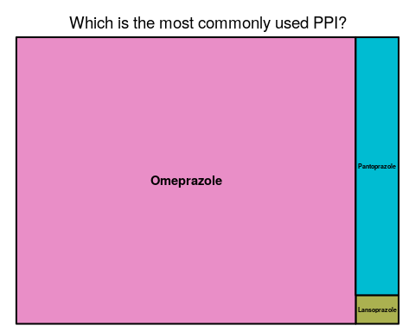
Slide 2

Slide 4
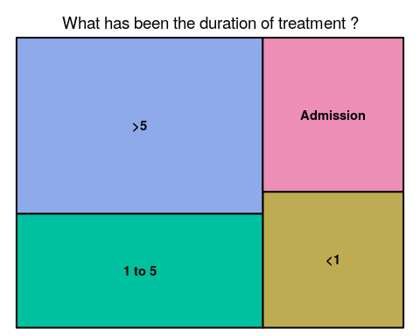
Slide 3

Slide 5
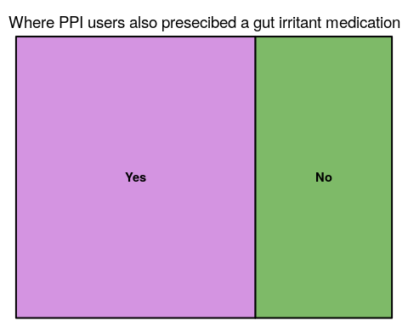
Slide 4

Slide 6
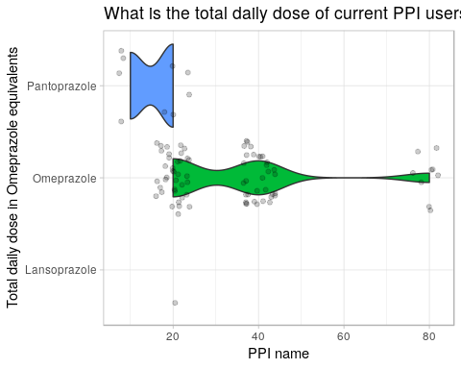
Slide 5

Slide 7
Slide 6
Please note “Yes” & “No” have an identical frequency, and the discontinued block is causing a visual distortion.

Slide 8
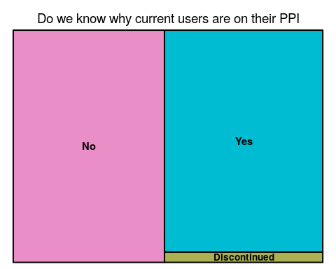

Slide 9
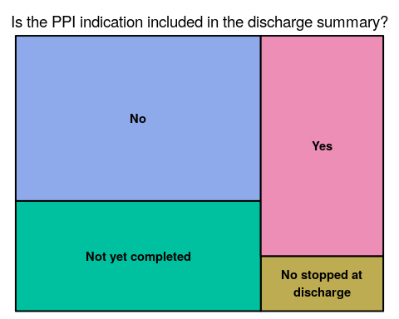
Slide 7

Slide 10
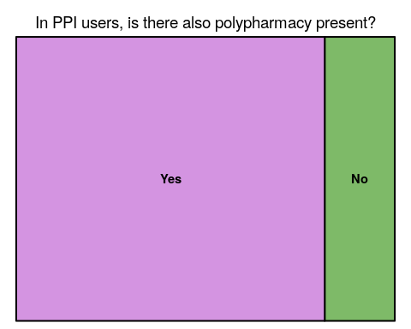
Slide 8

Slide 11
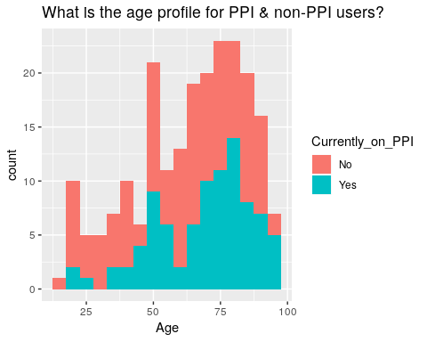
Slide 9

Slide 12
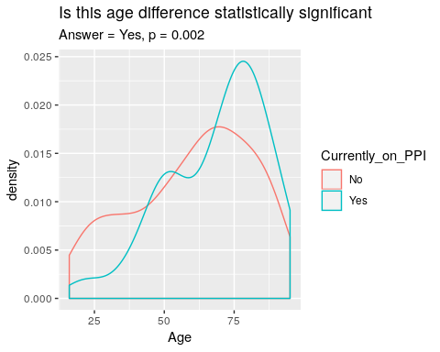
Slide 10

Slide 13
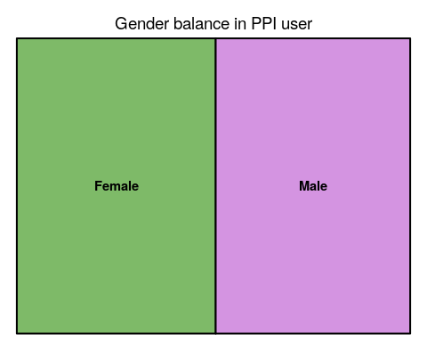
Slide 11

Slide 14
Slide 12
No significant difference is seen (p = 0.16)

Slide 15
Specialty | No | Yes
CARD | 2 (2%) | 2 (2%)
ELDER CARE | 0 (0%) | 1 (1%)
INT | 58 (45%) | 47 (53%)
MED | 1 (1%) | 1 (1%)
MENT | 20 (16%) | 4 (4%)
REHAB | 19 (15%) | 10 (11%)
SURG | 28 (22%) | 24 (27%)
NA | 1 (1%) | 0 (0%)
Total | 129 (100%) | 89 (100%)

Slide 16
Slide 13
No significant difference is seen (p = 0.24)

Slide 17
Ward | No | Yes
21 | 19 (15%) | 4 (4%)
23 | 12 (9%) | 4 (4%)
24 | 14 (11%) | 9 (10%)
25 | 15 (12%) | 13 (15%)
26 | 11 (9%) | 15 (17%)
27 | 6 (5%) | 6 (7%)
28 | 8 (6%) | 5 (6%)
29 | 13 (10%) | 14 (16%)
CCU | 3 (2%) | 3 (3%)
ICU | 0 (0%) | 1 (1%)
MAPU | 8 (6%) | 5 (6%)
STAR 1 | 7 (5%) | 2 (2%)
STAR 2 | 12 (9%) | 8 (9%)
NA | 1 (1%) | 0 (0%)
Total | 129 (100%) | 89 (100%)

Slide 18
Slide 14
No significant difference is seen (p = 0.1)

Slide 19
Locality | No | Yes
Areas Outside Territorial Authorities | 1 (1%) | 0 (0%)
Central Hawke’s Bay District | 0 (0%) | 1 (1%)
Hastings District | 3 (2%) | 0 (0%)
Horowhenua District | 14 (11%) | 19 (21%)
Kapiti Coast District | 6 (5%) | 2 (2%)
Manawatu District | 11 (9%) | 15 (17%)
Napier City | 1 (1%) | 0 (0%)
Nelson City | 1 (1%) | 0 (0%)
New Plymouth District | 1 (1%) | 0 (0%)
Palmerston North City | 50 (39%) | 42 (47%)
Rangitikei District | 1 (1%) | 2 (2%)
Ruapehu District | 1 (1%) | 0 (0%)
South Taranaki District | 2 (2%) | 0 (0%)
Tararua District | 18 (14%) | 5 (6%)
Upper Hutt City | 1 (1%) | 0 (0%)
NA | 18 (14%) | 3 (3%)
Total | 129 (100%) | 89 (100%)

Slide 20
Slide 15
No Significant difference is seen (p = 0.21)

Slide 21
Ethnicity | No | Yes
European - not further defined | 1 (1%) | 4 (4%)
Indian | 1 (1%) | 0 (0%)
Maori | 21 (16%) | 11 (12%)
NZ European | 84 (65%) | 62 (70%)
Other Ethnicity | 0 (0%) | 1 (1%)
Other European | 5 (4%) | 8 (9%)
Tongan | 1 (1%) | 0 (0%)
NA | 16 (12%) | 3 (3%)
Total | 129 (100%) | 89 (100%)

Slide 22
Slide 16
No significant difference is seen (p=0.29)

Slide 23
Discharge_destination | No | Yes
ARC | 11 (9%) | 12 (13%)
HOME | 112 (87%) | 76 (85%)
HOSPICE | 1 (1%) | 0 (0%)
MASH | 1 (1%) | 0 (0%)
SUPP | 3 (2%) | 0 (0%)
unknown | 0 (0%) | 1 (1%)
NA | 1 (1%) | 0 (0%)
Total | 129 (100%) | 89 (100%)

