Slide 1
Technology Value Stream
Greih Murray

Slide 2
Lead Time
Time for a request to be completed
Starts when request is received
Ends when request is fulfilled

Slide 3
Processing Time
Time for work on a request to be completed
Starts when work begins on the request
Ends when work is finished

Slide 4
Common Scenario
Lead times are months long
Potential for issues at the end
More time spent fixing issues
Most prevalent when:
Working with monoliths
High dependency on manual testing
Tightly coupled applications

Slide 5
DevOps Ideal
Lead time of minutes
Consistent, quick feedback
Small changes constantly checked in
Most likely when:
Using modular architecture
Maintain encapsulation
Small teams with high autonomy

Slide 6
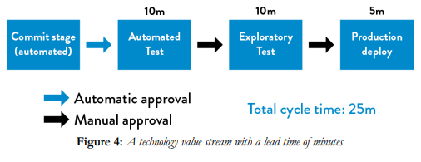
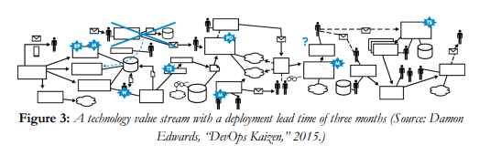
Common Scenario
DevOps IDeal

Slide 7
Citations
Kim, Gene, et al. The Devops Handbook: How to Create World-Class Agility, Reliability, & Security in Technology Organizations. IT Revolution Press, LLC, 2021.

