Slide 1
GUITAR LESSONS

Slide 2
Why LEARN guitars?
Very Common
Can be played without accompaniment from other instruments

Slide 3
BIBLICAL REFERENCES
1 Samuel 16:23 – evil spirit departed from Saul because David played him the harp
Psalms 43:4 – Expression of Joy to God
Isaiah 38:20 – “…sing my songs with stringed instruments All the days of our life in the house of Jehovah.”
Psalms 150:4 – “…Praise Him with stringed instruments…”

Slide 4
WHAT YOU WILL LEARN
Beginner
Basics (tuning, chords, strumming)
Objective : Play a song.
Intermediate
Strumming Patterns
Chord progressions and family
Transposing Chords
Objective : Play a song in different keys and strumming patterns.

Slide 5
What you will learn
Advanced
Chord Theory (Acoustic and Lead Guitar)
Scales (Lead Guitar)
Tone quality and effects (Lead Guitar)
Objective (Acoustic) : Play a song in different types of chord shapes.
Objective (Lead) : Play a song using scales and effects.

Slide 6
What you should expect
On Class
Exercises
Off the Class
Assignments

Slide 7
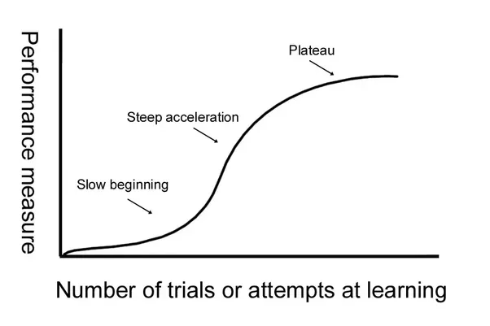
what you should expect

Slide 8
WHAT WE need FROM YOU
Passion for Music
Worshipping heart
Eagerness to Learn
Assignments
Asks questions
Full Commitment
Attendance
Participation on Activities
Practice, practice, and practice.

