Slide 1
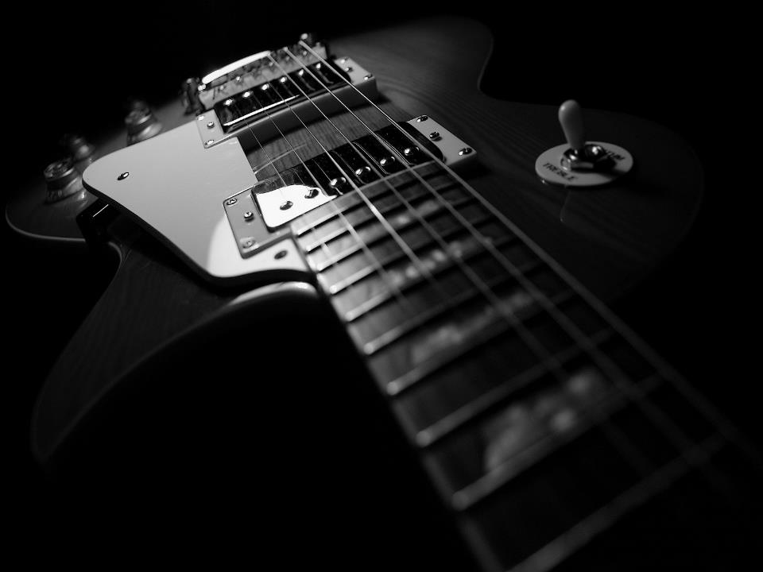
GUITARS

Slide 2
Types and roles of guitar players
Rhythm
provides all or part of the rhythmic pulse in conjunction with singers or other instruments.
provides all or part of the harmony, i.e. the chords.
cover up the spaces of the song
Lead
plays solos (melody) and riffs (audible guitar lines)
gives special effects to the song (swells, worship ambience)
ULTIMATE GOAL : Enhance (not distract) the worship experience.

Slide 3
Why LEARN guitars?
The bible urges us to praise God with instruments (Psalms 150)
So, why guitars?
Very Common (affordable, materials are available online)
One of the easiest to learn (referring to basics)
Can be played without accompaniment from other instruments
Easy to setup (portable) and maintain
Most songs are playable by guitars

Slide 4
BIBLICAL REFERENCES
1 Samuel 16:23 – evil spirit departed from Saul because David played him the harp
Psalms 43:4 – Expression of Joy to God
Isaiah 38:20 – “…sing my songs with stringed instruments All the days of our life in the house of Jehovah.”
Psalms 150:4 – “…Praise Him with stringed instruments…”

Slide 5
What you should expect
On Class
Discussions
Exercises
Off the Class
Practice
Assignments

Slide 6
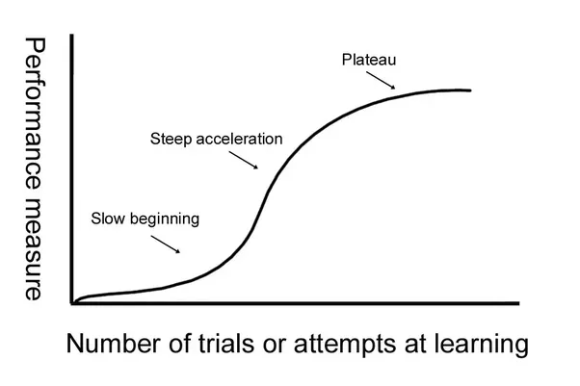
what you should expect
Beginner
Intermediate
Advanced

Slide 7
WHAT YOU WILL LEARN
Beginner
Basics (tuning, chords, strumming)
Objective : Play a song.
Intermediate
Strumming Patterns
Chord progressions and family
Transposing Chords
Covering a Song
Objective :
- Play a song in different keys and strumming patterns.
- Cover a song from scratch.

Slide 8
What you will learn
Advanced
Chord Theory (Acoustic and Lead Guitar)
“Soloing” using Scales (Lead Guitar)
Tone quality and effects (Lead Guitar)
Objective (Acoustic) :
- Play a song in different types of chord shapes(advanced).
Objective (Lead) :
- Play a song using scales (soloing).
- Identify the right tone and effect.

Slide 9
WHAT WE expect FROM YOU
Passion for Music
Loves worshipping God through music
Eagerness to Learn
Assignments
Asks questions
Full Commitment
Attendance
Participation on Activities
Practice, practice, and more practice.

Slide 10
God bless!

