Slide 1
THE «RUSH SPACE» GAME
Developed by S. Bespalov, A. Grischenko, I. Solopov

Slide 2
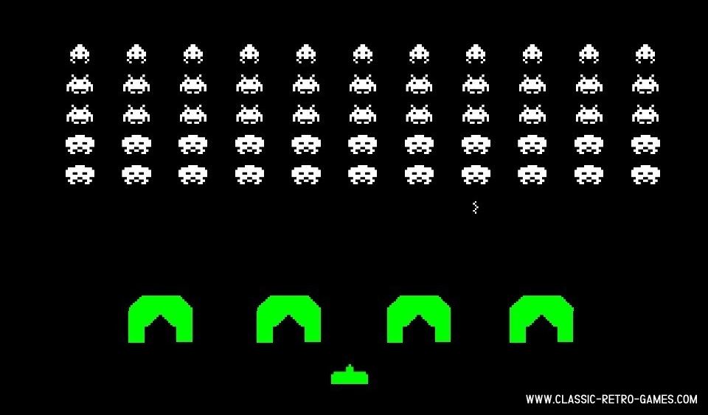
What is Shoot ’em up?
The example of shoot ‘em up game

Slide 3
The aim and the problems
The aim of this project was to design and build a Shoot 'em up game on logical circuits using the CdM-8 processor and its assembly language.
The problems:
To study examples of Shoot 'em up games (analogues);
To study and analyze information about the processor, its capabilities, commands and instructions;
To study and analyze programs for creating electrical circuits;
To define the functional requirements.

Slide 4
The functional requirements
Controlled movement of the player;
Uncontrolled movement of opponents;
Player's shooting;
Monster shooting;
Destruction of the monsters;
Keyboard control (player movement, player shooting);
Possibility of winning;
Possibility of losing.

Slide 5
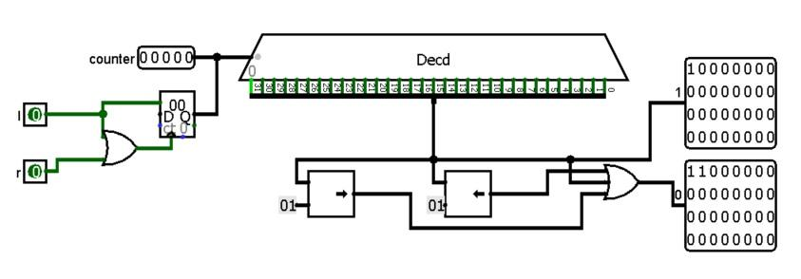
Player movement
The screenshot of the Player Move circuit

Slide 6
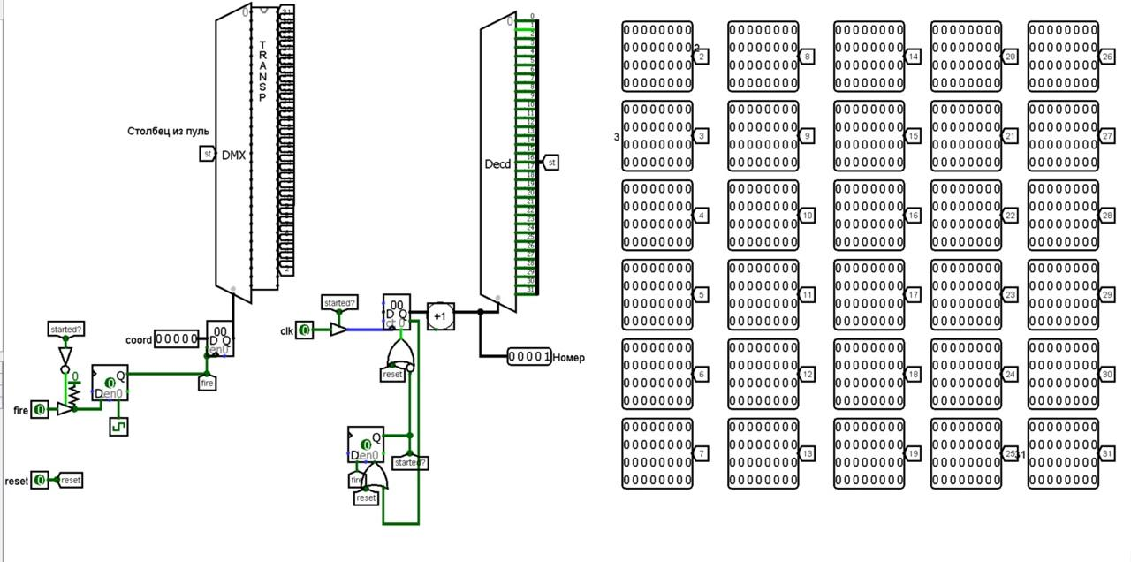
Player’s shooting
The screenshot of the Shooting circuit

Slide 7
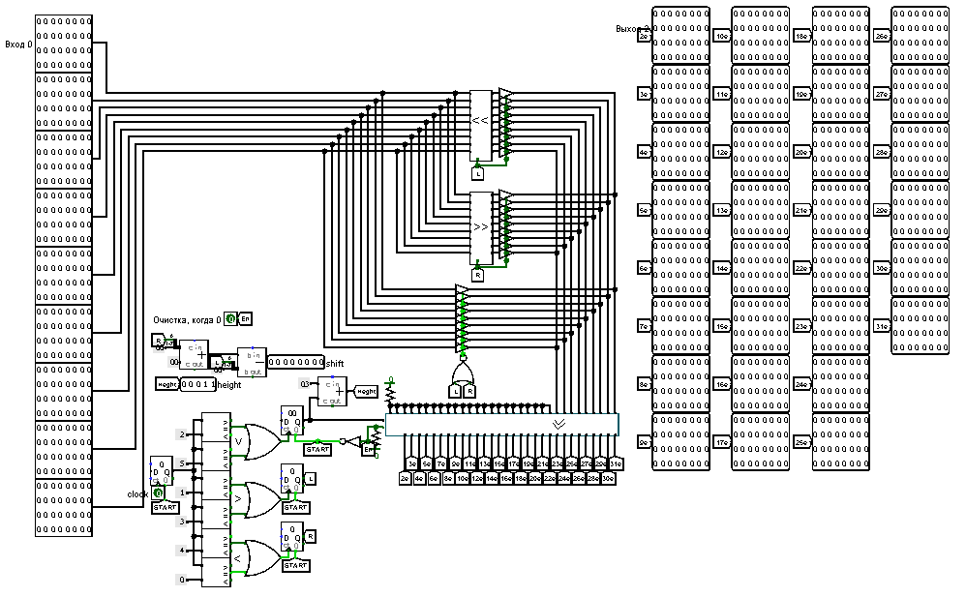
Enemies Movement
The screenshot of the Shifts circuit

Slide 8
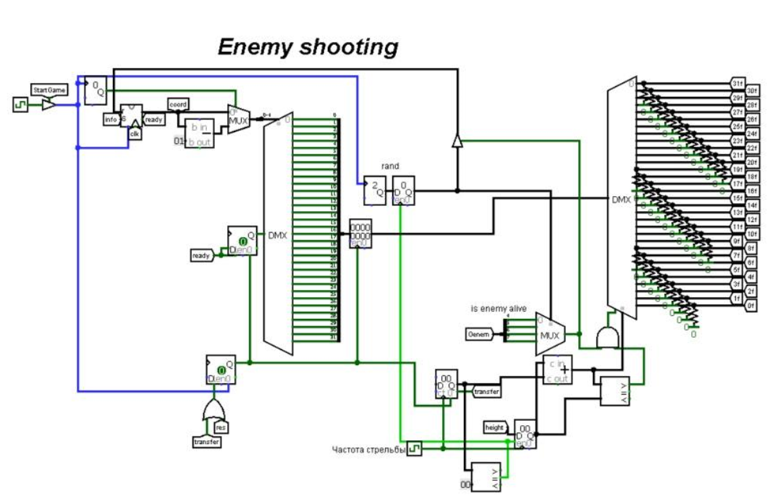
Monster shooting
The screenshot of the Enemies circuit

Slide 9
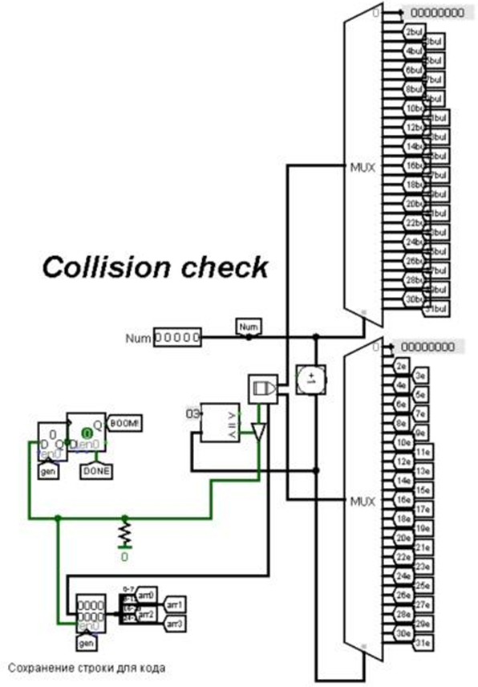
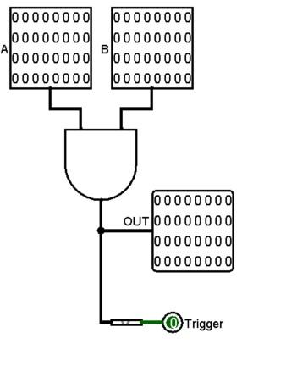
Destruction of the monsters
The screenshot of the Collision circuit
The screenshot of the part of the Enemies circuit

Slide 10
Win and lose conditions
The player needs to destroy all enemies to win.
If an enemy bullet hits the user, then this is a loss.
Also, if the aliens reach the walls, then this is a loss.

Slide 11
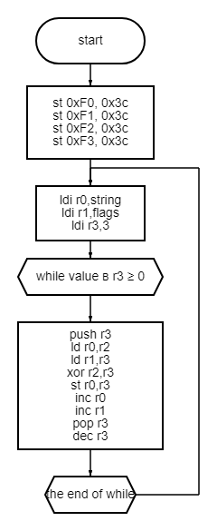
Wall destruction
The block diagram of the wall destruction code

Slide 12
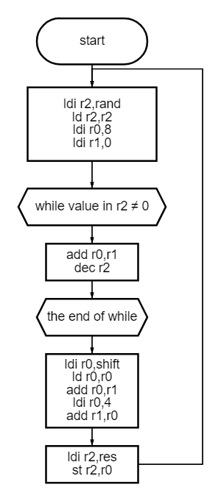
Monster’s shooting
The block diagram of the monster’s shooting code

Slide 13
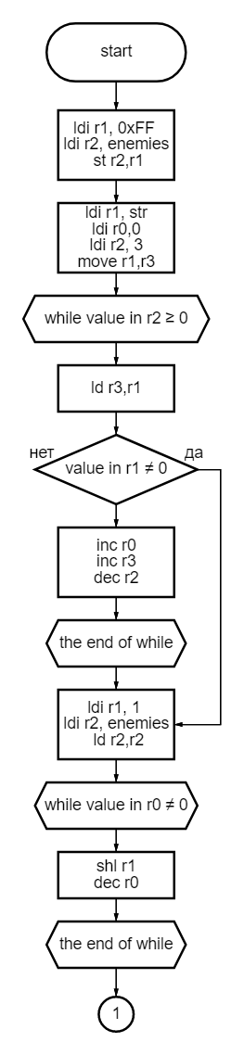
Hit
The first part of the block diagram of the hitting code

Slide 14
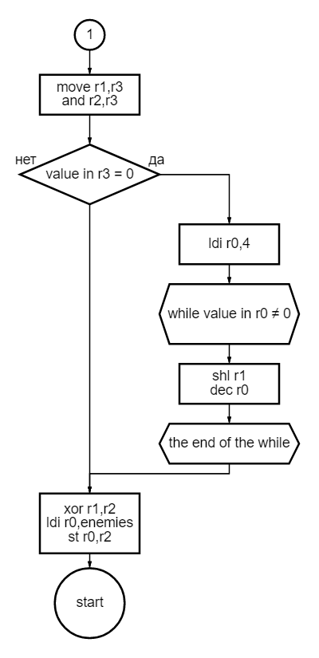
Hit
The second part of the block diagram of the hitting code

Slide 15
Conclusion
As a result of the work done, we created the game "Rush space" in the Shoot 'em up genre. The problems were successfully completed. We were able to implement all the indicated functional requirements. Creating the project, we got knowledge in the field of making logical circuits, working with a processor and its programming, writing project documentation and experience in working in a team.

Slide 16
Thank you for your attention!

